Slide 1
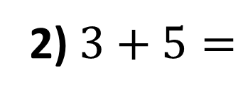
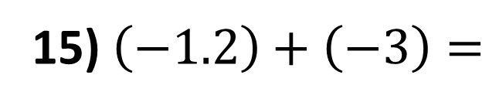
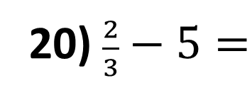
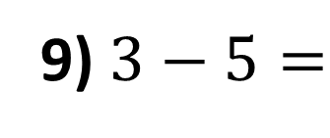
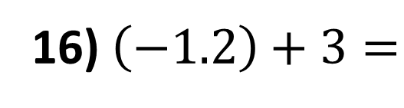
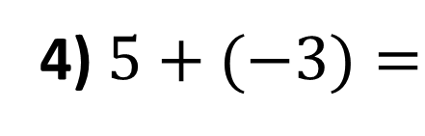
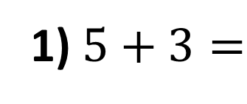
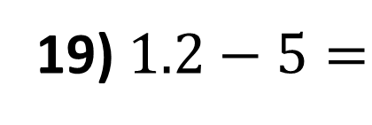
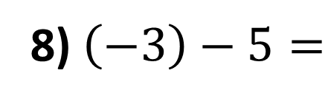
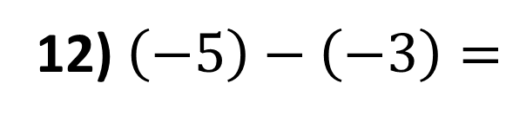
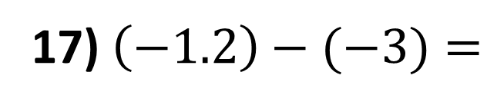
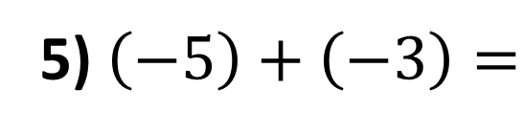
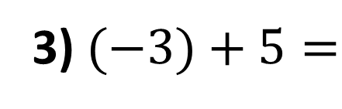
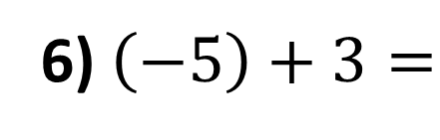
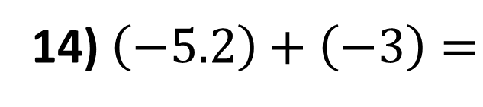
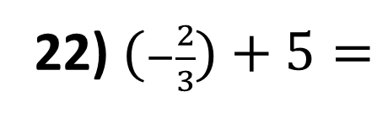
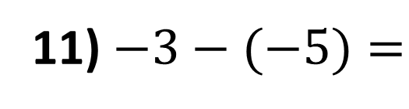
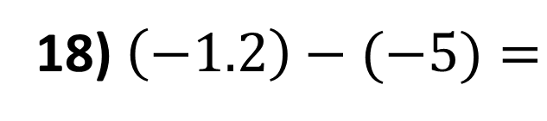
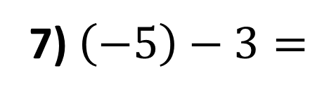
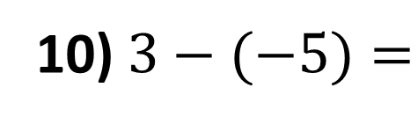
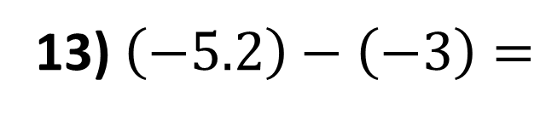
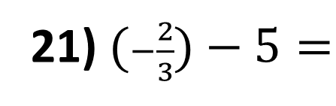
1) $5+3=$
12) $\left(−5\right)−\left(−3\right)=$
2) $3+5=$
13) $\left(−5.2\right)−\left(−3\right)=$
3) $(−3)+5=$
14) $\left(−5.2\right)+\left(−3\right)=$
4) $5+(−3)=$
15) $\left(−1.2\right)+\left(−3\right)=$
5) $\left(−5\right)+\left(−3\right)=$
16) $\left(−1.2\right)+3=$
6) $\left(−5\right)+3=$
17) $\left(−1.2\right)−(−3)=$
7) $\left(−5\right)−3=$
18) $\left(−1.2\right)−(−5)=$
8) $\left(−3\right)−5=$
19) $1.2−5=$
9) $3−5=$
20) $\frac{2}{3}−5=$
10) $3−(−5)=$
21) $(−\frac{2}{3})−5=$
11) $−3−(−5)=$
22) $(−\frac{2}{3})+5=$

Slide 2
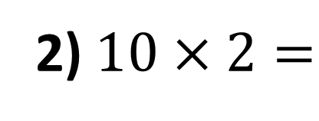
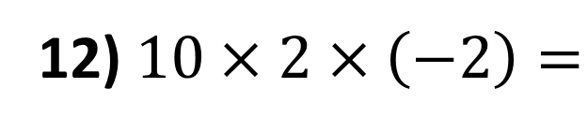
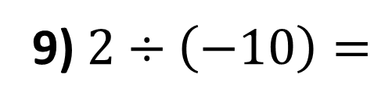
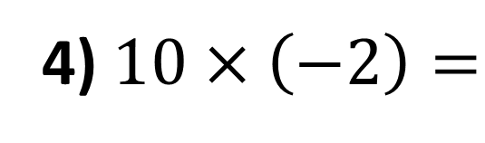
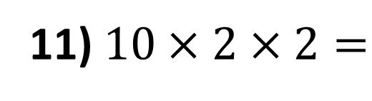
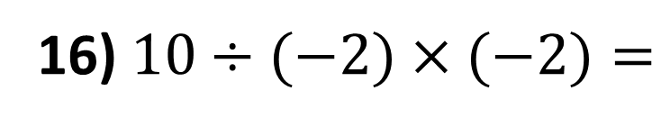
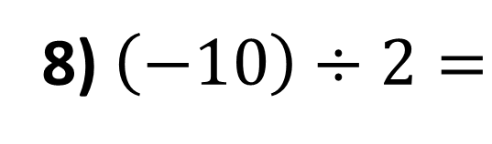
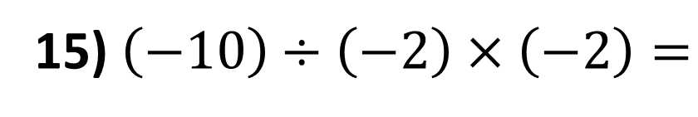
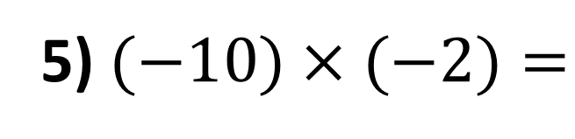
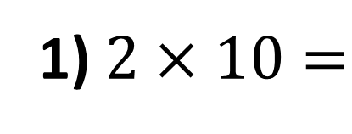
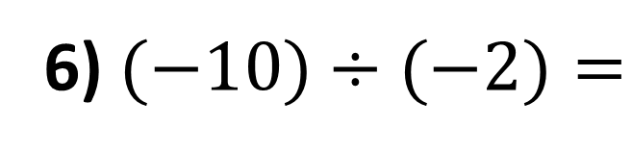
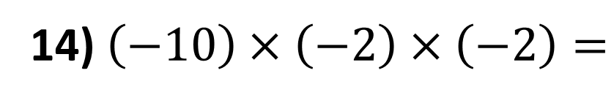
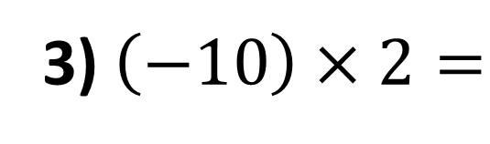
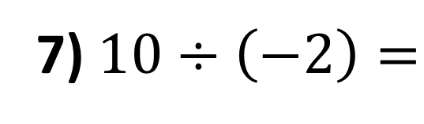
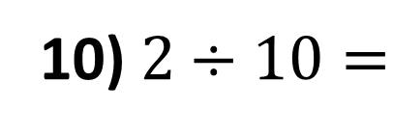
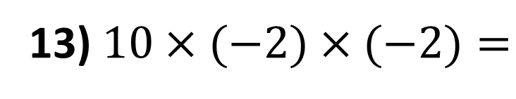
1) $2×10=$
9) $2÷\left(−10\right)=$
2) $10×2=$
10) $2÷10=$
3) $\left(−10\right)×2=$
11) $10×2×2=$
4) $10×\left(−2\right)=$
12) $10×2×\left(−2\right)=$
5) $(−10)×(−2)=$
13) $10×(−2)×(−2)=$
6) $(−10)÷(−2)=$
14) $\left(−10\right)×\left(−2\right)×\left(−2\right)=$
7) $10÷\left(−2\right)=$
15) $\left(−10\right)÷\left(−2\right)×\left(−2\right)=$
8) $\left(−10\right)÷2=$
16) $10÷(−2)×(−2)=$

Slide 3
ANSWERS

Slide 4









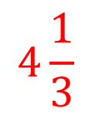



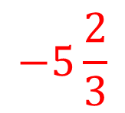



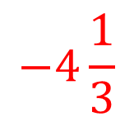




1) $5+3=$
$$8$$
12) $\left(−5\right)−\left(−3\right)=$
$$−2$$
2) $3+5=$
$$8$$
13) $\left(−5.2\right)−\left(−3\right)=$
$$−2.2$$
3) $(−3)+5=$
$$2$$
$$−8.2$$
14) $\left(−5.2\right)+\left(−3\right)=$
4) $5+(−3)=$
$$2$$
15) $\left(−1.2\right)+\left(−3\right)=$
$$−4.2$$
5) $\left(−5\right)+\left(−3\right)=$
$$−8$$
16) $\left(−1.2\right)+3=$
$$1.8$$
6) $\left(−5\right)+3=$
$$−2$$
17) $\left(−1.2\right)−(−3)=$
$$1.8$$
7) $\left(−5\right)−3=$
$$−8$$
18) $\left(−1.2\right)−(−5)=$
$$3.8$$
8) $\left(−3\right)−5=$
$$−8$$
19) $1.2−5=$
$$−3.8$$
$$−2$$
$$−4\frac{1}{3}$$
9) $3−5=$
20) $\frac{2}{3}−5=$
$$−5\frac{2}{3}$$
10) $3−(−5)=$
$$8$$
21) $(−\frac{2}{3})−5=$
$$2$$
$$4\frac{1}{3}$$
11) $−3−(−5)=$
22) $(−\frac{2}{3})+5=$

Slide 5
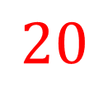

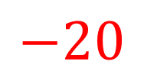
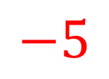

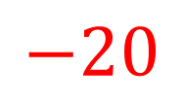





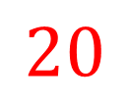

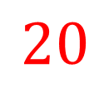


1) $2×10=$
$$20$$
$$−0.2$$
9) $2÷\left(−10\right)=$
2) $10×2=$
$$20$$
$$0.2$$
10) $2÷10=$
3) $\left(−10\right)×2=$
$$−20$$
11) $10×2×2=$
$$40$$
4) $10×\left(−2\right)=$
$$−20$$
12) $10×2×\left(−2\right)=$
$$−40$$
5) $(−10)×(−2)=$
$$20$$
13) $10×(−2)×(−2)=$
$$40$$
6) $(−10)÷(−2)=$
$$5$$
14) $\left(−10\right)×\left(−2\right)×\left(−2\right)=$
$$−40$$
7) $10÷\left(−2\right)=$
$$−5$$
$$−10$$
15) $\left(−10\right)÷\left(−2\right)×\left(−2\right)=$
8) $\left(−10\right)÷2=$
$$−5$$
16) $10÷(−2)×(−2)=$
$$10$$

