Slide 1
Representation of Data
Box Plots and Outliers
Chapter 3
(Part 1 of 3)

Slide 2
Box Plots
Box Plots allow us to visually represent
the spread of the data.
Range
IQR
0 5 10 15 20 25 30

Slide 3
Minimum | Lower Quartile | Median | Upper Quartile | Maximum
3 | 15 | 17 | 22 | 27
0 5 10 15 20 25 30

Slide 4
The diameters of 11 different Roman coins are
measured in centimetres:
2.2 2.5 2.7 2.7 2.8 3.0 3.1 3.2 3.6 4.0 4.2
Determine the following information:
Minimum | Lower Quartile (Q1) | Median (Q2) | Upper Quartile (Q3) | Maximum
2.2
2.7
3.0
3.6
4.2
2.2 2.5 2.7 2.7 2.8 3.0 3.1 3.2 3.6 4.0 4.2

Slide 5
True or False
“The right box represents more people than the left box.”
0 5 10 15 20 25 30
Age (years)
False
Each box represents 25% of people, i.e. the same number of people!

Slide 6
True or False
“The ages are more spread out above the median.”
0 5 10 15 20 25 30
Age (years)
The wider the box or whisker, the more spread out the values are within that 25% of the data
True

Slide 7
Outliers
An outlier is an extreme value.
There are many different definitions/calculations
for identifying an outlier.

Slide 8
One common definition is:
Outliers happen when
the data value is 1.5 IQRs below
the LQ and above the UQ.

Slide 9
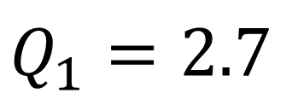
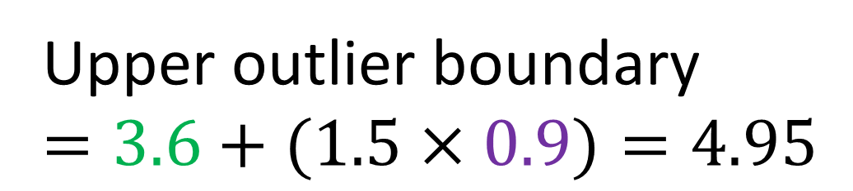
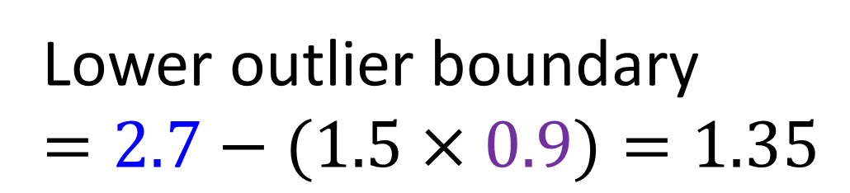
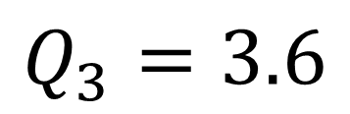
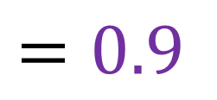
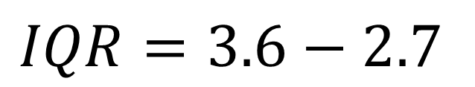
The diameters of 11 different Roman coins are
measured in centimetres:
2.2 2.5 2.7 2.7 2.8 3.0 3.1 3.2 3.6 4.0 4.7
Determine the quartiles and hence any outliers.
(Outlier is when the data value is 1.5 IQRs beyond UQ and LQ)
Lower outlier boundary
$$=2.7−(1.5×0.9)=1.35$$
$$Q_{1}=2.7$$
$$Q_{3}=3.6$$
Upper outlier boundary
$$=3.6+(1.5×0.9)=4.95$$
$$IQR=3.6−2.7$$
$$=0.9$$
Therefore, no outliers.

Slide 10
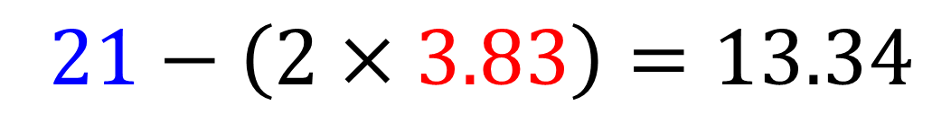
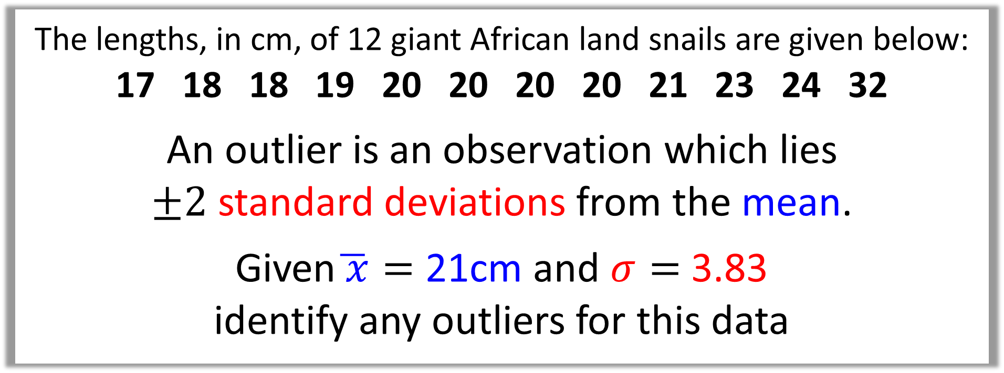
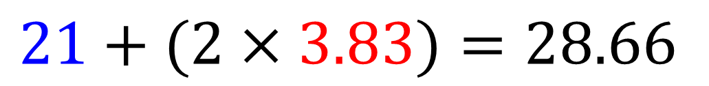
The lengths, in cm, of 12 giant African land snails are given below:
17 18 18 19 20 20 20 20 21 23 24 32
An outlier is an observation which lies
$±2$ standard deviations from the mean.
Given$\overline{ x}=$ 21cm and $σ=$ 3.83
identify any outliers for this data
$$21−\left(2×3.83\right)=13.34$$
The only outlier is 32
$$21+(2×3.83)=28.66$$

Slide 11
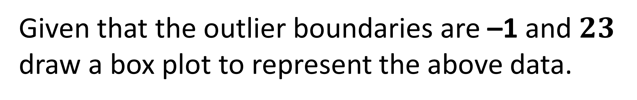
Two Smallest values | Two Largest values | Lower Quartile | Median | Upper Quartile
0, 3 | 21, 27 | 8 | 10 | 14
Given that the outlier boundaries are –1 and $23$
draw a box plot to represent the above data.
(23)
(0)
Use a cross
for each outlier
(21)
(27)
0 5 10 15 20 25 30

Slide 12
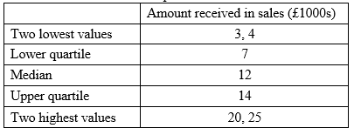
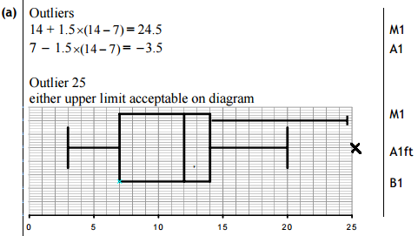
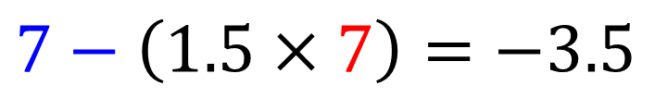
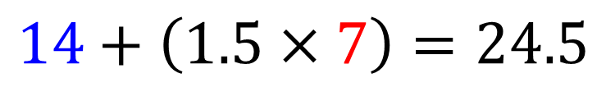
An outlier is an observation that falls either 1.5 x interquartile range above the upper quartile or below the lower quartile.
Draw a box plot to represent these data, indicating clearly any outliers.
$$14+\left(1.5×7\right)=24.5$$
$$7−\left(1.5×7\right)=−3.5$$

Slide 13
Comparing Box Plots
When comparing box plots you should include:
a comment on the measure of spread.
(IQR or Range)
a comment on the measure of location.
(Median)

Slide 14
“Compare the prices of houses in Croydon with those in Kingston”
(2 marks)
Box Plot Comparing House Prices
Croydon
Kingston
£400k £450k £500k £550k £600k £650k £700k £750k
In interquartile range of house prices in Kingston is greater than Croydon.
or
The range of house prices in Kingston is greater than Croydon.
Include some measure of location (median).

Slide 15
“Compare the prices of houses in Croydon with those in Kingston”
(2 marks)
Box Plot Comparing House Prices
Croydon
Kingston
£400k £450k £500k £550k £600k £650k £700k £750k
Comment of
measure of spread.
“The median house price in Kingston was greater than that in Croydon.”

