Slide 1
Moments
Equilibrium
Chapter 4
(Part 2 of 4)

Slide 2
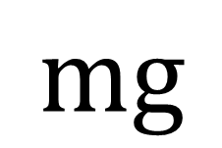
ROD
A rod is an object with one dimension.
A rod’s mass is considered to act a single point.
A rod is rigid (it does not bend or buckle).
$$mg$$

Slide 3
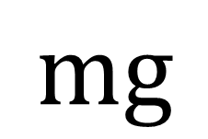
Uniform Rod
The centre of mass acts
at the halfway point of the rod.
$$mg$$

Slide 4
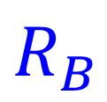
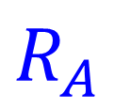
Supports
At the supports there will be
a reactional force.
$$R_{A}$$
$$R_{B}$$

Slide 5
Equilibrium
The rod is in it is not
moving up down or turning.

Slide 6
When dealing with moments questions you need to set up two equations.
Vertical Forces
Moment Forces

Slide 7
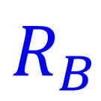
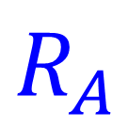
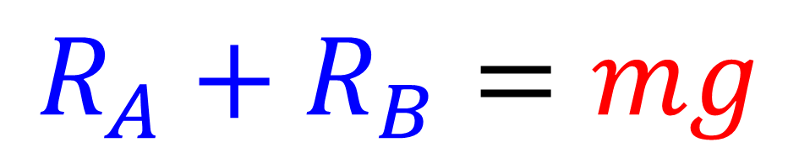
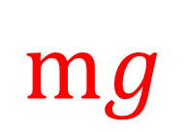
Vertical Forces
$$R_{A}$$
$$R_{B}$$
$$mg$$
$$R_{A}+R_{B}=mg$$

Slide 8
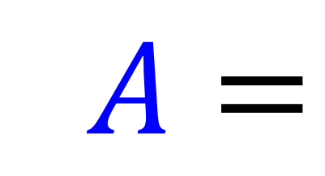
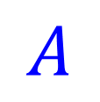
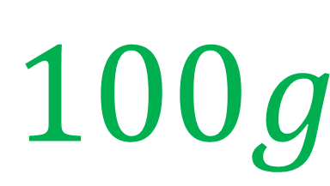
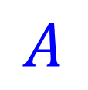
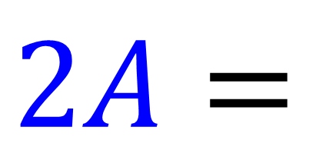
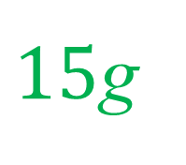
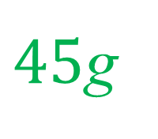
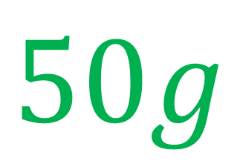
$$A$$
$$A$$
40g
$15$g
$45$g
$$2A=$$
$$100g$$
$$2A=$$
$$50g$$

Slide 9
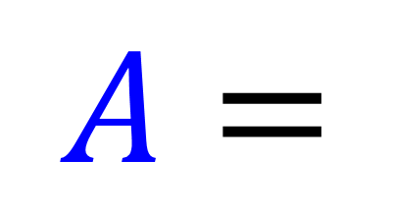
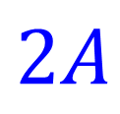
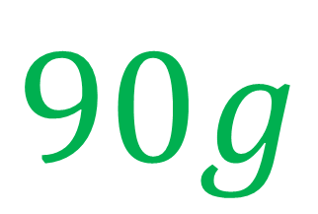

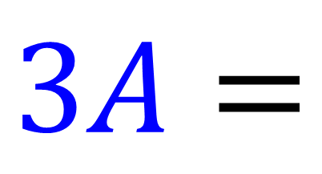
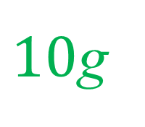
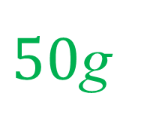
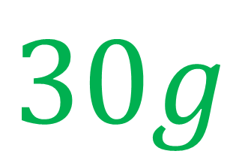
$$A$$
$$2A$$
30g
$10$g
$50$g
$$3A=$$
$$90g$$
$$A=$$
$$30g$$

Slide 10
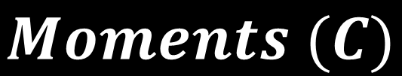
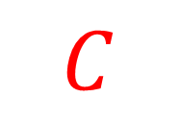
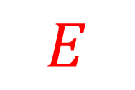
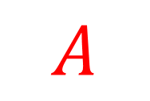

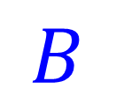
Moments
$$B$$
$$D$$
$$A$$
$$C$$
$$E$$
$$Moments (C)$$
Moments B + Moment E = Moment D + Moments A

Slide 11

$$B$$
$$D$$
$$A$$
$$C$$
$$E$$
$$Moments \left(E\right)$$
Moments B + Moment D = Moment A + Moments C

Slide 12

$$B$$
$$D$$
$$A$$
$$C$$
$$E$$
$$Moments \left(B\right)$$
Moments A + Moment D = Moment C + Moments E

Slide 13
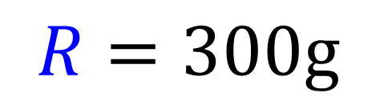
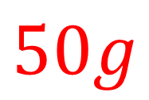
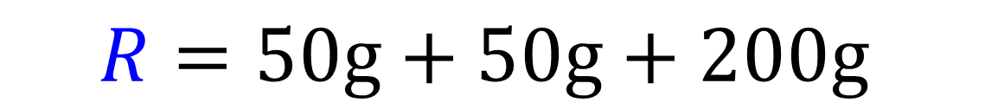
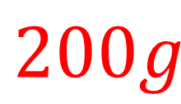
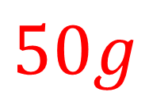


Using vertical forces find R
$$R$$
$$A$$
1m
1m
$$50g$$
2m
$$50g$$
2m
$$200g$$
$$R=50g+50g+200g$$
$$R=300g$$

Slide 14
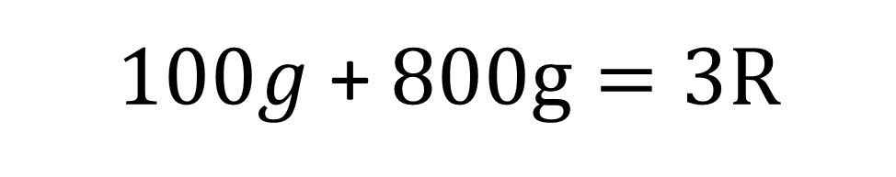

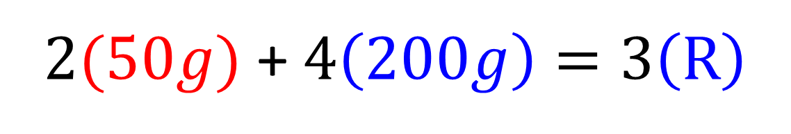


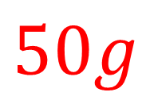


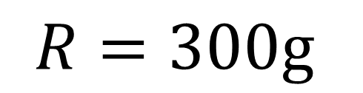
Using the moments at $A$ find $R$
$$R$$
$$A$$
1m
1m
$$50g$$
2m
$$50g$$
2m
$$200g$$
$2(50g)$ + $4\left(200g\right)=3\left(R\right)$
$100g$ + $800g=3R$
$$R=300g$$

Slide 15
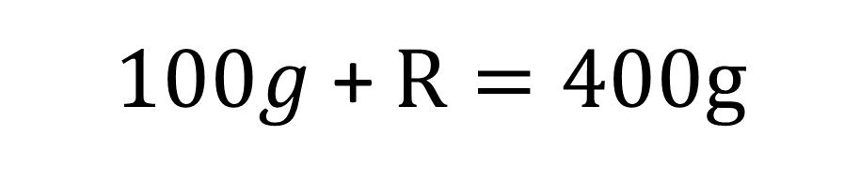
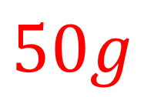
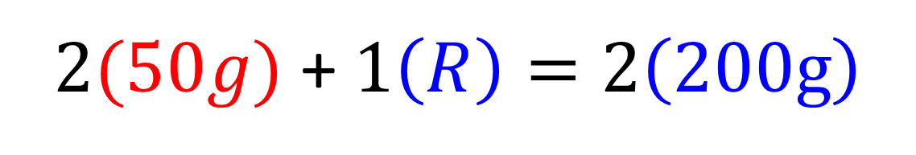


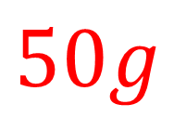


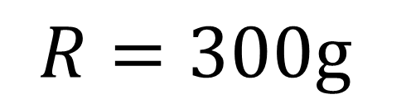
Using the moments at $B$ find $R$
$$R$$
$$B$$
1m
1m
$$50g$$
2m
$$50g$$
2m
$$200g$$
$2(50g)$ + $1\left(R\right)=2\left(200g\right)$
$100g$ + $R=400g$
$$R=300g$$

Slide 16
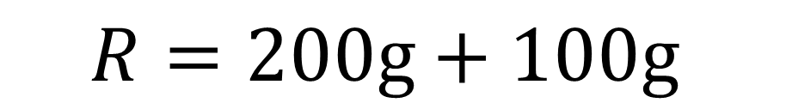
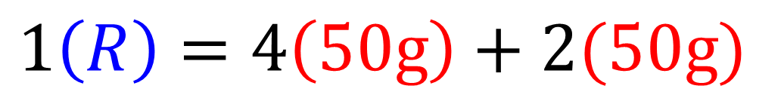


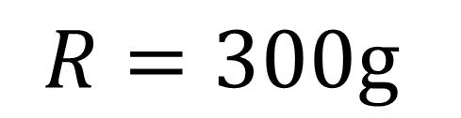
Using the moments at $C$ find $R$
$$R$$
1m
1m
$$C$$
$$50g$$
2m
$$50g$$
2m
$$200g$$
$$1\left(R\right)=4\left(50g\right)+2(50g)$$
$$R=200g+100g$$
$$R=300g$$

Slide 17



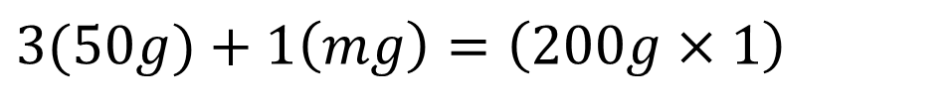
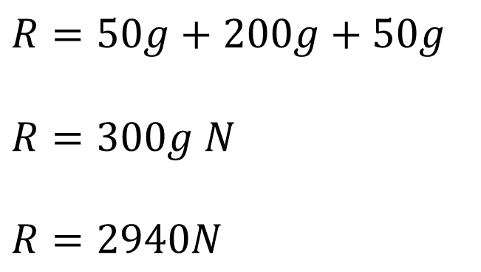




3m
2m
1m
$$A$$
1m
$$50g$$
$$mg$$
$$200g$$
Find $m$
Find A
Moments (A)
$$R=50g+200g+50g$$
$$R=300g N$$
$$R=2940N$$
$$3(50g)+1\left(mg\right)=\left(200g×1\right)$$
$$150g+mg=200g$$
$$m=50$$

Slide 18
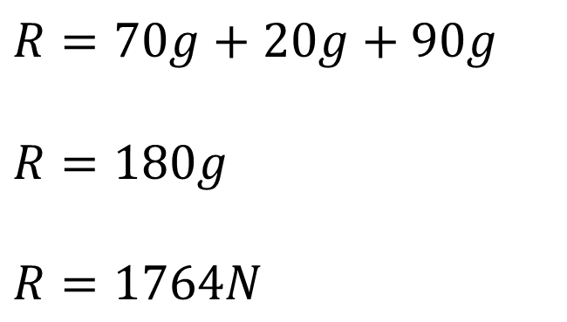

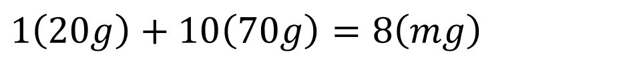



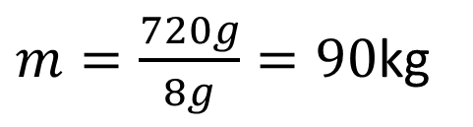


10m
9m
$$R$$
8m
$$70g$$
$$20g$$
$$mg$$
Find $m$
Find R
Moments (R)
$$R=70g+20g+90g$$
$$R=180g$$
$$R=1764N$$
$$1\left(20g\right)+10\left(70g\right)=8\left(mg\right)$$
$$720g=8mg$$
$m=\frac{720g}{8g}=90$kg

Slide 19












2m
1m
$$A$$
0.8m
$$mg$$
$$10g$$
Find $m$
Find A
Moments
$$A=mg+10g$$
$$2\left(mg\right)+3.8\left(10g\right)=3\left(A\right)$$
$$2mg+38g=3(mg+10g)$$
$$A=8g+10g$$
$$2mg+38g=3mg+30g$$
$$A=18g$$
$$8g=mg$$
$$m=8$$

Slide 20


Slide 21










$$R$$
$$2R$$
0.2
1.8 – x
x
1m
50$g$
2m
Find $R$
Moments (C)
$$\left(50g×0.8\right)=\left(1.8− x\right)\frac{100}{3}g$$
$$R+2R=50g$$
$$40=\frac{180}{3}−\frac{100x}{3}$$
$$R=\frac{50}{3}g$$
$$120=180−100x$$
$x=0.6$ m

