Slide 1
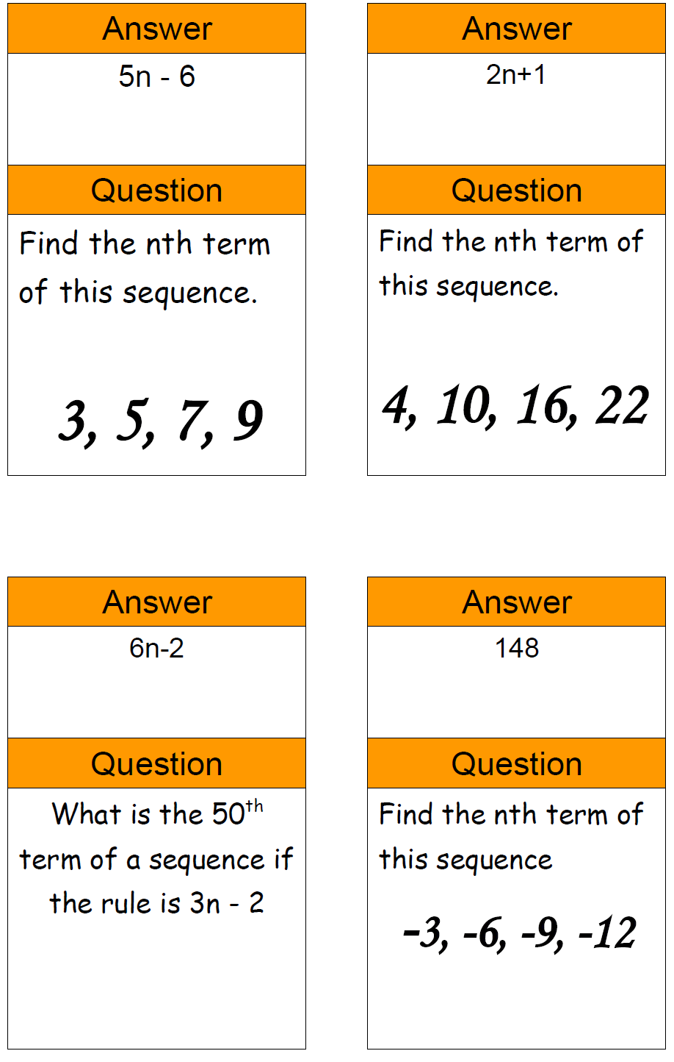
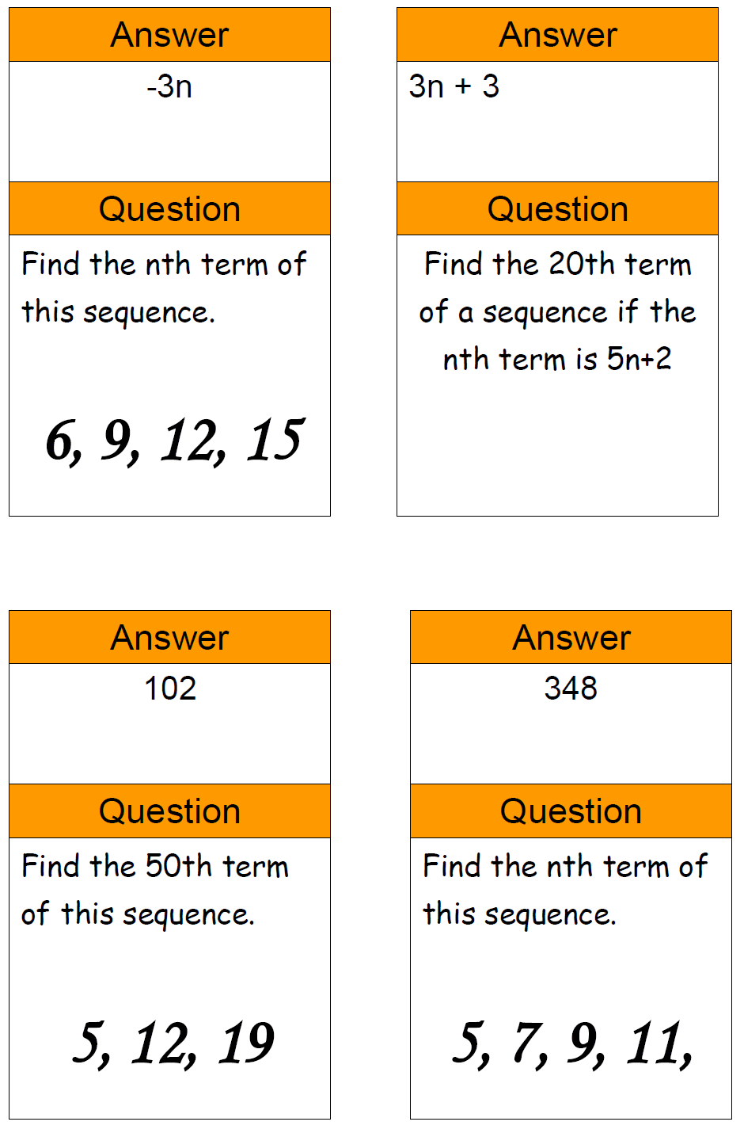
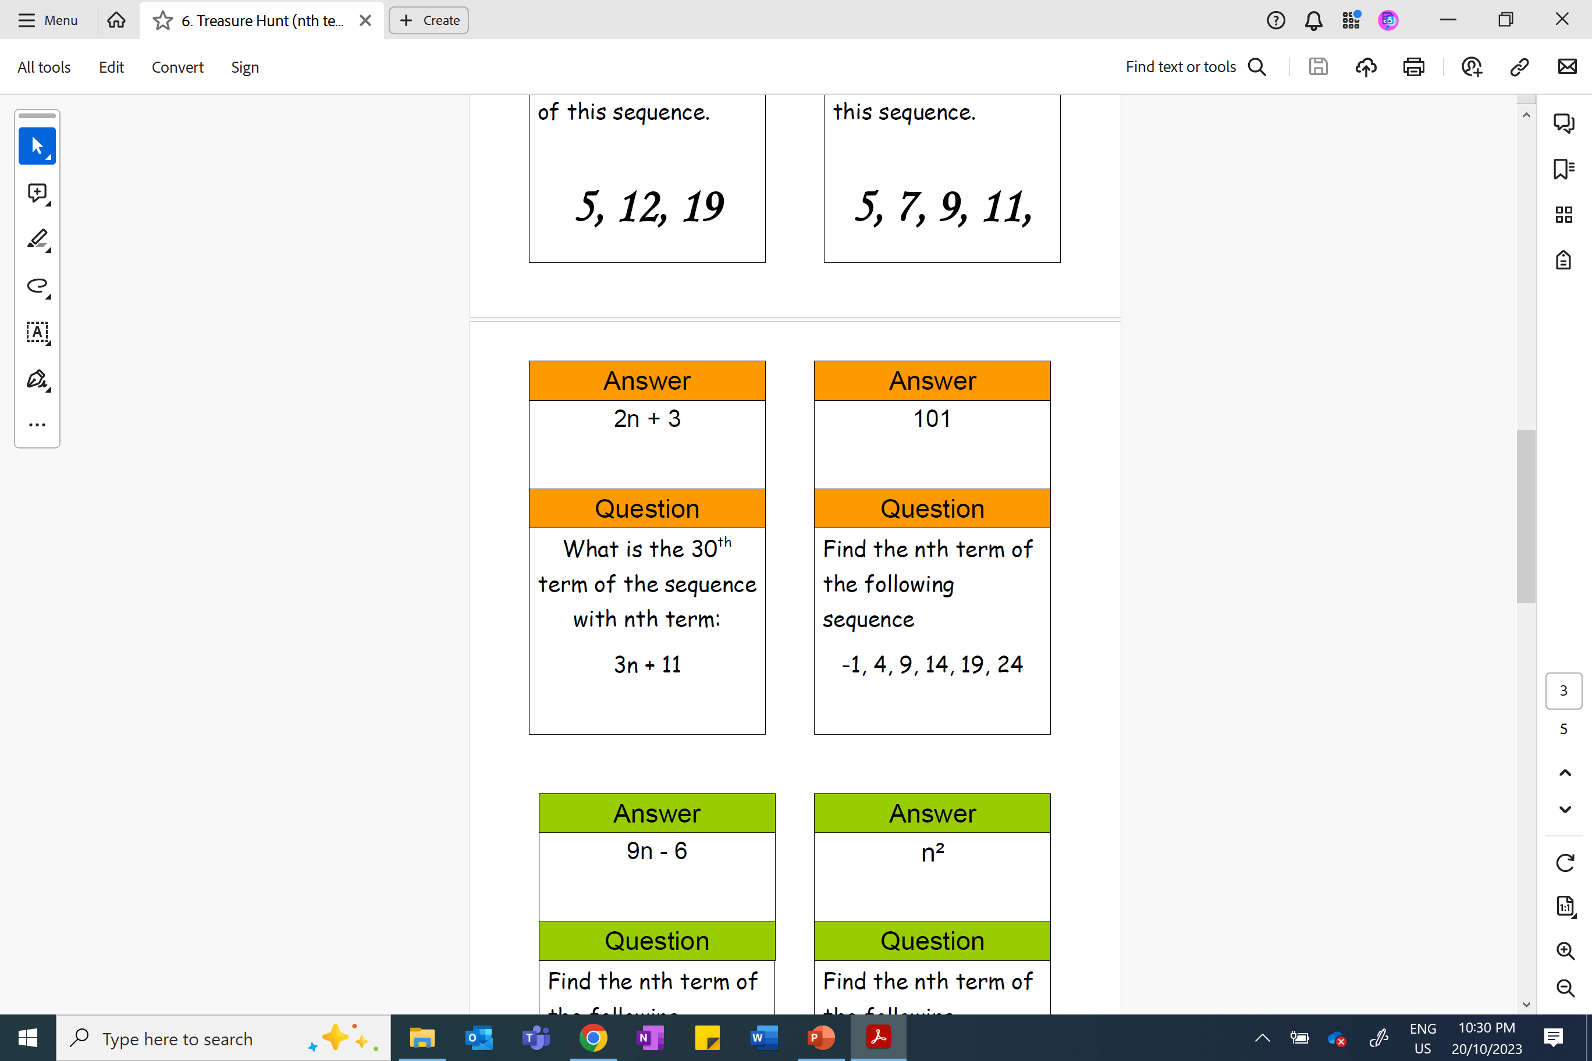

Slide 2
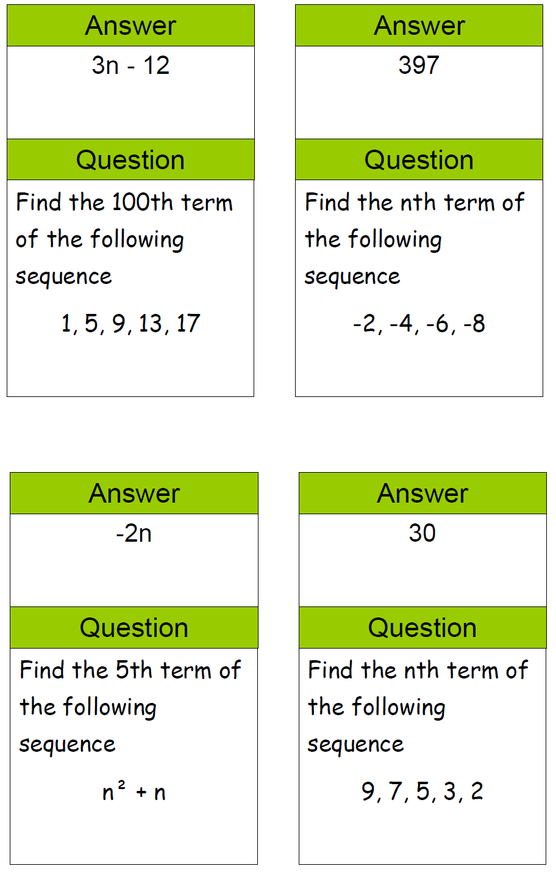
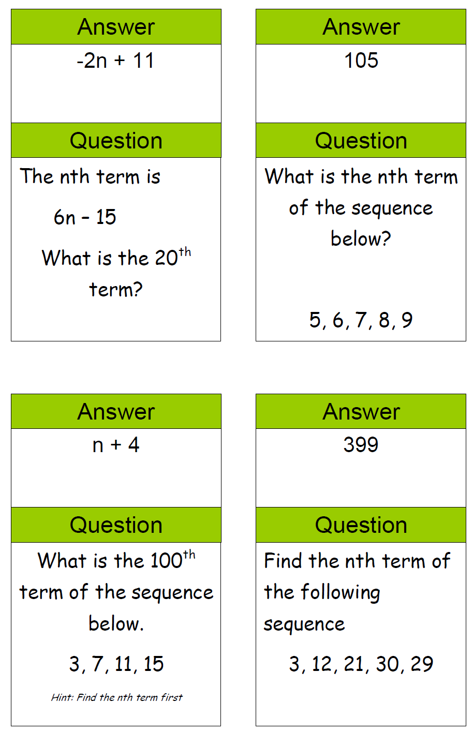
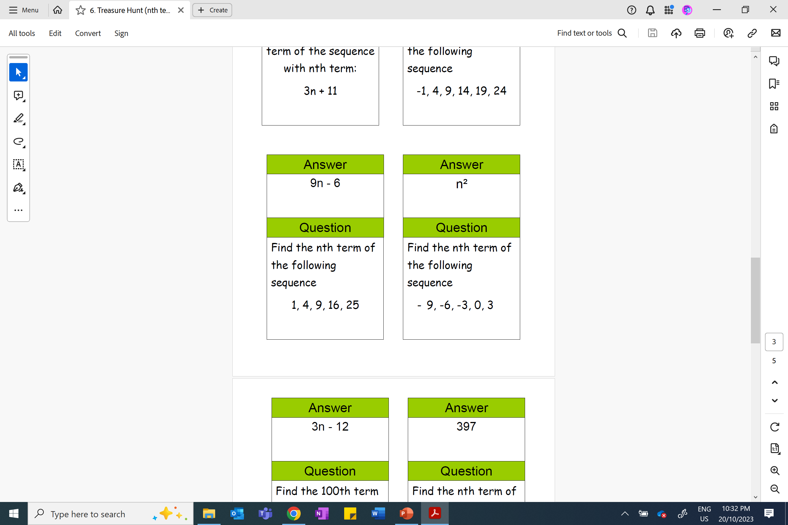

Slide 3
ANSWERS

Slide 4
148
–3n
3n + 3
102
348
2n + 3
101
5n – 6
2n + 1
6n – 2
3n – 12
397
–2n
30
–2n + 11
105
n + 4
399
9n – 6
n²

