Slide 1
Differentiation
Quotient Rule
Chapter 9
(Part 5 of 10)

Slide 2
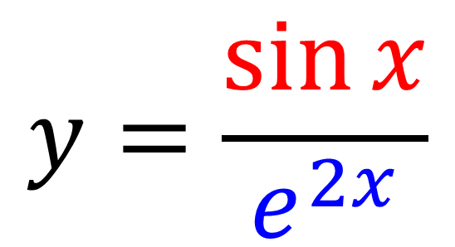
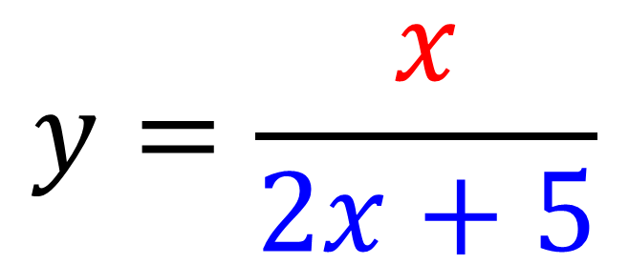
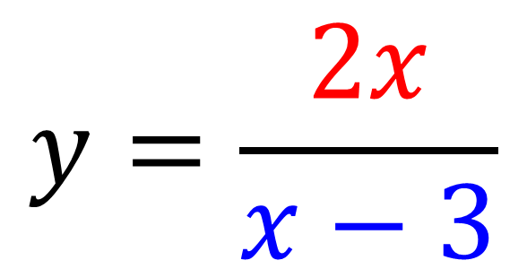
The quotient rule is used when
you have a division of two functions.
$$y=\frac{x}{2x+5}$$
$$y=\frac{2x}{x−3}$$
$$y=\frac{\sin{x}}{e^{2x}}$$

Slide 3
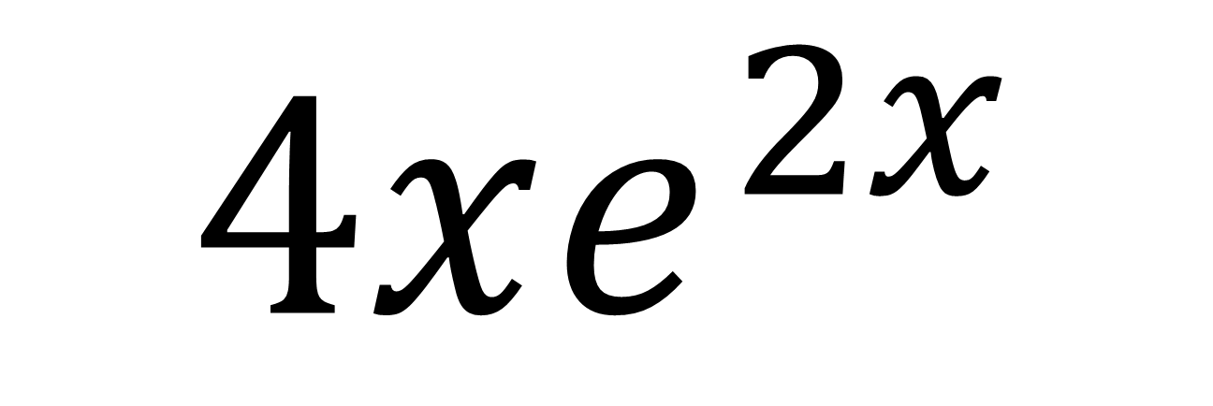
Product or Chain or Quotient?
$$4xe^{2x}$$
Product Rule

Slide 4
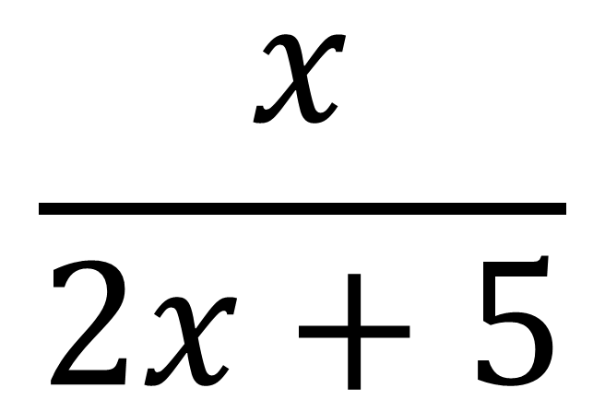
Product or Chain or Quotient?
$$\frac{x}{2x+5}$$
Quotient Rule

Slide 5
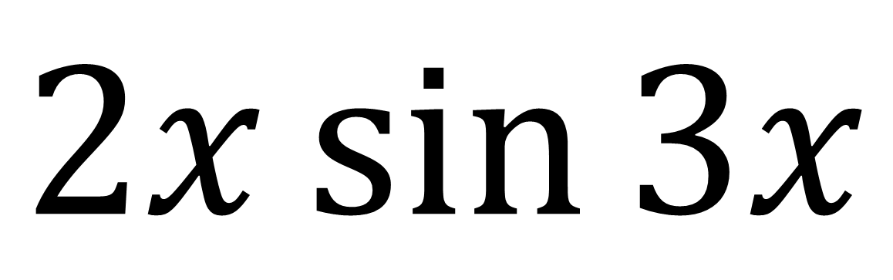
Product or Chain or Quotient?
$$2x\sin{3x}$$
Product

Slide 6
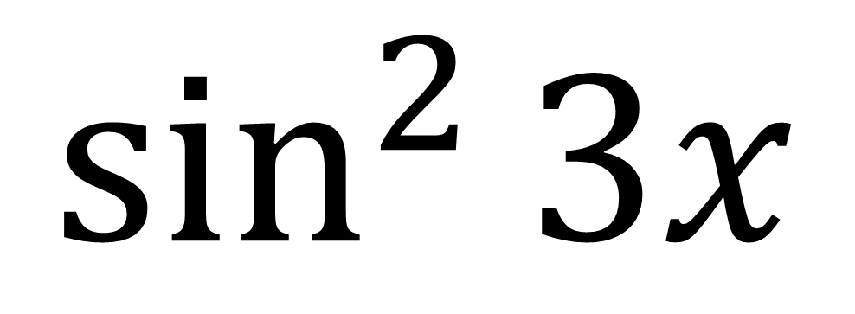
Product or Chain or Quotient?
$$\sin^{2}{3x}$$
Chain Rule

Slide 7
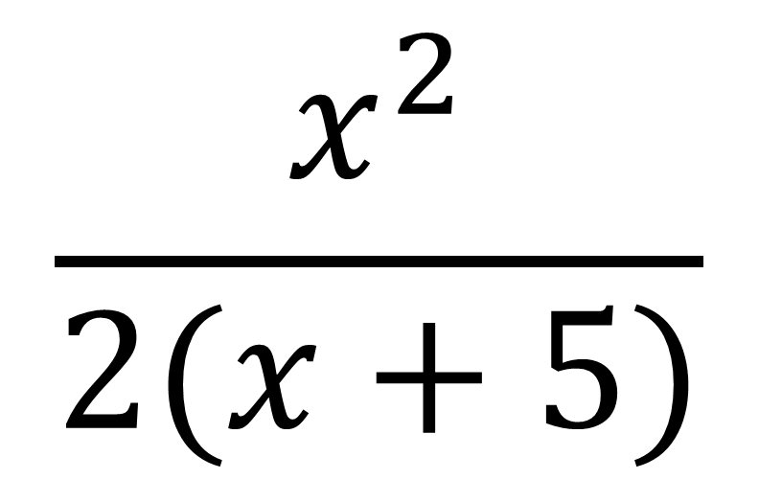
Product or Chain or Quotient?
$$\frac{x^{2}}{2(x+5)}$$
Quotient Rule

Slide 8
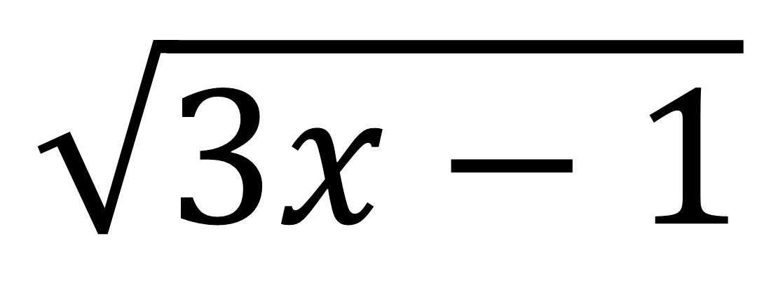
Product or Chain or Quotient?
$$\sqrt{3x−1}$$
Chain Rule

Slide 9
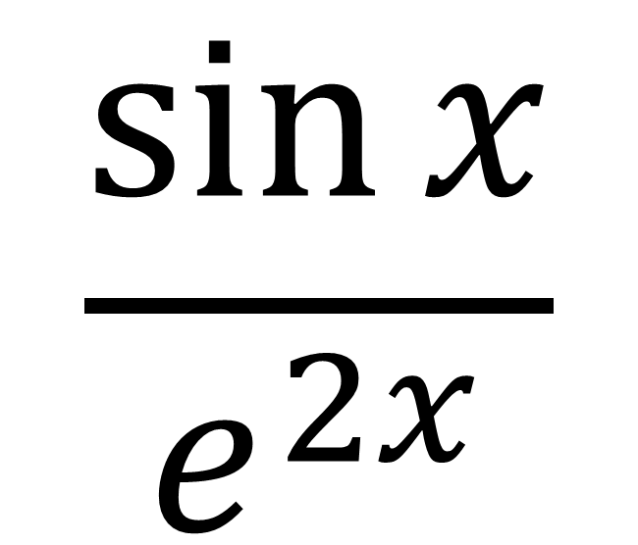
Product or Chain or Quotient?
$$\frac{\sin{x}}{e^{2x}}$$
Quotient Rule

Slide 10
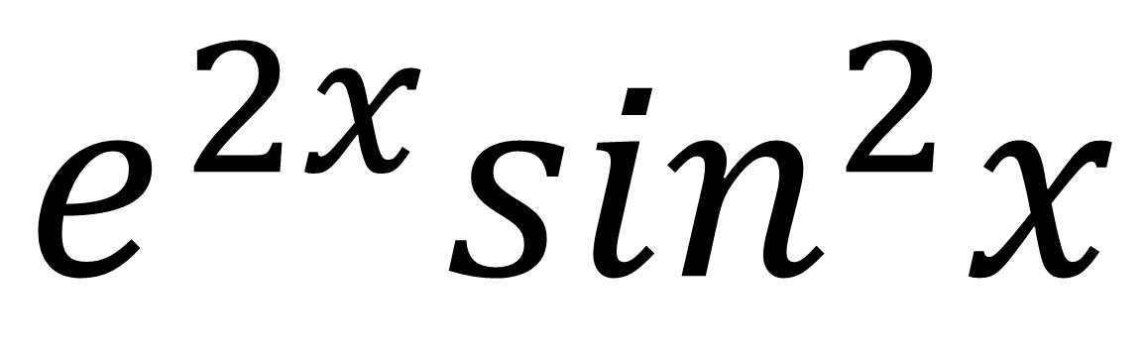
Product or Chain or Quotient?
$$e^{2x}\sin^{2}x$$
Product and Chain Rule

Slide 11
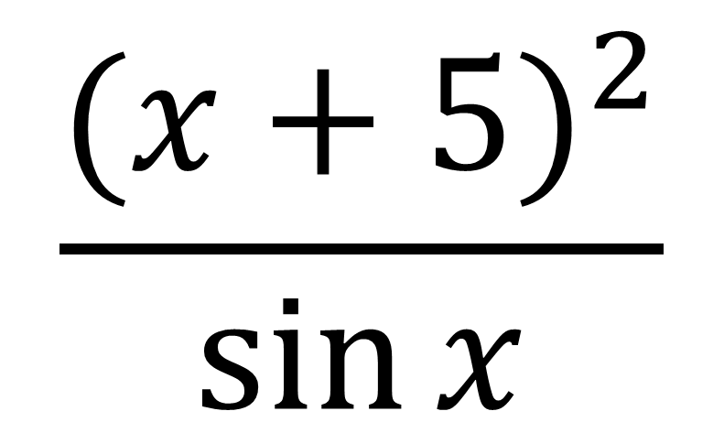
Product or Chain or Quotient?
$$\frac{{(x+5)}^{2}}{\sin{x}}$$
Quotient and Chain Rule

Slide 12

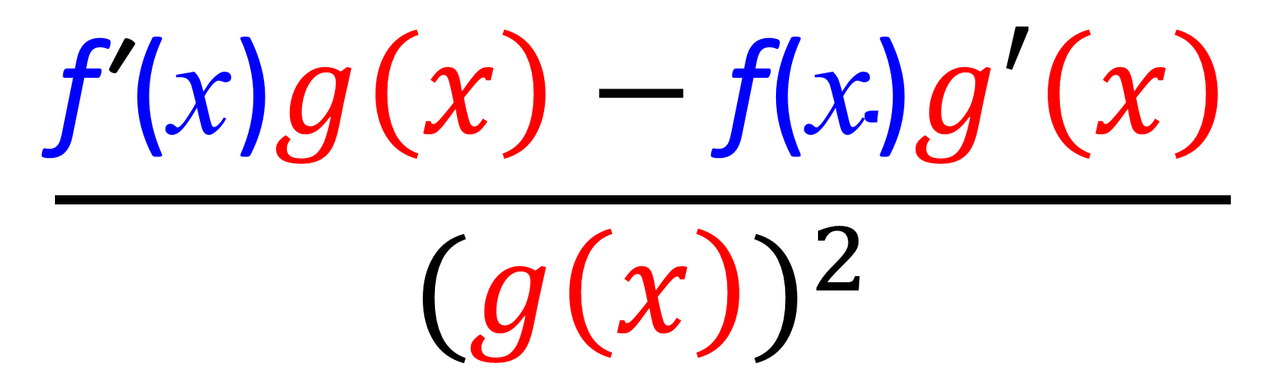
If $y=\frac{\text{f}\text{ (}\text{x}\text{)}}{g\left(x\right)}$ then
The Quotient Rule
$$\frac{\text{f}\text{′}\text{(}\text{x}\text{)}g\left(x\right)−\text{f}\text{(}\text{x}\text{)}g′\left(x\right)}{{(g\left(x\right))}^{2}}$$

Slide 13
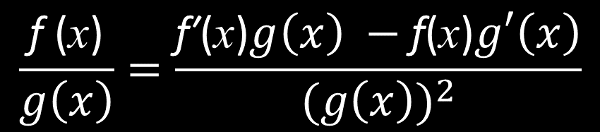

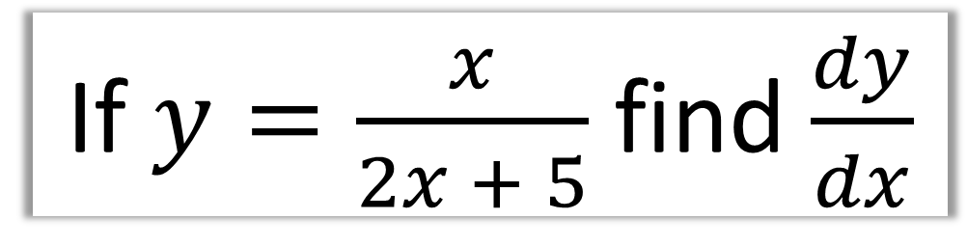
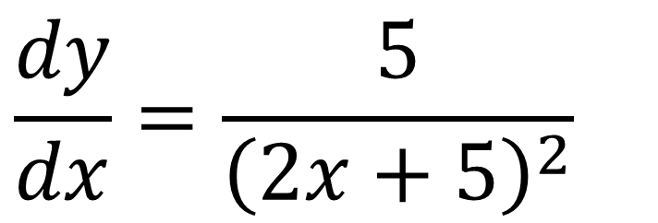
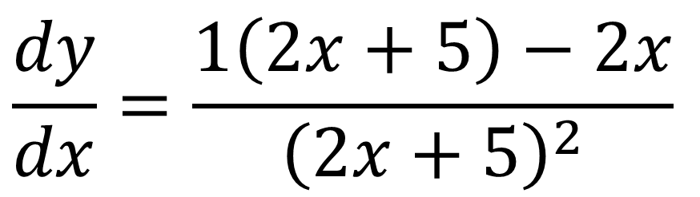
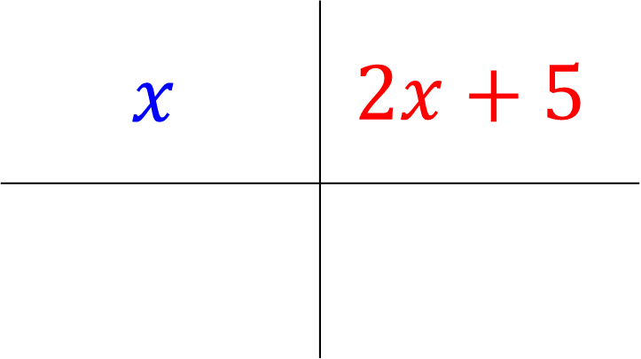
If $y=\frac{x}{2x + 5}$ find $\frac{dy}{dx}$
$$\frac{\text{f}\text{ (}\text{x}\text{)}}{g\left(x\right)}=\frac{\text{f}\text{′}\text{(}\text{x}\text{)}g\left(x\right) −\text{f}\text{(}\text{x}\text{)}g′\left(x\right)}{{(g\left(x\right))}^{2}}$$
$$x$$ | $$2x+5$$
$$\frac{dy}{dx}=\frac{1\left(2x+5\right)−2x}{{\left(2x+5\right)}^{2}}$$
$$1$$
2
$$\frac{dy}{dx}=\frac{5}{{\left(2x+5\right)}^{2}}$$

Slide 14
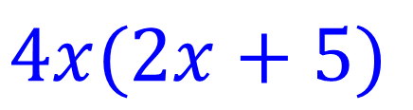
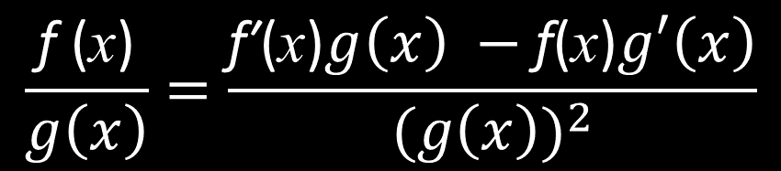
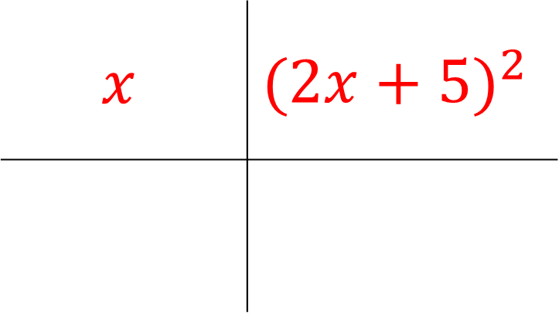
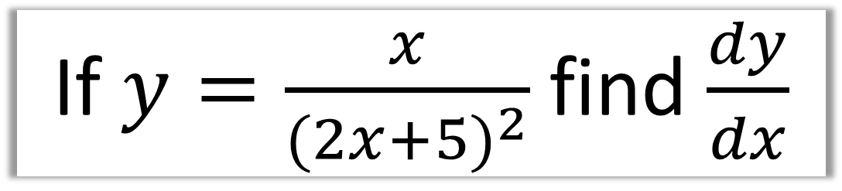
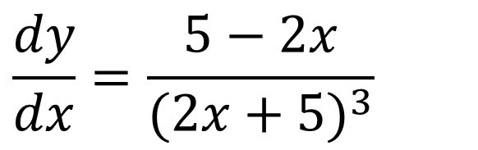
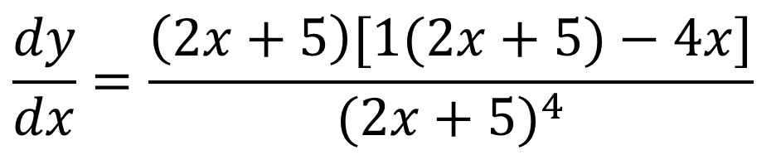
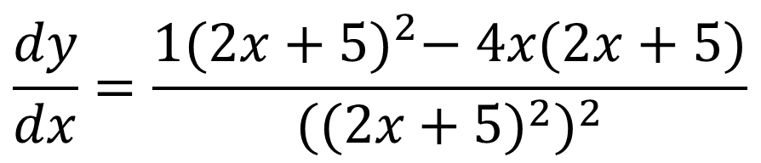
If $y=\frac{x}{{(2x+5)}^{2}}$find $\frac{dy}{dx}$
$$\frac{\text{f}\text{ (}\text{x}\text{)}}{g\left(x\right)}=\frac{\text{f}\text{′}\text{(}\text{x}\text{)}g\left(x\right) −\text{f}\text{(}\text{x}\text{)}g′\left(x\right)}{{(g\left(x\right))}^{2}}$$
$$\frac{dy}{dx}=\frac{1{(2x+5)}^{2}− 4x(2x+5)}{{{((2x+5)}^{2})}^{2}}$$
$$x$$ | $${(2x+5)}^{2}$$
$$\frac{dy}{dx}=\frac{\left(2x+5\right)[1(2x+5)−4x]}{{(2x+5)}^{4}}$$
$$1$$
$$4x(2x+5)$$
$$\frac{dy}{dx}=\frac{5−2x}{{(2x+5)}^{3}}$$

Slide 15

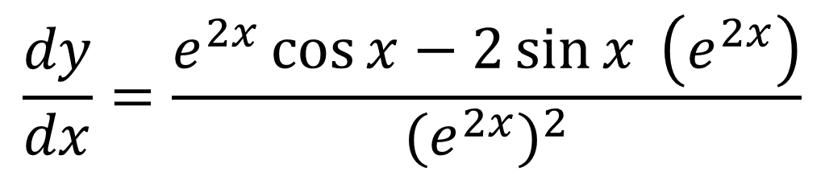
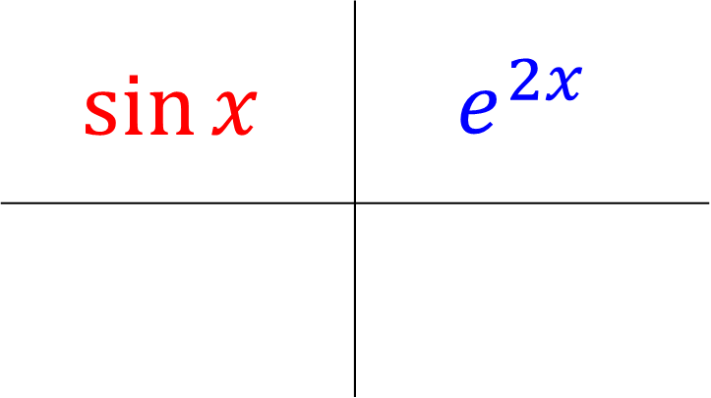
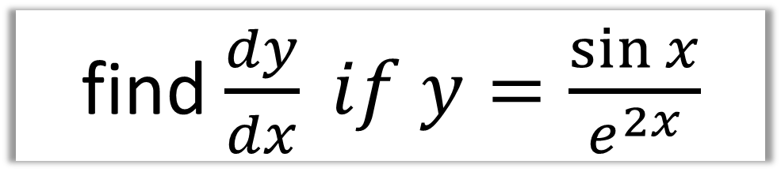
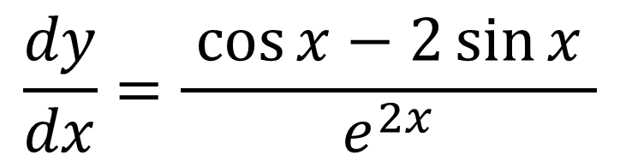
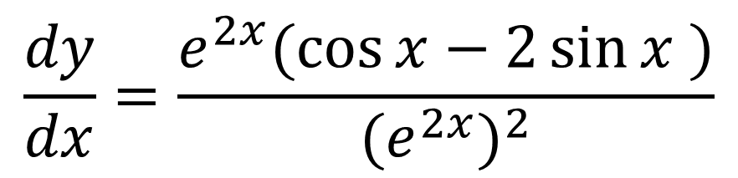
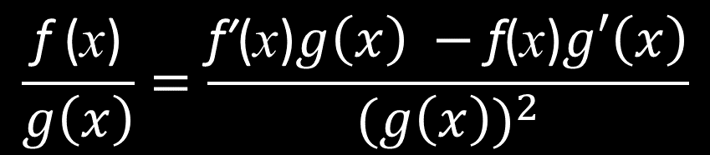

find $\frac{dy}{dx} if y=\frac{\sin{x}}{e^{2x}}$
$$\frac{\text{f}\text{ (}\text{x}\text{)}}{g\left(x\right)}=\frac{\text{f}\text{′}\text{(}\text{x}\text{)}g\left(x\right) −\text{f}\text{(}\text{x}\text{)}g′\left(x\right)}{{(g\left(x\right))}^{2}}$$
$$\frac{dy}{dx}=\frac{e^{2x}\cos{x}−2\sin{x} \left(e^{2x}\right)}{{{(e}^{2x})}^{2}}$$
$$\sin{x}$$ | $$e^{2x}$$
$$\frac{dy}{dx}=\frac{e^{2x}(\cos{x}−2\sin{x} )}{{{(e}^{2x})}^{2}}$$
$$\cos{x}$$
$$2e^{2x}$$
$$\frac{dy}{dx}=\frac{ \cos{x}−2\sin{x} }{e^{2x}}$$

Slide 16


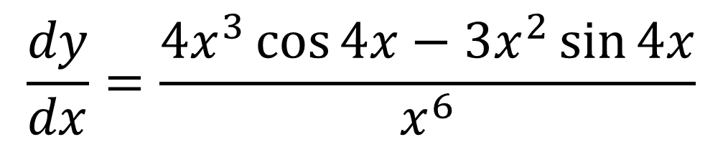

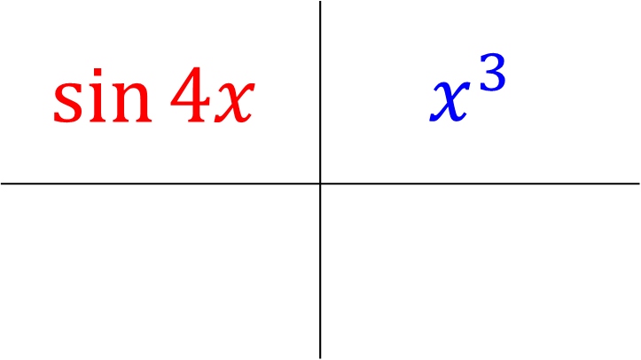
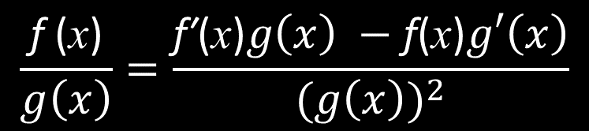
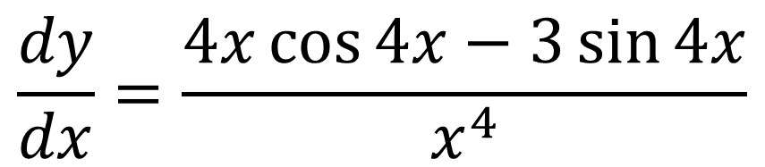
$$\frac{\text{f}\text{ (}\text{x}\text{)}}{g\left(x\right)}=\frac{\text{f}\text{′}\text{(}\text{x}\text{)}g\left(x\right) −\text{f}\text{(}\text{x}\text{)}g′\left(x\right)}{{(g\left(x\right))}^{2}}$$
$$\frac{dy}{dx}=\frac{4x^{3}\cos{4x}−3x^{2}\sin{4x}}{x^{6}}$$
$$\sin{4x}$$ | $$x^{3}$$
$$\frac{dy}{dx}=\frac{4x\cos{4x}−3\sin{4x}}{x^{4}}$$
$$4cos{4x}$$
$$3x^{2}$$

Slide 17
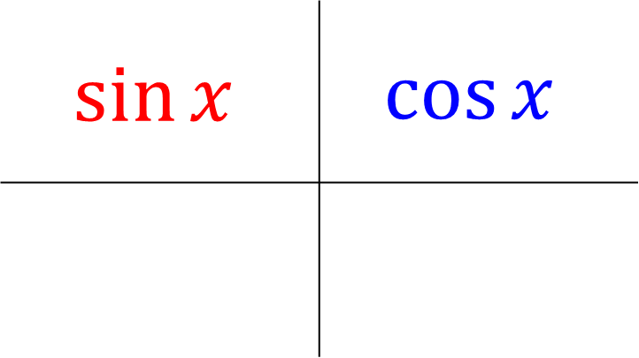
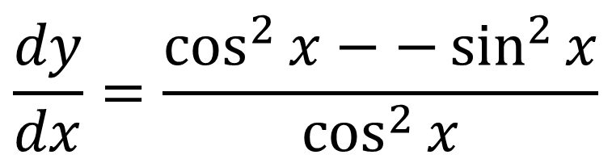

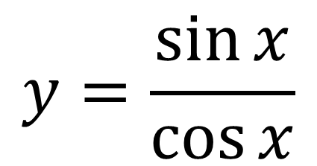
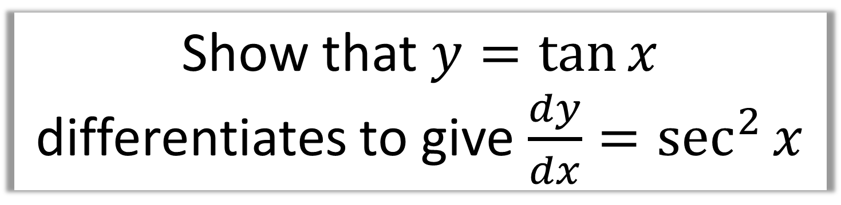
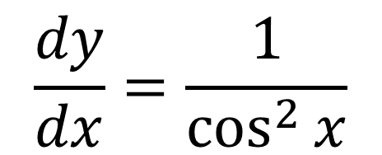

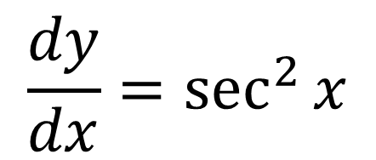
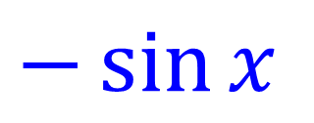
Show that $y=\tan{x}$ differentiates to give $\frac{dy}{dx}=\sec^{2}{x}$
$$y=\frac{\sin{x}}{\cos{x}}$$
$$\frac{\text{f}\text{ (}\text{x}\text{)}}{g\left(x\right)}=\frac{\text{f}\text{′}\text{(}\text{x}\text{)}g\left(x\right) −\text{f}\text{(}\text{x}\text{)}g′\left(x\right)}{{(g\left(x\right))}^{2}}$$
$$\frac{dy}{dx}=\frac{\cos^{2}{x}−−\sin^{2}{x}}{\cos^{2}{x}}$$
$$\sin{x}$$ | $$\cos{x}$$
$$\frac{dy}{dx}=\frac{1}{\cos^{2}{x}}$$
$$\cos{x}$$
$$−\sin{x}$$
$$\frac{dy}{dx}=\sec^{2}{x}$$

Slide 18
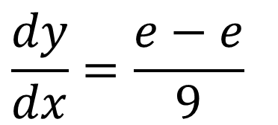
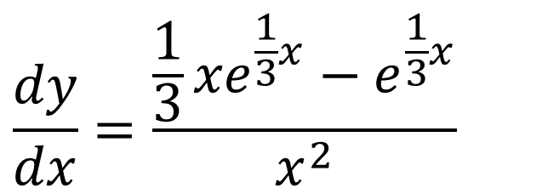







Find the equation of the tangent of the curve $y=\frac{e^{\frac{1}{3}x}}{x}$ at the point (3, $\frac{1}{3}e)$. Total marks 7
$$\frac{dy}{dx}=\frac{{\frac{1}{3}xe}^{\frac{1}{3}x}−e^{\frac{1}{3}x}}{x^{2}}$$
$$\frac{\text{f}\text{ (}\text{x}\text{)}}{g\left(x\right)}=\frac{\text{f}\text{′}\text{(}\text{x}\text{)}g\left(x\right) −\text{f}\text{(}\text{x}\text{)}g′\left(x\right)}{{(g\left(x\right))}^{2}}$$
$$e^{\frac{1}{3}x}$$ | $$x$$
Substitute $x=3$
$$\frac{dy}{dx}=\frac{e−e}{9}$$
$${\frac{1}{3}e}^{\frac{1}{3}x}$$
$$1$$
$$\frac{dy}{dx}=\frac{0}{9}=0$$

Slide 19



Find the equation of the tangent of the curve $y=\frac{e^{\frac{1}{3}x}}{x}$ at the point (3, $\frac{1}{3}e)$. Total marks 7
$$y−y_{1}=m(x −x_{1})$$
$$y−\frac{1}{3}e=0(x −3)$$
$$y=\frac{1}{3}e$$

Slide 20








Given that $f\left(x\right)=\frac{2x}{x+5}+\frac{6x}{x^{2} + 7x +10}$ show that $f\left(x\right)=\frac{2x}{x +2}$
Hence find $f′\left(3\right)$.
$$f\left(x\right)=\frac{2x}{x+5}+\frac{6x}{x^{2} + 7x +10}$$
$$f\left(x\right)=\frac{2x^{2}+10x}{(x+5)(x+2)}$$
$$f\left(x\right)=\frac{2x}{x+5}+\frac{6x}{(x+5)(x+2)}$$
$$f\left(x\right)=\frac{2x(x+5)}{(x+5)(x+2)}$$
$$f\left(x\right)=\frac{2x(x+2)}{(x+5)(x+2)}+\frac{6x}{(x+5)(x+2)}$$
$$f\left(x\right)=\frac{2x}{x+2}$$
$$f\left(x\right)=\frac{2x\left(x+2\right)+6x}{(x+5)(x+2)}$$

Slide 21








Given that $f\left(x\right)=\frac{2x}{x+5}+\frac{6x}{x^{2} + 7x +10}$ show that $f\left(x\right)=\frac{2x}{x +2}$
Hence find $f′\left(3\right)$.
$$\frac{\text{f}\text{ (}\text{x}\text{)}}{g\left(x\right)}=\frac{\text{f}\text{′}\text{(}\text{x}\text{)}g\left(x\right) −\text{f}\text{(}\text{x}\text{)}g′\left(x\right)}{{(g\left(x\right))}^{2}}$$
$$f\left(x\right)=\frac{2x}{x+2}$$
$$f′(x)=\frac{2x+4 −2x}{{\left(x+2\right)}^{2}}$$
$$2x$$ | $$x+2$$
$$f′(x)=\frac{4}{{\left(x+2\right)}^{2}}$$
$$2$$
$$1$$
$$f′(3)=\frac{4}{25}$$

