Slide 1
Find the nth term of the following quadratics Sequences
1) 5, 14, 27, 44, 65, …..
2) 12, 21, 36, 57, 84, …..
3) 11, 24, 41, 62, 87, …..
4) 12, 24, 40, 60, 84, …..
5) 19, 39, 67, 103, 147, …..

Slide 2
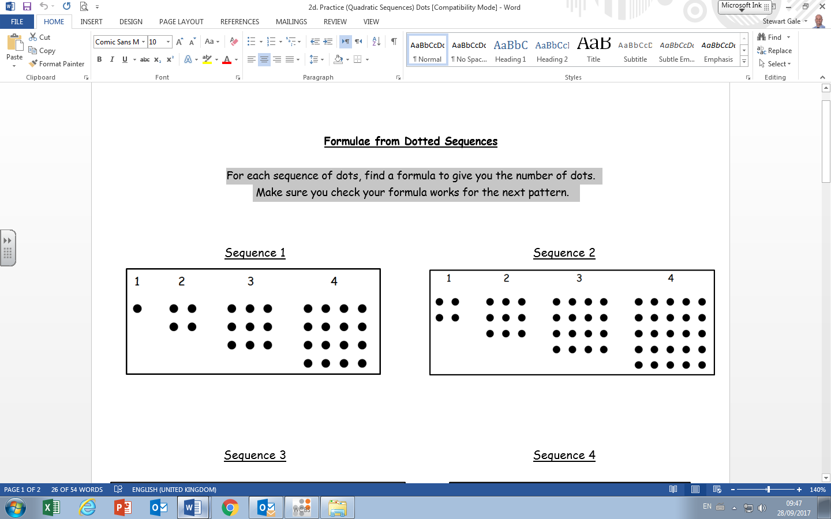
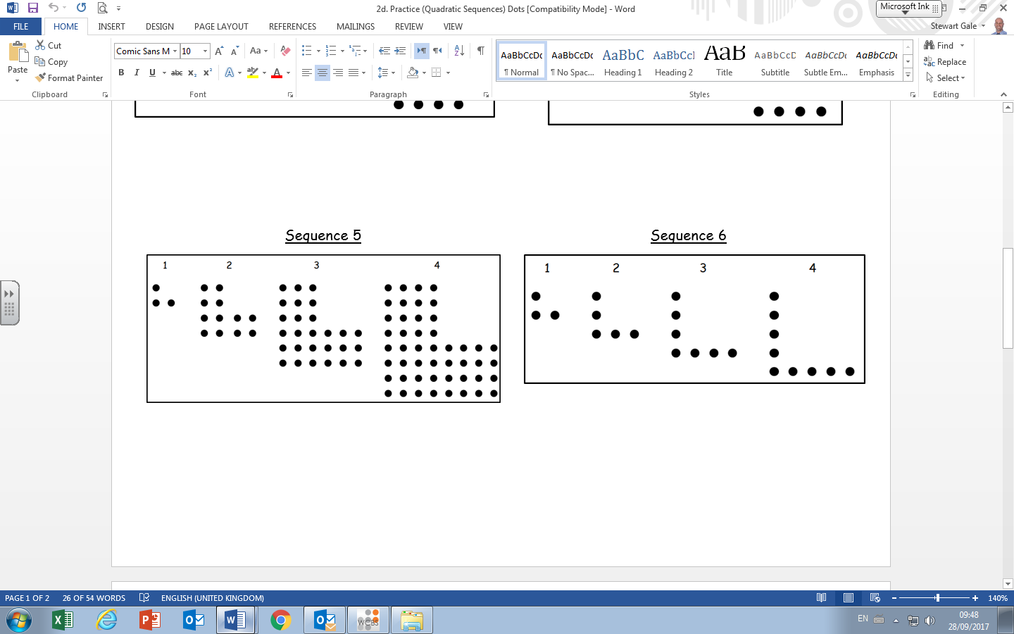
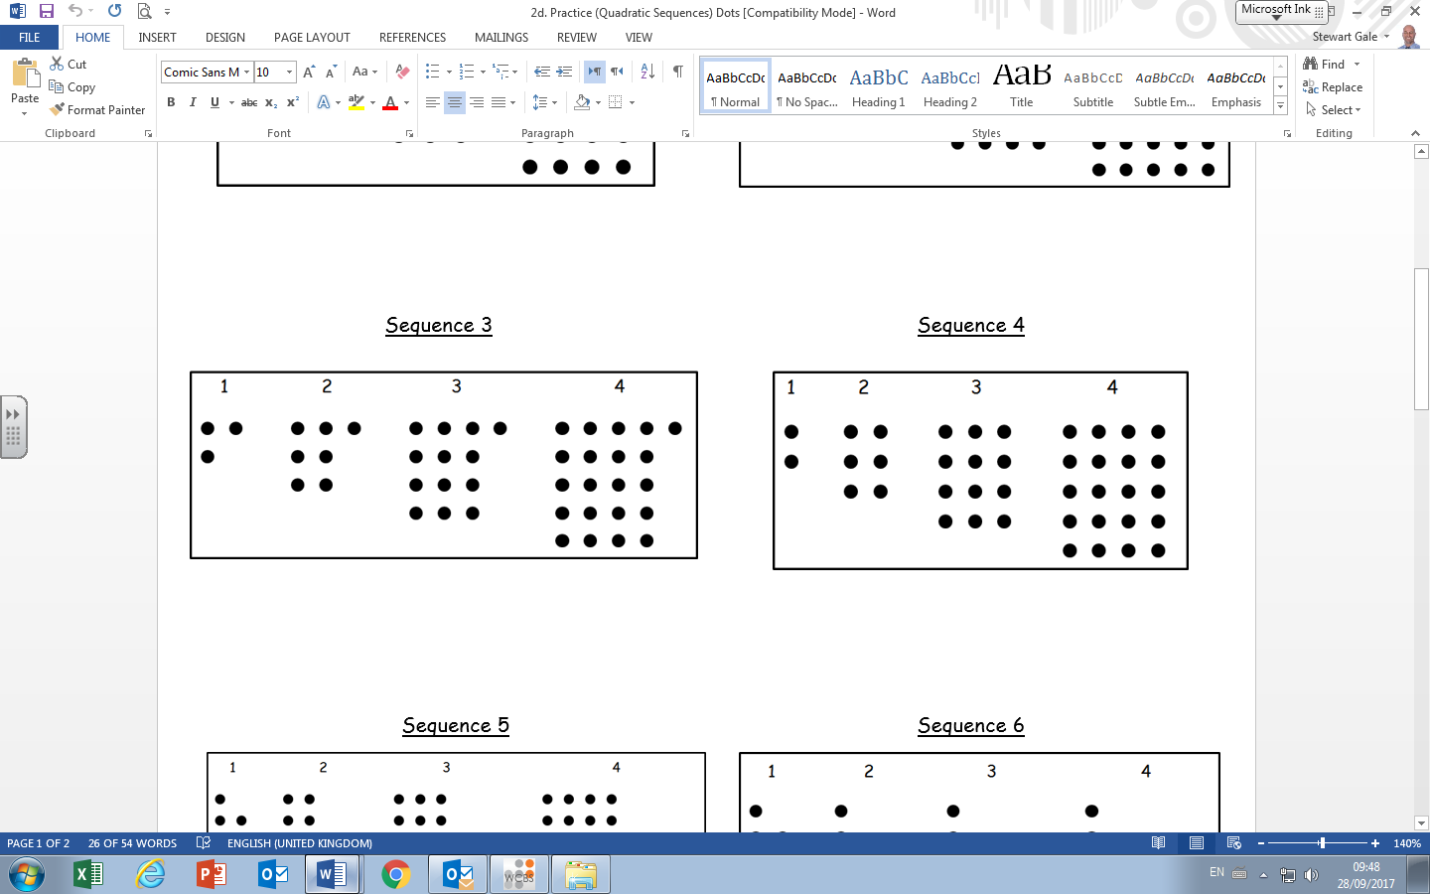
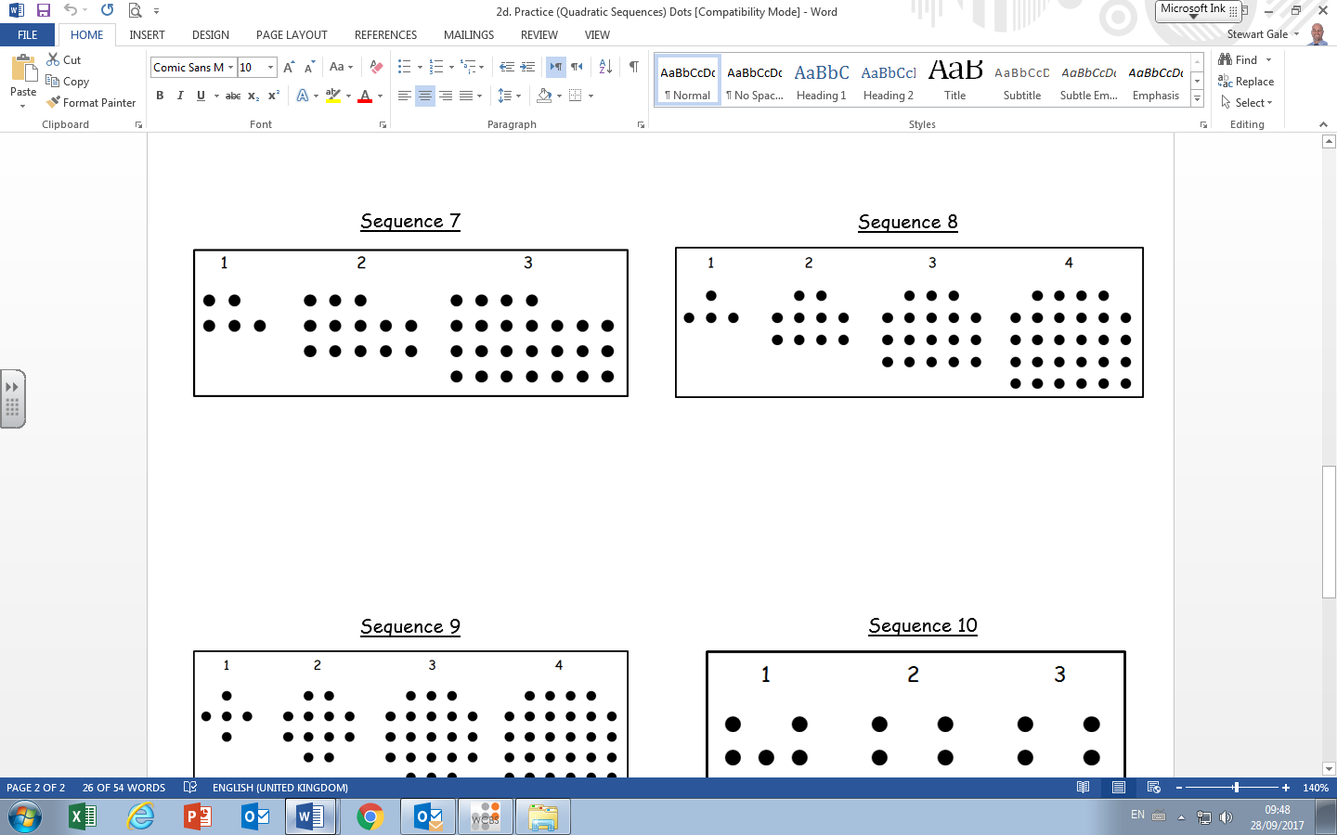
1)
5)
2)
6)
3)
7)
4)
8)

Slide 3
ANSWERS

Slide 4
Find the nth term of the following quadratics
1) 5, 14, 27, 44, 65, …..
2n² + 3n
2) 12, 21, 36, 57, 84, …..
3n² + 9
3) 11, 24, 41, 62, 87, …..
2n² + 7n + 2
4) 12, 24, 40, 60, 84, …..
2n² + 6n + 4
5) 19, 39, 67, 103, 147, …..
4n² + 8n + 7

Slide 5

1)
n²
2)
n² + 2n + 1
3)
n² + n + 1
4)
n² + n

Slide 6
5)
3n²
6)
2n + 1
7)
2n² + 2n + 1
8)
n² + 3n

