Slide 1
LO: Investigating Trigonometry Ratios

Slide 2
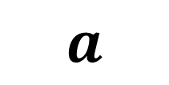
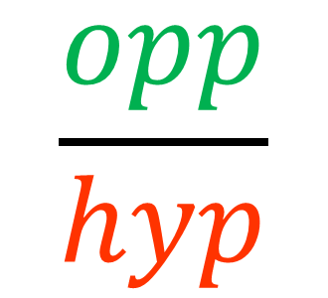
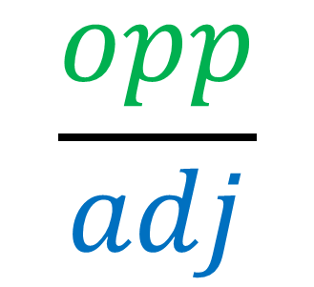
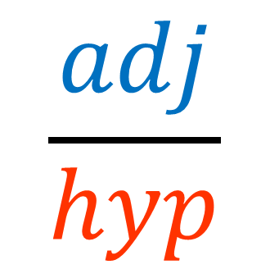
hyp
opp
$$a$$
adj
Investigate the following ratios
$$\frac{opp}{hyp}$$
$$\frac{adj}{hyp}$$
$$\frac{opp}{adj}$$

Slide 3
Complete the table and write down what you learn from the results.
Give your answers to 1 d.p.
b
c
a
 | Angle | Opp/Hyp | Adj/Hyp | Opp/Adj
a
b
c
What do you notice about the results?

Slide 4
Complete the table and write down what you learn from the results.
Give your answers to 1 d.p.
b
a
c
 | Angle | Opp/Hyp | Adj/Hyp | Opp/Adj
a
b
c
What do you notice about the results?

Slide 5
Complete the table and write down what you learn from the results.
Give your answers to 1 d.p.
b
c
a
 | Angle | Opp/Hyp | Adj/Hyp | Opp/Adj
a
b
c
What do you notice about the results?

Slide 6
Complete the table and write down what you learn from the results.
Give your answers to 1 d.p.
b
c
a
 | Angle | Opp/Hyp | Adj/Hyp | Opp/Adj
a
b
c
What do you notice about the results?

Slide 7
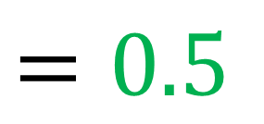
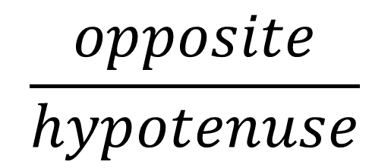
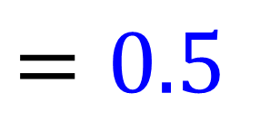
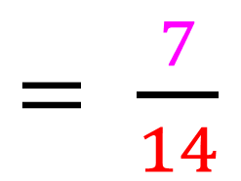
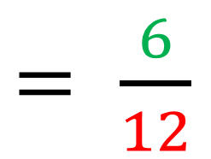
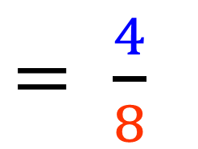
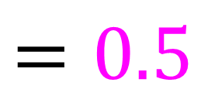
$$\frac{opposite}{hypotenuse}$$
$= \frac{4}{8}$
$= \frac{6}{12}$
$= \frac{7}{14}$
$=0.5$
$=0.5$
$=0.5$
30°

Slide 8
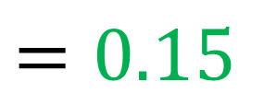
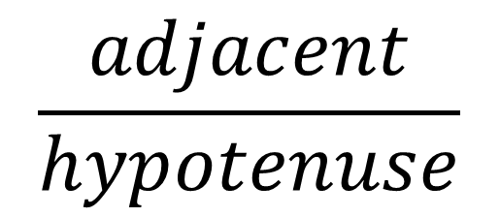
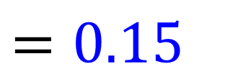
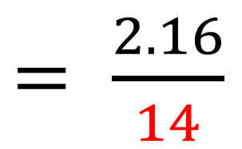
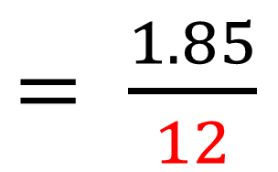
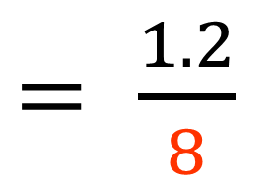
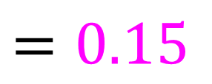
$$\frac{adjacent}{hypotenuse}$$
$= \frac{1.2}{8}$
$= \frac{1.85}{12}$
$= \frac{2.16}{14}$
$=0.15$
$=0.15$
$=0.15$
30°

Slide 9
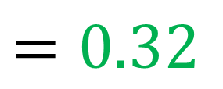
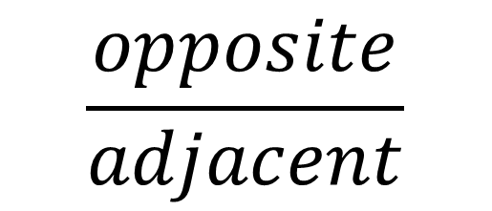
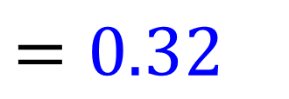
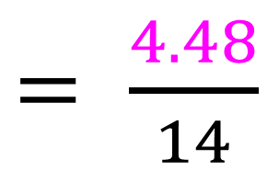
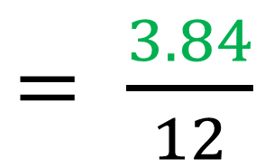
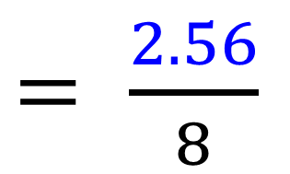
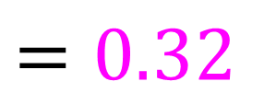
$$\frac{opposite}{adjacent}$$
$= \frac{2.56}{8}$
$= \frac{3.84}{12}$
$= \frac{4.48}{14}$
$=0.32$
$=0.32$
$=0.32$
60°

Slide 10
How can you use the trigonometry ratios
to help you find the missing side?
120
6
?
3
30°
30°

Slide 11

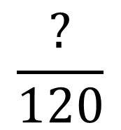
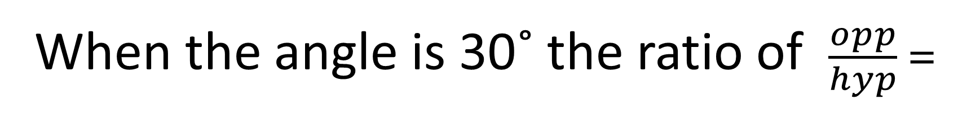
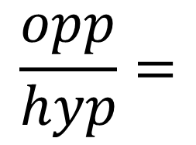

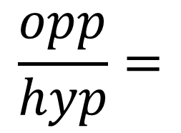
When the angle is 30˚ the ratio of $\frac{opp}{hyp} =$
$$\frac{1}{2}$$
120
60
6
?
3
30°
30°
$$\frac{opp}{hyp}=$$
$$\frac{3}{6}$$
$$\frac{opp}{hyp}=$$
$$\frac{?}{120}$$

Slide 12
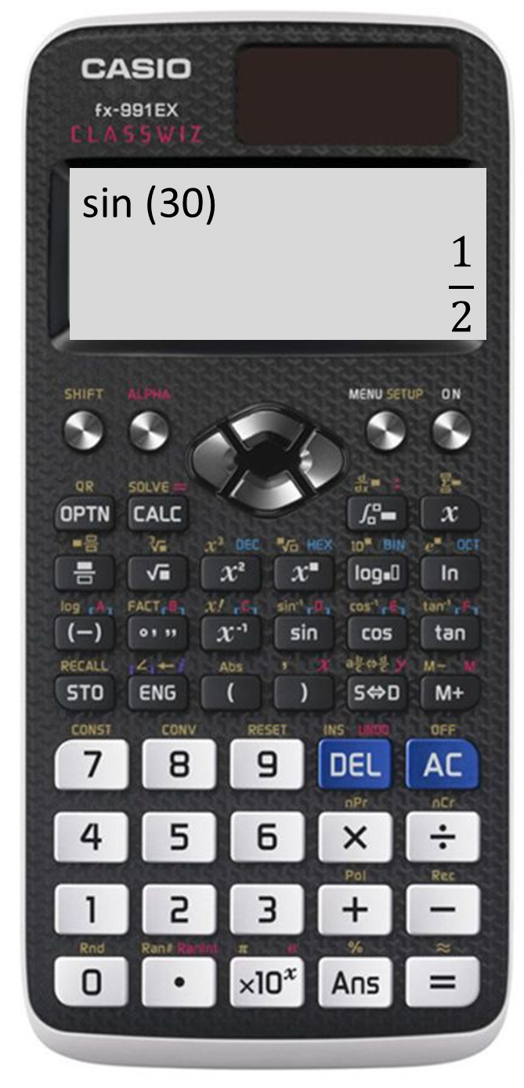
Do you need to remember these ratios?
No Way!
Your calculator will do the hard work!
Just make sure your
calculator is in degree mode.

Slide 13
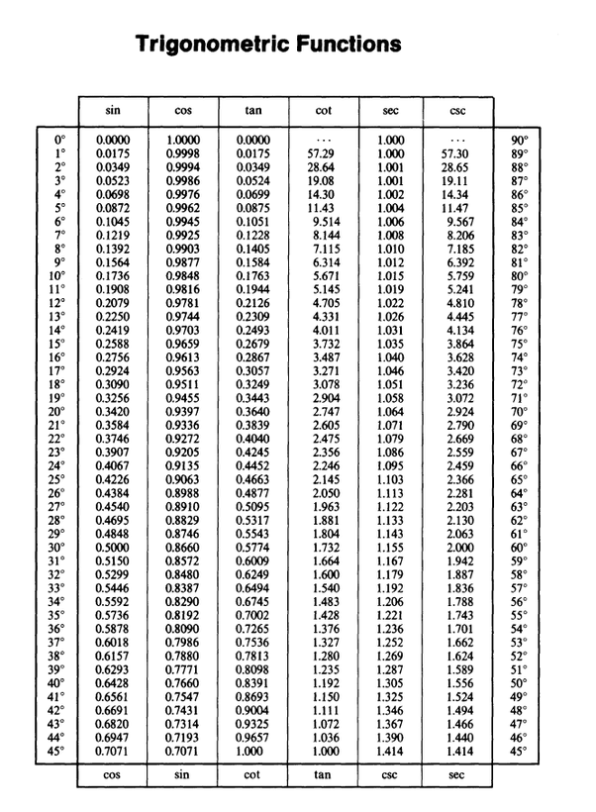



$$\frac{opp}{hyp}$$
$$\frac{adj}{hyp}$$
$$\frac{opp}{adj}$$
In the good old days
you would have had to use a book!

Slide 14
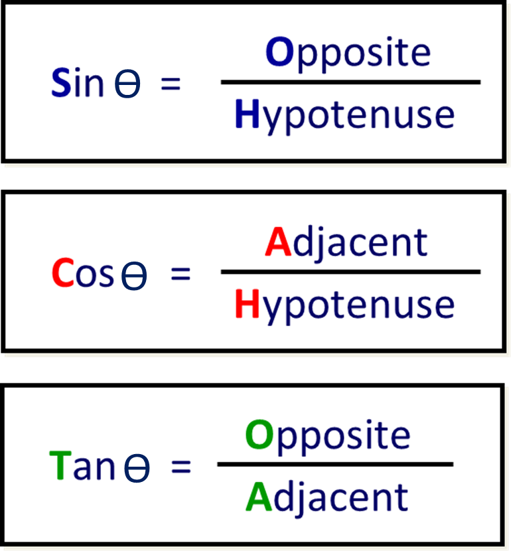
Each ratio is given a name.
ϴ = the given angle

Slide 15
ϴ = the given angle

Slide 16
ϴ = the given angle

