Slide 1
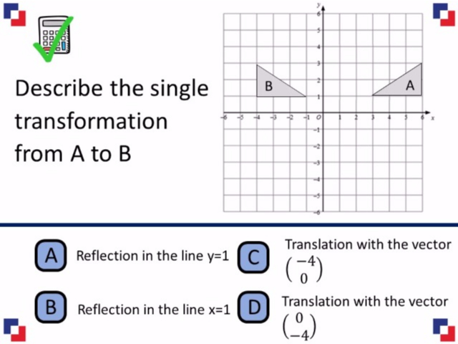
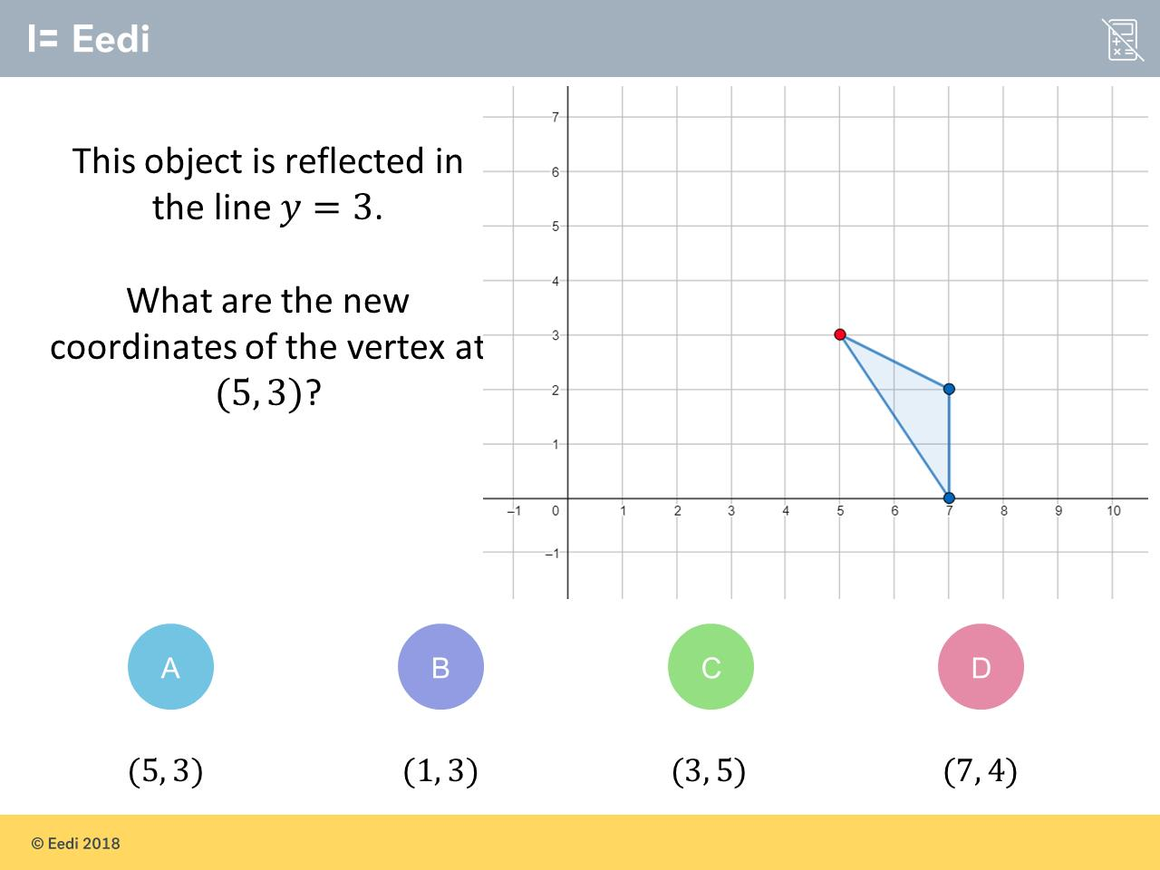
Worst answered question?
Most common wrong answer?

Slide 2
ANSWERS

Slide 3
Worst answered question?

Slide 4
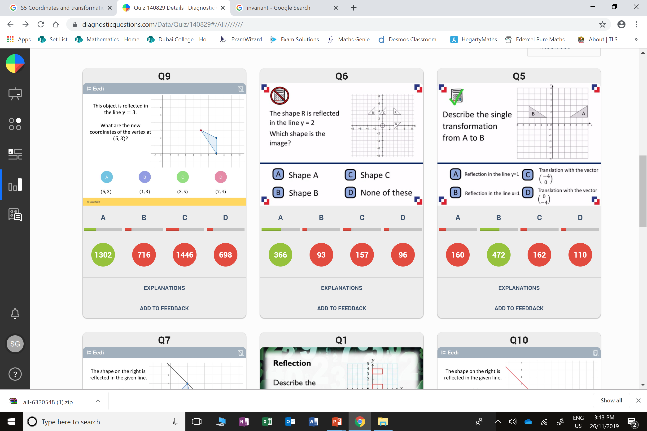
C
The student think the numbers get reflected.

Slide 5
C
The student has counted the number of squares between the triangles.

