Slide 1
FM: Combining Transformations

Slide 2

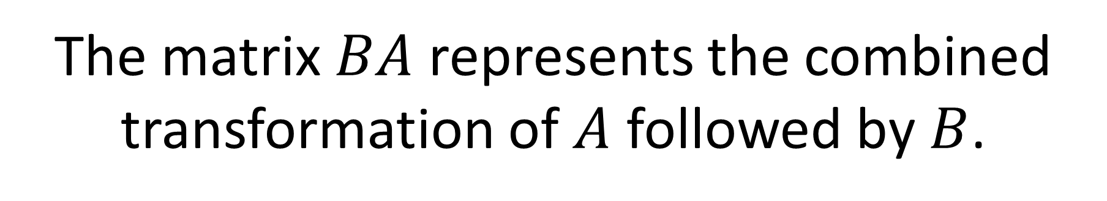


The matrix $BA$ represents the combined transformation of $A$ followed by $B$.
$$A$$
$$B$$
$$BA$$

Slide 3

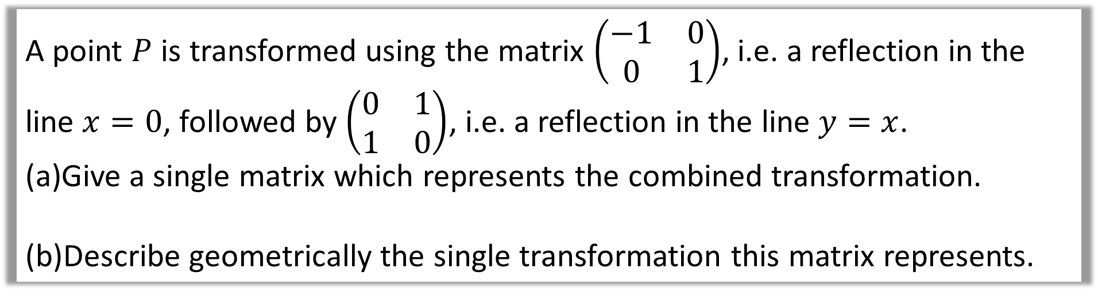
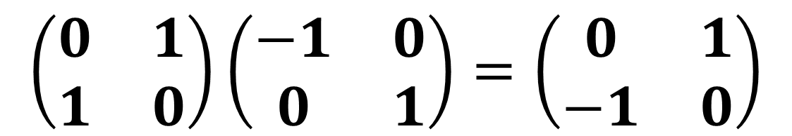
A point $P$ is transformed using the matrix $\left(\begin{matrix}−1 & 0 \\ 0 & 1\end{matrix}\right)$, i.e. a reflection in the line $x=0$, followed by $\left(\begin{matrix}0 & 1 \\ 1 & 0\end{matrix}\right)$, i.e. a reflection in the line $y=x$.
Give a single matrix which represents the combined transformation.
Describe geometrically the single transformation this matrix represents.
$$\left(\begin{matrix}0 & 1 \\ 1 & 0\end{matrix}\right)\left(\begin{matrix}−1 & 0 \\ 0 & 1\end{matrix}\right)=\left(\begin{matrix}0 & 1 \\ −1 & 0\end{matrix}\right)$$
Rotation $90°$ clockwise about the origin.

Slide 4
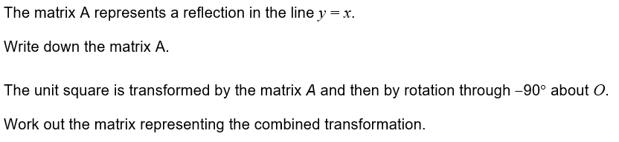
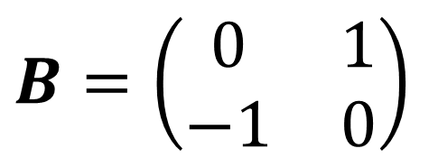
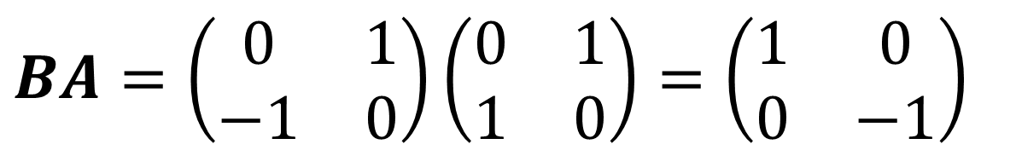
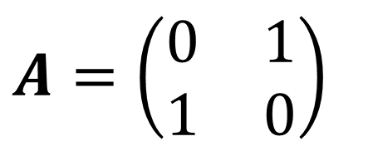
Note: The default direction of rotation is anticlockwise if not specified.
$$A=\left(\begin{matrix}0 & 1 \\ 1 & 0\end{matrix}\right)$$
$$B=\left(\begin{matrix}0 & 1 \\ −1 & 0\end{matrix}\right)$$
$$BA=\left(\begin{matrix}0 & 1 \\ −1 & 0\end{matrix}\right)\left(\begin{matrix}0 & 1 \\ 1 & 0\end{matrix}\right)=\left(\begin{matrix}1 & 0 \\ 0 & −1\end{matrix}\right)$$

Slide 5

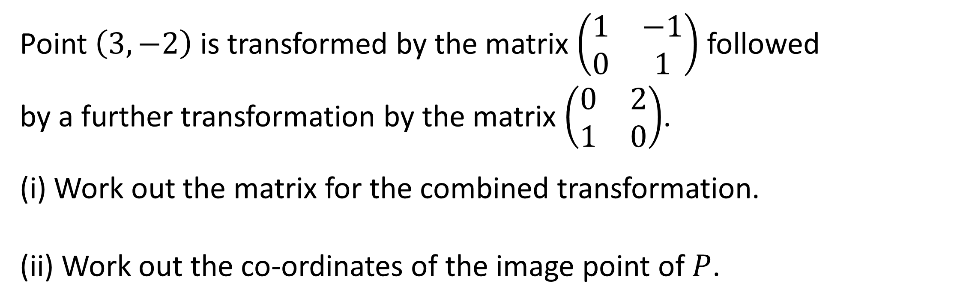
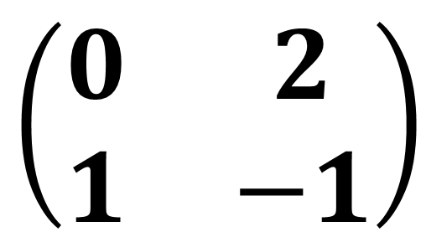
Point $\left(3,−2\right)$ is transformed by the matrix $\left(\begin{matrix}1 & −1 \\ 0 & 1\end{matrix}\right)$ followed by a further transformation by the matrix $\left(\begin{matrix}0 & 2 \\ 1 & 0\end{matrix}\right)$.
(i) Work out the matrix for the combined transformation.
(ii) Work out the co-ordinates of the image point of $P$.
$$\left(\begin{matrix}0 & 2 \\ 1 & −1\end{matrix}\right)$$
$$(−4,5)$$

Slide 6
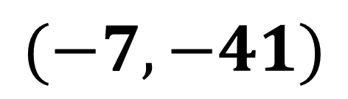
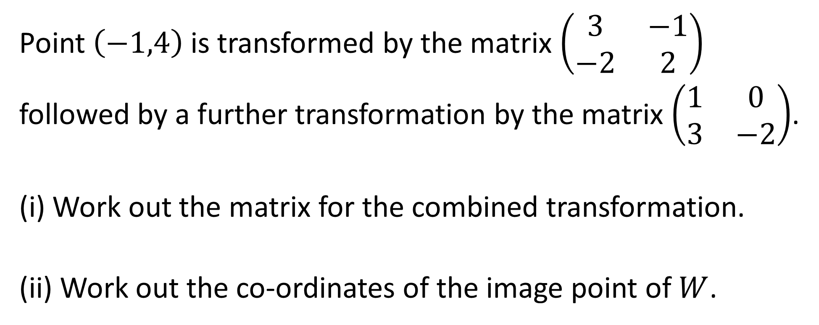
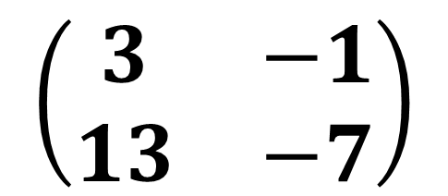
Point $\left(−1,4\right)$ is transformed by the matrix $\left(\begin{matrix}3 & −1 \\ −2 & 2\end{matrix}\right)$ followed by a further transformation by the matrix $\left(\begin{matrix}1 & 0 \\ 3 & −2\end{matrix}\right)$.
(i) Work out the matrix for the combined transformation.
(ii) Work out the co-ordinates of the image point of $W$.
$$\left(\begin{matrix}3 & −1 \\ 13 & −7\end{matrix}\right)$$
$$(−7,−41)$$

