Slide 1
Further Kinematics
Variable Acceleration Vectors Differentiation
Chapter 8
(Part 4 of 5)

Slide 2
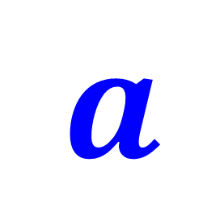
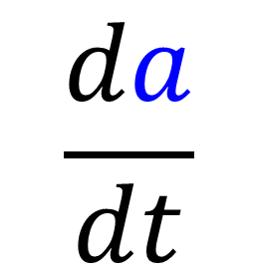

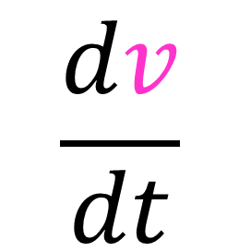

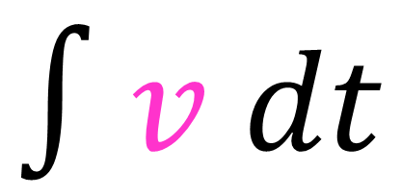
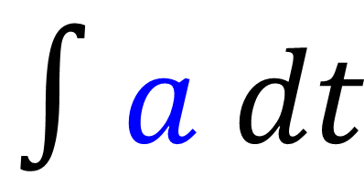
$$s$$
$$\frac{dv}{dt}$$
$$∫v dt$$
$$v$$
$$\frac{da}{dt}$$
$$∫a dt$$
$$a$$

Slide 3
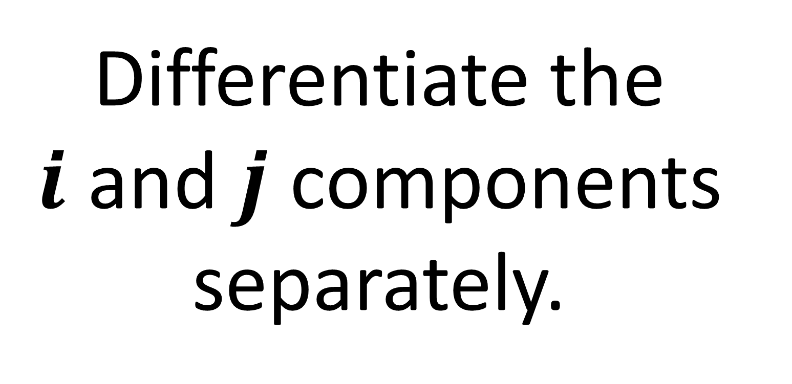
Differentiating Vectors
Differentiate the
$i$ and $j$ components separately.

Slide 4
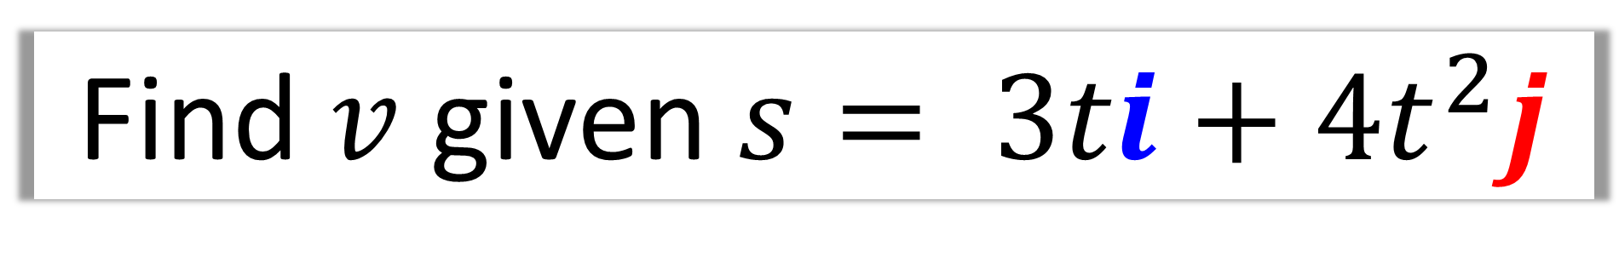
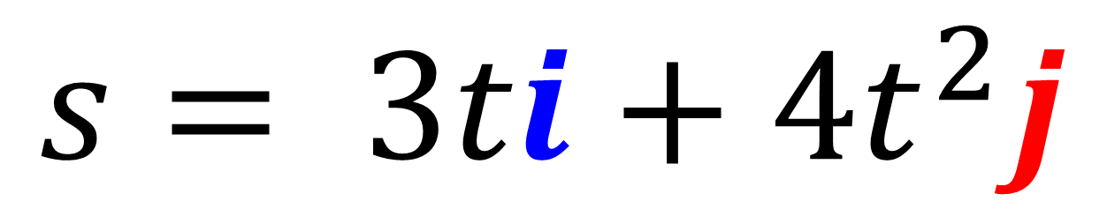
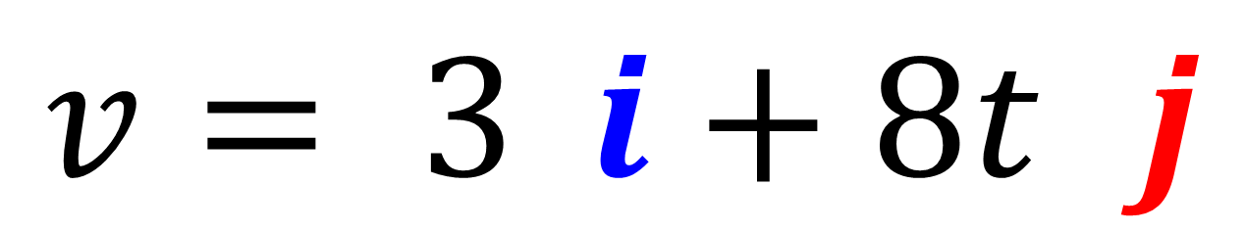
Find $v$ given $s= 3ti+4t^{2}j$
$$s= 3ti+4t^{2}j$$
$$v= 3ti+8t^{2}j$$

Slide 5
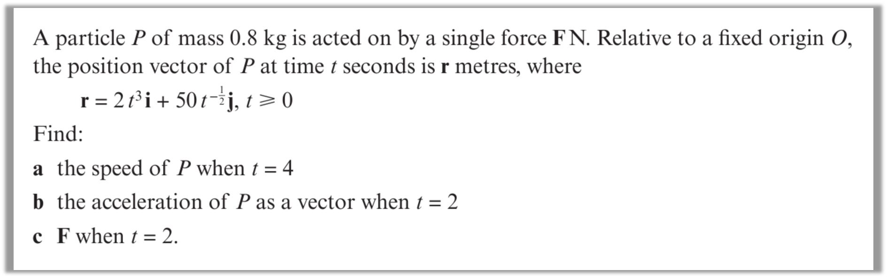
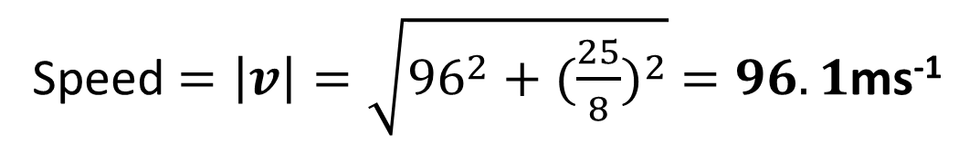
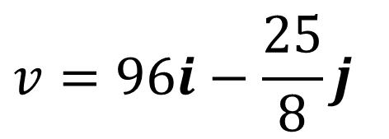
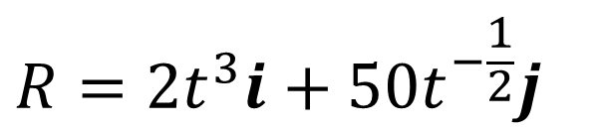

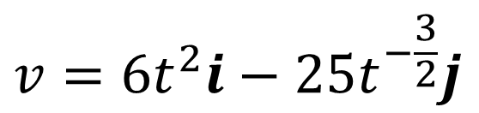
a
$$R=2t^{3}i+50t^{−\frac{1}{2}}j$$
$$t=4$$
$$v=96i−\frac{25}{8}j$$
$$v=6t^{2}i−25t^{−\frac{3}{2}}j$$
Speed $=\left|v\right|=\sqrt{{96}^{2}+{(\frac{25}{8})}^{2}} =96.1$ms⁻¹

Slide 6
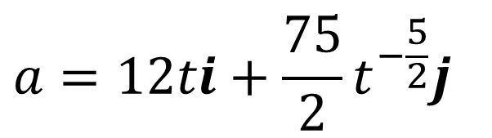


$$a=12ti+\frac{75}{2}t^{−\frac{5}{2}}j$$
b
$$t=2$$
$$a=24i+6.6291..j$$

Slide 7
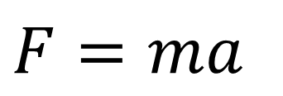
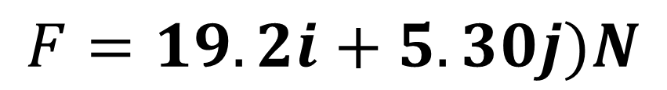
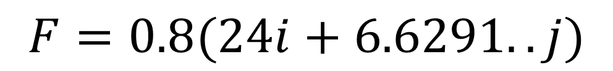
$$F=ma$$
c
$$F=0.8(24i+6.6291..j)$$
$$F=19.2i+5.30j)N$$

