Slide 1
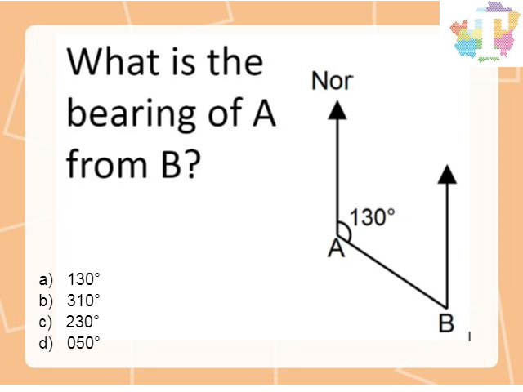
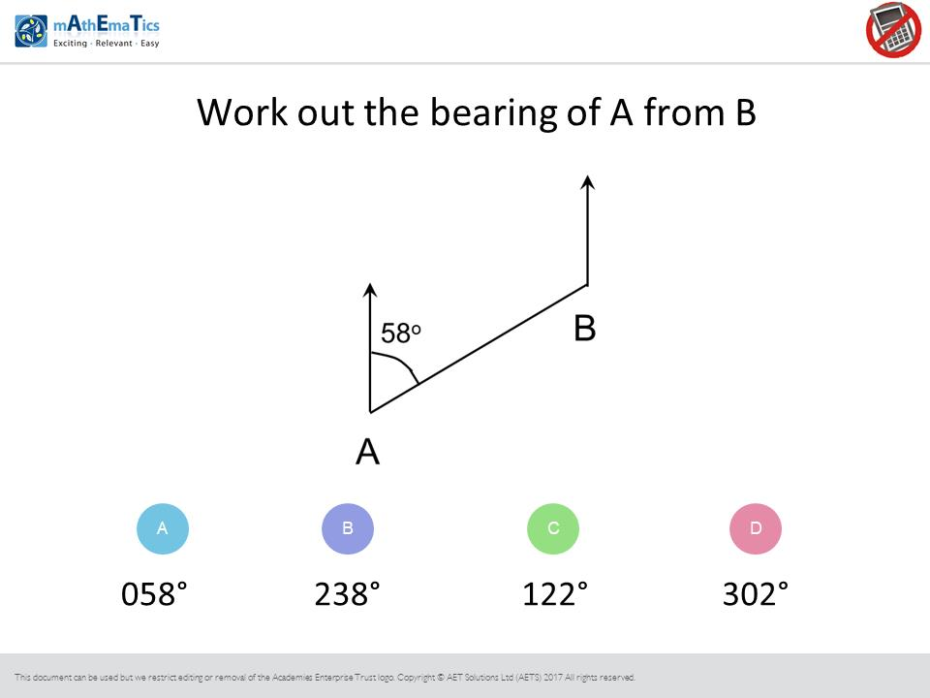
Worst answered question?
Most common wrong answer?

Slide 2
ANSWERS

Slide 3
Worst answered question?

Slide 4
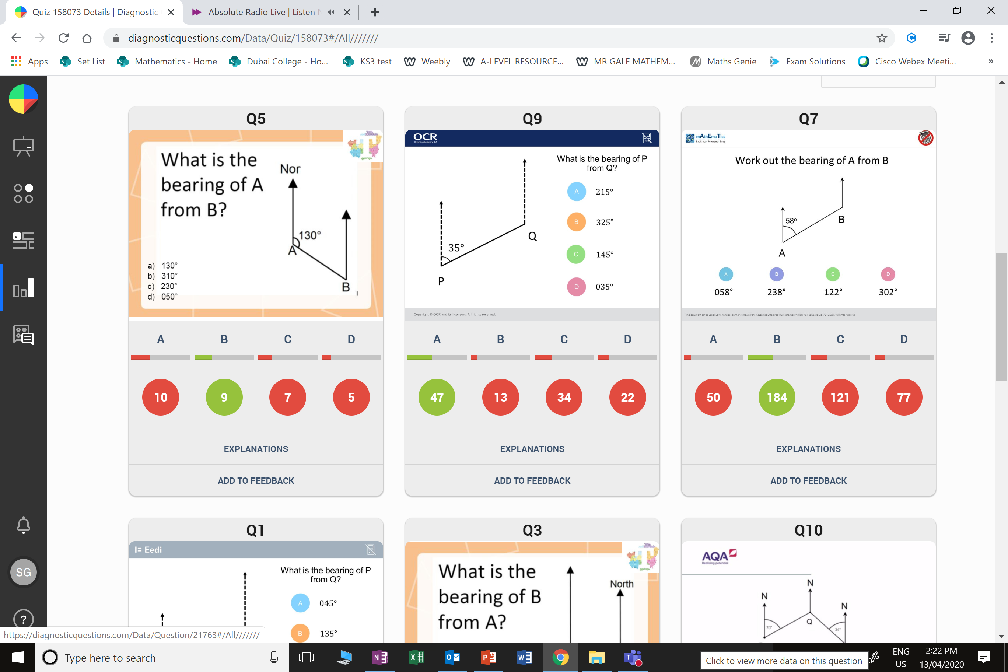
A
The found the bearing of
B from A.

Slide 5
C
They found the bearing measuring
anti-clockwise.

