Slide 1
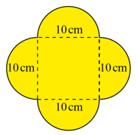
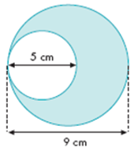
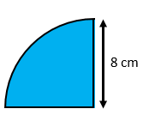
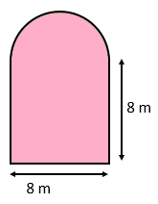
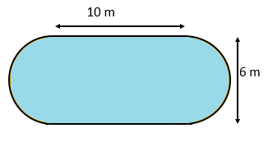
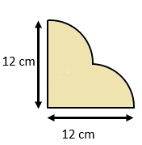
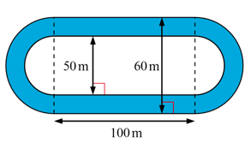
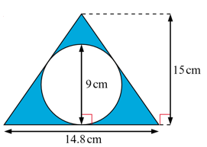
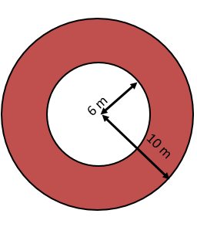
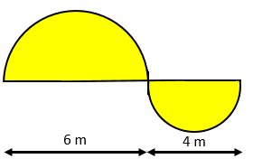
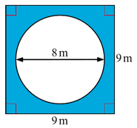
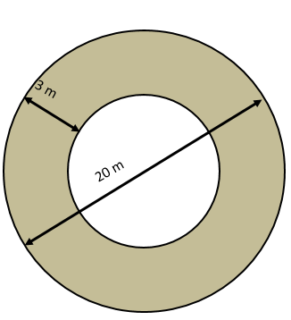
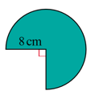
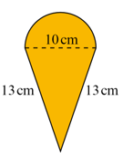
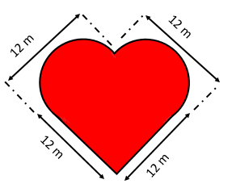
Lesson Objective:
To be able to calculate the compound areas or problems involving circles
10
11
1
2
3
12
13
4
5
6
14
15
7
8
9

Slide 2
ANSWERS

Slide 3
1
2
3
4
5
50.3 cm²
89.1 m²
88.3 m²
201.1 m²
92.6 cm²

Slide 4
7
8
9
10
6
20.4 m²
30.7 cm²
160.2 m²
150.8 cm²
257.1 cm²

Slide 5
11
12
13
44.0 cm²
4455.8 m²
47.4 cm²
14
15
99.3 cm²
257.1 m²

Slide 6
50.3 cm²
89.1 m²
88.3 m²
201.1 m²
92.6 cm²
25.7 m²
30.7 cm²
160.2 m²
150.8 cm²
257.1 cm²
44.0 cm²
4455.8 m²
47.4 cm²
99.3 cm²
257.1 m²

