Slide 1
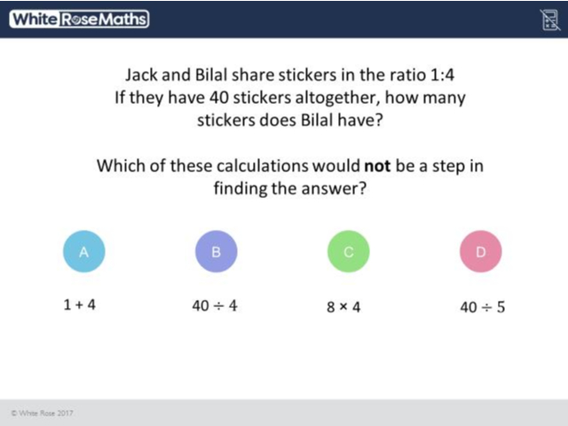
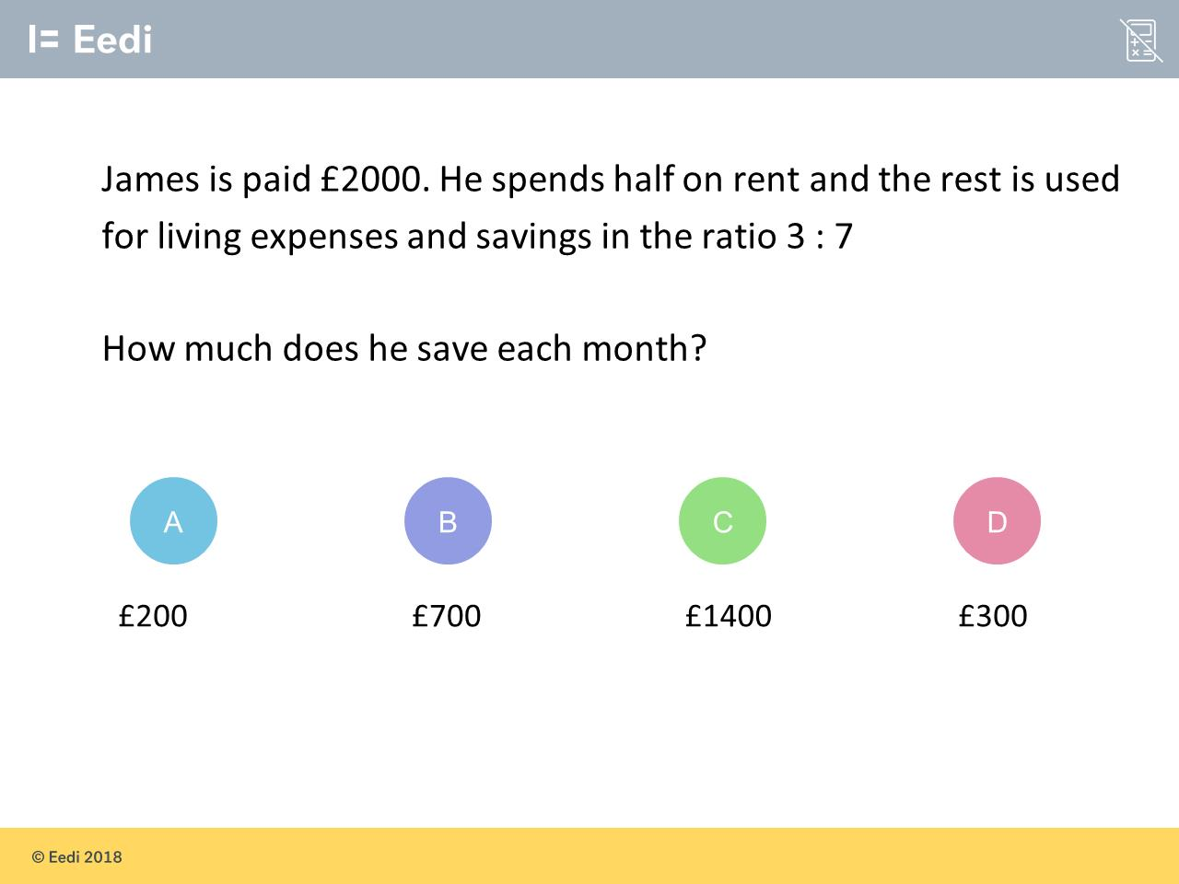
Worst answered question?
Most common wrong answer?

Slide 2
ANSWERS

Slide 3
Worst answered question?

Slide 4

C
They divided by Bilal’s individual ratio instead of the total ratio (5).

Slide 5
C
They did not
half the original amount.

