Slide 1
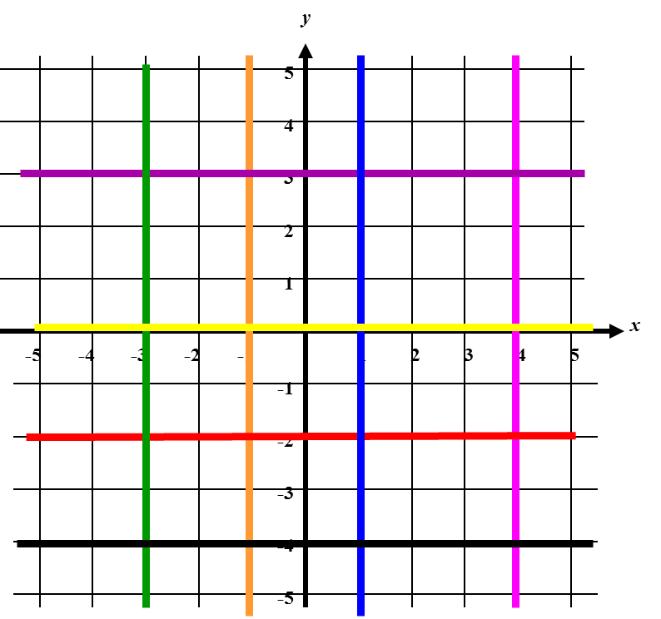
Write an equation for each line.
e
f
d
a
a |  |  | =
b |  |  | =
c |  |  | =
d |  |  | =
e |  |  | =
f |  |  | =
g |  |  | =
h |  |  | =
b
h
c
g

Slide 2
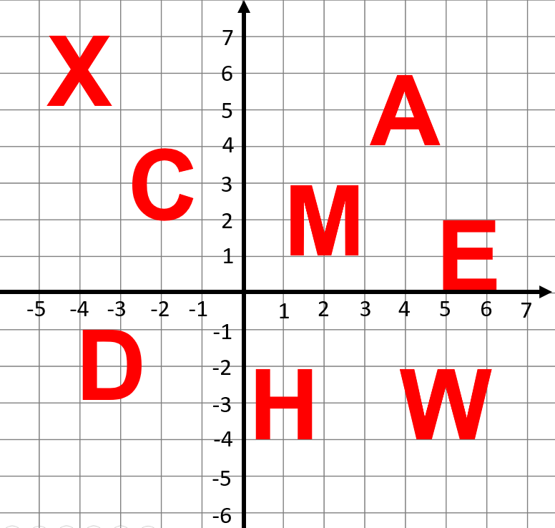
What are the equations of the lines of symmetry?
E
X
C
D
H
M
W
A

Slide 3
ANSWERS

Slide 4
Write an equation for each line.
a |  | x | = | 4
b |  | y | = | 3
c |  | y | = | -2
d |  | x | = | 1
e |  | x | = | -3
f |  | x | = | -1
g |  | y | = | -4
h |  | y | = | 0

Slide 5
E
What is the equation of the lines of symmetry?
y = 1
X
x = -4
y = 6
C
y = 3
D
y = -2
H
y = -3
x = 1
M
x = 2
W
x = 5
A
x = 4

