Slide 1

Junior Challenge 5
BRONZE

Slide 2
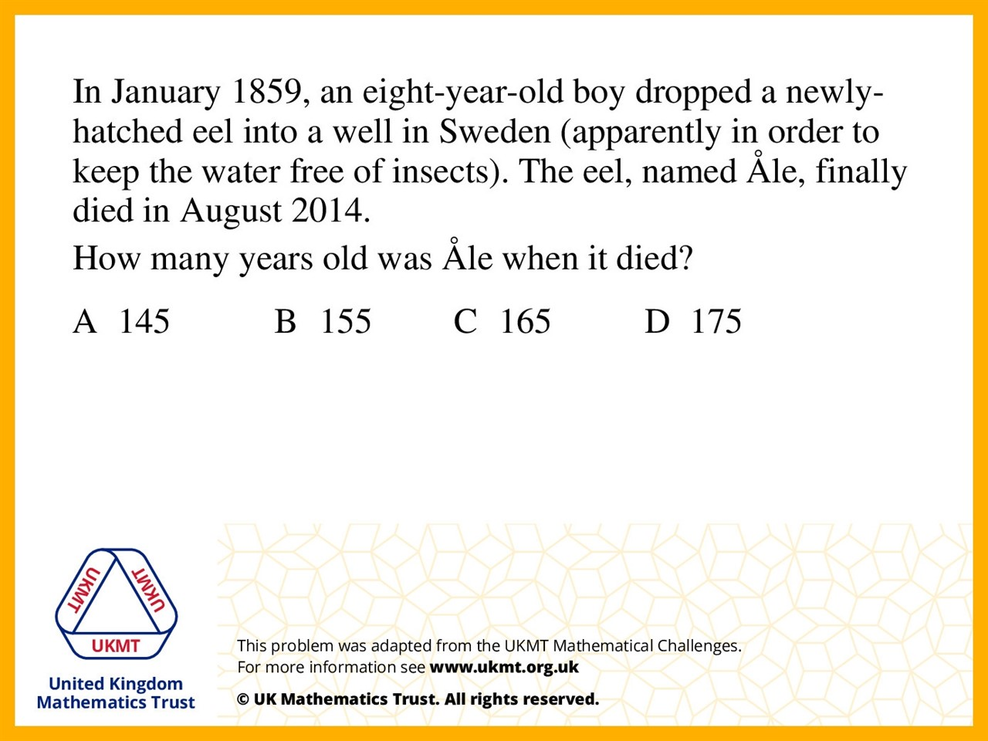
Q1.
1859 to 1959 is 100 years, 1959 to 2000 is 41 years and 2000 to 2014 is 14 years.
100 + 41 + 14 is 155 years.

Slide 3
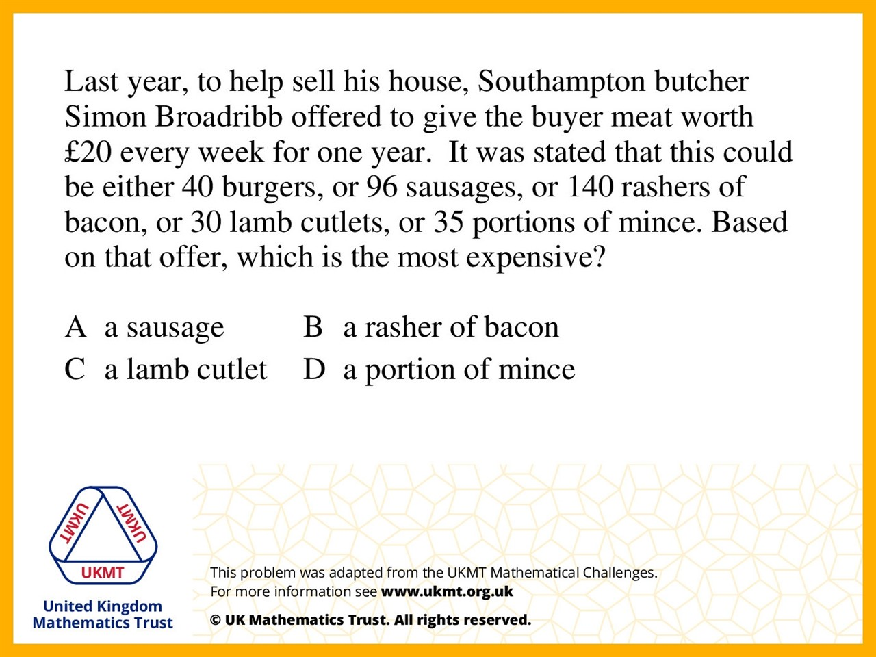
Q2.
Because he is offering less of the lamb which means it must be the most expensive

Slide 4
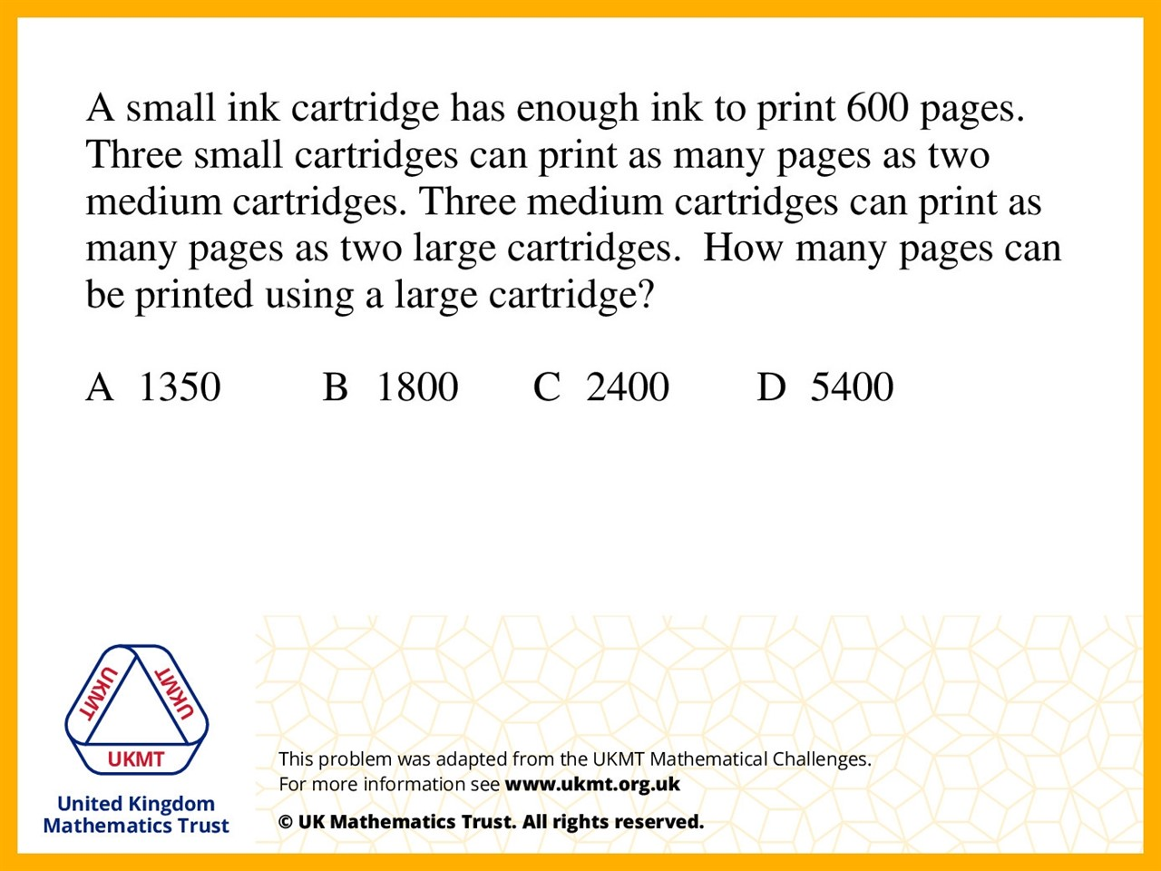
Q3.
1 small = 600
1 medium = 900
1 large = 1350
600 + 600 + 600 = 1800
1800 divided by 2 = 900
900 + 1800 = 2700
2700 divided by 2 = 1350

Slide 5
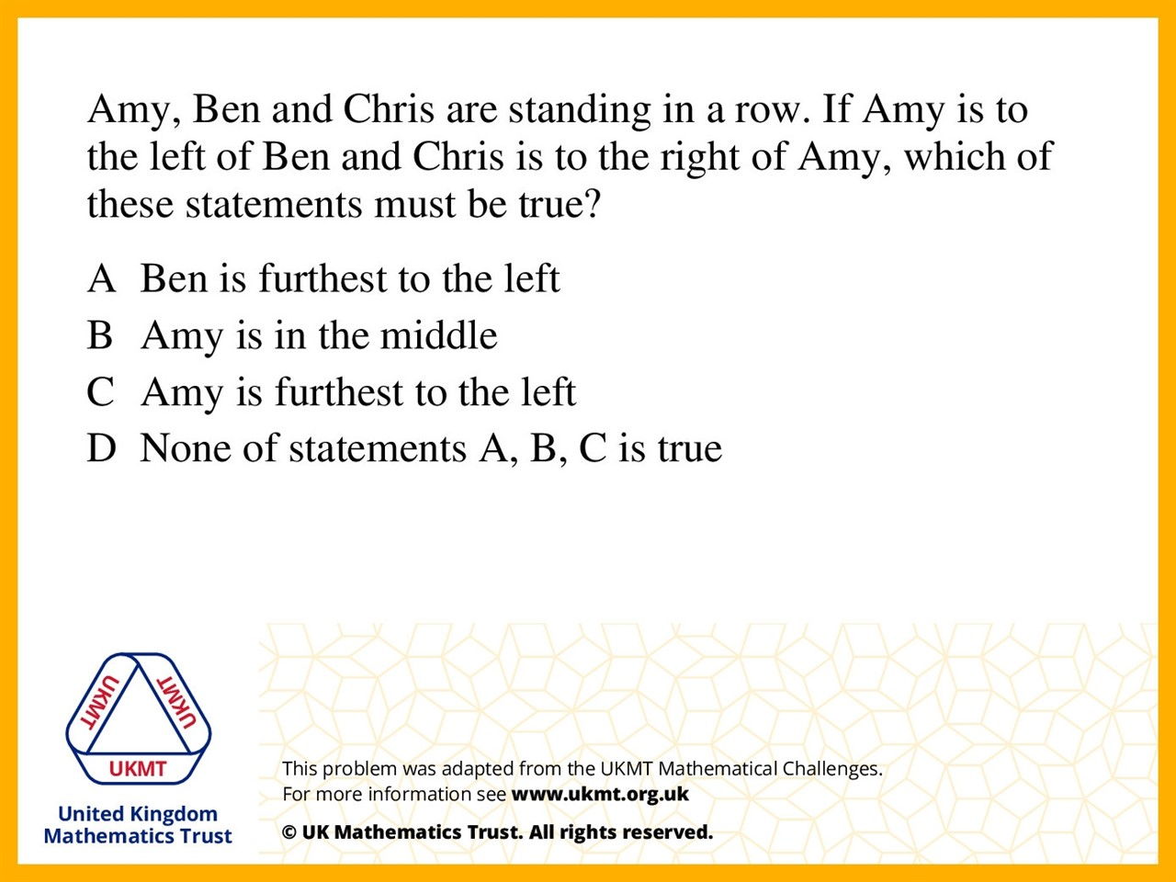
Q4.
Amy is to the left of Ben but Chris is to the right of Amy so Chris is in the middle and so Amy is still on the left.

Slide 6
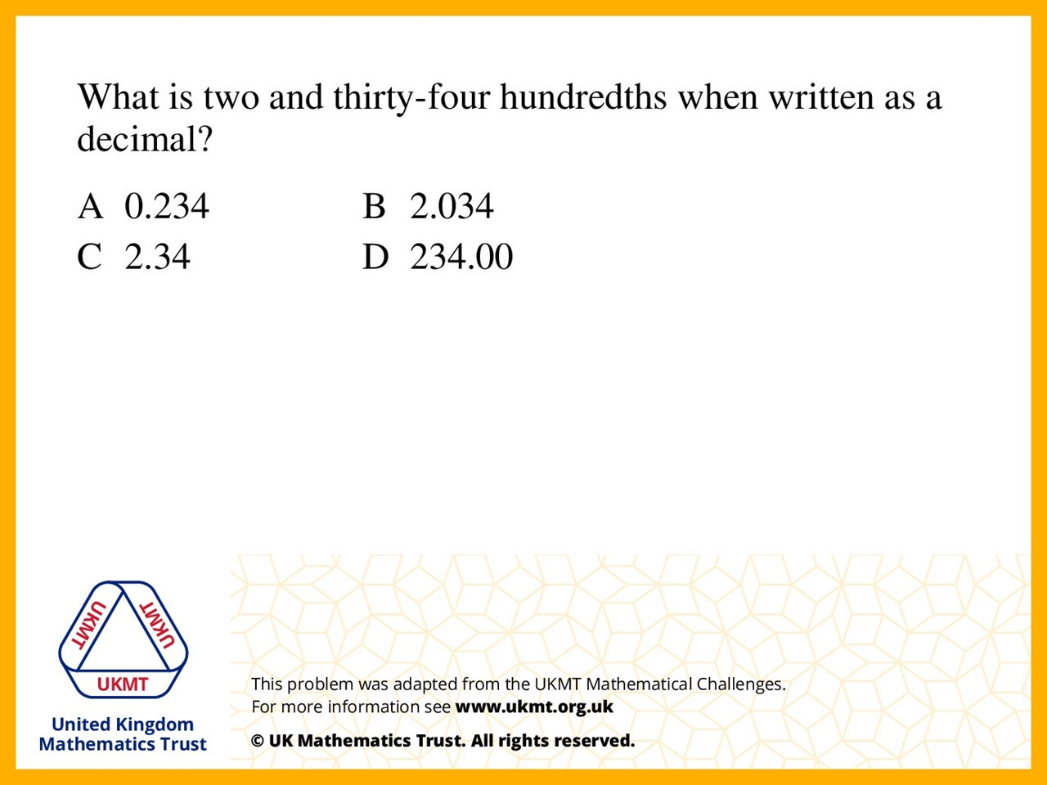
Q5.
2.34 is the same as 2 and 34/100

