Slide 1
Drawing Cuboid Nets
3sq
2sq
6sq
First draw the base. 2 cm by 6cm.
Then the two ends. 2cm by 3cm
Next draw the
sides of the shape. 3cm by 6cm.
DON’T FORGET THE TOP!
2cm by 6cm

Slide 2
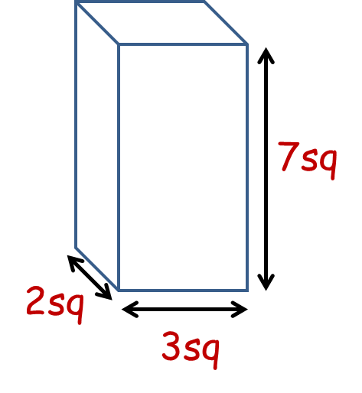
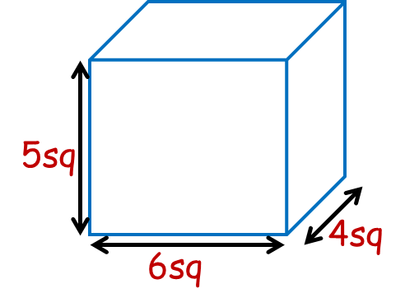
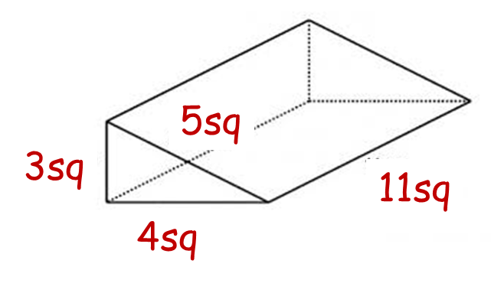
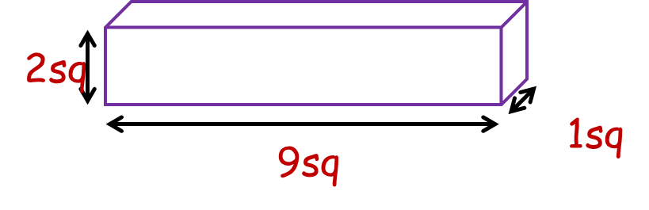
Q1
Q3
Q4
Q2

Slide 3
ANSWERS

Slide 4
7sq
2sq
3sq
Q1

Slide 5
2sq
Q2
1sq
9sq

Slide 6
5sq
4sq
6sq
Q3

Slide 7
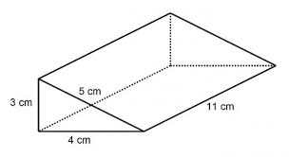
Q4
5sq
3sq
8sq
4sq

