Slide 1
LO: Inverse
Proportion

Slide 2

What happens to the time taken to cover a distance by a car if you double its speed?
If the car doubles its speed, it will take
half the time to cover the distance.

Slide 3
Two sets of values are said to be inversely proportional if,
 |  | one value increases as
 |  | the other decreases.

Slide 4

What is the inverse of x?
$$\frac{1}{x}$$

Slide 5
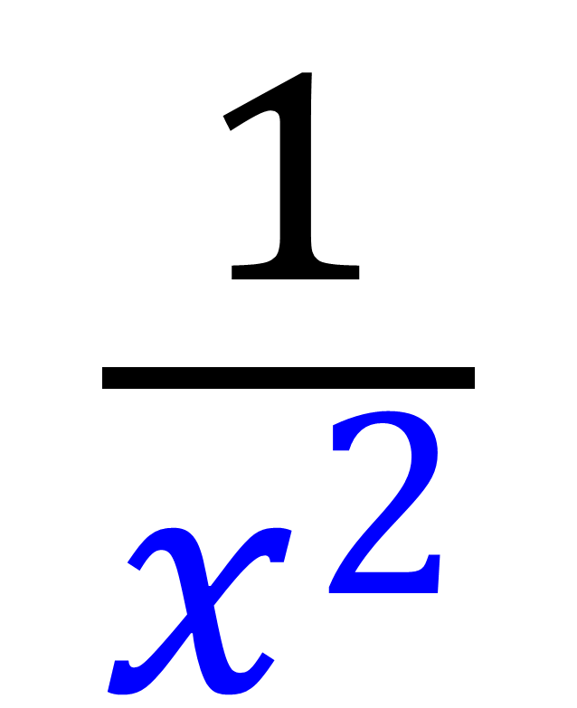
What is the inverse of x²?
$$\frac{1}{x^{2}}$$

Slide 6
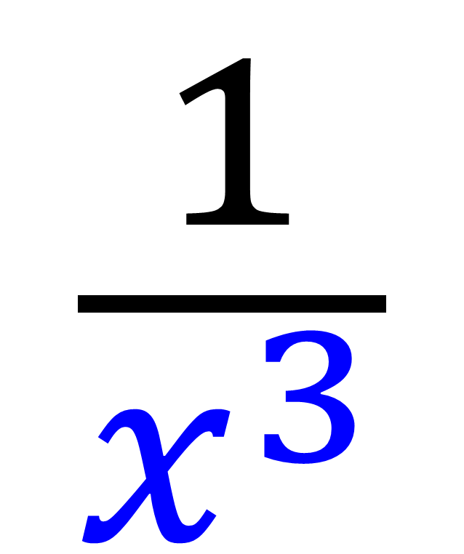
What is the inverse of x³?
$$\frac{1}{x^{3}}$$

Slide 7
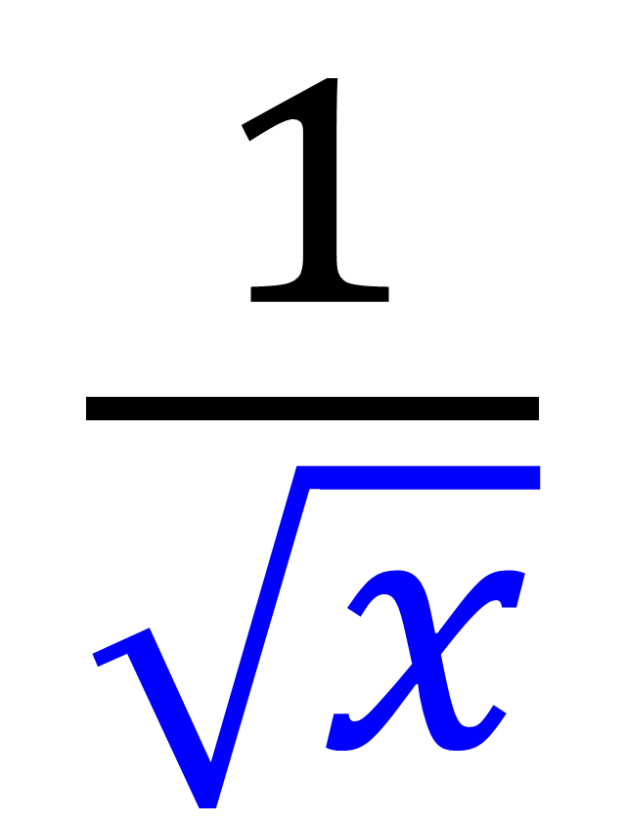
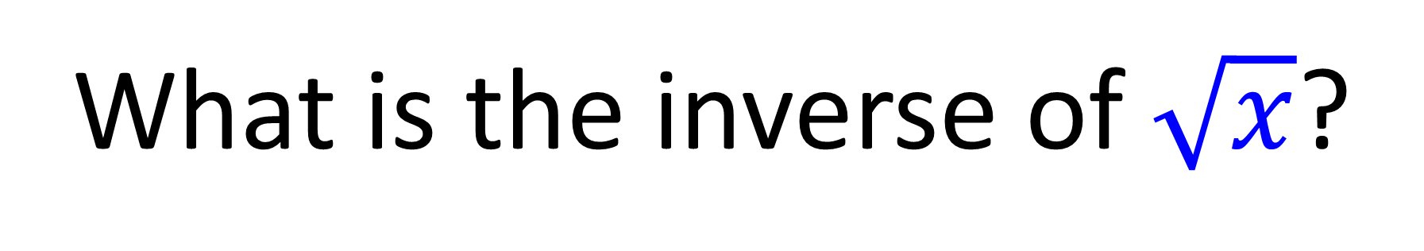
What is the inverse of $\sqrt{x}$?
$$\frac{1}{\sqrt{x}}$$

Slide 8
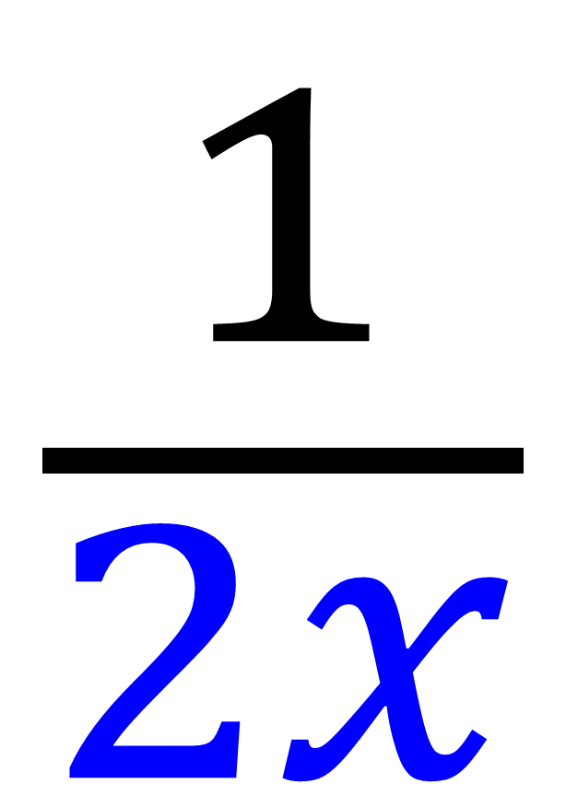
What is the inverse of 2x?
$$\frac{1}{2x}$$

Slide 9
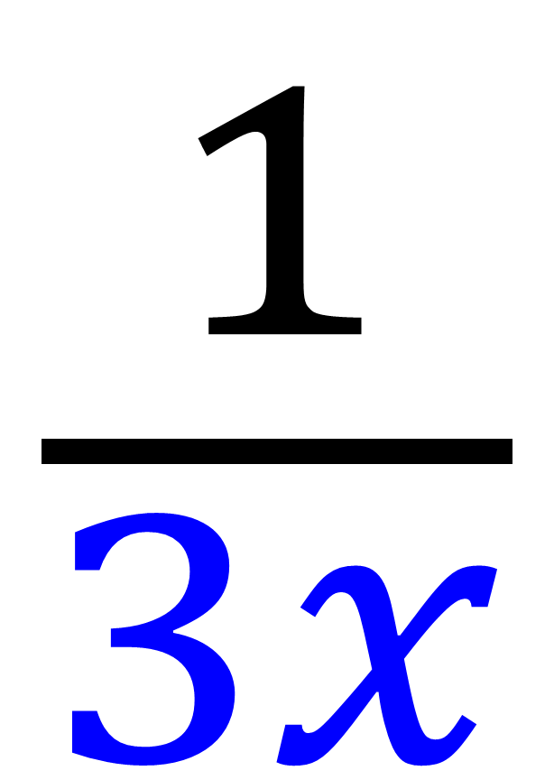
What is the inverse of 3x?
$$\frac{1}{3x}$$

Slide 10
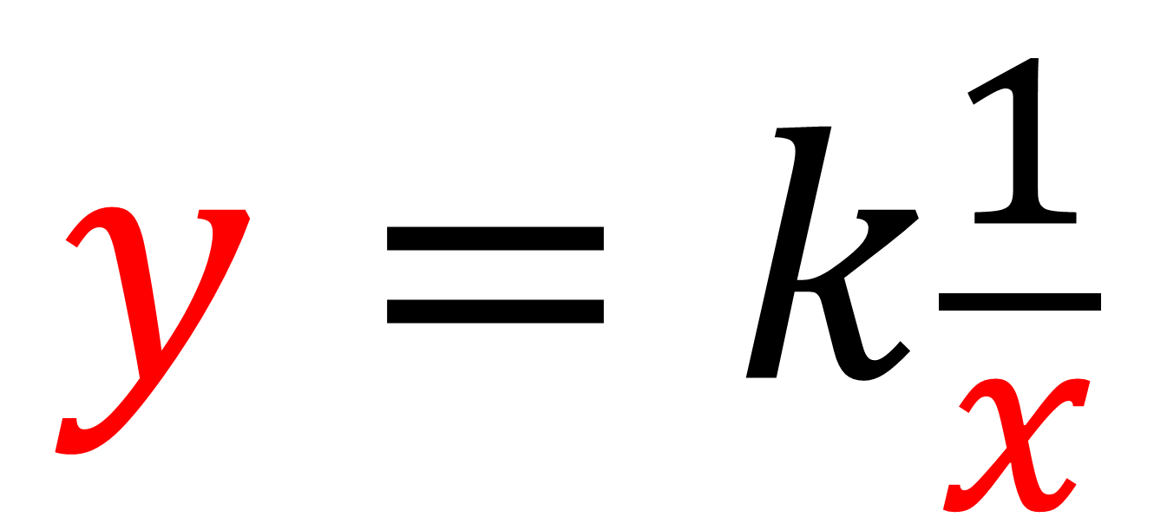
If y is inversely proportional to the x
$$y=k\frac{1}{x}$$
k = common multiplier = yx

Slide 11
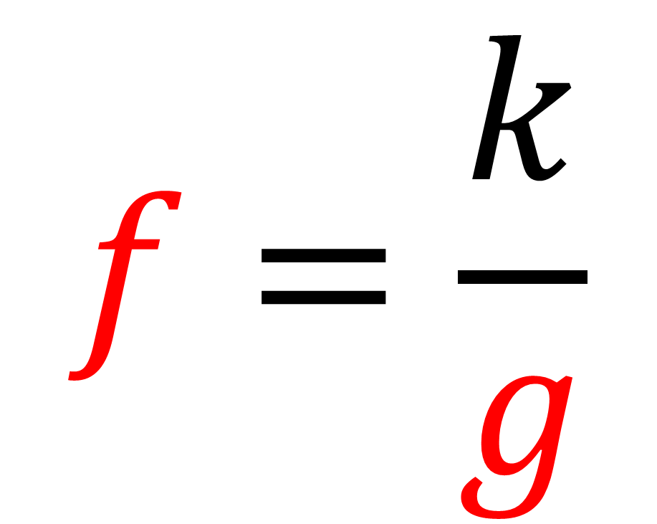
If f is inversely proportional to the g
$$f=\frac{k}{g}$$
k = common multiplier = yx

Slide 12
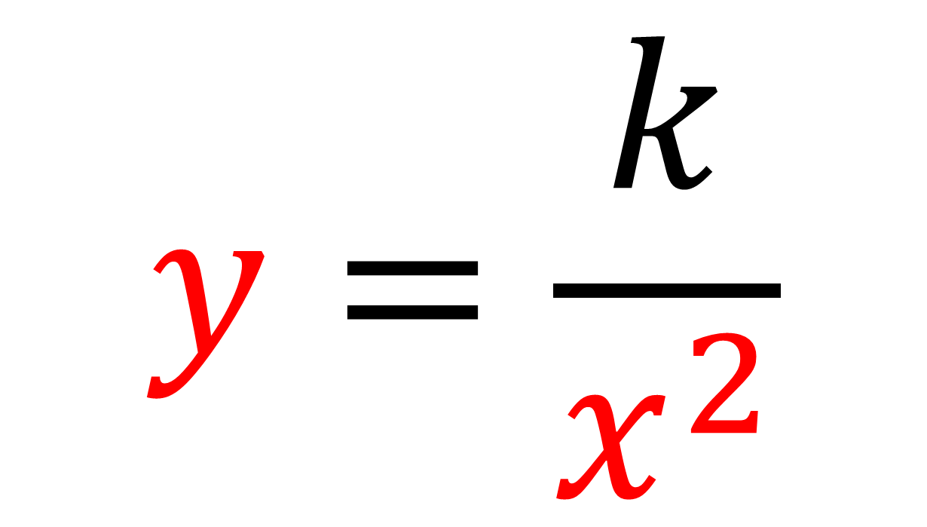
If y is inversely proportional to the x²
$$y=\frac{k}{x^{2}}$$
k = common multiplier = yx²

Slide 13
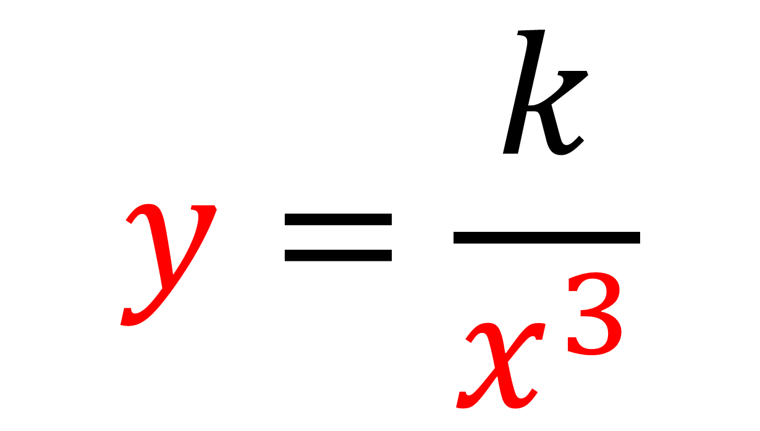
If y is inversely proportional to the x³
$$y=\frac{k}{x^{3}}$$
k = common multiplier = yx³

Slide 14
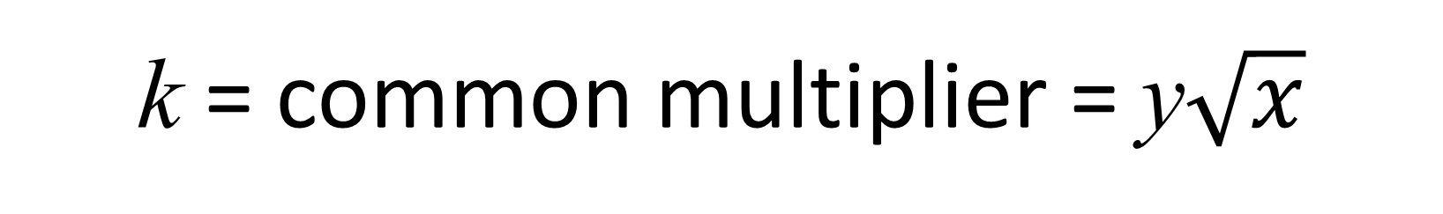
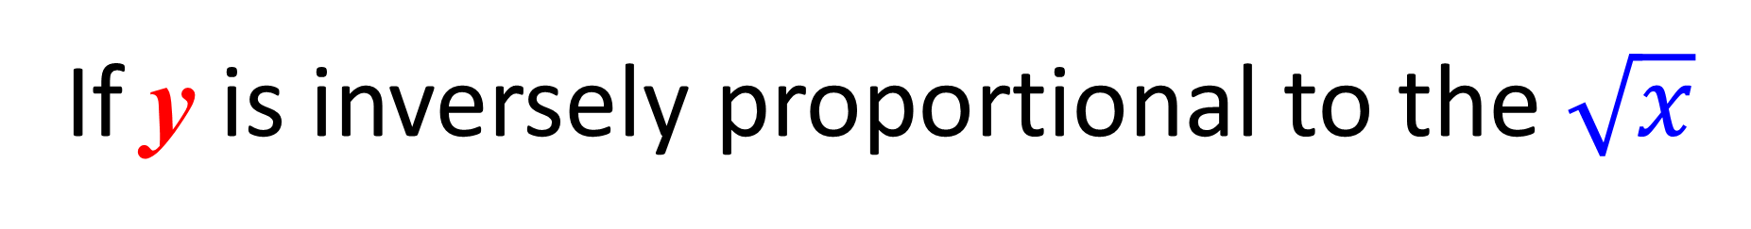
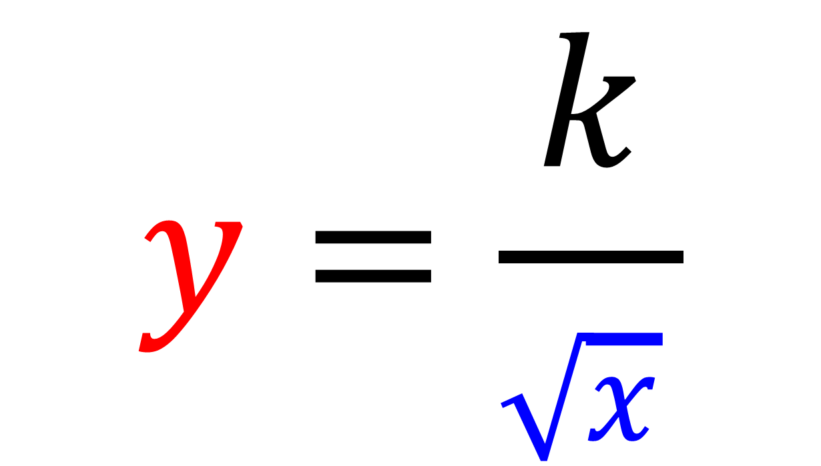
If y is inversely proportional to the $\sqrt{x}$
$$y=\frac{k}{\sqrt{x} }$$
k = common multiplier = y$\sqrt{x}$

Slide 15
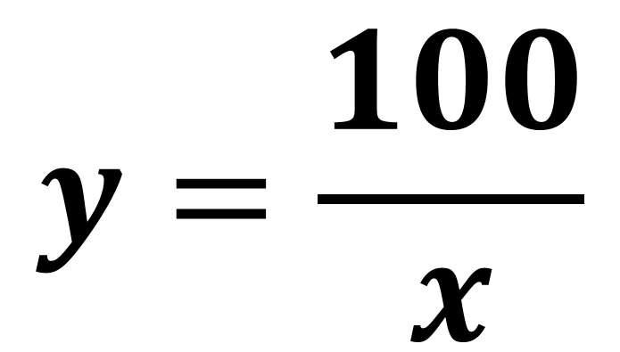
y and x are inversely proportional.
Write an equation for y in terms of x
Given that when x = 4, y = 25
$$y=\frac{100}{x}$$
x | 4
y | 25
k = 4 x 25 = 100

Slide 16
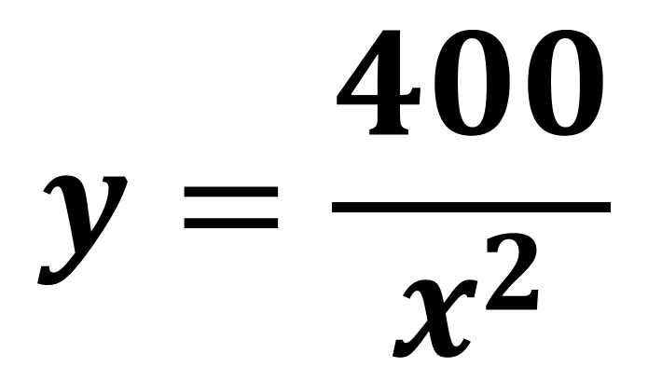
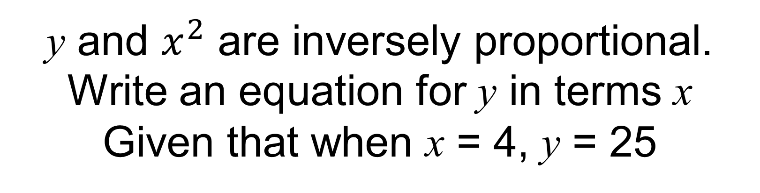
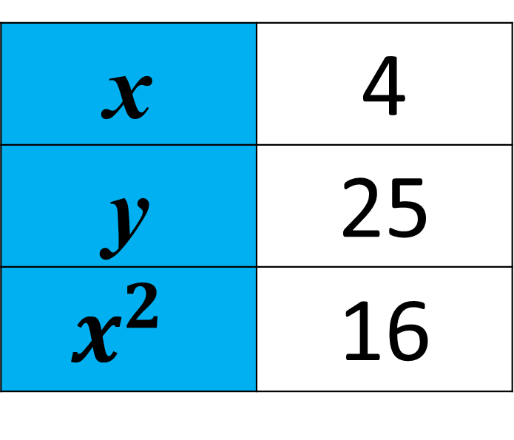
y and $x^{2}$ are inversely proportional.
Write an equation for y in terms x
Given that when x = 4, y = 25
x | 4
y | 25
$$x^{2}$$ | 16
$$y=\frac{400}{x^{2}}$$
k = 16 x 25 = 400

Slide 17
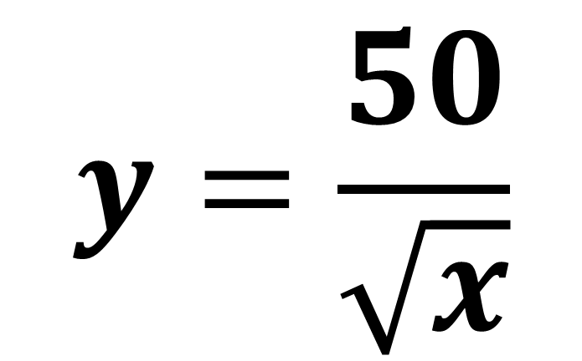
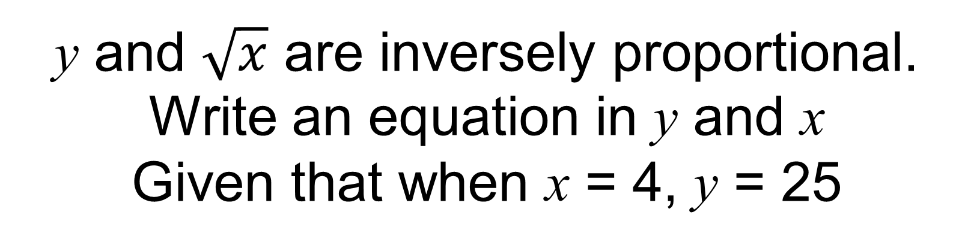
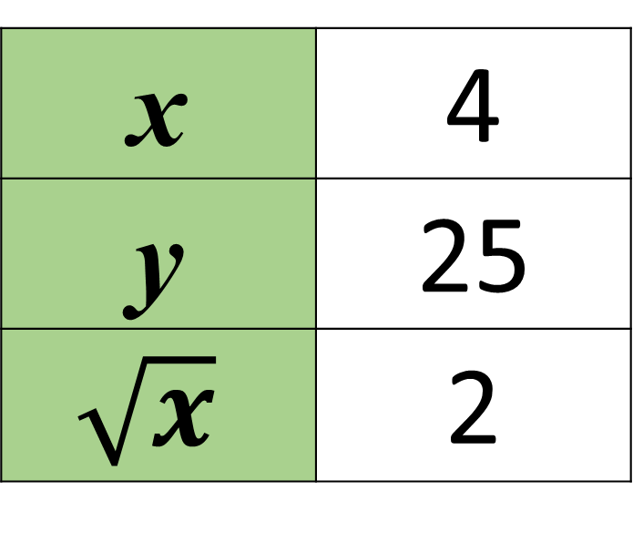
y and $\sqrt{x}$ are inversely proportional.
Write an equation in y and x
Given that when x = 4, y = 25
x | 4
y | 25
$$\sqrt{x}$$ | 2
$$y=\frac{50}{\sqrt{x}}$$
k = 25 x 2 = 50

Slide 18
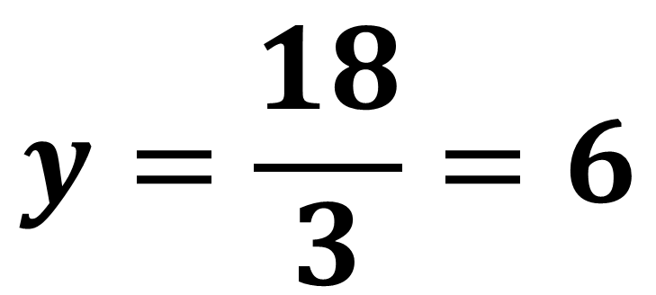
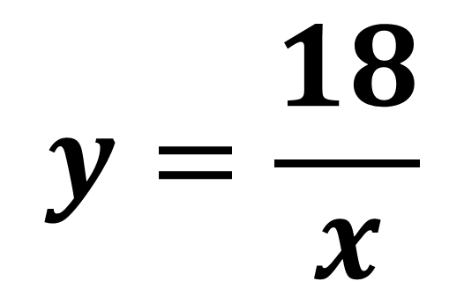
y and x are inversely proportional.
i) Write an equation for y in terms of x
Given that when x = 2, y = 9 ii) Find y when x = 3
$$y=\frac{18}{x}$$
x | 2
y | 9
$$y=\frac{18}{3}=6$$
k = 2 x 9 = 18

