Slide 1
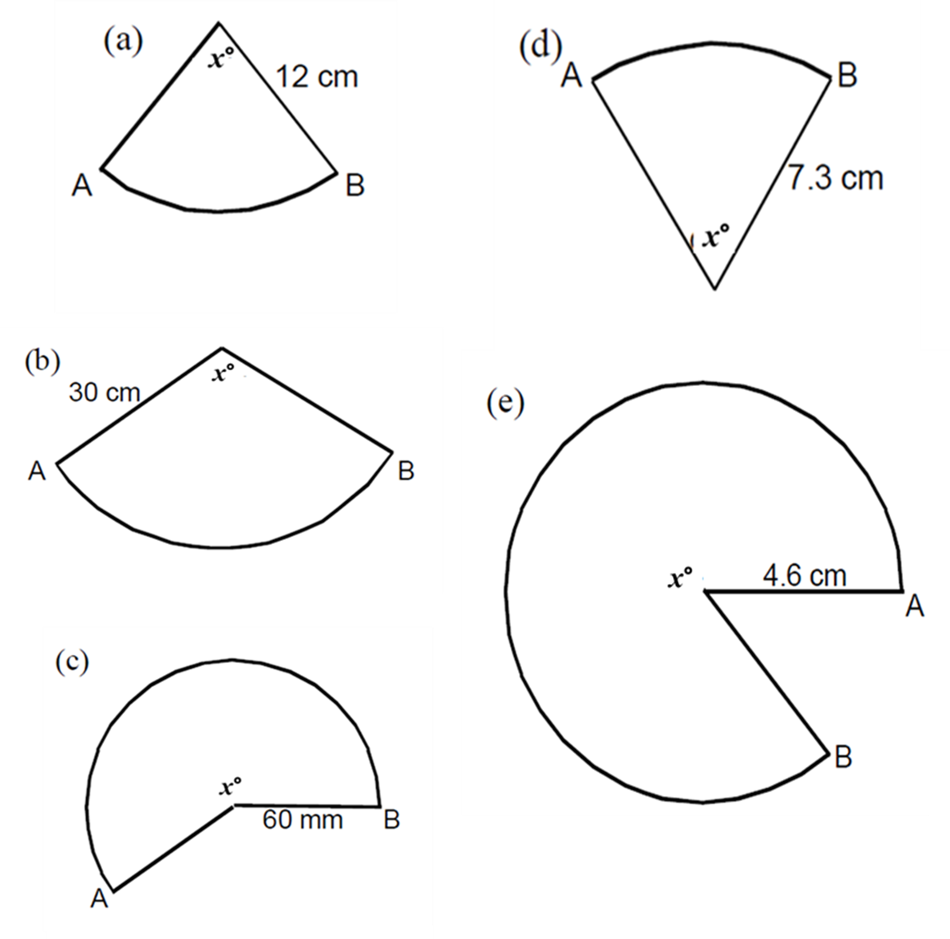
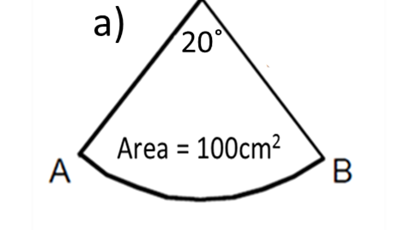
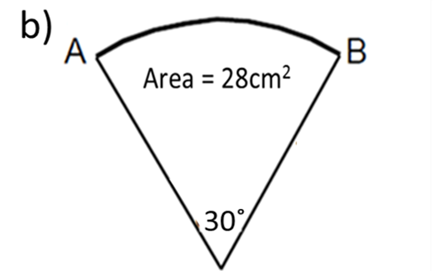
Calculate the angle of each sectors.
Calculate the radius of each sectors.
Area = 28cm²
Area = 100cm²
Area = 940cm²
Area = 61cm²
Area = 6500mm²

Slide 2
ANSWERS

Slide 3
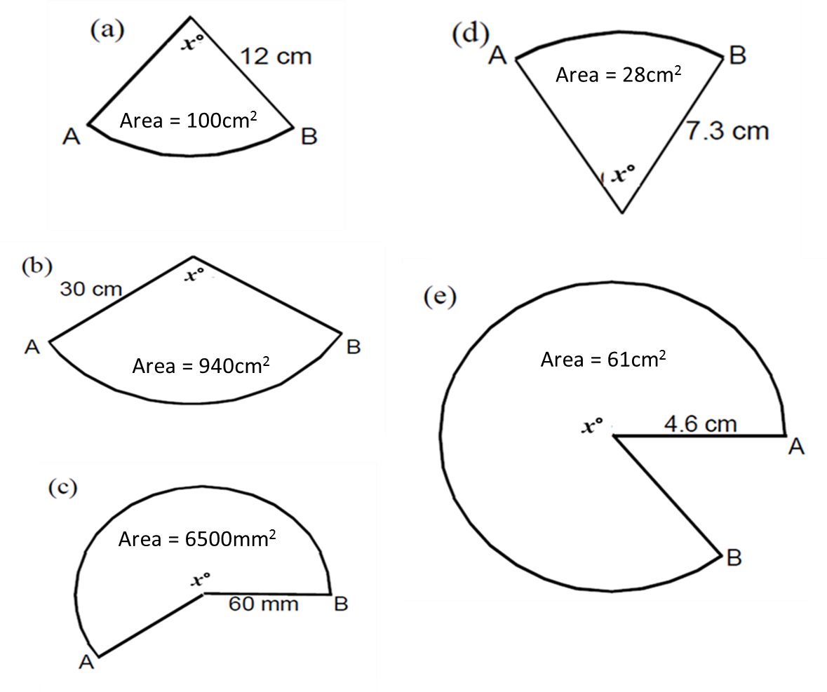
d) 60.2°
a) 79.6°
a) 23.9
b) 119.7°
e) 330.3°
c) 206.9
b) 10.3

