Slide 1
LO: Similar Shapes

Slide 2
What is meant by
similar shapes?
One shape is an enlargement of the other.

Slide 3


Which two pictures are similar?
A
B
C

Slide 4
If a shape is enlarged does the size
of the angles increase?
No

Slide 5
What can you say about the angles
of shapes that are similar?
70˚
70˚
30˚
80˚
30˚
80˚
The angles will be the same.

Slide 6
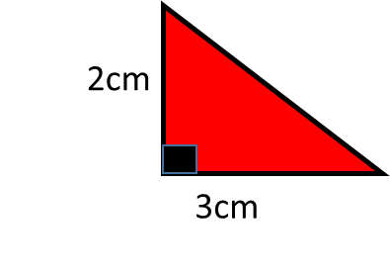
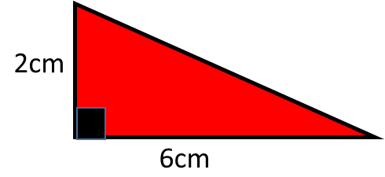
Similar or Not?
Not

Slide 7
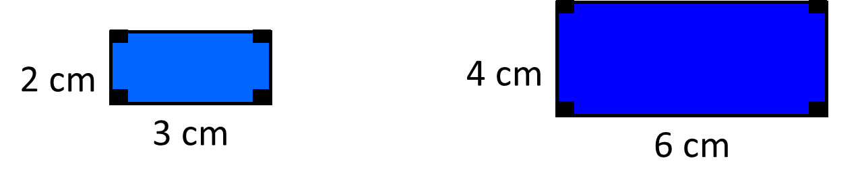
Similar or Not?
Similar

Slide 8
Similar or Not?
6cm
6cm
3cm
3cm
3cm
6cm
Similar

Slide 9
Similar or Not?
70˚
40˚
70˚
40˚
3cm
6cm
Similar

Slide 10
Similar or Not?
8cm
4cm
70˚
30˚
70˚
40˚
3cm
6cm
Not

Slide 11
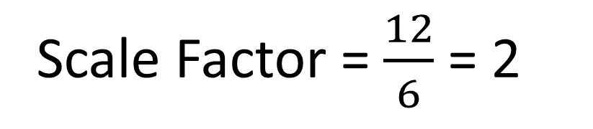
The following shapes are similar.
What is the length of the missing side?
x
9 cm
4 cm
6 cm
12cm
Scale Factor = $\frac{12}{6}$ = 2
x = 9 ÷ 2 = 4.5cm

Slide 12
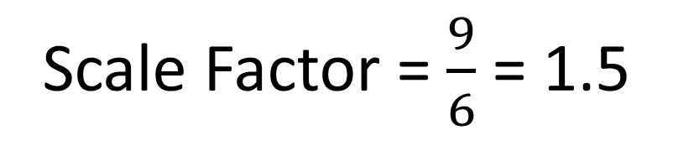
The following shapes are similar.
What is the length of the missing side?
12 cm
x
4 cm
6 cm
9 cm
Scale Factor = $\frac{9}{6}$ = 1.5
x = 4 x 1.5 = 6cm

Slide 13
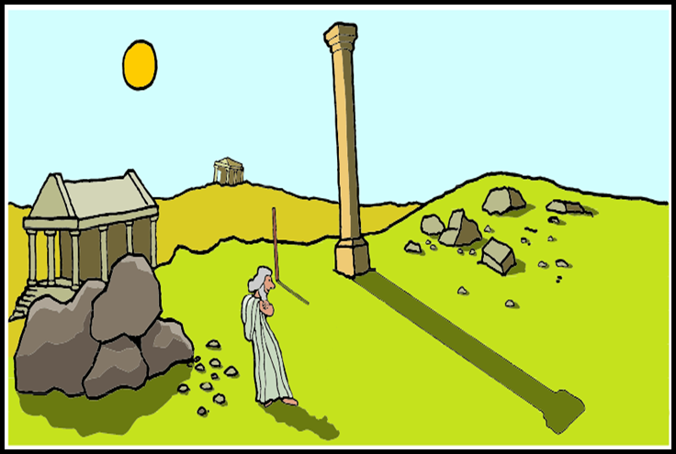
Using shadows to measure height.
In ancient times the height of tall objects where measured by using a stick and comparing the length of its shadow to the length of the shadow of the tall object.

Slide 14


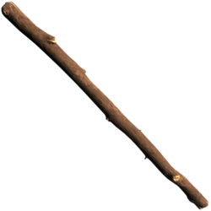
How tall is the pillar?
3.6m
1.2m
1m
3m

Slide 15


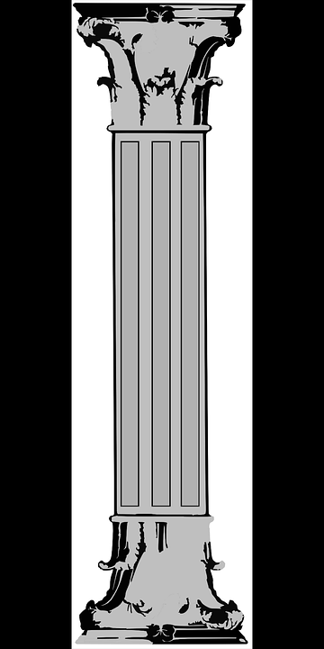
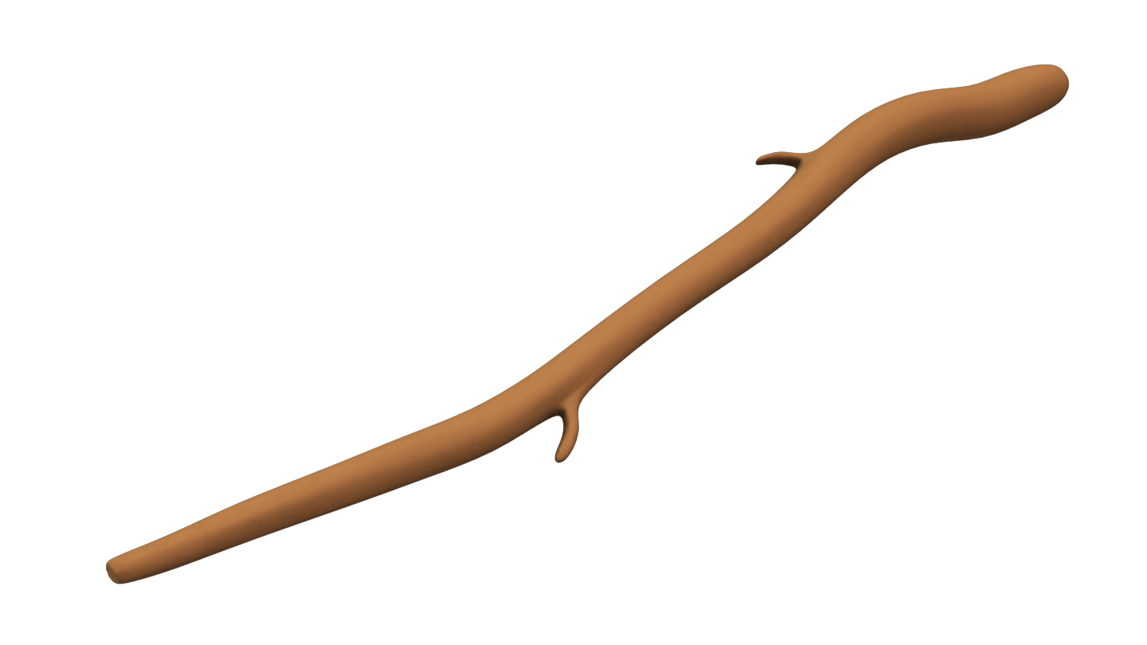
How tall is the pillar?
3.6m
1.2m
1m
3m

