Slide 1

Senior Challenge 2
BRONZE

Slide 2
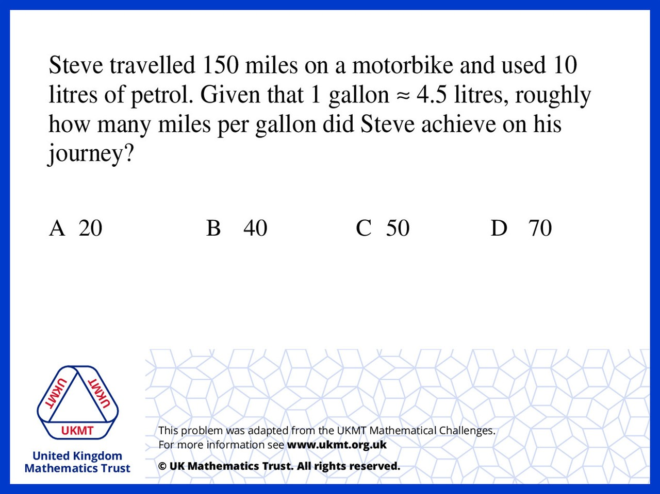
Q1.
He travels 15 miles per litre so you multiply that by 4.5 to find out how far he travelled from a gallon.
This is 67.5 miles so roughly 70 miles

Slide 3
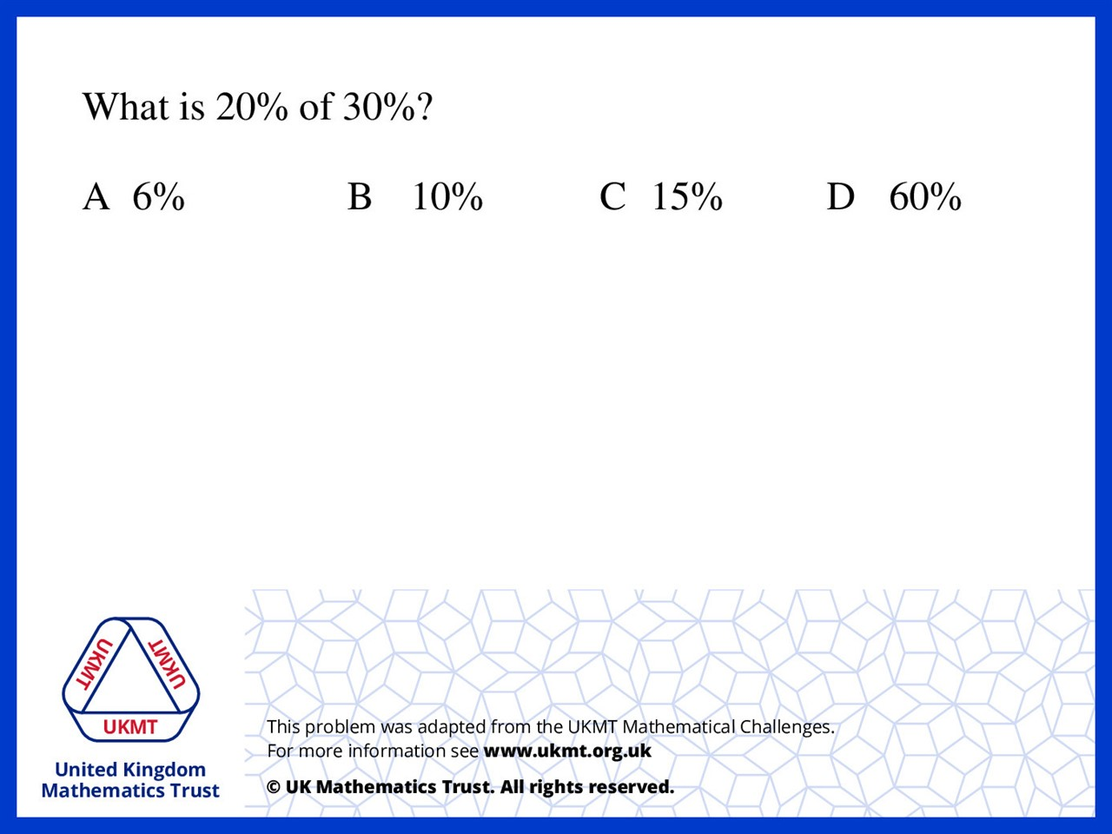
Q2.
(2/10) x (3/10) = 6/100

Slide 4
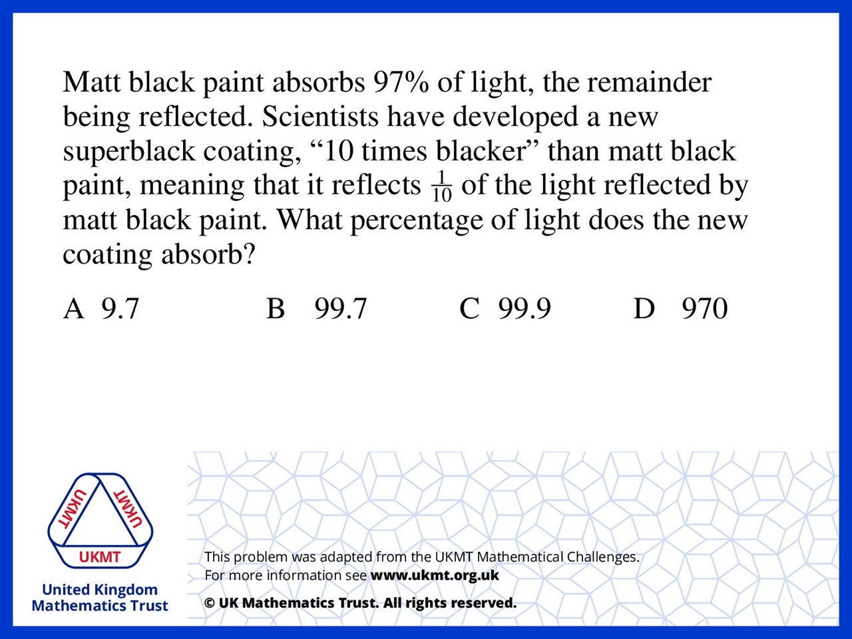
Q3.
Matt black paint reflects 3% of the light so the superblack coating reflects 0.3% of the light and therefore it absorbs 99.7% of the light

Slide 5
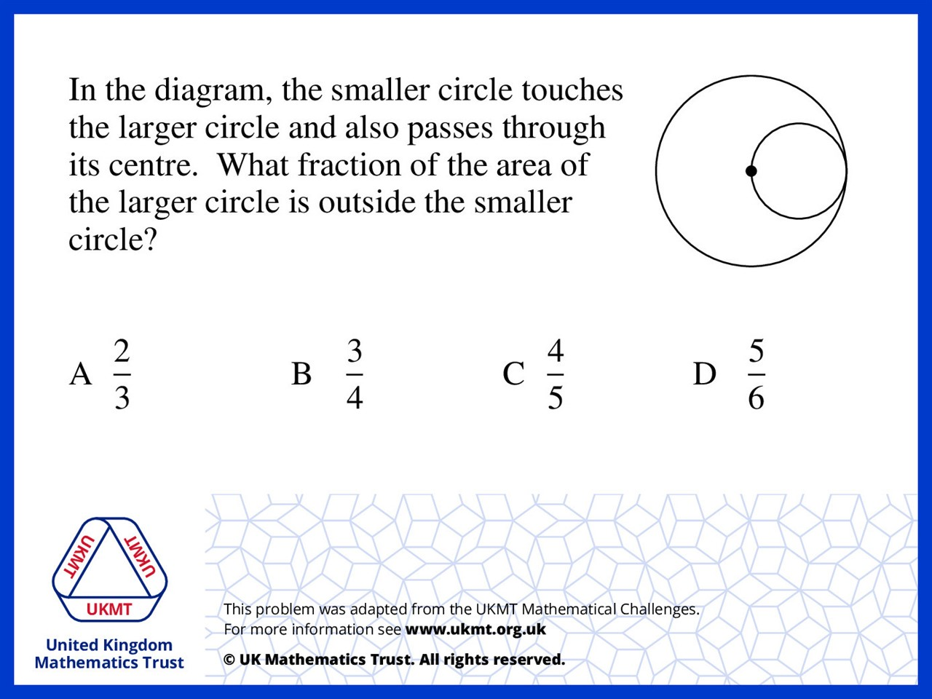
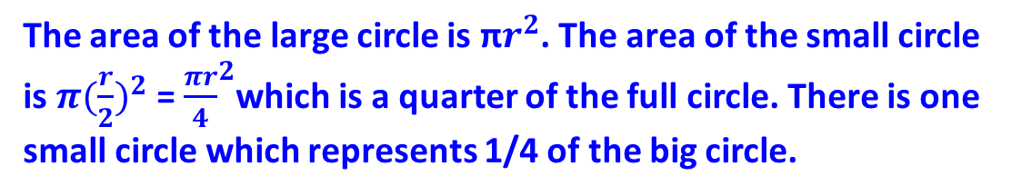
Q4.
The area of the large circle is π$r^{2}$. The area of the small circle is $π({\frac{r}{2})}^{2}$ = ${\frac{πr}{4}}^{2}$which is a quarter of the full circle. There is one small circle which represents 1/4 of the big circle.

Slide 6
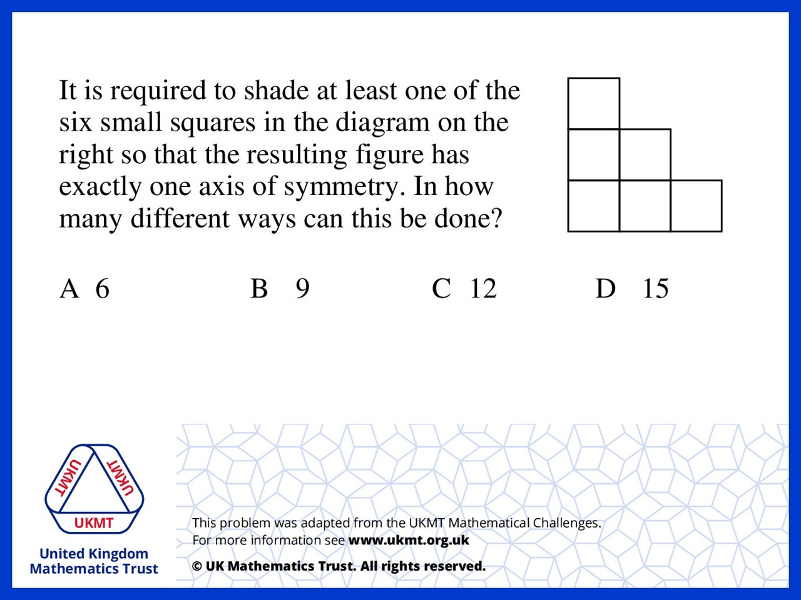
Q5.
There can only be a line of symmetry diagonally and for that to be achieved either of the two middle squares can be shaded or not, and of the two pairs of squares diagonally opposite to each other, both must be shaded or not for symmetry. The gives 4 objects to consider, in any combination, leaving 15 viable combinations.

