Slide 1
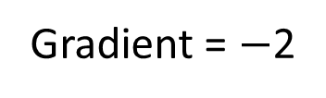
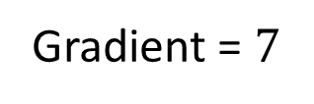
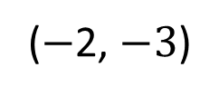
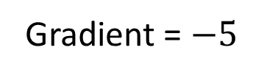
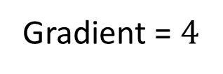
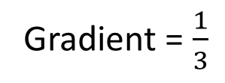
Gradient = 3
1
2
3
Gradient = $−$2
(0, 2)
Gradient = $\frac{1}{3}$
(0, 0)
4
(1, 5)
5
6
(2, 8)
Gradient = $−5$
Gradient = $4$
Gradient = $7$
($−$2, $−3$)

Slide 2
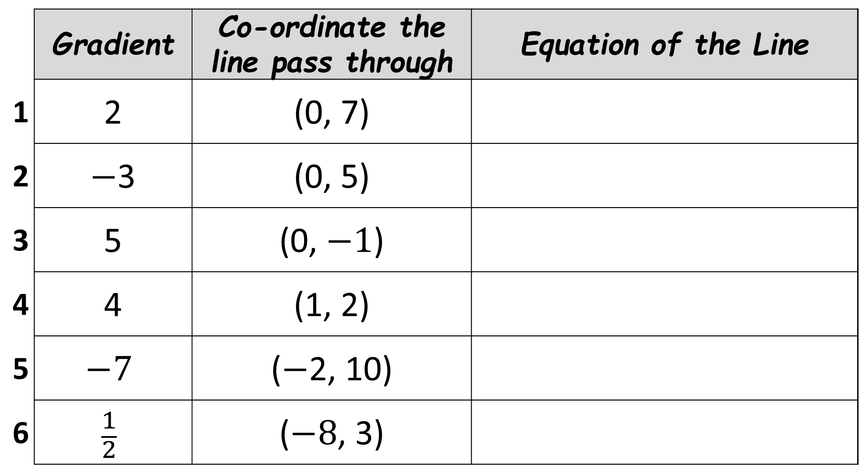
 | Gradient | Co-ordinate the line pass through | Equation of the Line
1 | 2 | (0, 7)
2 | $−$3 | (0, 5)
3 | 5 | (0, $−1$)
4 | 4 | (1, 2)
5 | $$−7$$ | ($−$2, 10)
6 | $$\frac{1}{2}$$ | ($−8$, 3)

Slide 3
ANSWERS

Slide 4





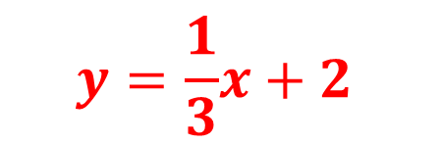
Gradient = 3
1
2
3
Gradient = $−$2
(0, 2)
Gradient = $\frac{1}{3}$
(0, 0)
$$y=\frac{1}{3}x+2$$
$$y=3x$$
$$y=−2x$$
4
(1, 5)
5
6
(2, 8)
Gradient = $−5$
Gradient = $4$
Gradient = $7$
($−$2, $−3$)
$$y=4x+1$$
$$y=7x−6$$
$$y=−5x−13$$

Slide 5
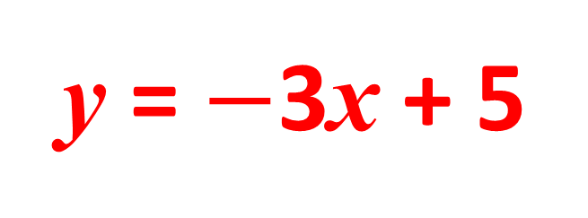
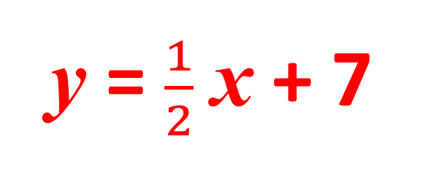
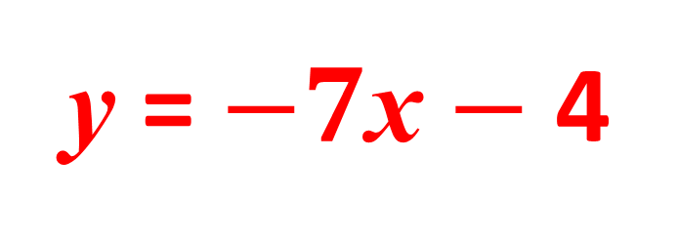
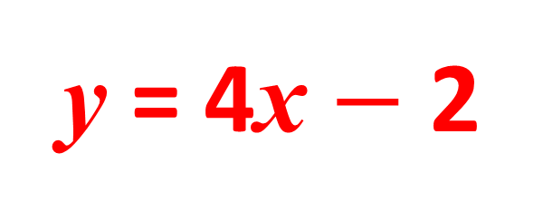
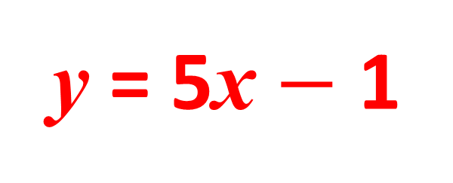
 | Gradient | Co-ordinate the line pass through | Equation of the Line
1 | 2 | (0, 7)
2 | $−$3 | (0, 5)
3 | 5 | (0, $−1$)
4 | 4 | (1, 2)
5 | $$−7$$ | ($−$2, 10)
6 | $$\frac{1}{2}$$ | ($−8$, 3)
y = 2x + 7
y = $−$3x + 5
y = 5x $−$ 1
y = 4x $−$ 2
y = $−7$x $−$ 4
y = $\frac{1}{2}$x + 7

