Slide 1
Vectors
Introduction
Chapter 11
(Part 1 of 4)

Slide 2
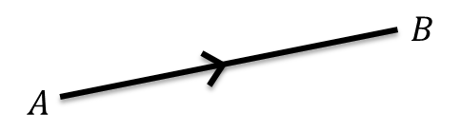
A vector has 2 properties
Direction and Magnitude.

Slide 3
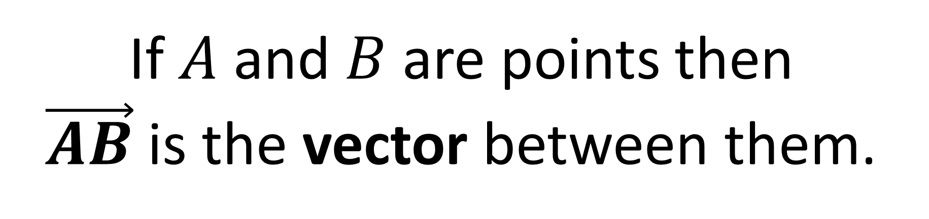
If $A$ and $B$ are points then
$\vec{AB}$ is the vector between them.

Slide 4
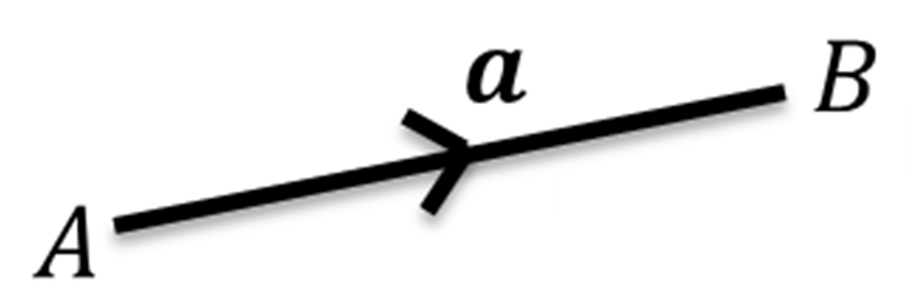
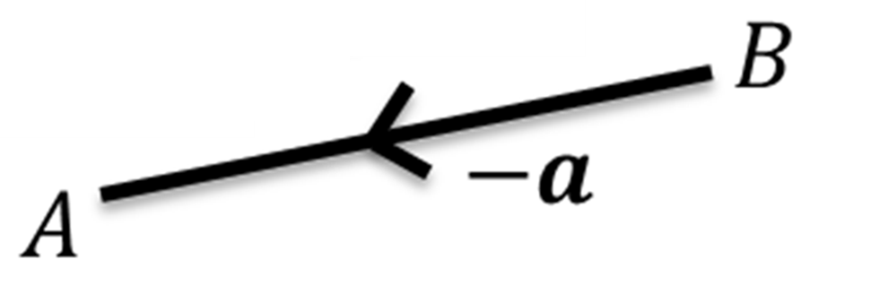
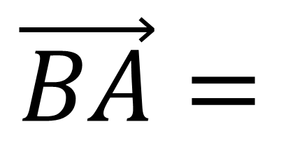
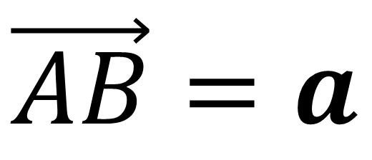
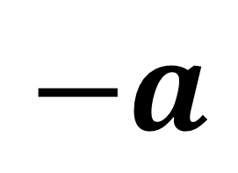
$\vec{AB}=a$
$$\vec{BA}=$$
$$−a$$

Slide 5
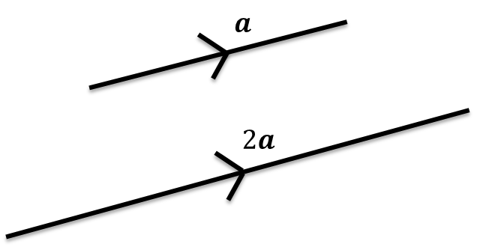
Scalars
A scalar is a multiplier,
which can be used to ‘scale’ a vector.

Slide 6



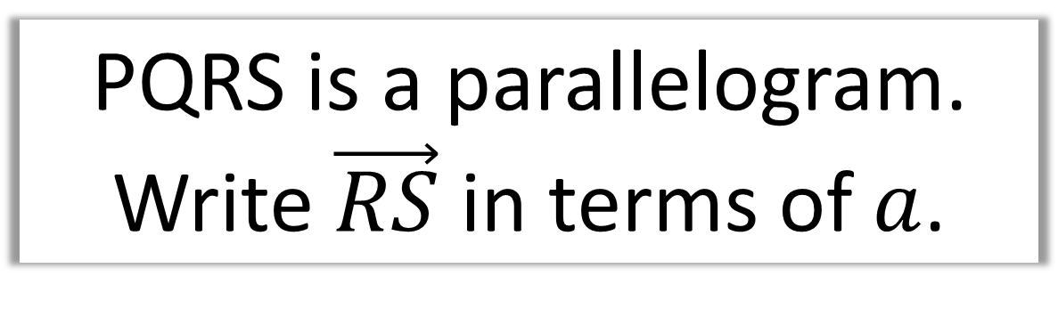



PQRS is a parallelogram. Write $\vec{RS}$ in terms of $a$.
$$3a$$
$$Q$$
$$P$$
$$S$$
$$3a$$
$$R$$
If two vectors have the same magnitude and direction, they can be given the same label.

Slide 7




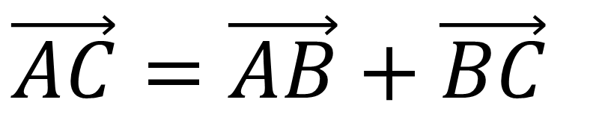







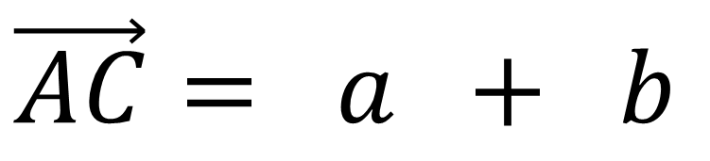
Write $\vec{AC}$ in terms of $a$ and b.
$$B$$
$$B$$
$$\vec{AC}=\vec{AB}+\vec{BC}$$
$$a$$
$$b$$
$$a$$
$$C$$
$$\vec{AC}= a + b$$
$$C$$
$$a+ b$$
$$A$$
$$A$$

Slide 8
Parallel Vectors
Vectors are parallel if
one is a multiple of the other.

Slide 9
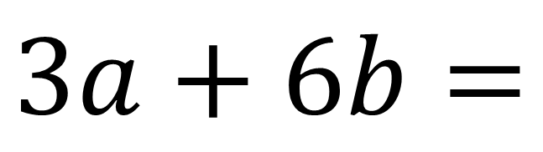
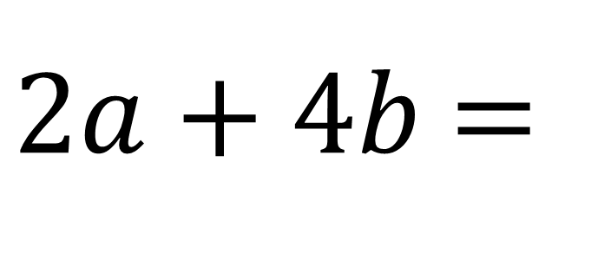
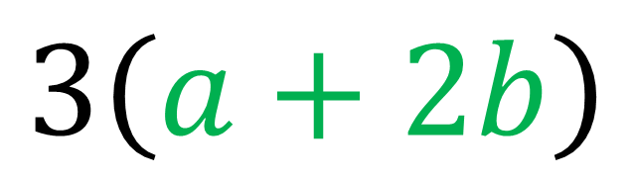
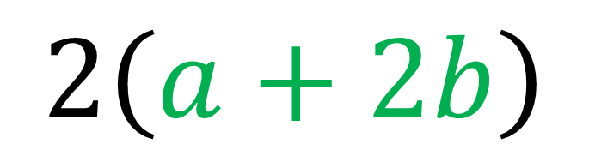
Show 𝟐𝒂 + 𝟒𝒃 and 𝟑𝒂 + 𝟔𝒃 are parallel.
$2a+4b$ =
$$2\left(a+2b\right)$$
$$3a+6b=$$
$$3\left(a+2b\right)$$
One is a multiple of the other
therefore they are parallel

Slide 10
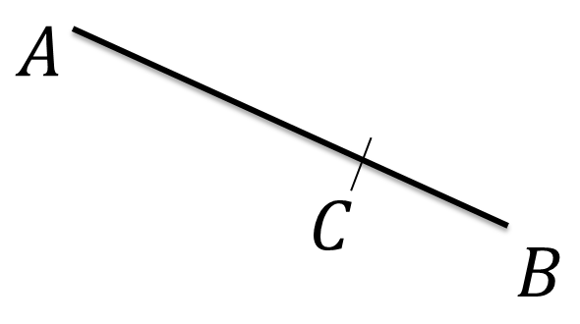


Vector in Ratios
AC : CB is in the ratio 3:1
What fraction of AB is AC?
$$\frac{3}{4}$$
$$\frac{1}{4}$$

Slide 11
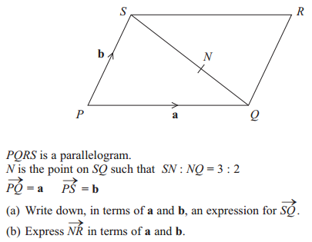

Slide 12

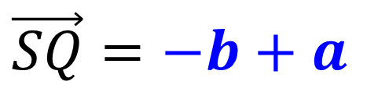

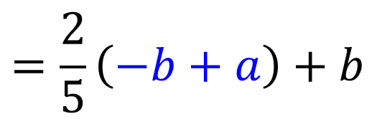
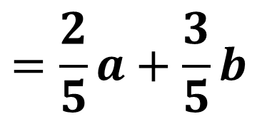
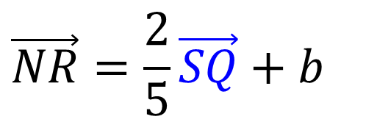
a)
$$\frac{3}{5}$$
$$\vec{SQ}=−b+a$$
$$\frac{2}{5}$$
b)
$$\vec{NR}=\frac{2}{5}\vec{SQ}+b$$
$$=\frac{2}{5}\left(−b+a\right)+b$$
$$=\frac{2}{5}a+\frac{3}{5}b$$

Slide 13
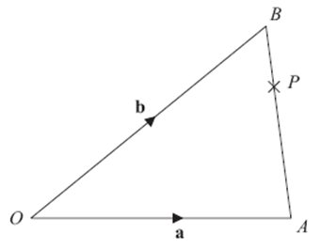
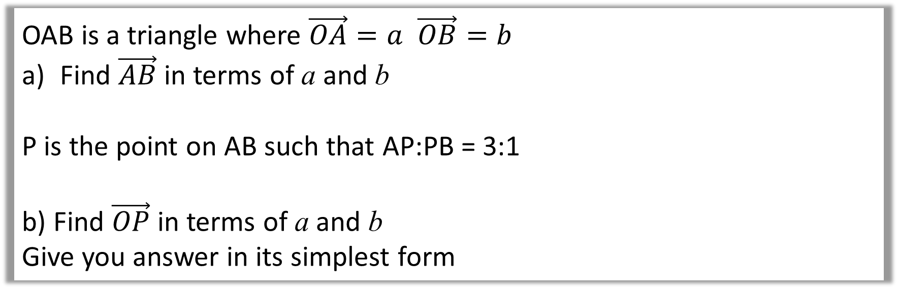
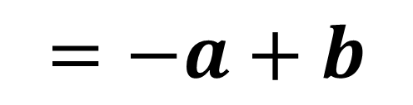
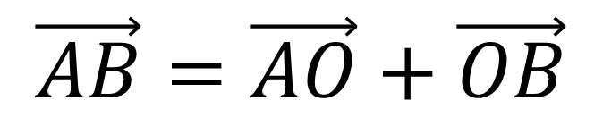
OAB is a triangle where $\vec{OA}=a$ $\vec{OB}=b$
Find $\vec{AB}$ in terms of a and b
P is the point on AB such that AP:PB = 3:1
b) Find $\vec{OP}$ in terms of a and b
Give you answer in its simplest form
a)
$$\vec{AB}=\vec{AO}+\vec{OB}$$
$$=−a+b$$

Slide 14
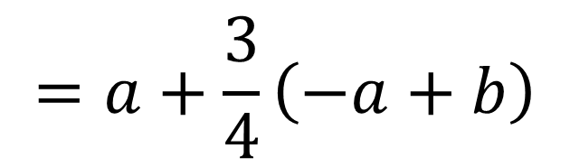
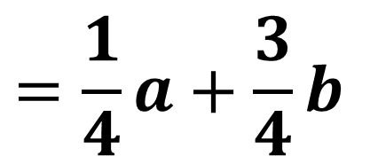
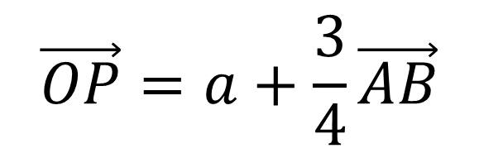
OAB is a triangle where $\vec{OA}=a$ $\vec{OB}=b$
Find $\vec{AB}$ in terms of a and b
P is the point on AB such that AP:PB = 3:1
b) Find $\vec{OP}$ in terms of a and b
Give you answer in its simplest form
b)
$$\vec{OP}=a+\frac{3}{4}\vec{AB}$$
$$=a+\frac{3}{4}\left(−a+b\right)$$
$$=\frac{1}{4}a+\frac{3}{4}b$$

