Slide 1
FM: Binomial Expansion

Slide 2
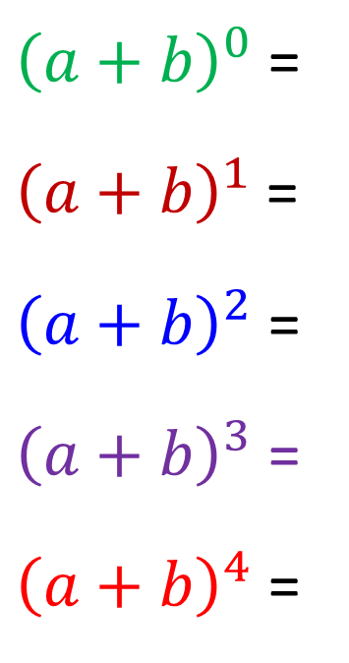



Expand the following brackets
${\left(a+b\right)}^{0}$ =
${\left(a+b\right)}^{1}$ =
${\left(a+b\right)}^{2}$ =
${\left(a+b\right)}^{3}$ =
${\left(a+b\right)}^{4}$ =
$$1$$
$$a + b$$
$$a^{2} + 2ab + b^{2}$$
$$a^{3} + 3a^{2}b + 3ab^{2} + b^{3}$$
$$a^{4} + {4a}^{3}b + {6a}^{2}b^{2} + 4ab^{3} + b^{4}$$

Slide 3

Imagine Expanding
${\left(a+b\right)}^{8}$
Binomial Expansion is a method
that makes expanding brackets
a much friendlier process.

Slide 4
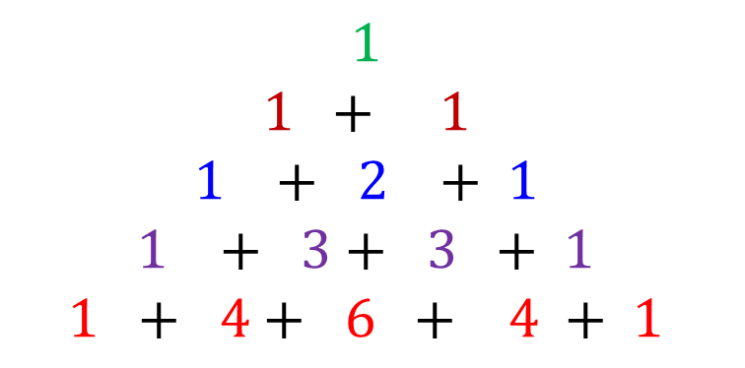
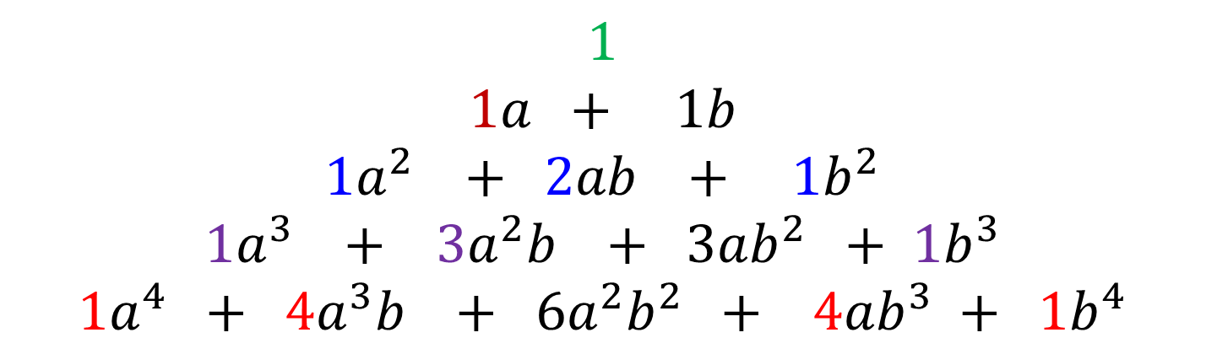
What do you notice about
the coefficients of each term?
$$1$$
$$1a + 1b$$
$$1a^{2} + 2ab + {1b}^{2}$$
$$1a^{3} + 3a^{2}b + 3ab^{2} + 1b^{3}$$
$$1a^{4} + 4a^{3}b + 6a^{2}b^{2} + 4ab^{3} + {1b}^{4}$$
$$1$$
$$1 + 1$$
$$1 + 2 + 1$$
$$1 + 3+ 3 + 1$$
$$1 + 4+ 6 + 4 + 1$$
Pascal’s Triangle!
Predict the next row of numbers.

Slide 5
In Pascal’s Triangle, each term (except for the 1s) is
the sum of the two terms above.
1
1
1
1
2
1
1
3
3
1
1
4
6
4
1
1
5
10
10
1
1

Slide 6
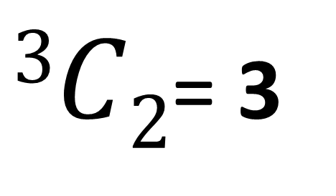



$$\left(a+b\right)\left(a+b\right)\left(a+b\right)$$
$$=(aa+ab+ba+bb)\left(a+b\right)$$
$$=aaa+aab+aba+abb+baa+bab+bba+bbb$$
$$=1aaa+3aab+3abb+1bbb$$
Get 2 a’s from 3 outcomes
$3C2$= 3
aab
aba
baa

Slide 7
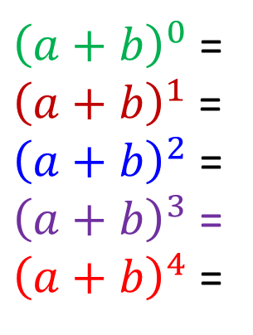
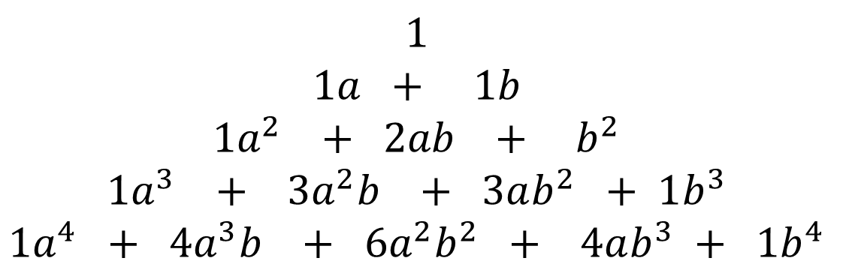
What is the connection between
the total powers of each individual term
and the power of the bracket?
${\left(a+b\right)}^{0}$ =
${\left(a+b\right)}^{1}$ =
${\left(a+b\right)}^{2}$ =
${\left(a+b\right)}^{3}$ =
${\left(a+b\right)}^{4}$ =
$$1$$
$$1a + 1b$$
$$1a^{2} + 2ab + b^{2}$$
$$1a^{3} + 3a^{2}b + 3ab^{2} + 1b^{3}$$
$$1a^{4} + 4a^{3}b + 6a^{2}b^{2} + 4ab^{3} + {1b}^{4}$$
The total powers of each term
equal the power of the bracket.

Slide 8
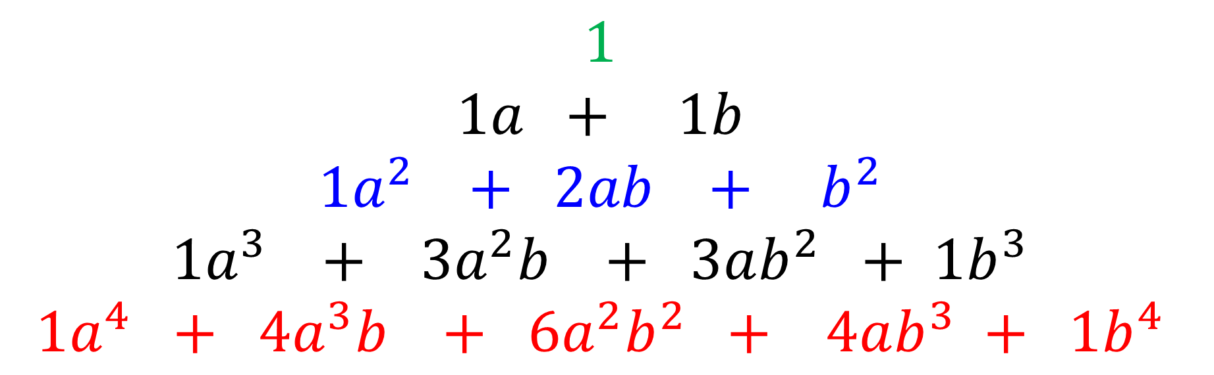

$$1$$
$$1a + 1b$$
$$1a^{2} + 2ab + b^{2}$$
$$1a^{3} + 3a^{2}b + 3ab^{2} + 1b^{3}$$
$$1a^{4} + 4a^{3}b + 6a^{2}b^{2} + 4ab^{3} + 1b^{4}$$
Expand ${\left(a+b\right)}^{5}$
$$1a^{5} + 5a^{4}b + 10{a^{3}b}^{2} +10a^{2}b^{3 }+5ab^{4} + {1b}^{5}$$

Slide 9
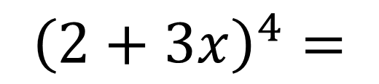
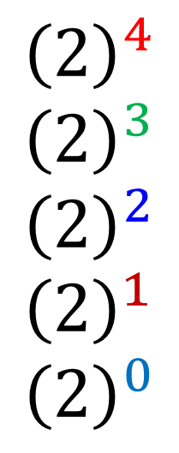

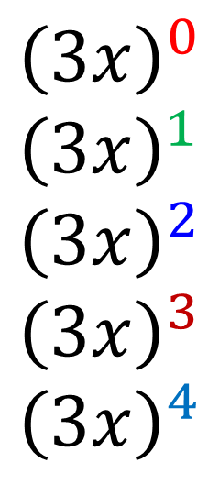
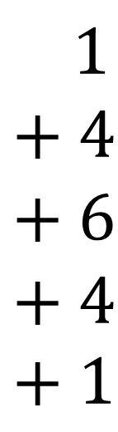
Find the expansion of ${\left(2+3x\right)}^{4}$
$${\left(2+3x\right)}^{4}=$$
$$1 \\ + 4 \\ + 6 \\ + 4 \\ + 1$$
$${\left(2\right)}^{4} \\ {\left(2\right)}^{3} \\ {\left(2\right)}^{2} \\ {\left(2\right)}^{1}$$
$${\left(2\right)}^{0}$$
$${\left(3x\right)}^{0}$$
$${\left(3x\right)}^{1} \\ {\left(3x\right)}^{2} \\ {\left(3x\right)}^{3} \\ {\left(3x\right)}^{4}$$
$$=16+96x+216x^{2}+216x^{3}+81x^{4}$$

Slide 10
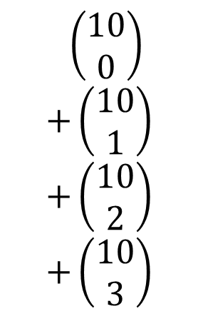
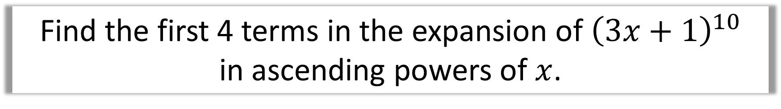
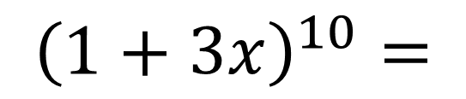
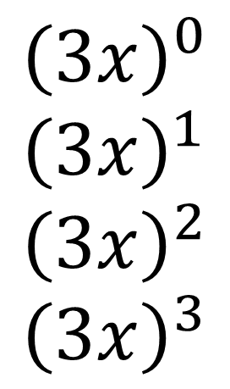
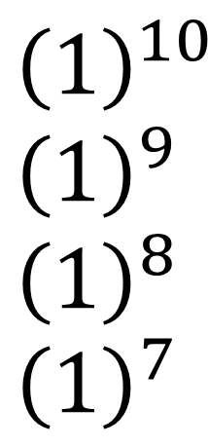
Find the first 4 terms in the expansion of ${\left(3x+1\right)}^{10}$
in ascending powers of $x$.
$${\left(1+3x\right)}^{10}=$$
$$\left(\begin{matrix}10 \\ 0\end{matrix}\right) \\ +\left(\begin{matrix}10 \\ 1\end{matrix}\right) \\ +\left(\begin{matrix}10 \\ 2\end{matrix}\right) \\ +\left(\begin{matrix}10 \\ 3\end{matrix}\right)$$
$${\left(1\right)}^{10} \\ {\left(1\right)}^{9} \\ {\left(1\right)}^{8} \\ {\left(1\right)}^{7}$$
$${\left(3x\right)}^{0}$$
$${\left(3x\right)}^{1} \\ {\left(3x\right)}^{2} \\ {\left(3x\right)}^{3}$$
$$=1+30x+405x^{2}+3240x^{3}+…$$

Slide 11
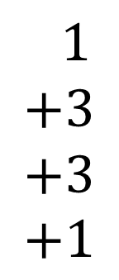


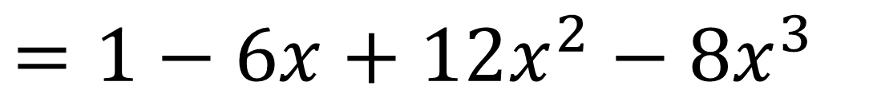
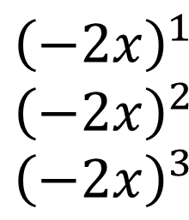
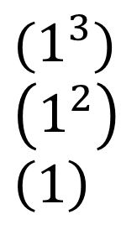
Find the expansion of ${\left(1−2x\right)}^{3}$
$${\left(1−2x\right)}^{3}=$$
$$1 \\ +3 \\ +3 \\ +1$$
$$(1^{3}) \\ \left(1^{2}\right) \\ \left(1\right)$$
$${\left(−2x\right)}^{1} \\ {\left(−2x\right)}^{2} \\ {\left(−2x\right)}^{3}$$
$$=1−6x+12x^{2}−8x^{3}$$

Slide 12
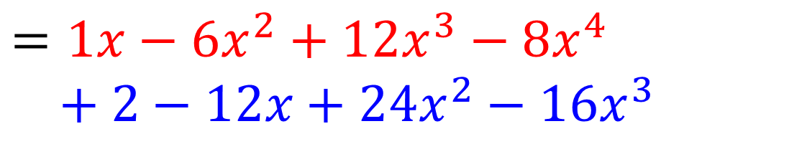
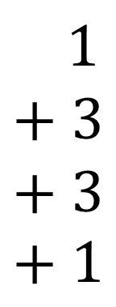
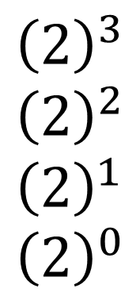
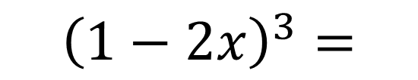
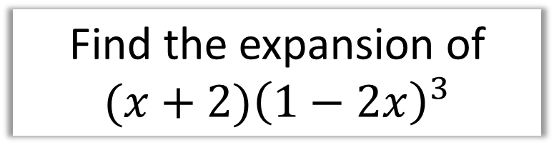
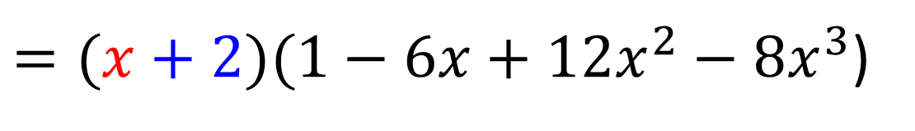
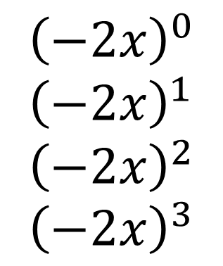
Find the expansion of ${(x+2)\left(1−2x\right)}^{3}$
$${\left(1−2x\right)}^{3}=$$
$$1 \\ + 3 \\ + 3 \\ + 1$$
$${\left(2\right)}^{3} \\ {\left(2\right)}^{2} \\ {\left(2\right)}^{1} \\ {\left(2\right)}^{0}$$
$${\left(−2x\right)}^{0}$$
$${\left(−2x\right)}^{1} \\ {\left(−2x\right)}^{2} \\ {\left(−2x\right)}^{3}$$
$=(x+2)(1−6x+12x^{2}−8x^{3}$)
$$=1x−6x^{2}+12x^{3}−8x^{4}$$
$$+ 2−12x+24x^{2}−16x^{3}$$
$$=2−11x+18x^{2}−4x^{3}−8x^{4}$$

