Slide 1
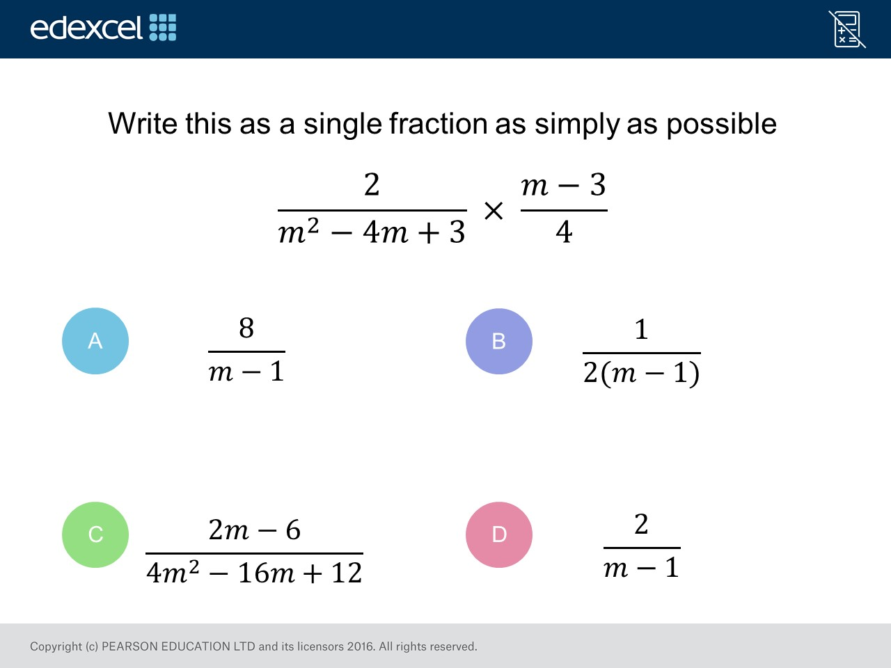
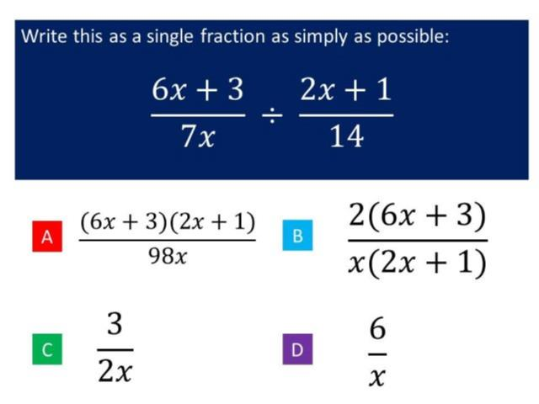
Worst answered question?
Most common wrong answer?

Slide 2
ANSWERS

Slide 3
Worst answered question?

Slide 4
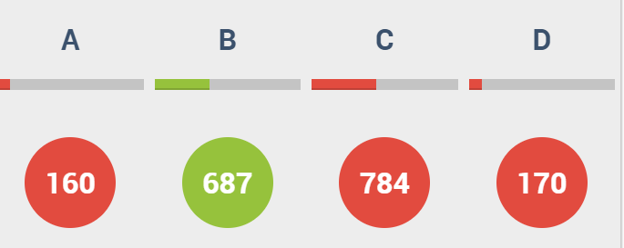
C
They have multiplied but
not factorised
and simplified.

Slide 5
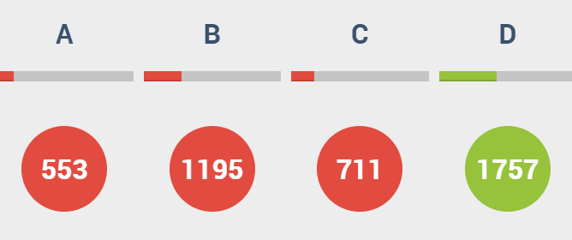
B
They divided correctly by have not factorised before simplifying.

