Slide 1
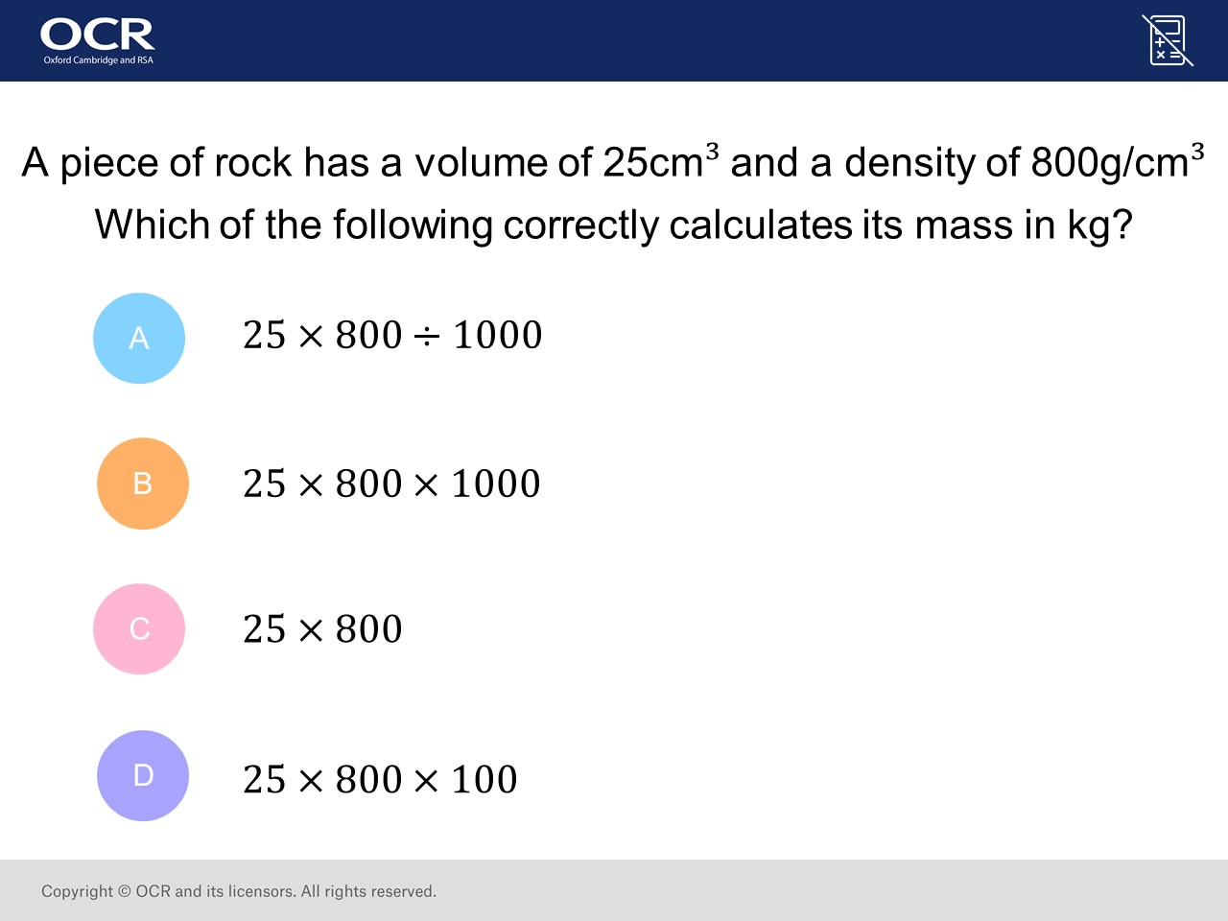
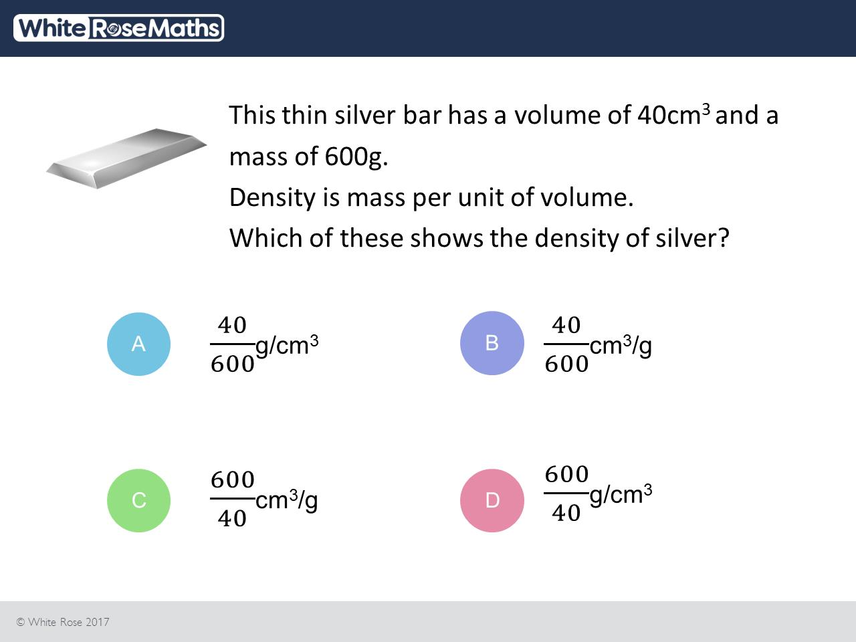
Worst answered question?
Most common wrong answer?

Slide 2
ANSWERS

Slide 3
Worst answered question?

Slide 4

C
The forgot to convert it from grams to kg.

Slide 5
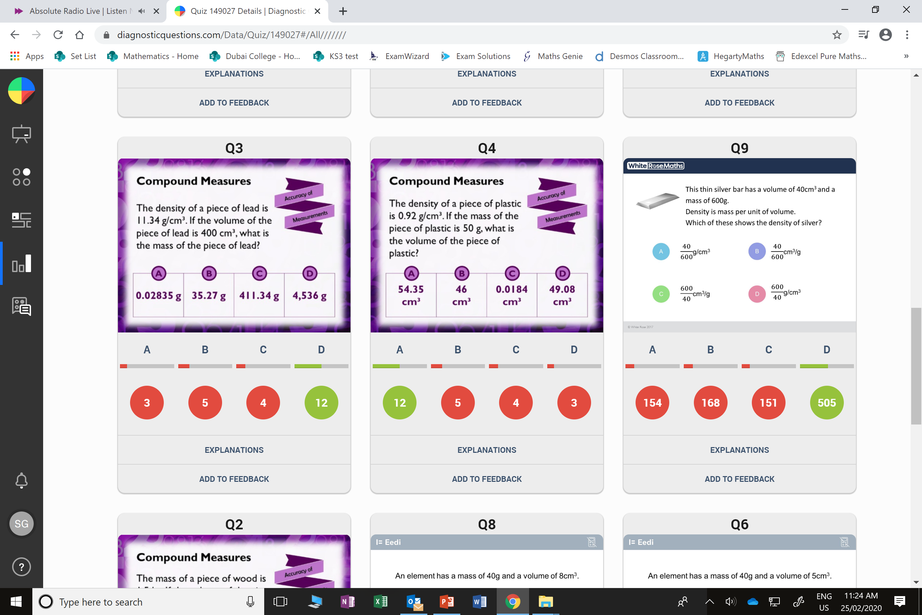
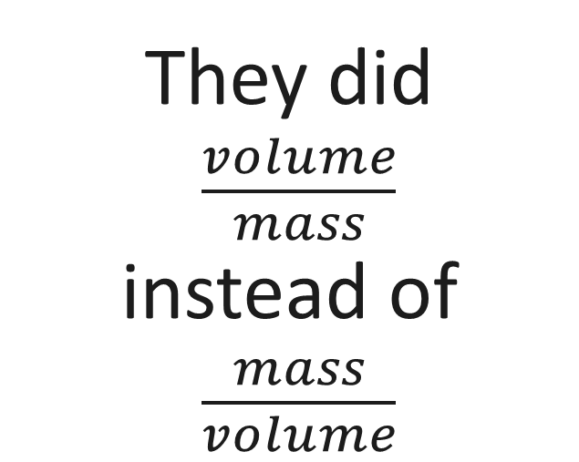
B
They did
$\frac{volume}{mass}$
instead of
$\frac{mass}{volume}$

