Slide 1
LO: Enlarging Shapes

Slide 2
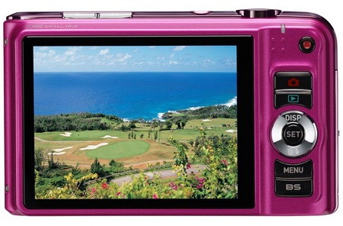
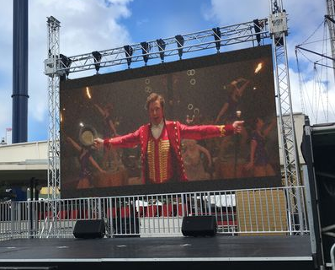
An enlargement is when you make
a shape bigger or smaller!

Slide 3
What is a scale factor?
A scale factor is a
multiplier.
2
1.3
0.25

Slide 4

What is a scale factor for mapping A to B?
The Scale factor is 3
B
A

Slide 5
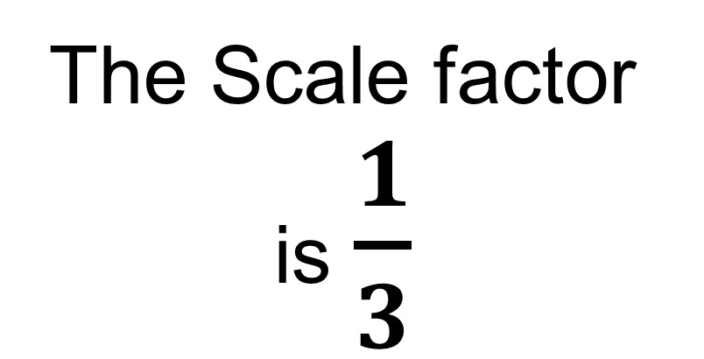
What is a scale factor for mapping B to A?
The Scale factor is $\frac{1}{3}$
B
A

Slide 6
What is a scale factor for mapping A to B?
A
The Scale factor is ½
B

Slide 7
What is a scale factor for mapping B to A?
A
The Scale factor is 2
B

Slide 8
What is a scale factor for mapping A to B?
The Scale factor is 5
B
A

Slide 9
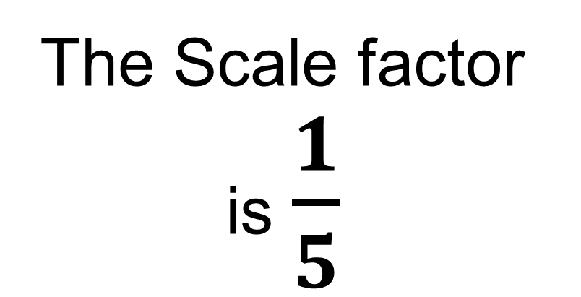
What is a scale factor for mapping B to A?
The Scale factor is $\frac{1}{5}$
B
A

Slide 10
What's wrong with this enlargement?
B
A

Slide 11
What is a Centre of Enlargement ?
This is a point that determines the position of the new shape.
This is the centre of enlargement
B
A

Slide 12
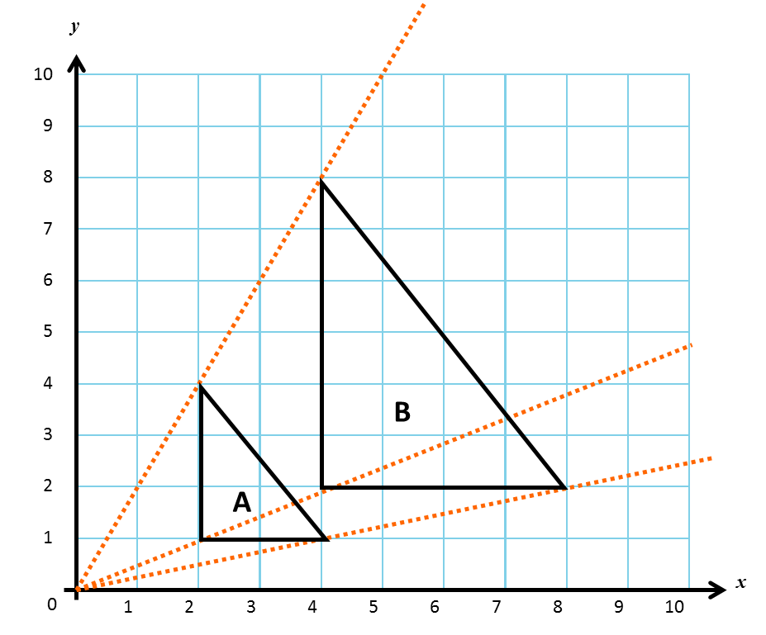
What is the centre of enlargement?
(0,0)

Slide 13
y
What is the centre of enlargement?
10
9
8
7
6
5
B
(0,2)
4
3
A
2
1
0
1
2
3
4
5
6
7
8
9
10
x

Slide 14
y
10
What is the centre of enlargement?
9
B
8
7
6
5
4
(1,1)
A
3
2
1
x
0
1
2
3
4
5
6
7
8
9
10

Slide 15
Locating your new position.
Enlarge shape A
Scale factor of 2
Centre of enlargement of (0,0)
y
10
9
8
B
7
6
New position
5
2
x 2 =
4
4
1
2
A
3
2
1
x
0
1
2
3
4
5
6
7
8
9
10

Slide 16
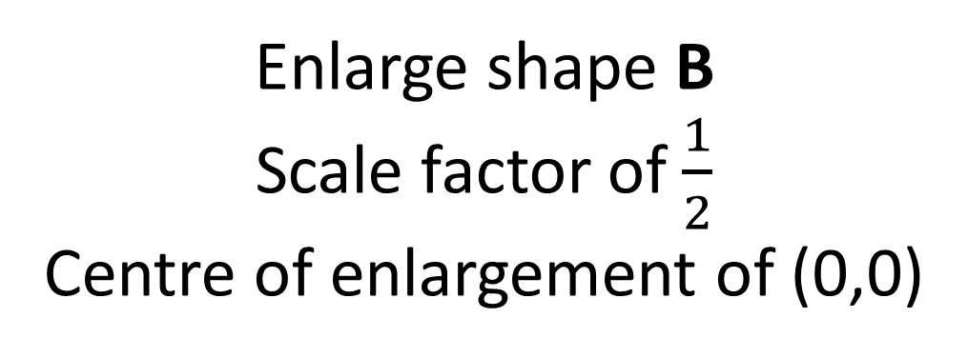
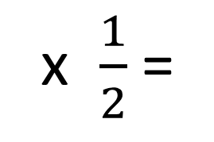
Locating your new position.
Enlarge shape B
Scale factor of $\frac{1}{2}$
Centre of enlargement of (0,0)
y
10
9
8
B
7
6
New position
5
4
x $\frac{1}{2}$ =
2
4
2
1
A
3
2
1
x
0
1
2
3
4
5
6
7
8
9
10

Slide 17
Locating your new position.
y
Enlarge shape A
Scale factor of 3
Centre of enlargement of (1,1)
10
B
9
8
7
6
New Position
5
4
1
x 3 =
3
A
3
0
0
2
1
x
0
1
2
3
4
5
6
7
8
9
10

