Slide 1
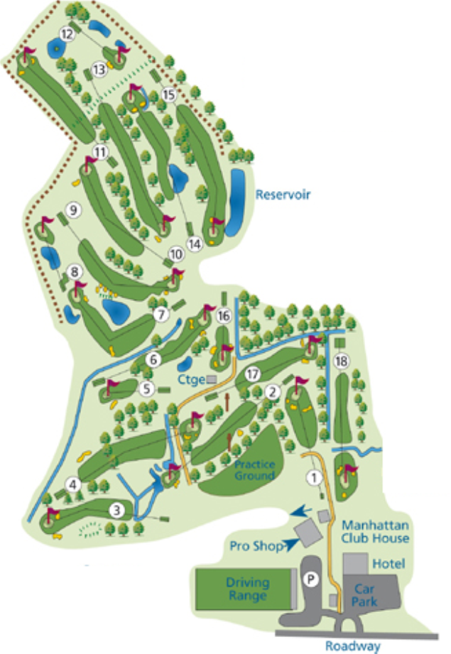
Scale Factors and Golf
You will be given a map of the course
You will be given the distance for each hole
Calculate the distance of each shot
You will need a calculator and ruler
Give your final answer to the nearest yard

Slide 2
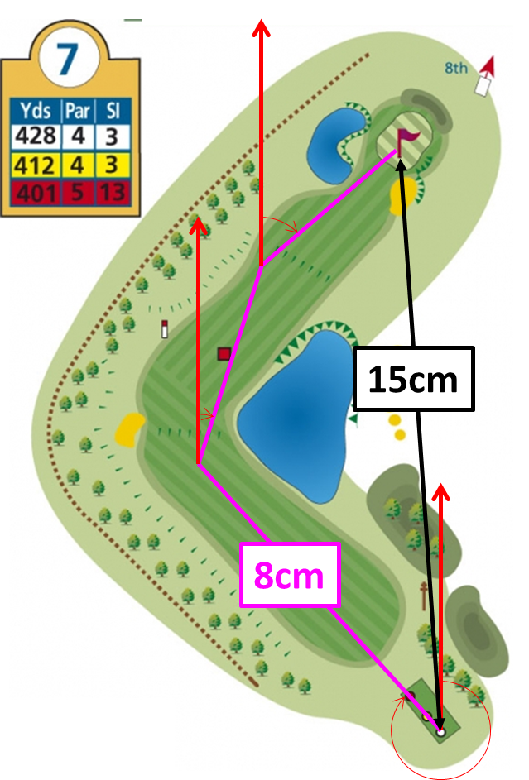

SF = 428 ÷ 15 = 28.5333...
1cm : 28.5yards
Shot 1: 8 x $\frac{428}{15}$= 228 yards
Shot 2:
Shot 3:

Slide 3
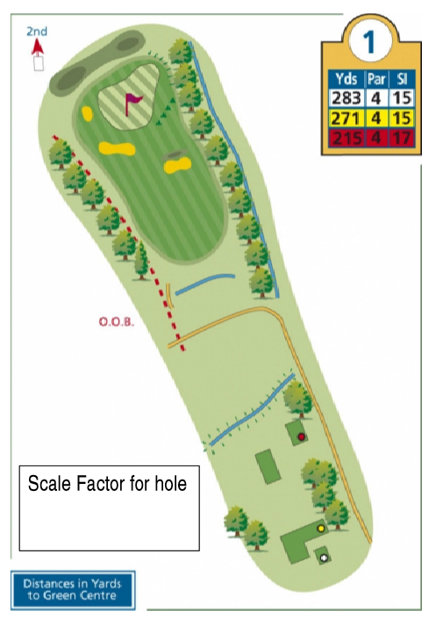
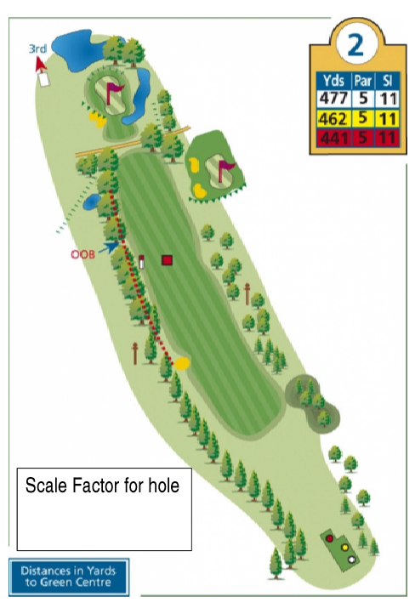
Shot 1
Shot 1
Shot 2
Shot 2
Shot 3

Slide 4
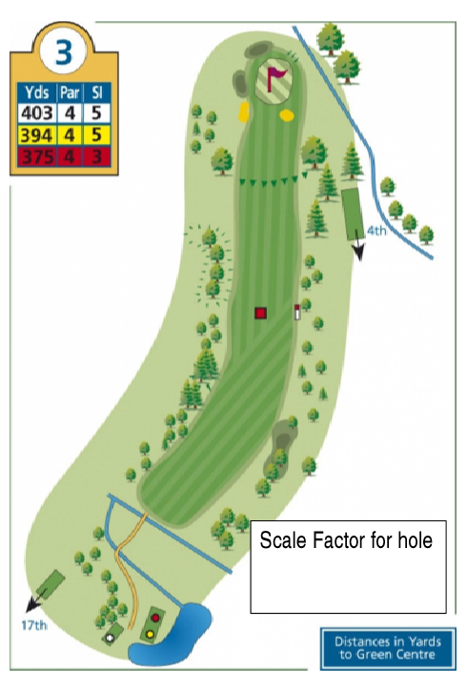
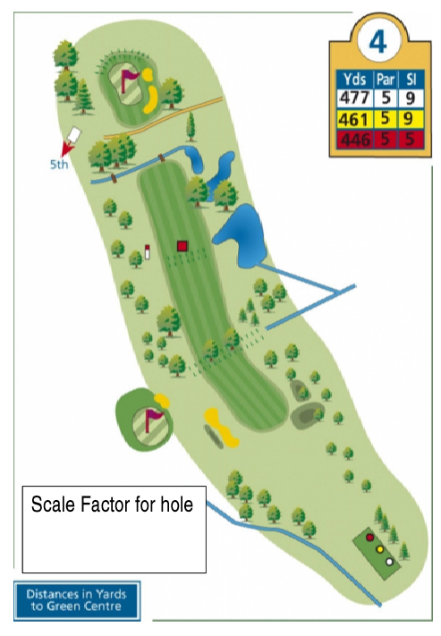
Shot 1
Shot 1
Shot 2
Shot 2
Shot 3

Slide 5
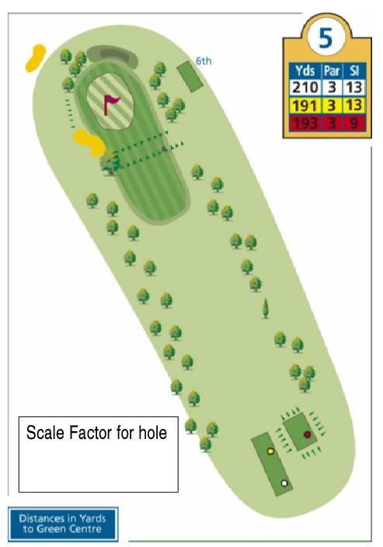
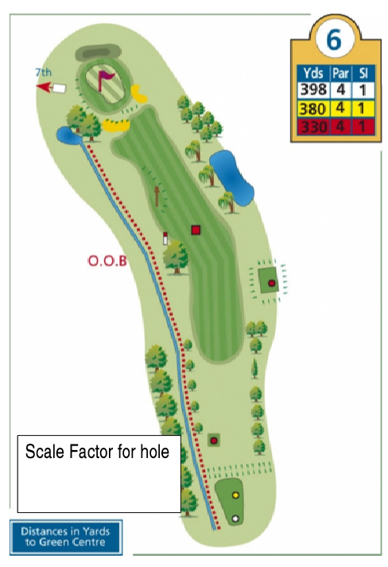
Shot 1
Shot 1
Shot 2

Slide 6
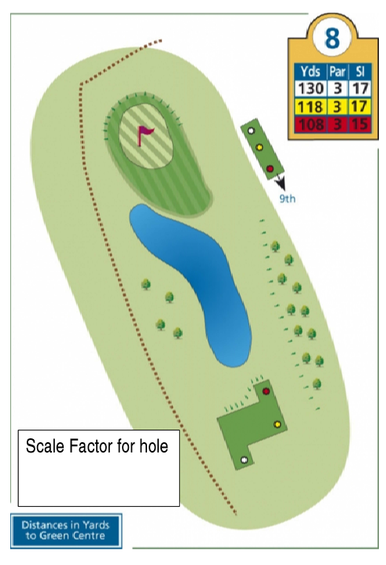
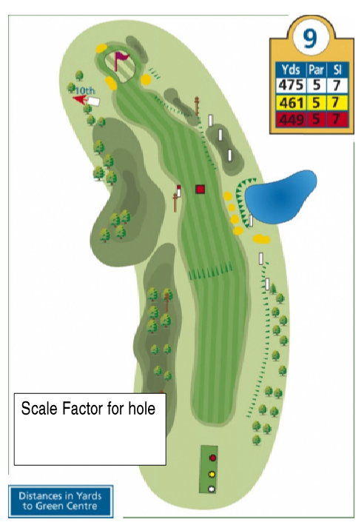
Shot 1
Shot 1
Shot 2
Shot 3

Slide 7
ANSWERS

Slide 8


Shot 1
Shot 1
7.5cm
218 yards
5.6cm
252 yards
Shot 2
Shot 2
2.2cm
64 yards
2.3cm
104 yards
Shot 3
3.3cm
149 yards
$$\frac{285}{9.7}$$
$$\frac{477}{10.6}$$

Slide 9


Shot 1
Shot 1
6.6 cm
244 yards
4.5 cm
204 yards
Shot 2
Shot 2
4.3 cm
159 yards
4.5 cm
204 yards
Shot 3
1.8 cm
82 yards
$$\frac{403}{10.9}$$
$$\frac{477}{10.5}$$

Slide 10


Shot 1
Shot 1
9.4 cm
210 yards
6.8 cm
265 yards
Shot 2
3.8 cm
228 yards
$$\frac{210}{9.4}$$
$$\frac{398}{10.2}$$

Slide 11


Shot 1
Shot 1
5.7 cm
253 yards
7.8 cm
130 yards
Shot 2
3.9 cm
173 yards
Shot 3
2.2 cm
98 yards
$$\frac{475}{10.7}$$
$$\frac{130}{7.8}$$

