Slide 1

Diagnostic Assessment .Delta 3
Unit 2
Quadratic Sequences
Expanding Brackets
Factorising
Solving Quadratics by Factorising

Slide 2
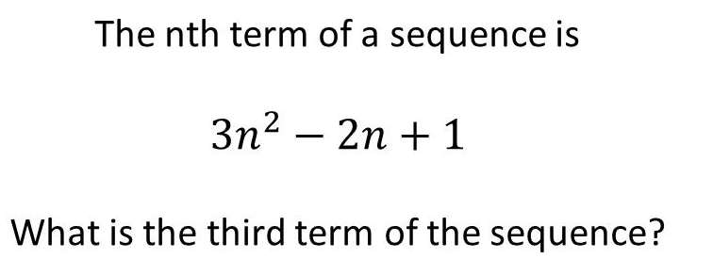
Question 1 – Quadratic Sequences

Slide 3
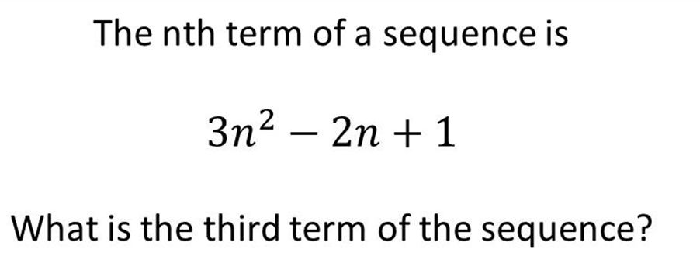
Answer 1 – Quadratic Sequences
CORRECT ANSWER | CORRECT EXPLANATION
22 | We substitute n = 3 to get 3 × 3² - 2 × 3 + 1 = 27 - 6 + 1 = 22.
COMMON MISTAKES | WHAT MIGHT BE YOUR MISTAKE
310 | The student has substituted incorrectly. They may benefit from revising substitution in expressions.
76 | The student has used the wrong order of operations. They may benefit from revising this topic.
34 | The student has added the second term, rather than subtracting.

Slide 4
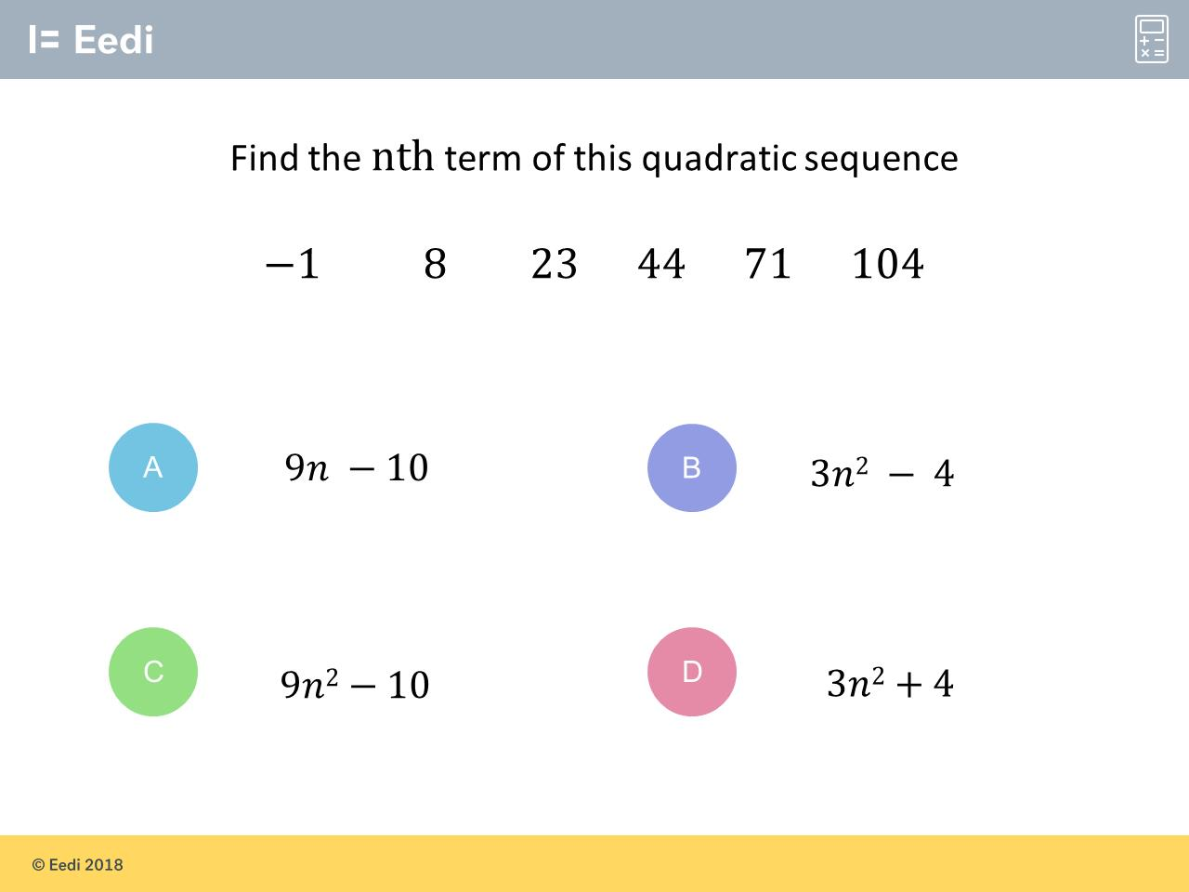
Question 2 – Quadratic Sequences

Slide 5
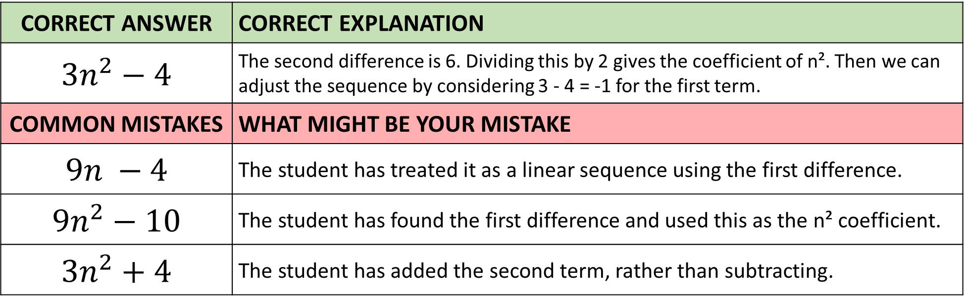
Answer 2 – Quadratic Sequences
CORRECT ANSWER | CORRECT EXPLANATION
${3n}^{2}−4$ | The second difference is 6. Dividing this by 2 gives the coefficient of n². Then we can adjust the sequence by considering 3 - 4 = -1 for the first term.
COMMON MISTAKES | WHAT MIGHT BE YOUR MISTAKE
$9n −4$ | The student has treated it as a linear sequence using the first difference.
${9n}^{2}−10$ | The student has found the first difference and used this as the n² coefficient.
${3n}^{2}+4$ | The student has added the second term, rather than subtracting.

Slide 6
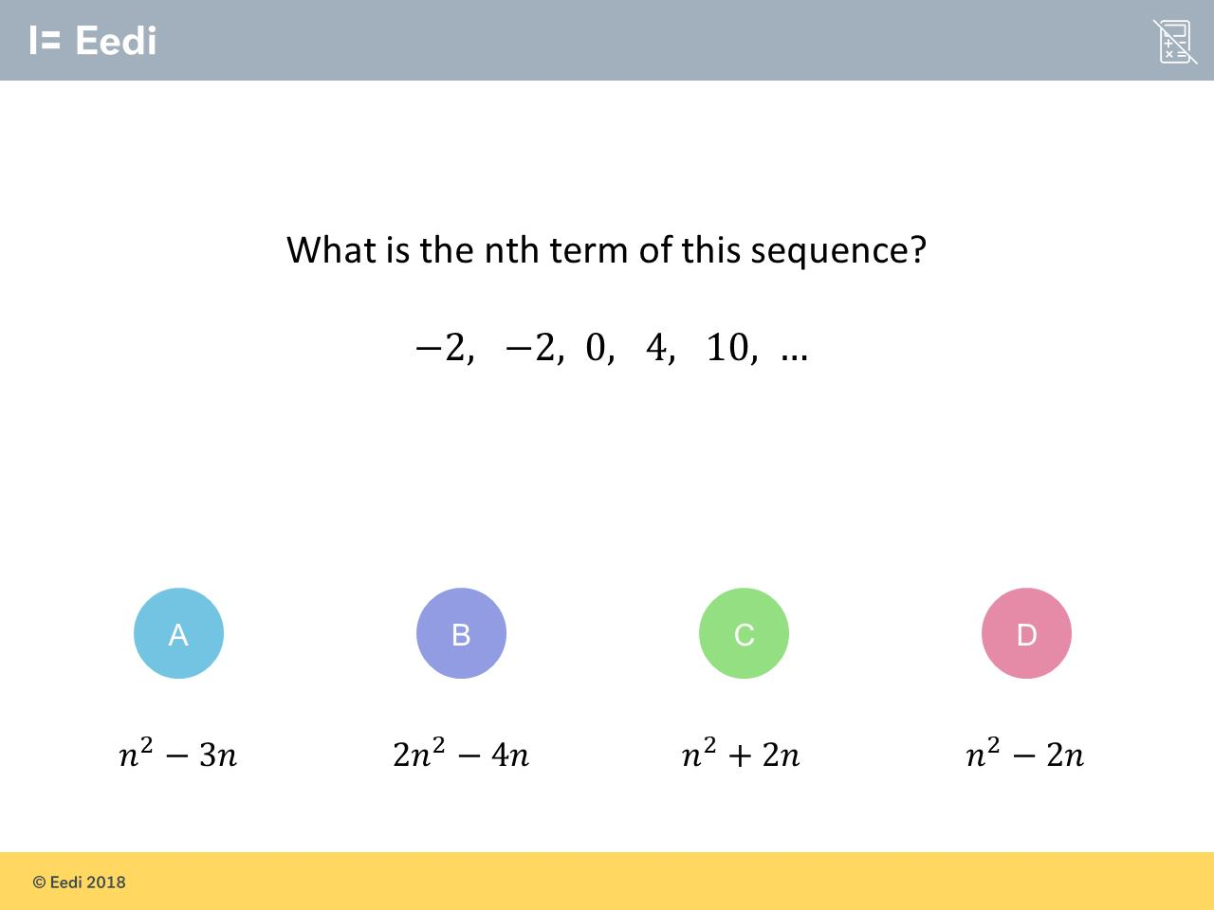
Question 3 – Quadratic Sequences

Slide 7
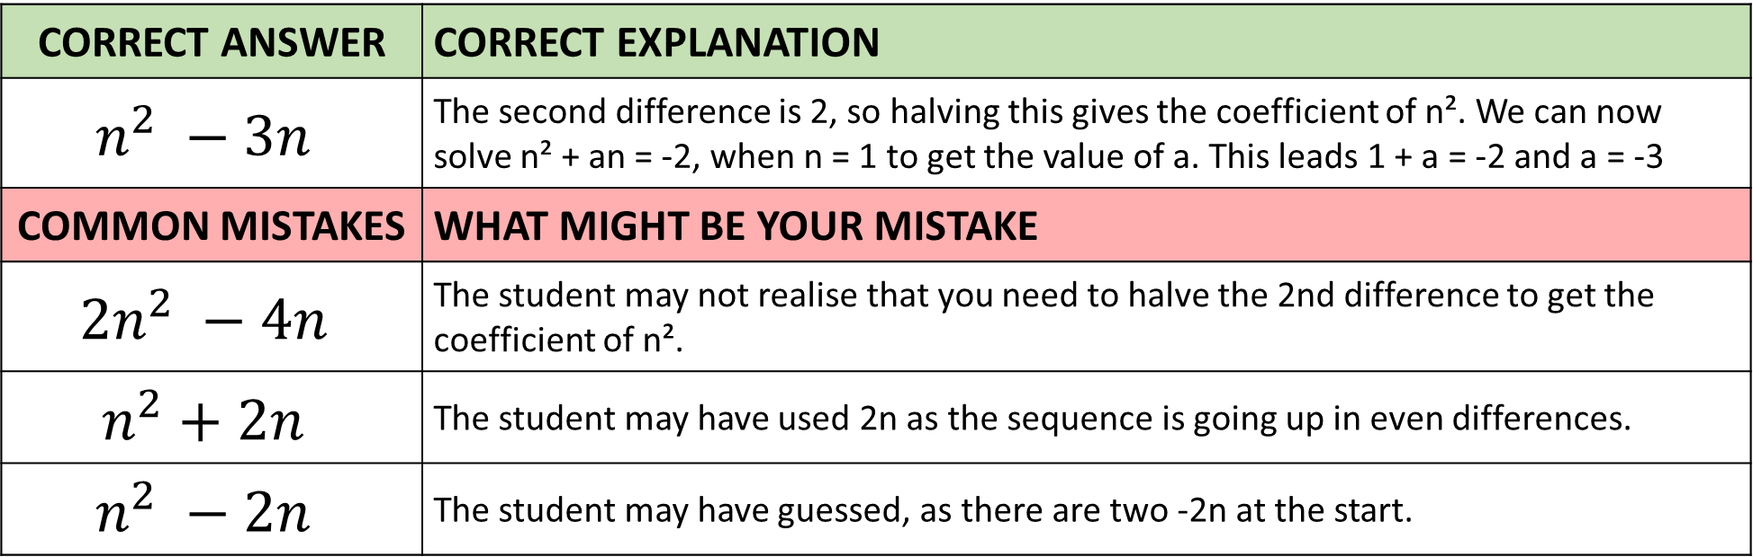
Answer 3 – Quadratic Sequences
CORRECT ANSWER | CORRECT EXPLANATION
$$n^{2} −3n$$ | The second difference is 2, so halving this gives the coefficient of n². We can now solve n² + an = -2, when n = 1 to get the value of a. This leads 1 + a = -2 and a = -3
COMMON MISTAKES | WHAT MIGHT BE YOUR MISTAKE
$$2n^{2} −4n$$ | The student may not realise that you need to halve the 2nd difference to get the coefficient of n².
$$n^{2}+2n$$ | The student may have used 2n as the sequence is going up in even differences.
$$n^{2} −2n$$ | The student may have guessed, as there are two -2n at the start.

Slide 8
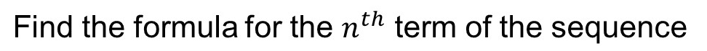
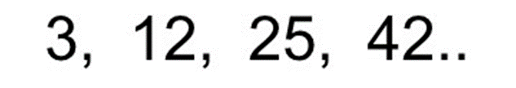
Question 4 – Quadratic Sequences

Slide 9
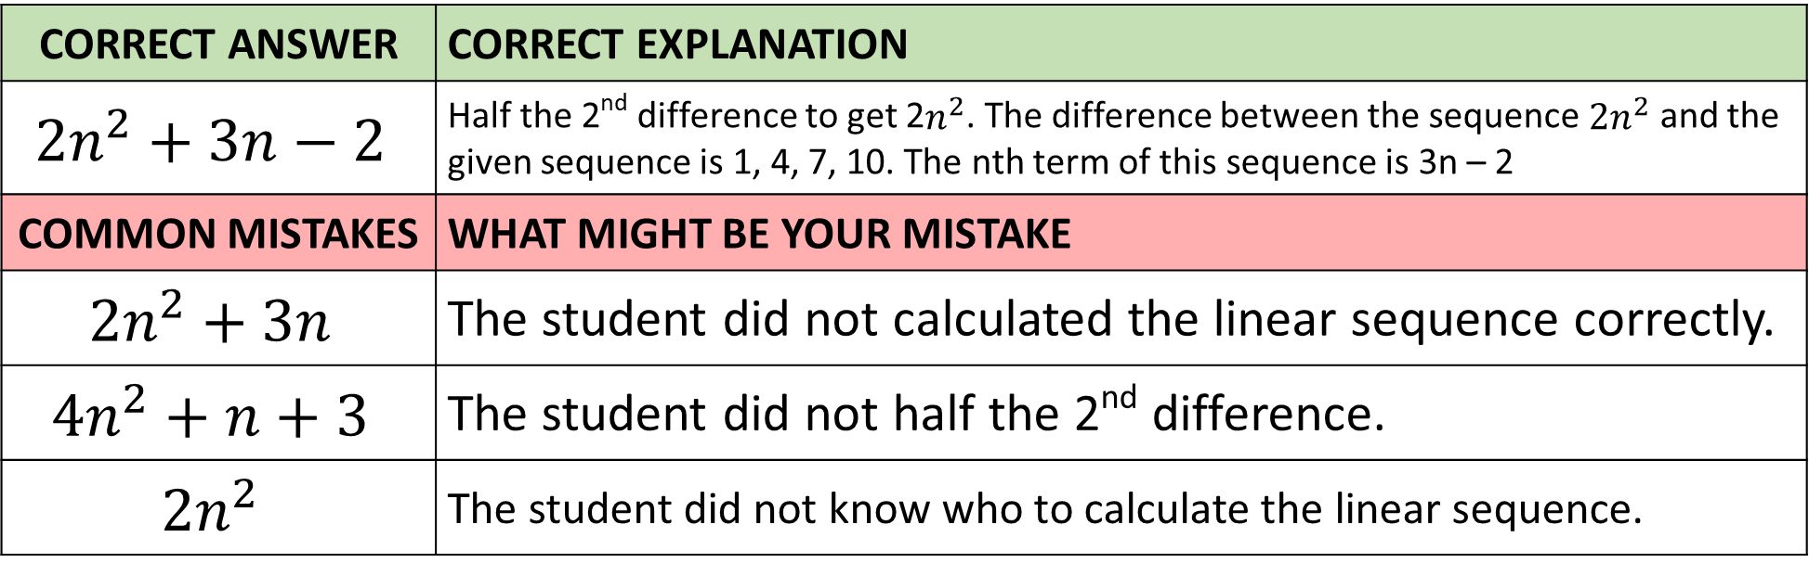
Answer 4 – Quadratic Sequences
CORRECT ANSWER | CORRECT EXPLANATION
$${2n}^{2}+3n−2$$ | Half the 2nd difference to get 2$n^{2}$. The difference between the sequence $2n^{2}$ and the given sequence is 1, 4, 7, 10. The nth term of this sequence is 3n – 2
COMMON MISTAKES | WHAT MIGHT BE YOUR MISTAKE
$${2n}^{2}+3n$$ | The student did not calculated the linear sequence correctly.
$${4n}^{2}+n+3$$ | The student did not half the 2nd difference.
$${2n}^{2}$$ | The student did not know who to calculate the linear sequence.

Slide 10
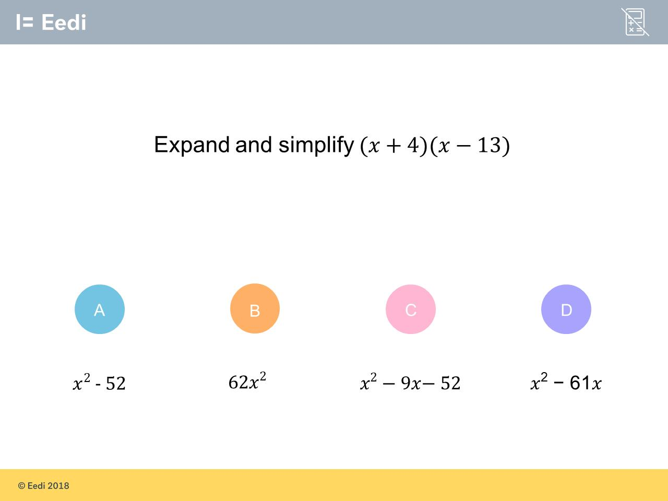
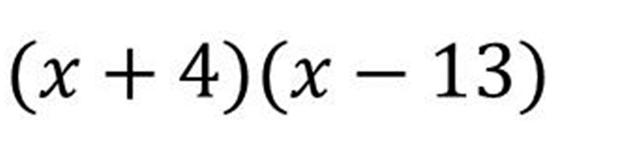
Question 5 – Expanding Brackets

Slide 11
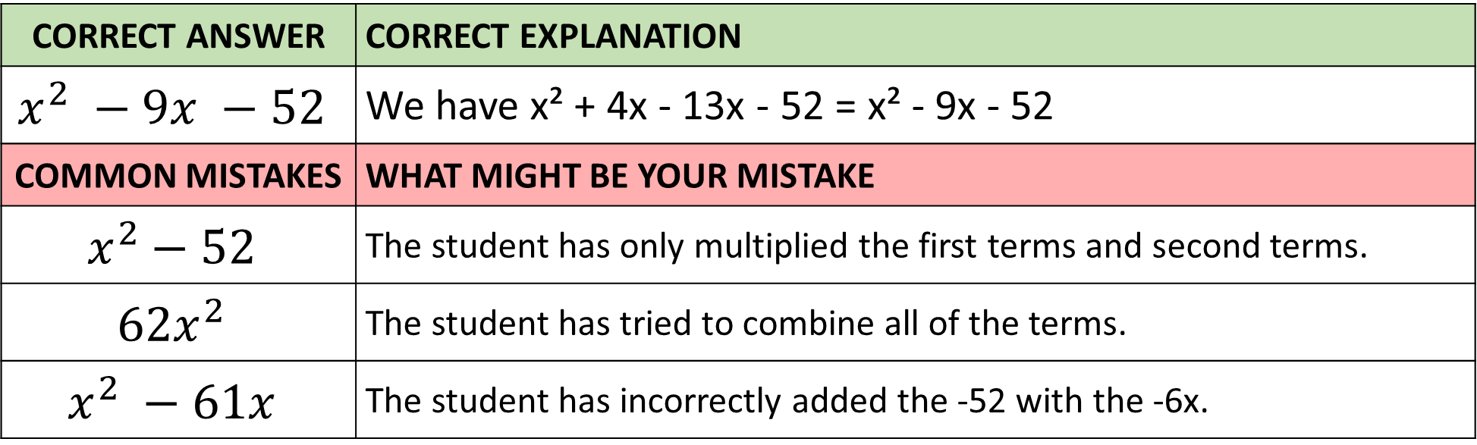
Answer 5 – Expanding Brackets
CORRECT ANSWER | CORRECT EXPLANATION
$$x^{2} −9x −52$$ | We have x² + 4x - 13x - 52 = x² - 9x - 52
COMMON MISTAKES | WHAT MIGHT BE YOUR MISTAKE
$$x^{2}−52$$ | The student has only multiplied the first terms and second terms.
$${62x}^{2}$$ | The student has tried to combine all of the terms.
$$x^{2} −61x$$ | The student has incorrectly added the -52 with the -6x.

Slide 12
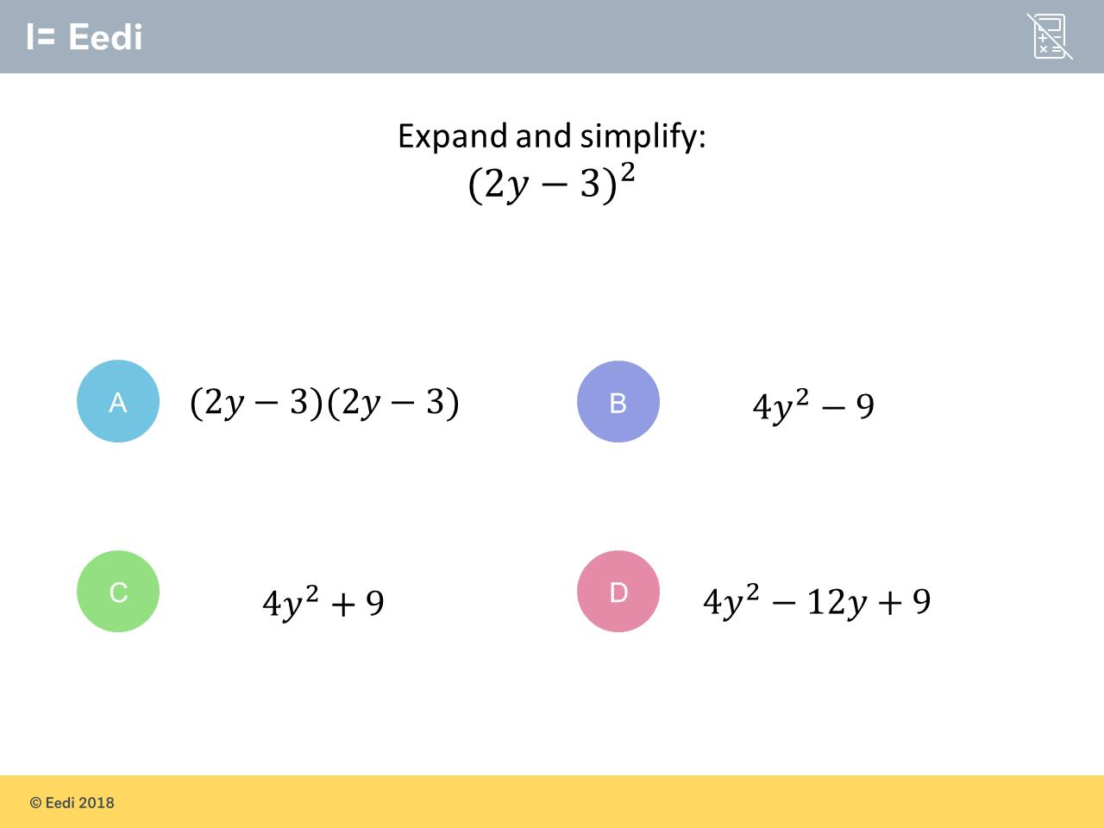
Question 6 – Expanding Brackets

Slide 13
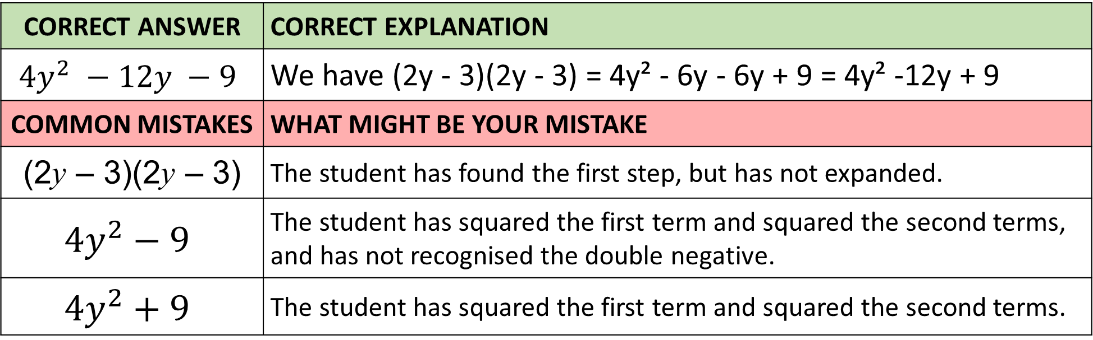
Answer 6 – Expanding Brackets
CORRECT ANSWER | CORRECT EXPLANATION
$${4y}^{2} −12y −9$$ | We have (2y - 3)(2y - 3) = 4y² - 6y - 6y + 9 = 4y² -12y + 9
COMMON MISTAKES | WHAT MIGHT BE YOUR MISTAKE
(2y – 3)(2y – 3) | The student has found the first step, but has not expanded.
$${4y}^{2}−9$$ | The student has squared the first term and squared the second terms, and has not recognised the double negative.
$${4y}^{2}+9$$ | The student has squared the first term and squared the second terms.

Slide 14
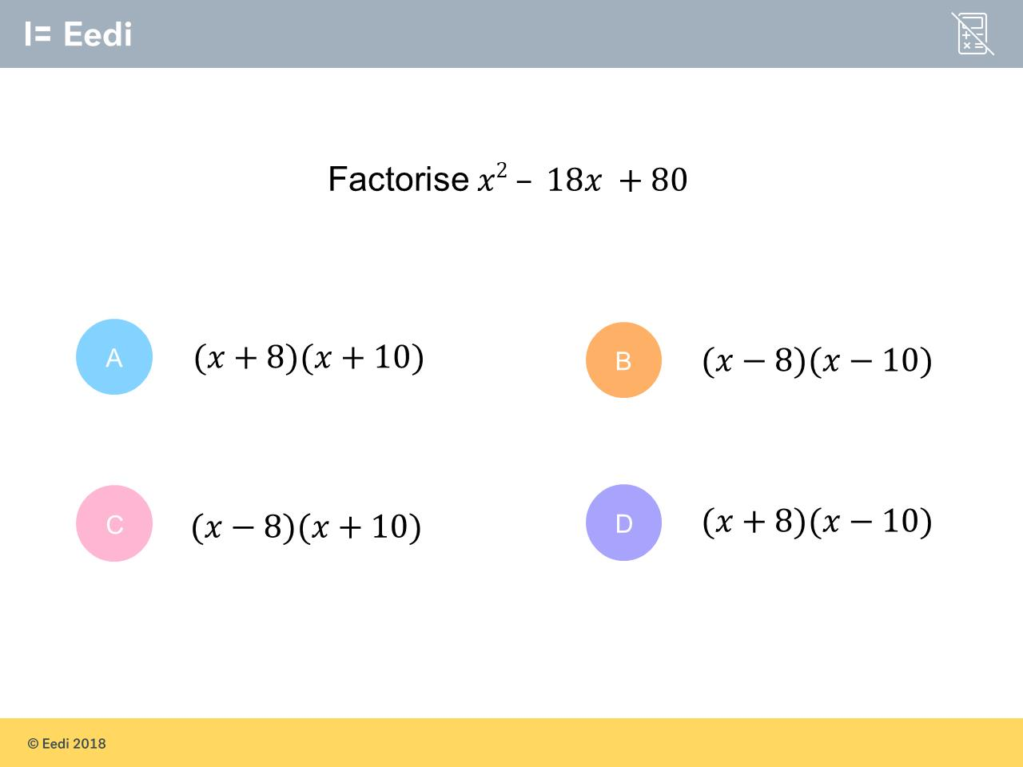
Question 7 – Factorising

Slide 15
Answer 7 – Factorising
CORRECT ANSWER | CORRECT EXPLANATION
(x – 8)(x – 10) | We have -8 -10 = -18 for the coefficient of x, and -8 × - 10 = 80
COMMON MISTAKES | WHAT MIGHT BE YOUR MISTAKE
(x + 8)(x + 10) | The student has used the wrong signs.
(x – 8)(x + 10) | The student may have miscalculated -8 + 10 = -18
(x + 8)(x – 10) | The student may have miscalculated +8 - 10 = -18

Slide 16
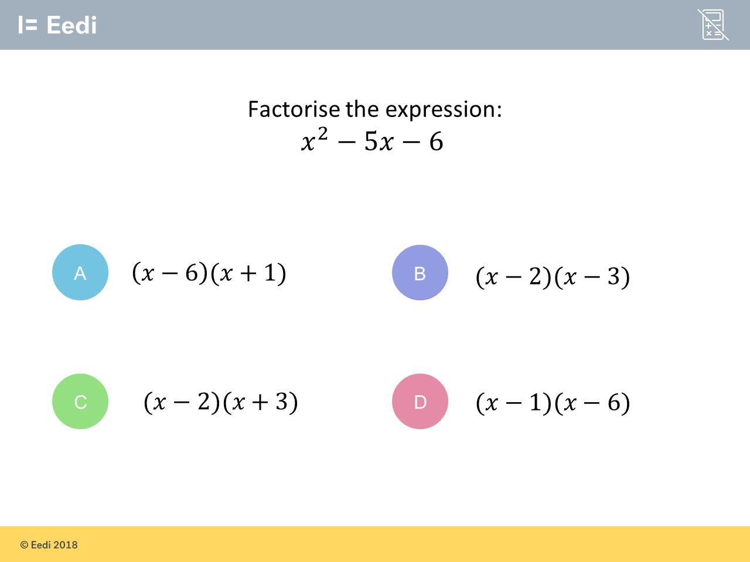
Question 8 – Factorising

Slide 17
Answer 8 – Factorising
CORRECT ANSWER | CORRECT EXPLANATION
(x – 6)(x + 1) | We have -6 + 1 = -5 for the x coefficient, and -6 × 1 = -6 for the final number.
COMMON MISTAKES | WHAT MIGHT BE YOUR MISTAKE
(x – 2)(x – 3) | The student has not recognised that -2 × -3 is positive.
(x – 2)(x + 3) | The student has not recognised that this gives the wrong x coefficient.
(x – 1)(x – 6) | The student has used the wrong signs.

Slide 18
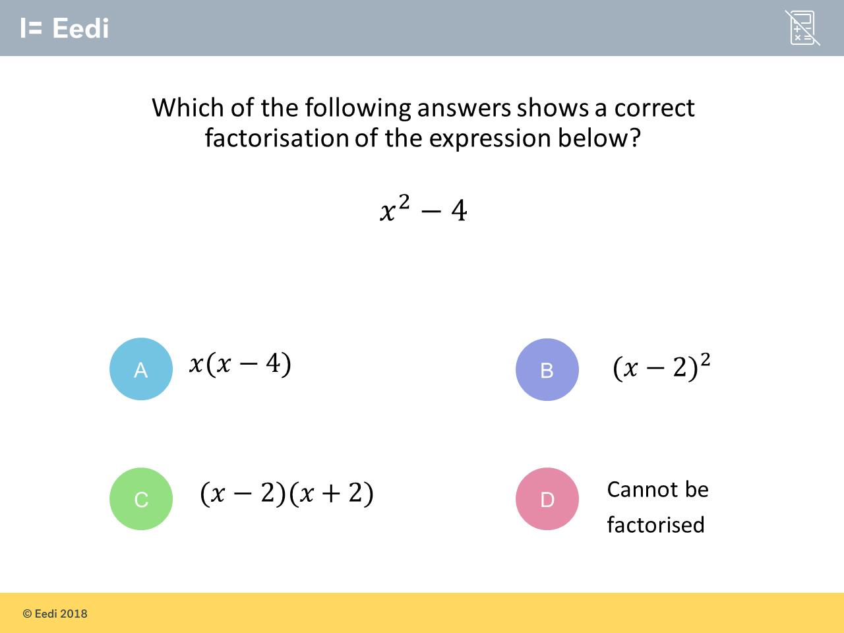
Question 9 – Factorising
Factorise

Slide 19
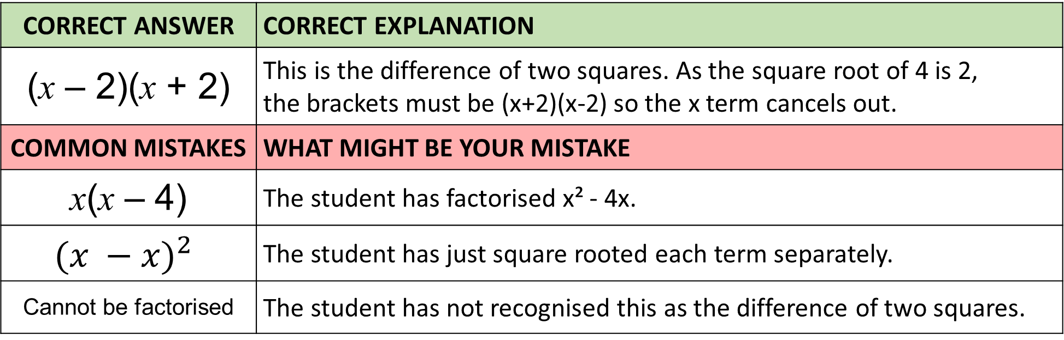
Answer 9 – Factorising
Factorise
CORRECT ANSWER | CORRECT EXPLANATION
(x – 2)(x + 2) | This is the difference of two squares. As the square root of 4 is 2, the brackets must be (x+2)(x-2) so the x term cancels out.
COMMON MISTAKES | WHAT MIGHT BE YOUR MISTAKE
x(x – 4) | The student has factorised x² - 4x.
$${(x −x)}^{2}$$ | The student has just square rooted each term separately.
Cannot be factorised | The student has not recognised this as the difference of two squares.

Slide 20
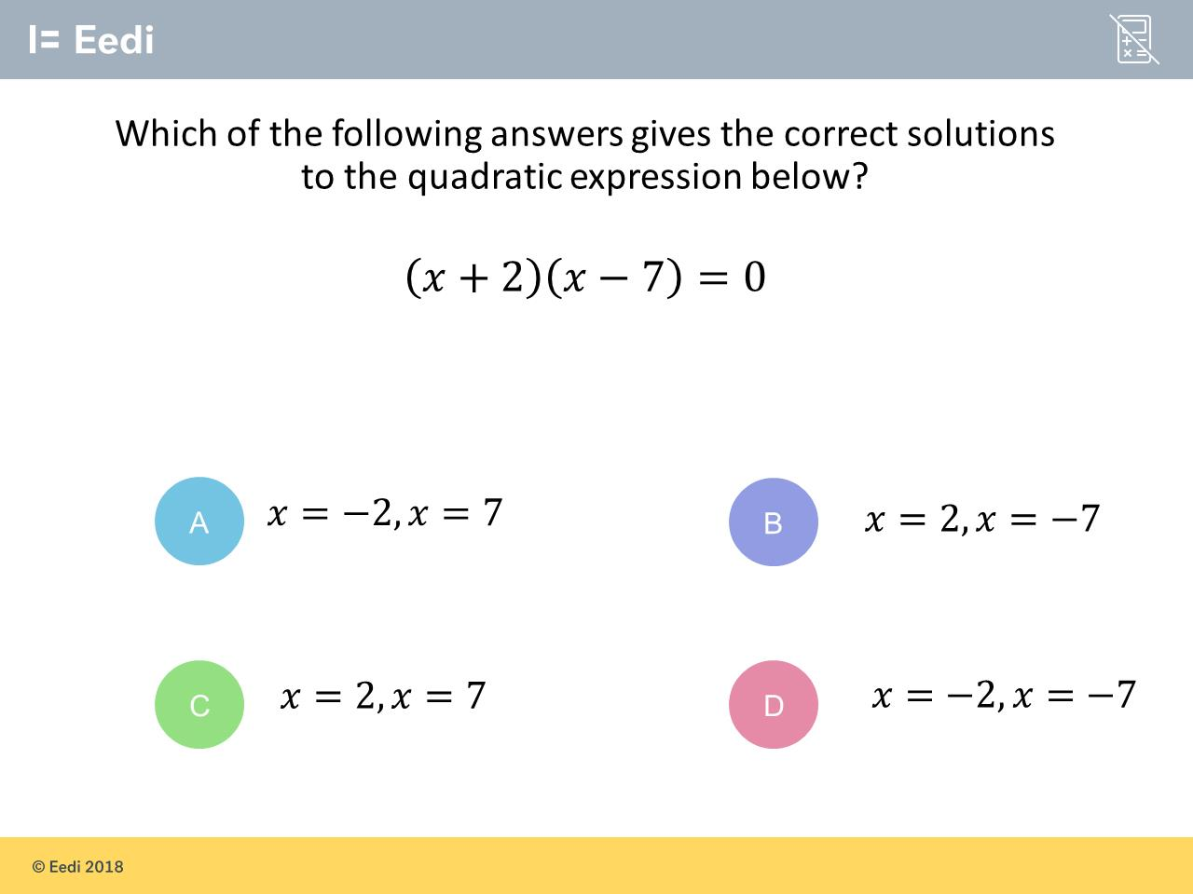
Question 10 – Solving Quadratics by Factorising
What are the solutions for the following quadratic?

Slide 21
Answer 10 – Solving Quadratics by Factorising
What are the solutions for the following quadratic?
CORRECT ANSWER | CORRECT EXPLANATION
x = -2 or 7 | We can simply take the negative of the two numbers inside the brackets i.e. -2 and - - 7=7.
COMMON MISTAKES | WHAT MIGHT BE YOUR MISTAKE
x = 2 or -7 | The student has copied the signs from inside the brackets.
x = 2 or 7 | The student may have ignored the signs.
x = -2 or -7 | The student may believe that the solutions are always negative.

Slide 22
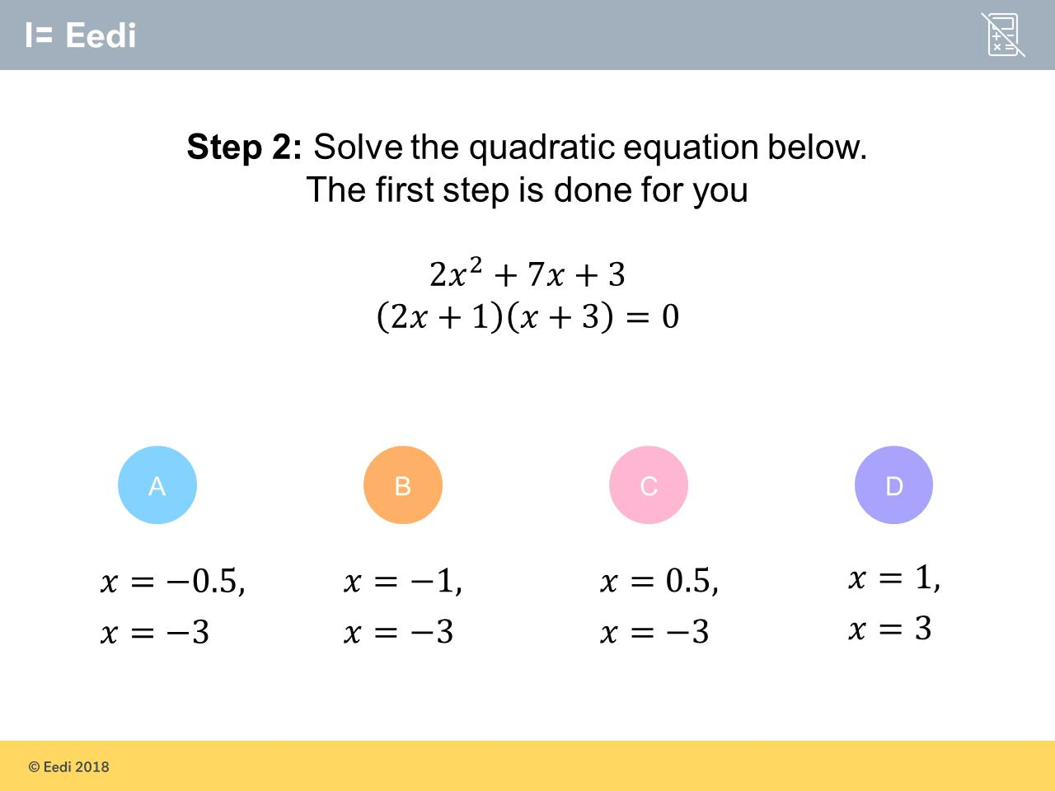
Question 11 – Solving Quadratics by Factorising
What are the solutions for the following quadratic?

Slide 23
Answer 11 – Solving Quadratics by Factorising
What are the solutions for the following quadratic?
CORRECT ANSWER | CORRECT EXPLANATION
x = -0.5 or -3 | Make each bracket equal 0 and solve to find 2 values of x 2x + 1 = 0 and x + 3 = 0
COMMON MISTAKES | WHAT MIGHT BE YOUR MISTAKE
x = -1 or -3 | The student has not noticed that 2𝑥 = -1 so we need to divide -1 by 2. 𝑥 = -0.5
x = 0.5 or -3 | The student has the wrong sign on 0.5
x = 1 or 3 | The student has not noticed that 2𝑥 = -1 so we need to divide -1 by 2. 𝑥 = -0.5

Slide 24
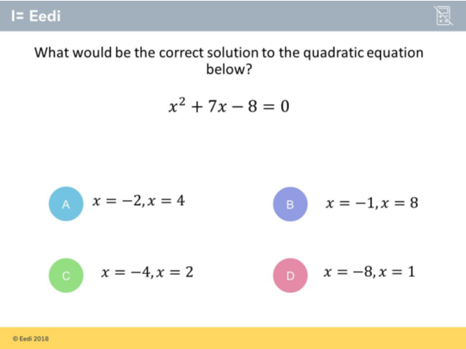
Question 12 – Solving Quadratics by Factorising

Slide 25
Answer 12 – Solving Quadratics by Factorising
CORRECT ANSWER | CORRECT EXPLANATION
x = -8 or 1 | We first factorise the quadratic into (𝑥+8)(𝑥-1)=0. We can then see that the solutions must be 𝑥=-8 and 𝑥=1.
COMMON MISTAKES | WHAT MIGHT BE YOUR MISTAKE
x = -2 or 4 | The student has factorised incorrectly.
x = -1 or 8 | The student may have factorised correctly, but has then taken the signs of the numbers inside the brackets.
x = -4 or 2 | The student has factorised incorrectly.

Slide 26
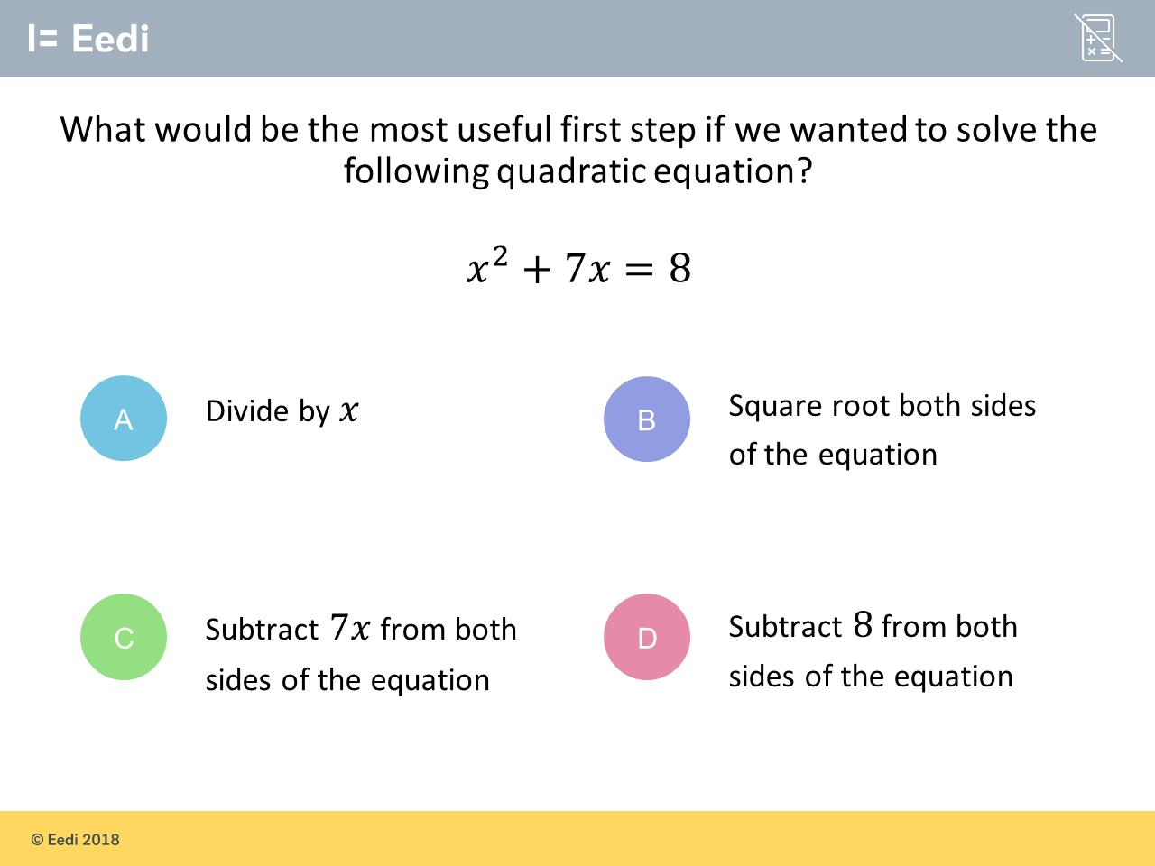
Question 13 – Solving Quadratics by Factorising

Slide 27
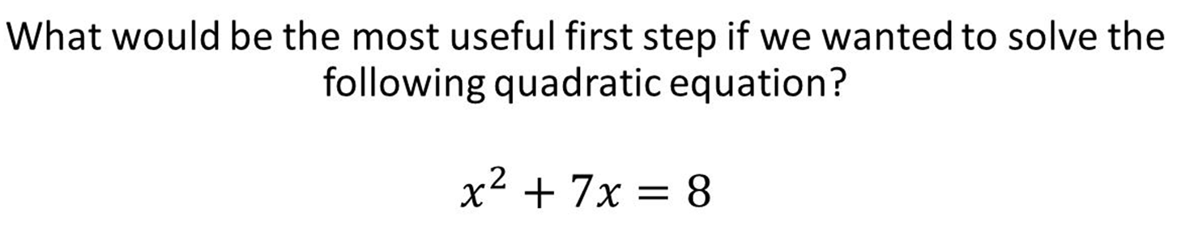
Answer 13 – Solving Quadratics by Factorising
CORRECT ANSWER | CORRECT EXPLANATION
D | To solve a quadratic, we first make one side equal to 0. This is achieved by subtracting 8 from both sides.
COMMON MISTAKES | WHAT MIGHT BE YOUR MISTAKE
A | The student may not recall that to solve a quadratic we need one side equal to 0.
B | The student may be attempting to remove the 𝑥² term
C | The student may be attempting to remove the 𝑥 term.

