Slide 1
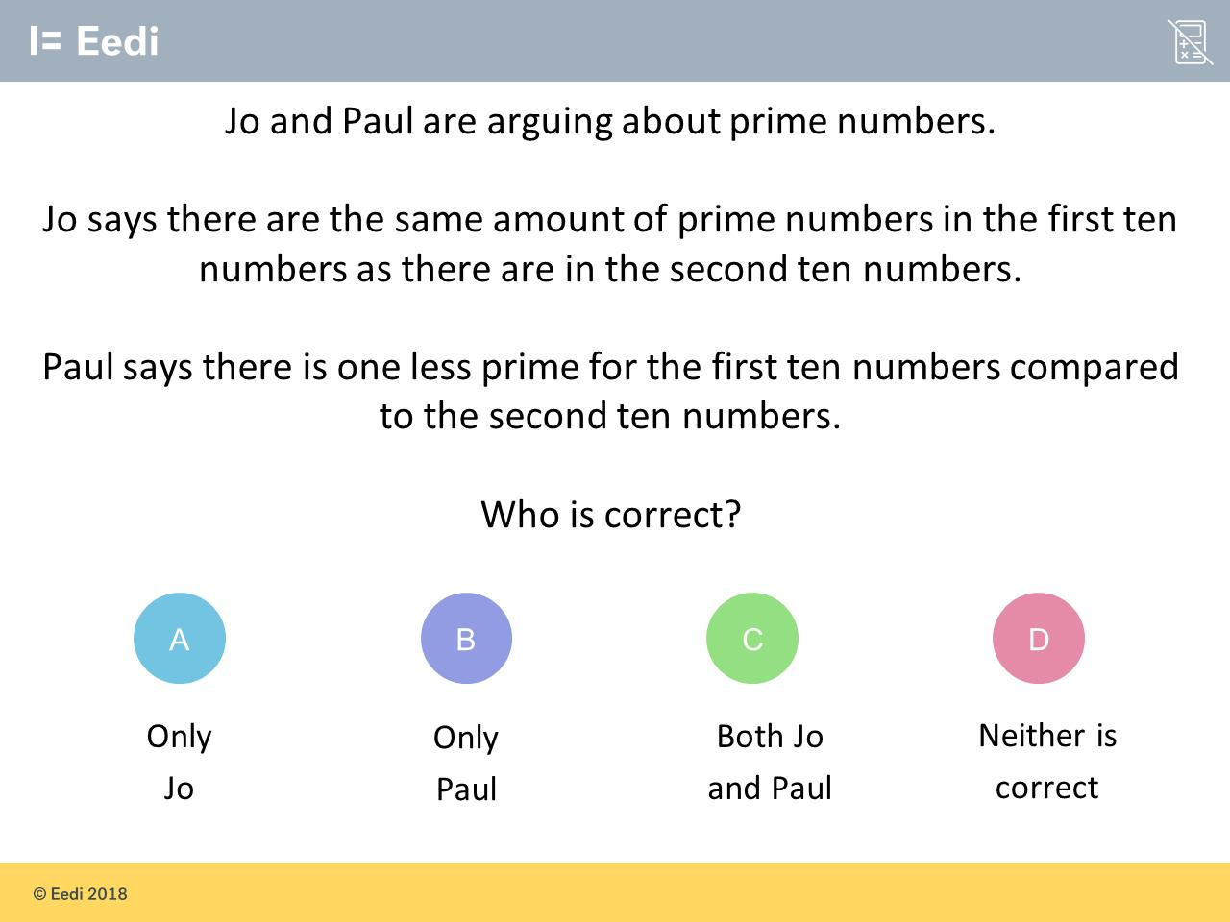
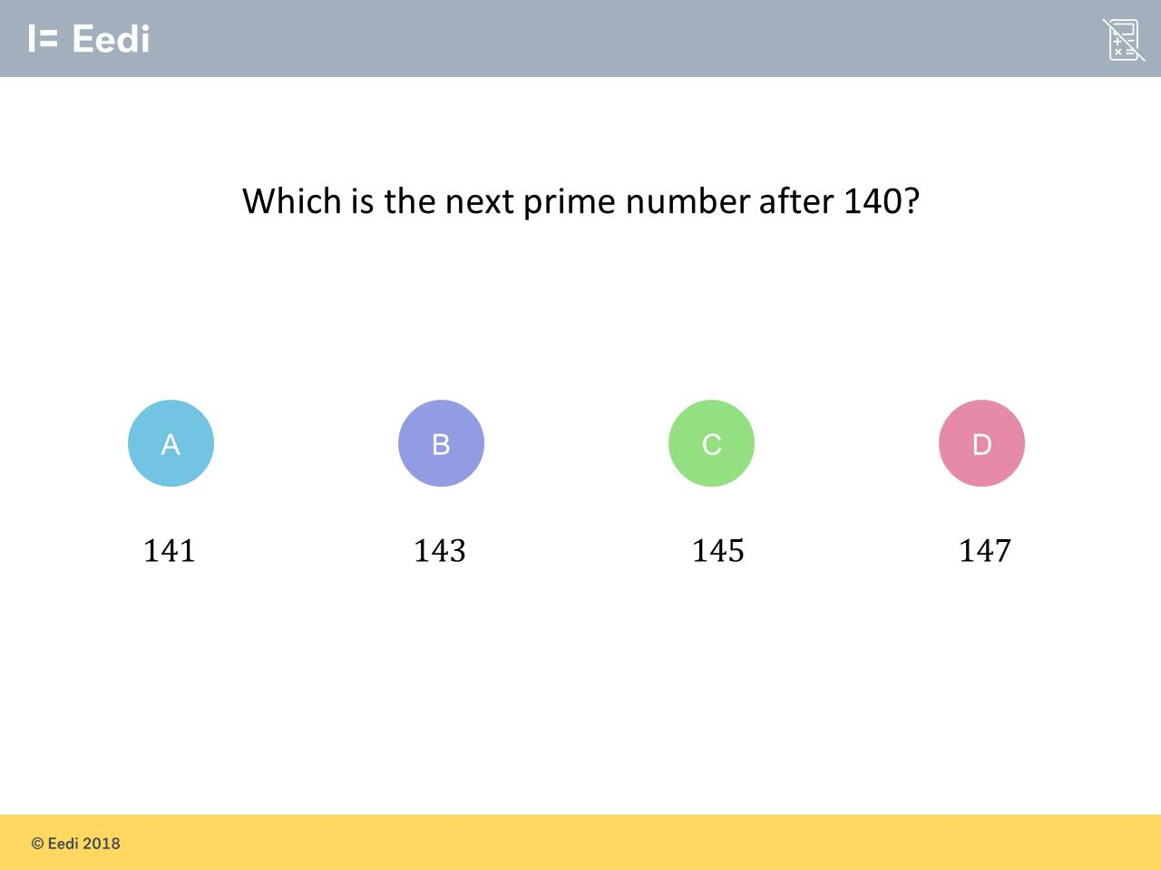
Worst answered question?
Most common wrong answer?

Slide 2
ANSWERS

Slide 3
Worst answered question?

Slide 4
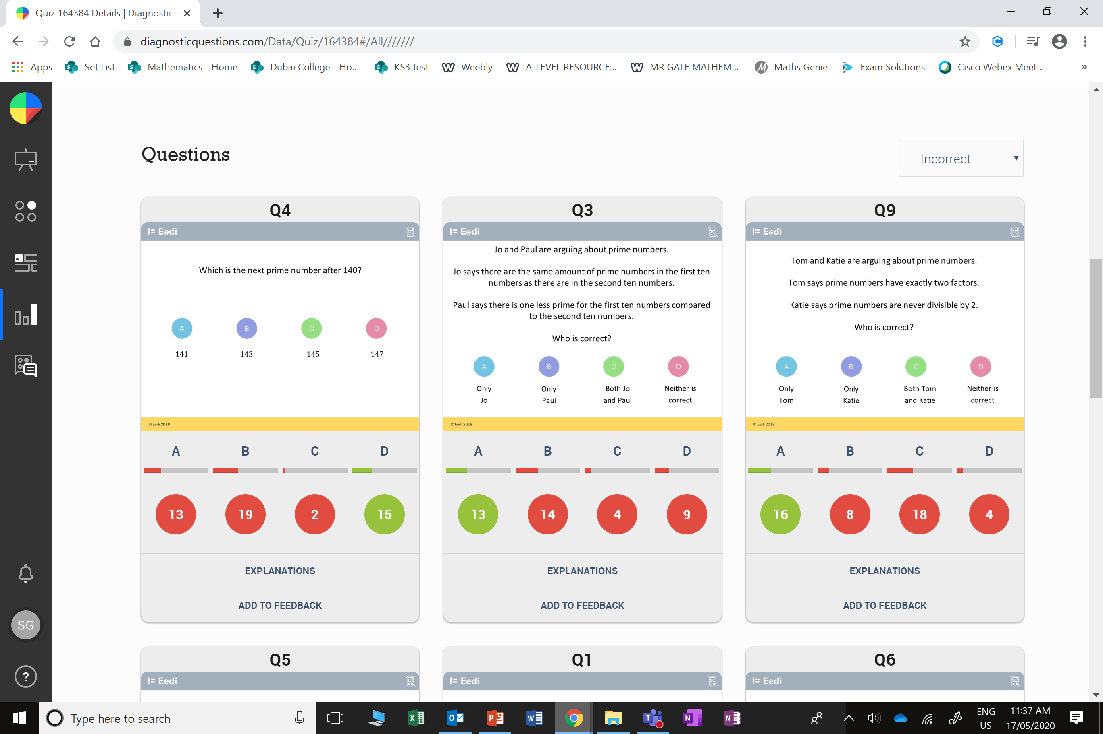
A
They did not realise it is dividable 3.

Slide 5
B
Paul probably did not include 2 as a prime number.

