Slide 1
LO: Circles and
Tangents

Slide 2
How many points of intersection are there?
2

Slide 3
How many points of intersection are there?
0

Slide 4
How many points of intersection are there?
1

Slide 5
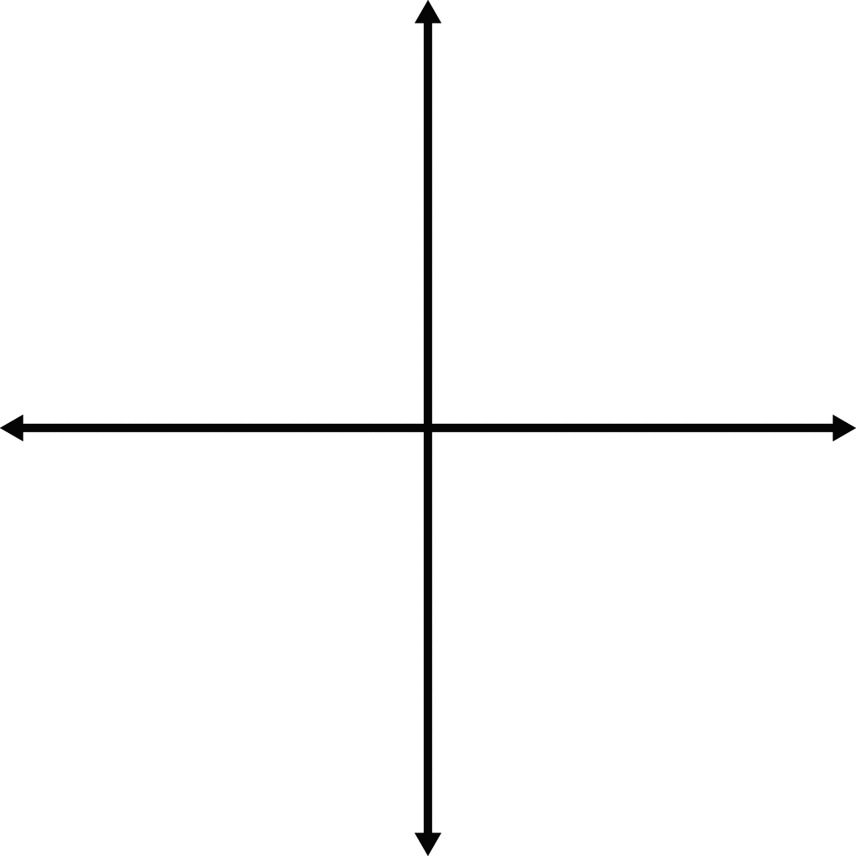
What is a tangent?
A line that only touches a
circle once.

Slide 6
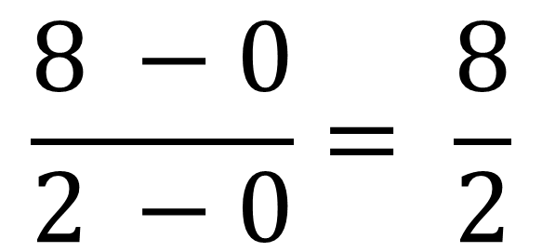
What is the gradient of the line?
(2,8)
$$\frac{8 −0}{2 −0}= \frac{8}{2}$$
Gradient = 4
(0,0)

Slide 7
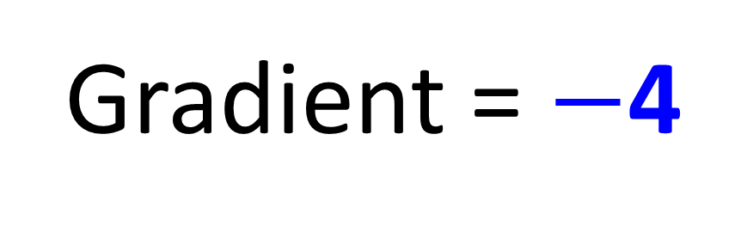
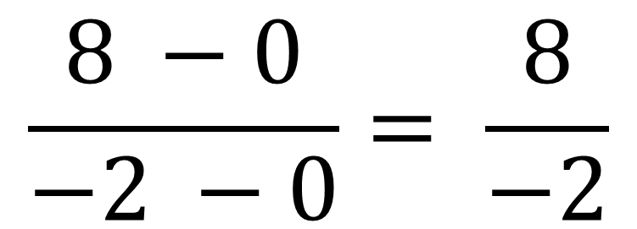
What is the gradient of the line?
(-2,8)
$$\frac{8 −0}{−2 −0}= \frac{8}{−2}$$
Gradient = $−$4
(0,0)

Slide 8
What is the equation of the line given the gradient is 4?
y = 4x + c
(2,3)
3 = 8 + c
y = 4x – 5

Slide 9
What is the equation of the line given the gradient is 2?
y = 2x + c
(4,5)
5 = 8 + c
y = 4x – 3

Slide 10
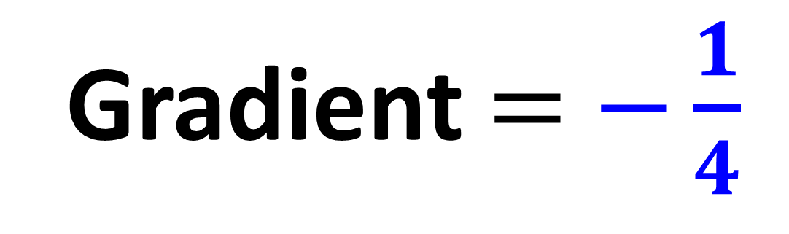
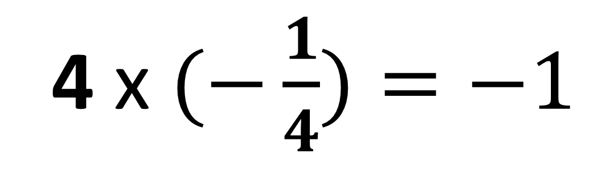
The lines are perpendicular.
The green line has a gradient of 4.
What is the gradient of the blue line?
4 x $(−\frac{1}{4})=−1$
Gradient $=$ $−\frac{1}{4}$

Slide 11
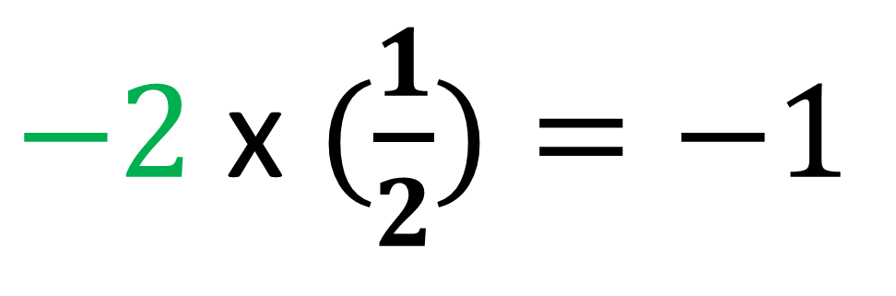
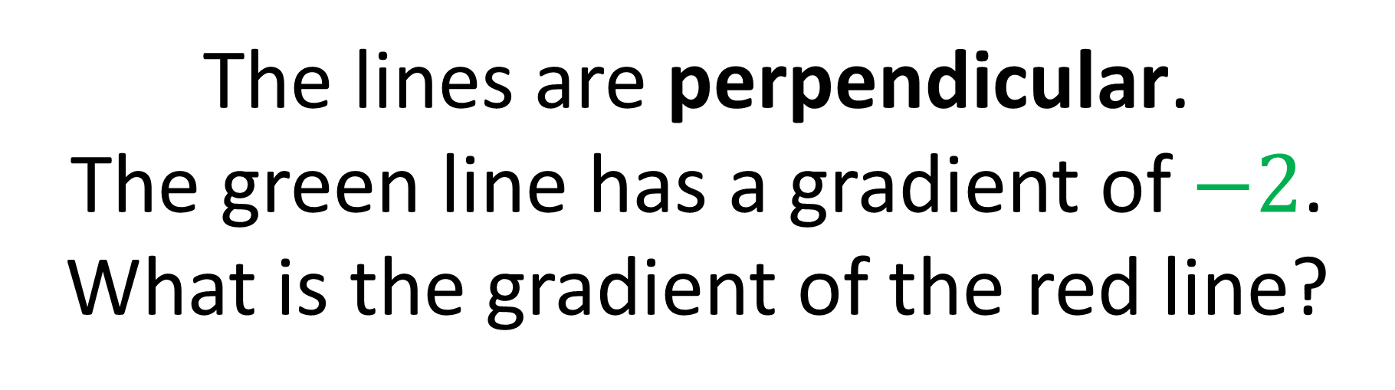
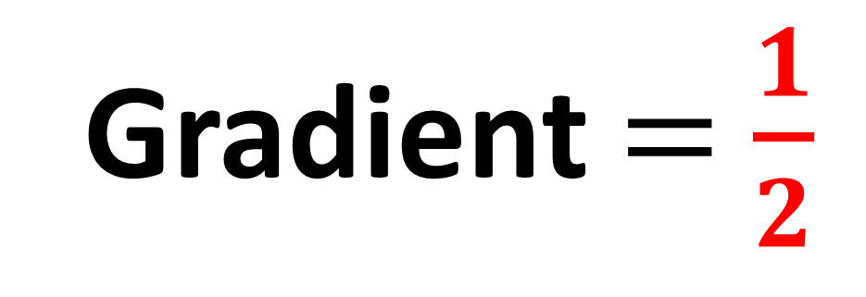
The lines are perpendicular.
The green line has a gradient of $−2$.
What is the gradient of the red line?
$−2$ x $(\frac{1}{2})=−1$
Gradient $=$ $\frac{1}{2}$

Slide 12
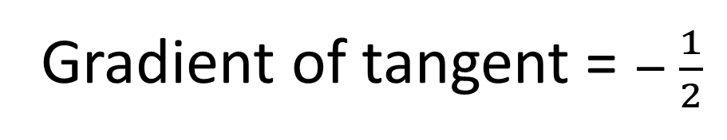
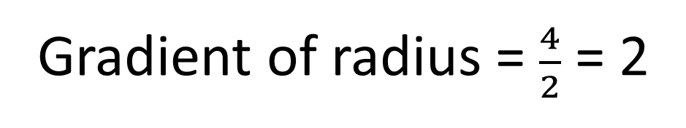
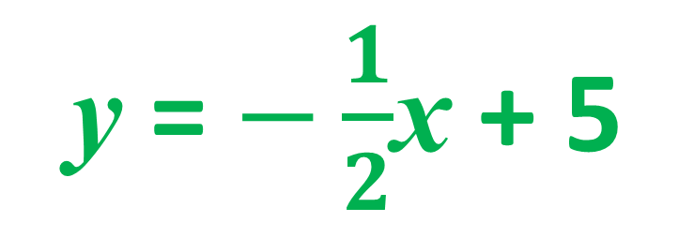
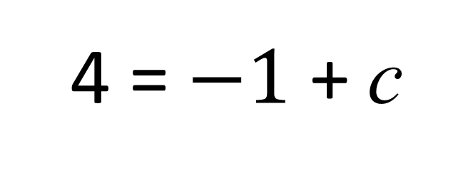
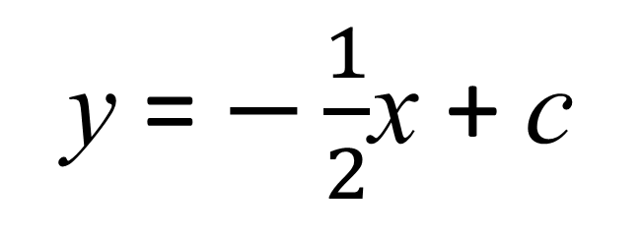
What is the equation of the tangent?
Gradient of radius = $\frac{4}{2}$ = 2
(2,4)
Gradient of tangent = $− \frac{1}{2}$
y = $−\frac{1}{2}$x + c
4 = $−1$ + c
y = $−\frac{1}{2}$x + 5

Slide 13
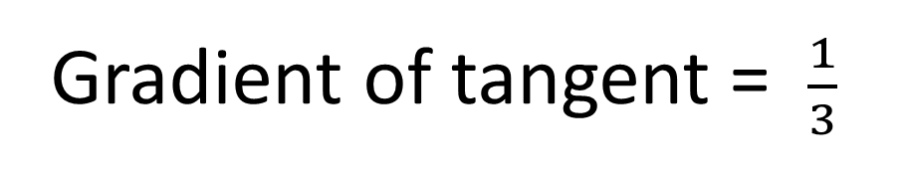
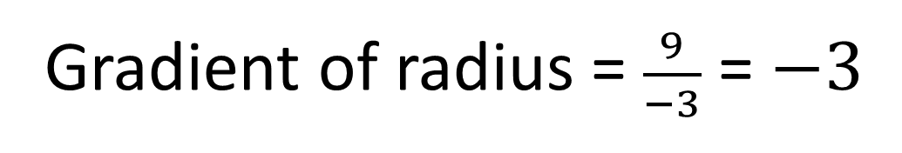
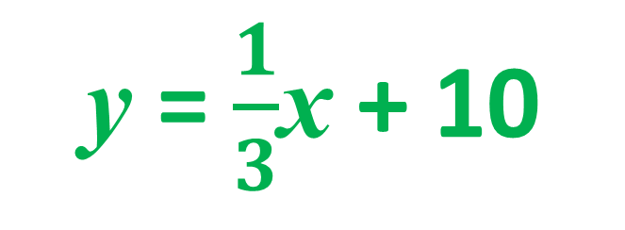
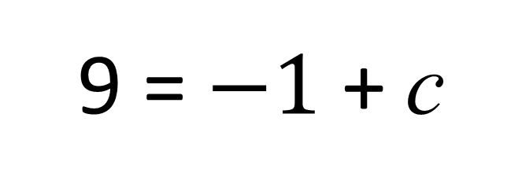
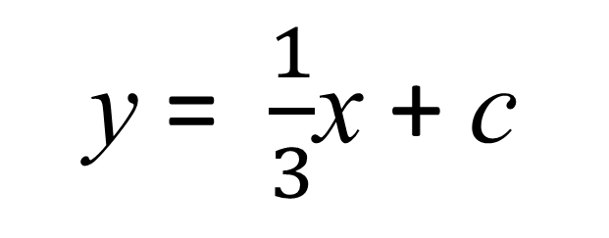
What is the equation of the tangent?
Gradient of radius = $\frac{9}{−3}$ = $−3$
(-3,9)
Gradient of tangent = $\frac{1}{3}$
y = $\frac{1}{3}$x + c
9 = $−1$ + c
y = $\frac{1}{3}$x + 10

