Slide 1
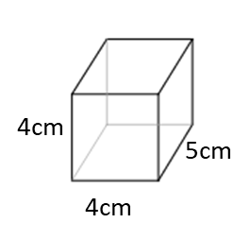
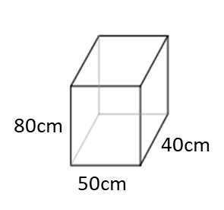
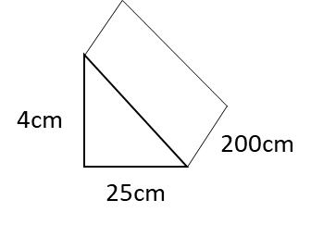
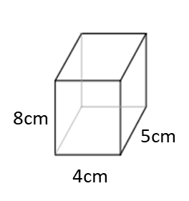
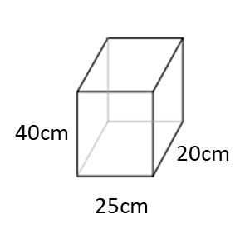
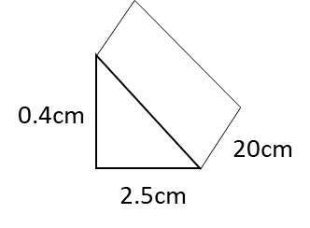
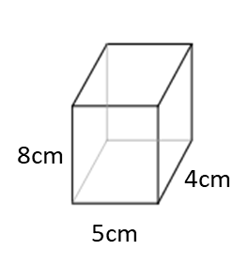
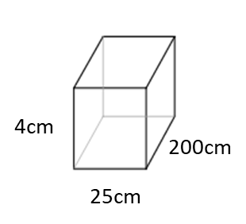
Calculate the capacity of each fish tank. Give you answer in litres.
1)
4)
7)
2)
5)
8)
3)
6)

Slide 2
Calculate and missing volume and capacities.
ml | cm³ | l
45
200
 |  | 2
 |  | 30
 | 2500
 | 600

Slide 3
ANSWERS

Slide 4
Calculate the capacity of each fish tank. Give you answer in litres.
1)
Volume = 80cm³
4)
Volume = 160 000cm³
7)
Capacity = 0.08 l
Capacity = 160 l
2)
5)
Volume = 20 000cm³
Volume = 10 000cm³
Volume = 160 cm³
Capacity = 20 l
Capacity = 10 l
Capacity = 0.16 l
8)
3)
6)
Volume = 160cm³
Volume = 20 000cm³
Capacity = 0.16 l
Capacity = 20 l
Volume = 10cm³
Capacity = 0.01 l

Slide 5
Calculate and missing volume and capacities.
ml | cm³ | l
45
200
 |  | 2
 |  | 30
 | 2500
 | 600
45
0.045
200
0.2
2000
2000
30000
30000
2500
2.5
600
0.6

