Slide 1
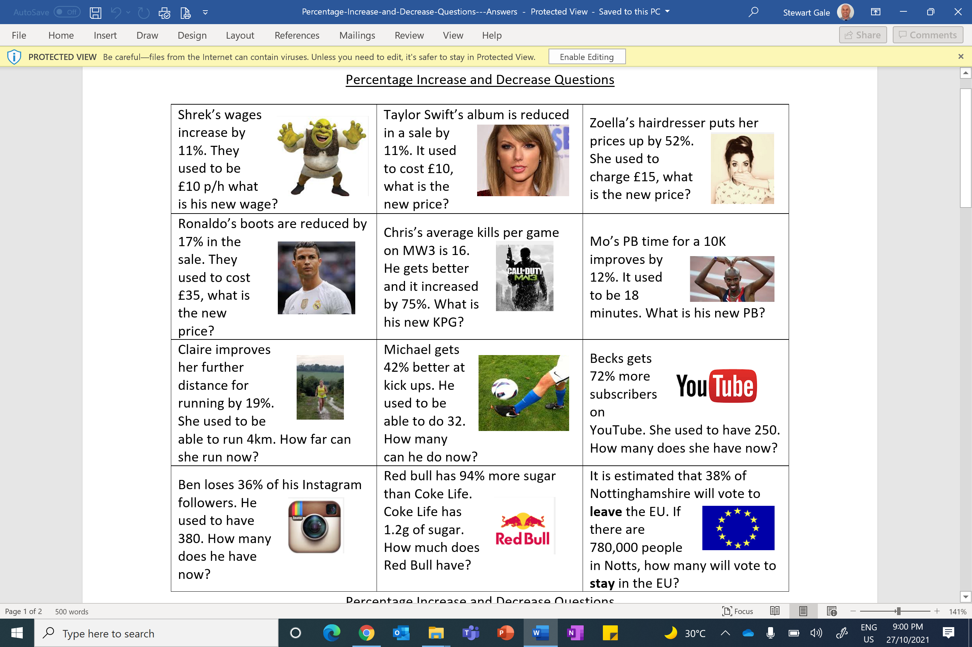

Slide 2
Thailand
Pricing: Adult Price: £455 per week
Child Price: 32% off adult price.
Special Offer: 35% off the second week.
Tax: You must add on 5% on to your final price (after discounts and offers)
New York
Pricing: Adult Price: £520 per week Child Price: 55% off adult price.
Special Offer: 30% off the second week
Tax: You must add on 5% on to your final price (after discounts and offers)
Hawaii
Pricing: Adult Price: £687 per week Child Price: 15% off adult price.
Special Offer: 90% off the 2nd Week
Tax: You must add on 5% on to your final price (after discounts and offers)

Slide 3
ANSWERS

Slide 4
1.11 x 10 = £11.10
0.83 x 35 = £29.05
1.19 x 4 = 4.76km
380 x 0.64 = 243.2 (243)

Slide 5
0.89 x 10 = £8.90
1.75 x 16 = 28
1.42 x 32 = 45.44 (45)
1.94 x 1.2 = 2.328g

Slide 6
1.52 x 15 = £22.80
0.88 x 18 = 15.84
1.72 x 250 = 430
0.62 x 780,000 = 483,600

Slide 7
Thailand
Pricing: Adult Price: £455 per week
Child Price: 32% off adult price.
Special Offer: 35% off the second week.
Tax: You must add on 5% on to your final price (after discounts and offers)
Week 1: 455 + 455 + 2(0.68 x 455) = 1528.80
Week 2: 1528.80 x 0.65 = 993.72
Total: 1528.80 + 993.72 = 2522.52
Total with tax: 2522.52 x 1.05 = £2648.65

Slide 8
New York
Pricing: Adult Price: £520 per week Child Price: 55% off adult price.
Special Offer: 30% off the second week
Tax: You must add on 5% on to your final price (after discounts and offers)
Week 1: 520 + 520 + 2(520 x 0.45) = 1508
Week 2: 1508 x 0.7 = 1055.60
Total: 1508 + 1055.60 = 2563.6
Total with tax: 2563.6 x 1.05 = £2691.78

Slide 9
Hawaii
Pricing: Adult Price: £687 per week Child Price: 15% off adult price.
Special Offer: 90% off the 2nd Week
Tax: You must add on 5% on to your final price (after discounts and offers)
Week 1: 687 + 687 + 2(687 x 0.85) = 2541.90
Week 2: 2541.9 x 0.1 = 254.19
Total: 2541.9 + 254.19 = 2796.09
Total with tax: 2796.09 x 1.05 = £2935.89

