Slide 1
Differentiation
Implicit
Chapter 9
(Part 8 or 10)

Slide 2
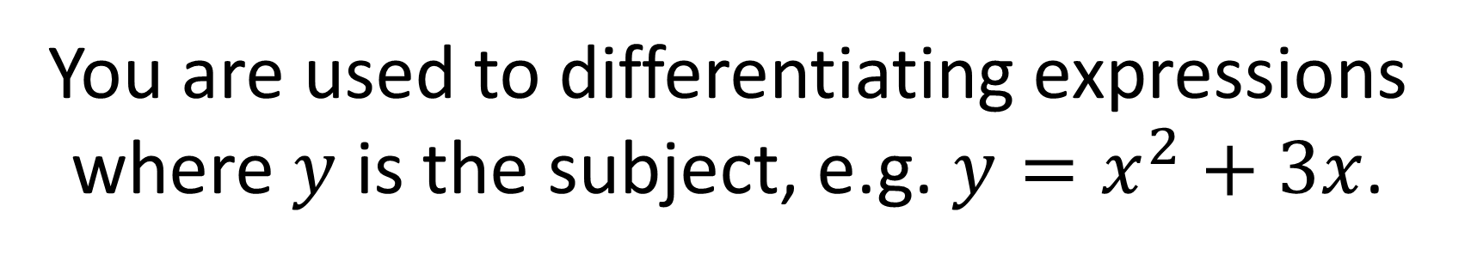
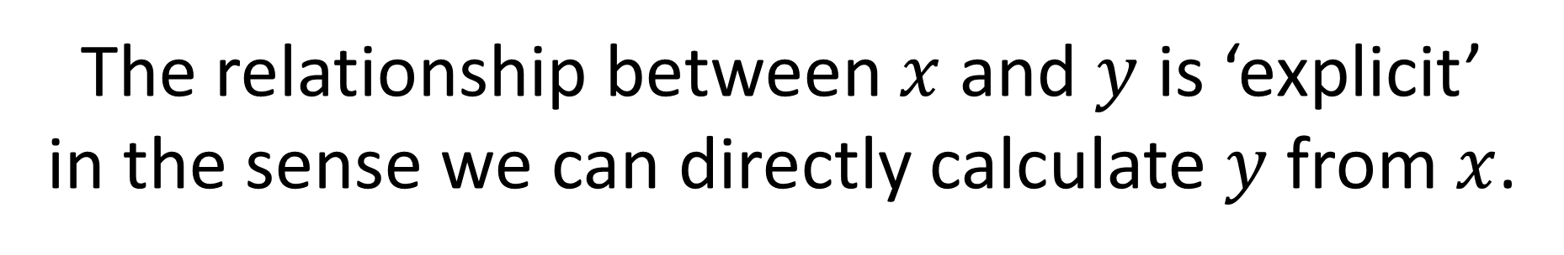
You are used to differentiating expressions
where $y$ is the subject, e.g. $y=x^{2}+3x$.
The relationship between $x$ and $y$ is ‘explicit’
in the sense we can directly calculate $y$from $x$.
But what about implicit relations, e.g:
$$x^{2}+y^{2}=8x or \cos\left(x+y\right)=\sin{y}$$

Slide 3
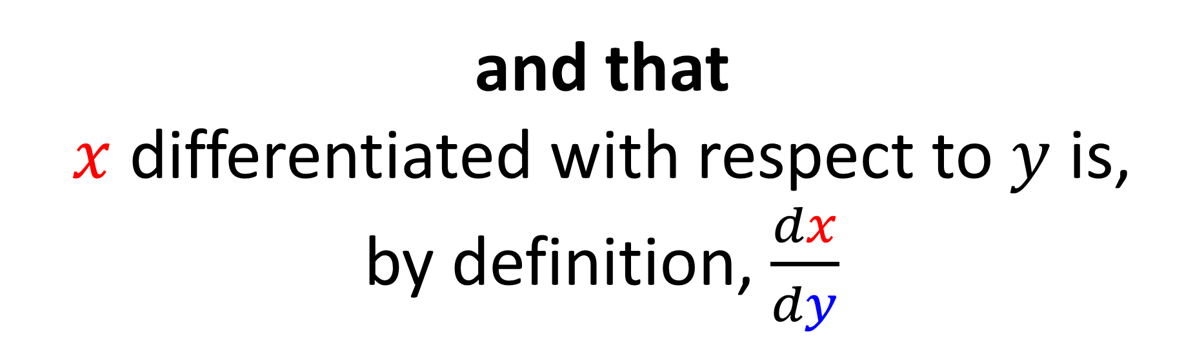
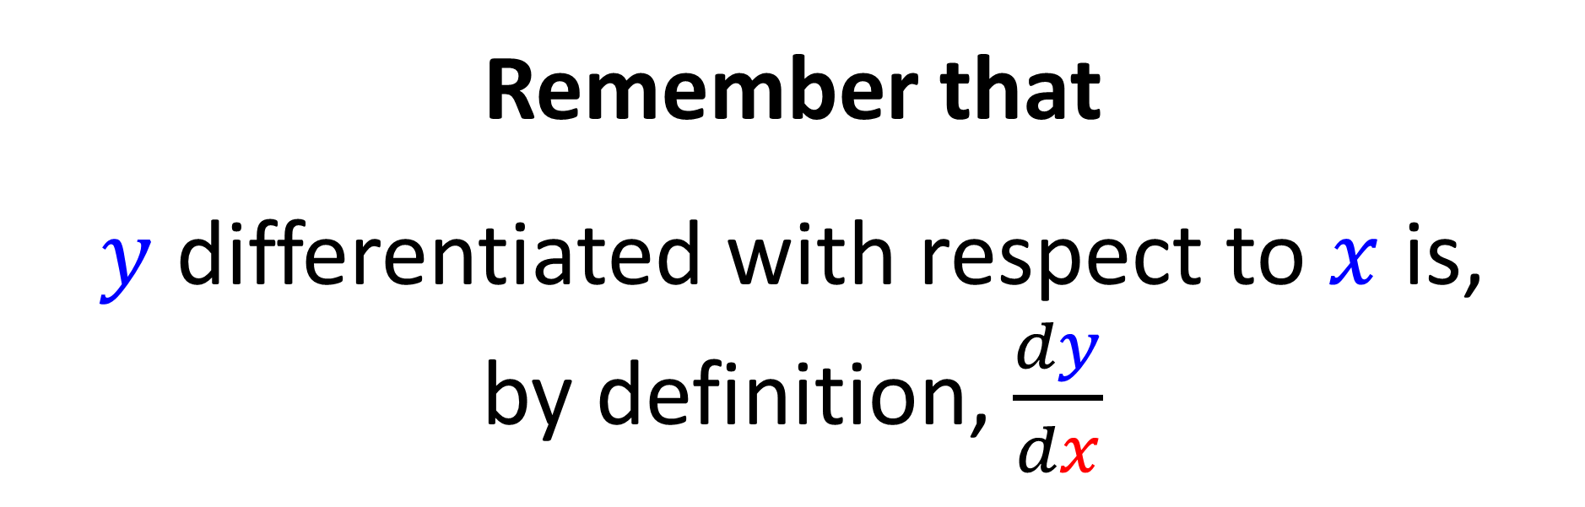
Remember that
$y$ differentiated with respect to $x$ is,
by definition, $\frac{dy}{dx}$
and that
$x$ differentiated with respect to $y$ is,
by definition, $\frac{dx}{dy}$

Slide 4

Click below to learn about implicit differentiation.

Slide 5
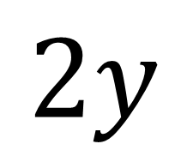
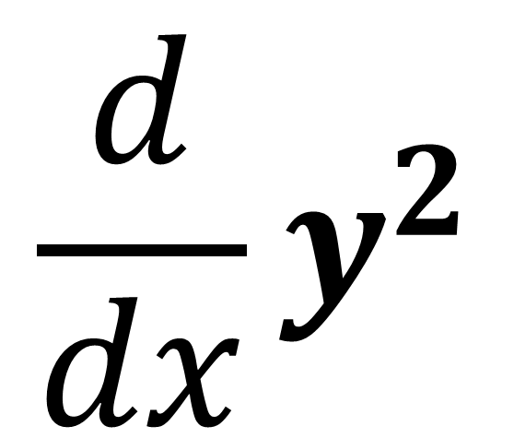
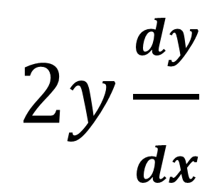
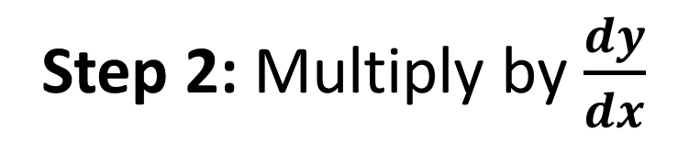
$$\frac{d}{dx}y^{2}$$
$$2y$$
Step 1: Differentiate with respect to y
$$2y\frac{dy}{dx}$$
Step 2: Multiply by $\frac{dy}{dx}$

Slide 6
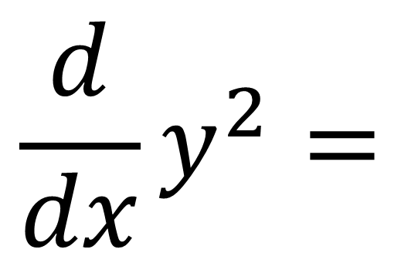
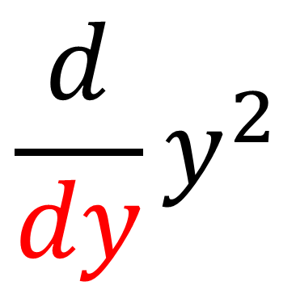
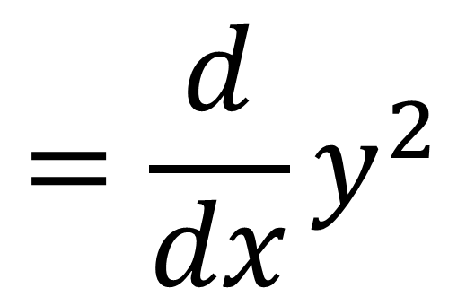
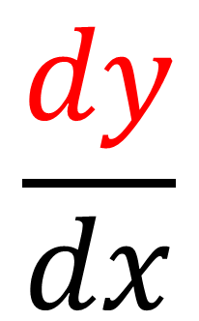
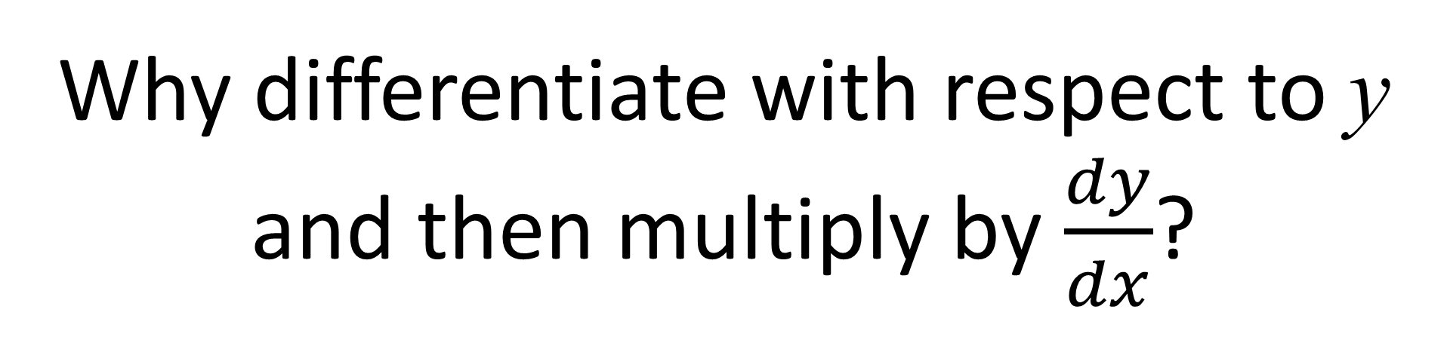
Why differentiate with respect to y
and then multiply by $\frac{dy}{dx}$?
$$\frac{d}{dx}y^{2}=$$
$$\frac{d}{dy}y^{2}$$
$$\frac{dy}{dx}$$
$$=\frac{d}{dx}y^{2}$$

Slide 7
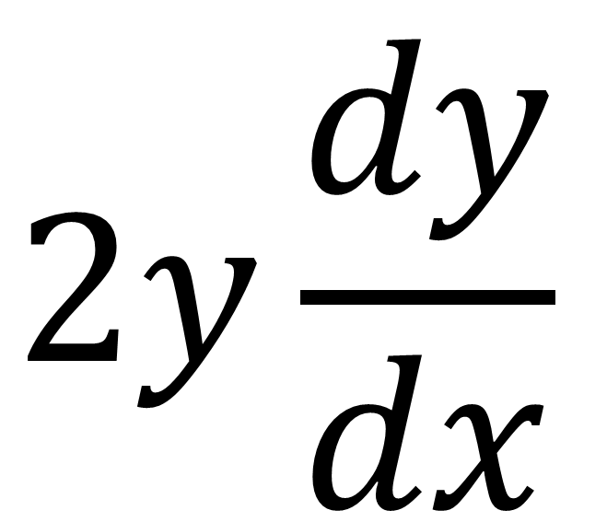
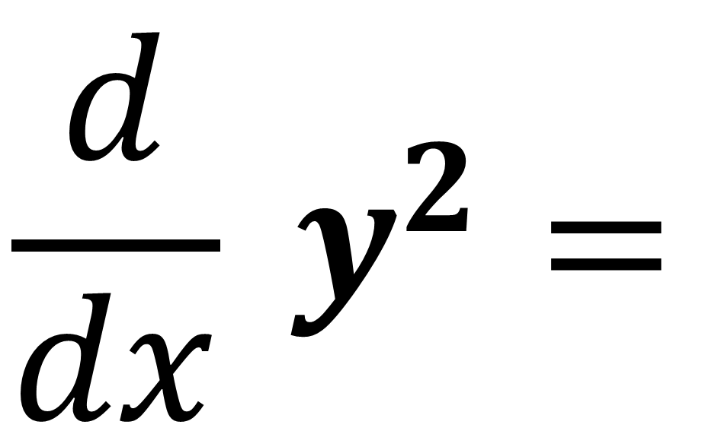
$$\frac{d}{dx} y^{2}=$$
$$2y\frac{dy}{dx}$$

Slide 8
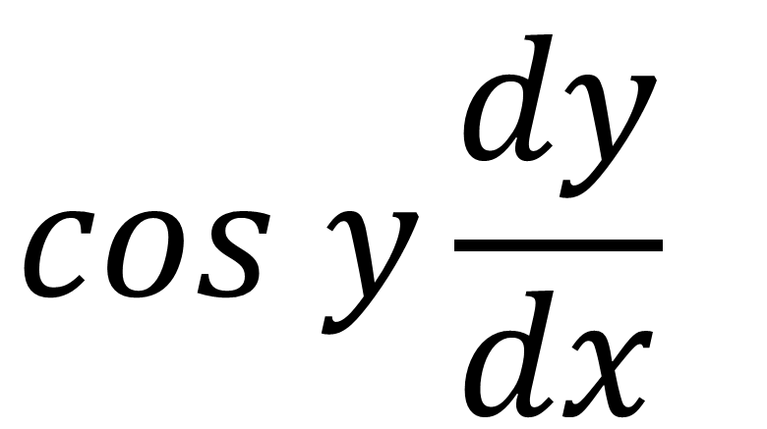
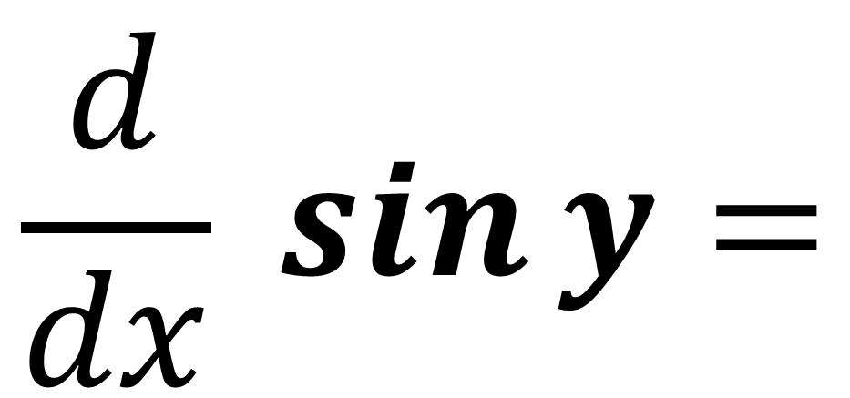
$$\frac{d}{dx} \sin{y}=$$
$$cos y\frac{dy}{dx}$$

Slide 9
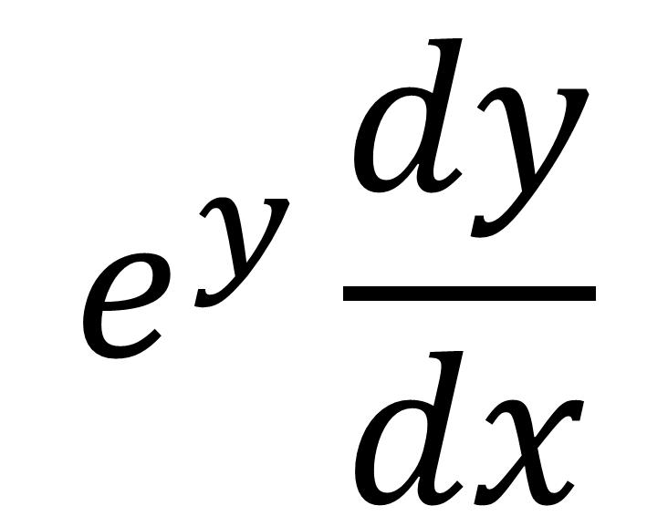
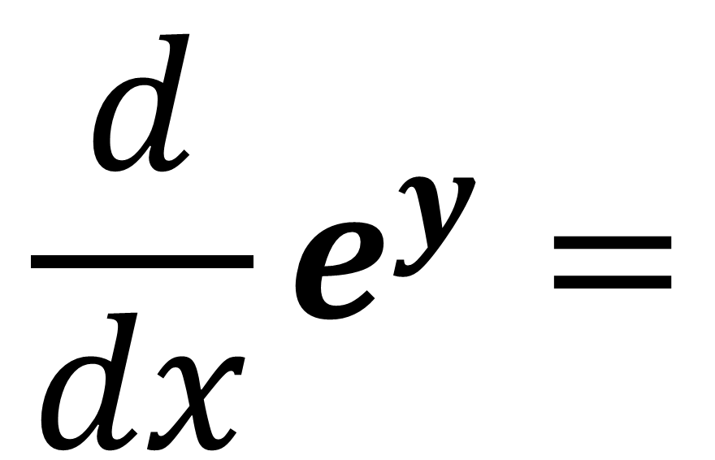
$$\frac{d}{dx}e^{y}=$$
$$e^{y}\frac{dy}{dx}$$

Slide 10
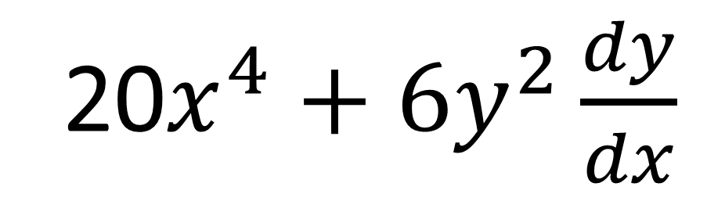
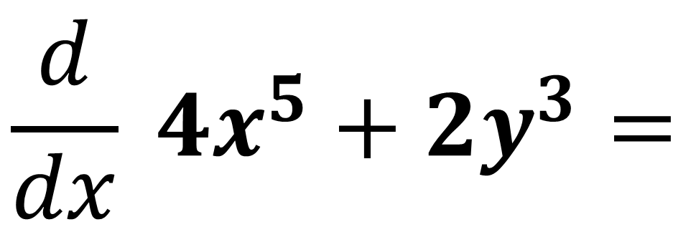
$$\frac{d}{dx} 4x^{5}+2y^{3}=$$
20$x^{4}+{6y}^{2}\frac{dy}{dx}$

Slide 11
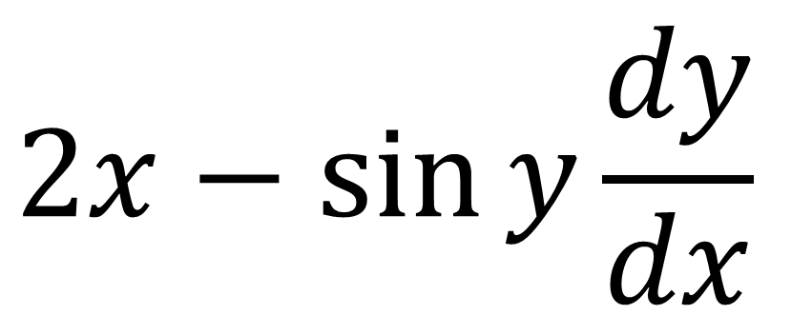
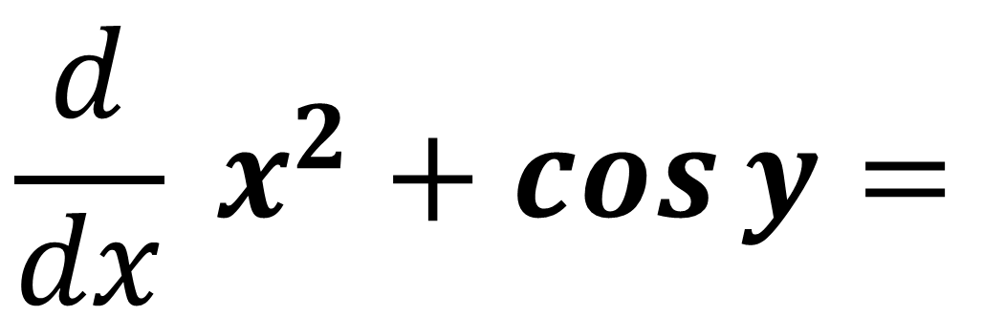
$$\frac{d}{dx} x^{2}+\cos{y}=$$
$$2x−\sin{y}\frac{dy}{dx}$$

Slide 12
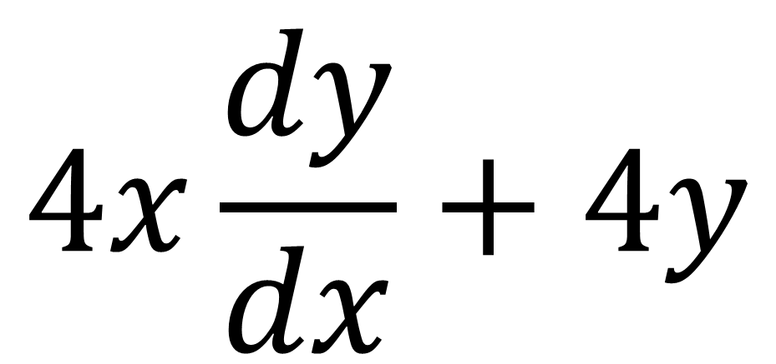
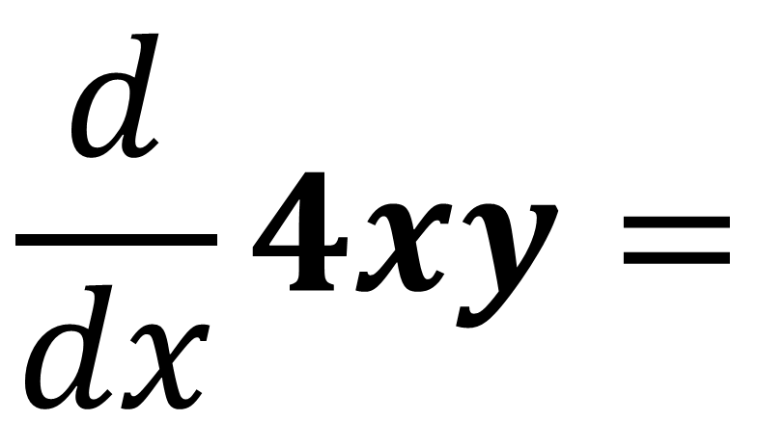



$$\frac{d}{dx}4xy=$$
$$4x\frac{dy}{dx}+4y$$
Product Rule
$$4x$$ | $$y$$
$$5u4$$ | $$12x3+1$$
$$\frac{dy}{dx}$$
$$4$$

Slide 13
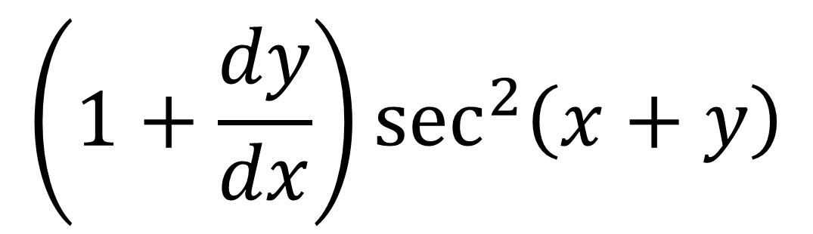
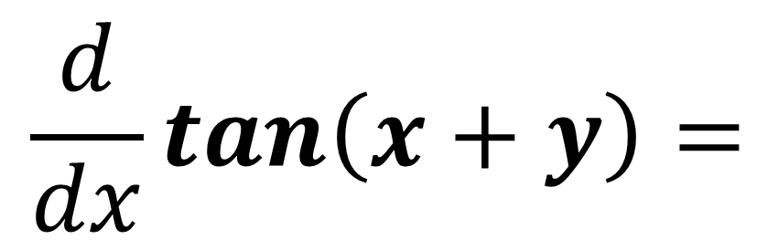


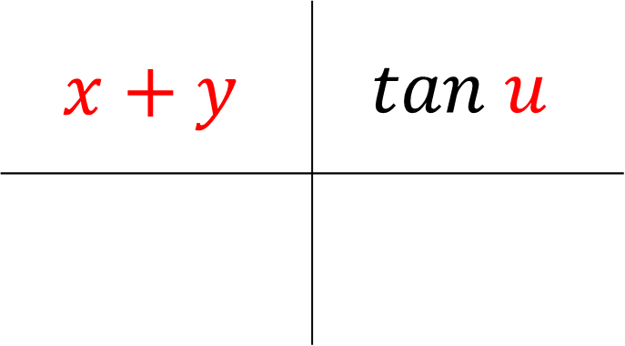
$$\frac{d}{dx}\tan\left(x+y\right)=$$
$$\left(1+\frac{dy}{dx}\right)\sec^{2}\left(x+y\right)$$
Chain Rule
$$x+y$$ | $$tan u$$
$$5u4$$ | $$12x3+1$$
$$1+\frac{dy}{dx}$$
$$\sec^{2}{u}$$

Slide 14
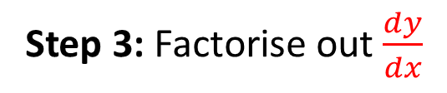
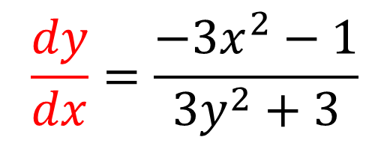
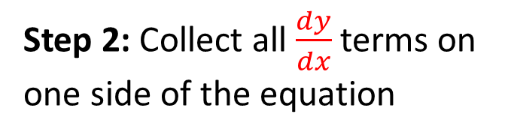
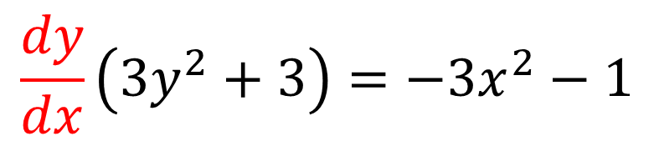
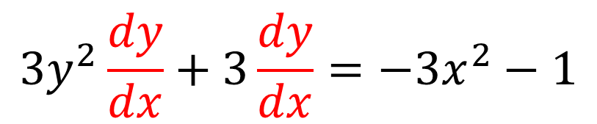
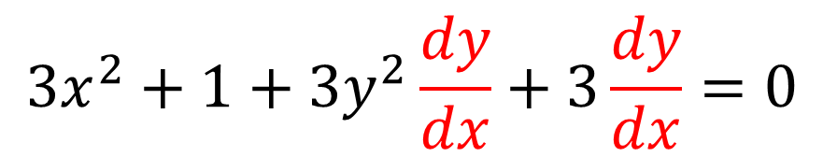
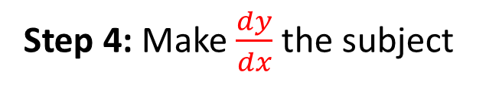
Find $\frac{dy}{dx}$ in terms of $x$ and $y$ where $x^{3}+x+y^{3}+3y=6$
$$3x^{2}+1+3y^{2}\frac{dy}{dx}+3\frac{dy}{dx}=0$$
Step 1: Differentiate all terms
Step 2: Collect all $\frac{dy}{dx}$ terms on
one side of the equation
$$3y^{2}\frac{dy}{dx}+3\frac{dy}{dx}=−3x^{2}−1$$
$$\frac{dy}{dx}\left(3y^{2}+3\right)=−3x^{2}−1$$
Step 3: Factorise out $\frac{dy}{dx}$
$$\frac{dy}{dx}=\frac{−3x^{2}−1}{3y^{2}+3}$$
Step 4: Make $\frac{dy}{dx}$ the subject

Slide 15
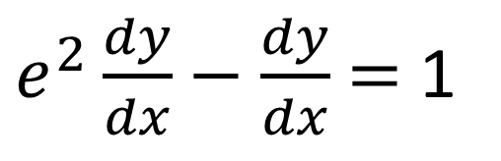
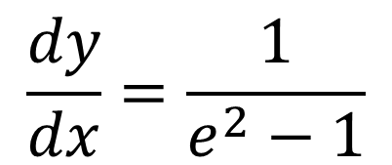
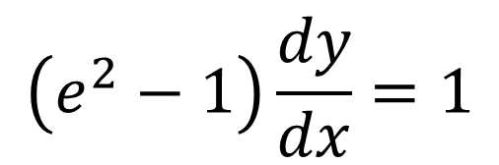
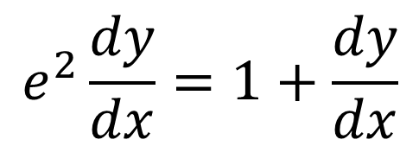
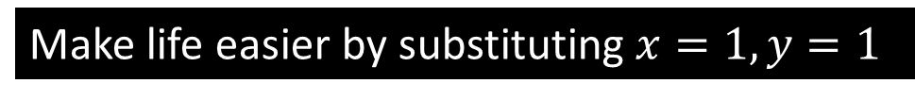
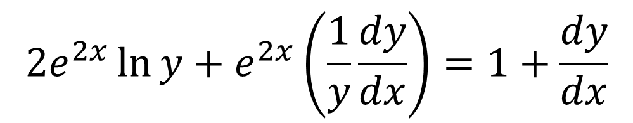
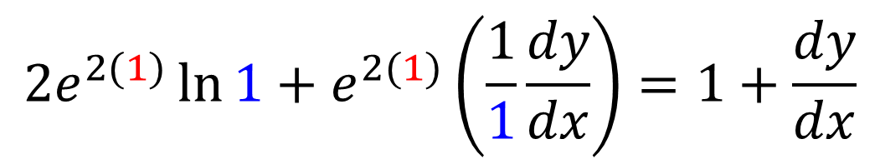
Find the value of $\frac{dy}{dx}$ at the point $(1,1)$, where $e^{2x}\ln{y}=x+y−2$
$$2e^{2x}\ln{y}+e^{2x}\left(\frac{1}{y}\frac{dy}{dx}\right)=1+\frac{dy}{dx}$$
$e^{2}\frac{dy}{dx}−\frac{dy}{dx}$ $=$ 1
Make life easier by substituting $x=1, y=1$
$$\left(e^{2}−1\right)\frac{dy}{dx}=1$$
$$2e^{2(1)}\ln{1}+e^{2(1)}\left(\frac{1}{1}\frac{dy}{dx}\right)=1+\frac{dy}{dx}$$
$$\frac{dy}{dx}=\frac{1}{e^{2}−1}$$
$$e^{2}\frac{dy}{dx}=1+\frac{dy}{dx}$$

Slide 16
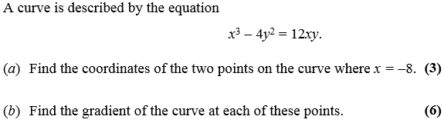
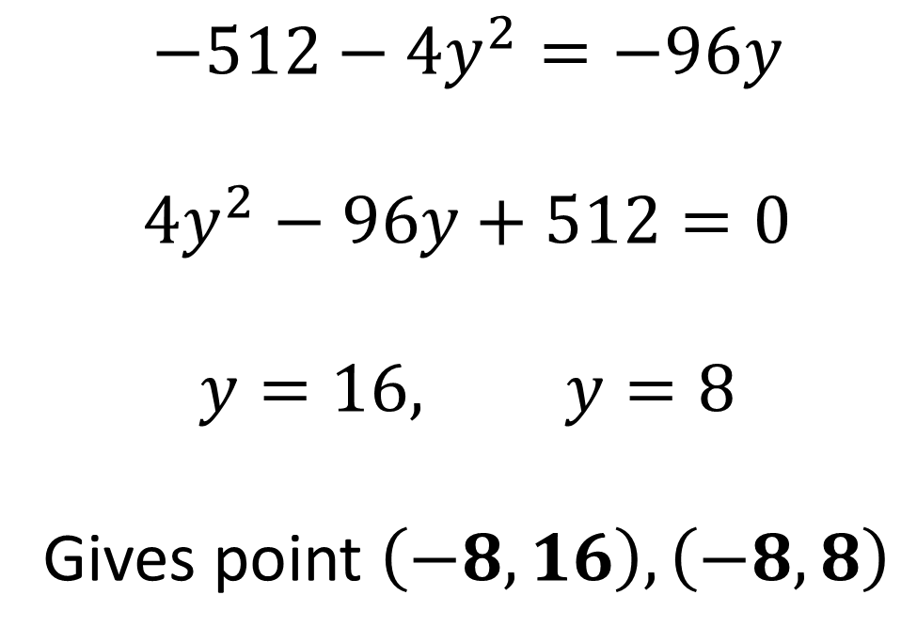
a)
$$−512−4y^{2}=−96y$$
$${4y}^{2}−96y+512=0$$
$$y=16, y=8$$
Gives point $\left(−8,16\right), \left(−8,8\right)$

Slide 17
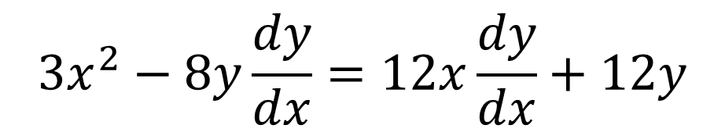
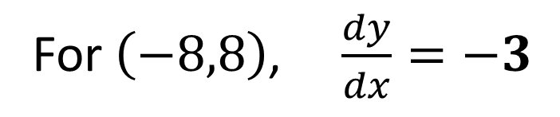


b)
$$3x^{2}−8y\frac{dy}{dx}=12x\frac{dy}{dx}+12y$$
$$\frac{dy}{dx}= \frac{3x^{2}−12y}{12x+8y}$$
For $\left(−8,16\right)$, $\frac{dy}{dx}=0$
For $\left(−8,8\right)$, $\frac{dy}{dx}=−3$

Slide 18




a)
$$x^{2}+y^{2}+10x+2y −4xy=10$$
$$\frac{dy}{dx}=\frac{2x+10−4y}{4x −2y −2}$$
$$2x+2y\frac{dy}{dx}+10+2\frac{dy}{dx}−(4y+4x\frac{dy}{dx})=0$$
$$\frac{dy}{dx}=\frac{x+5−2y}{2x −y −1}$$

Slide 19







b)
$$x^{2}+y^{2}+10x+2y −4xy=10$$
$${(2y−5)}^{2 }+ y^{2} + 10(2y−5)+2y −4(2y−5)y=10$$
$$0=\frac{x+5−2y}{2x −y −1}$$
$${4y}^{2}−20y+25+y^{2}+20y−50+2y −8y^{2}+20y=10$$
$$0=x+5−2y$$
$$3y^{2}−22y+35=0$$
$$y=\frac{7}{3}$$
$$x=2y−5$$
$$y=5$$

