Slide 1
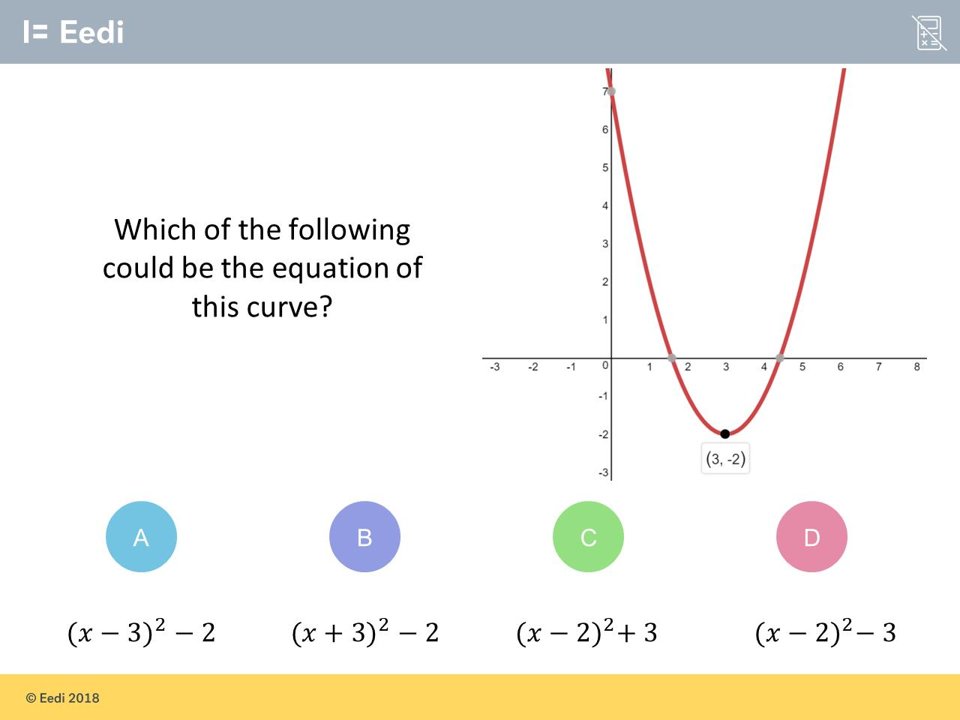
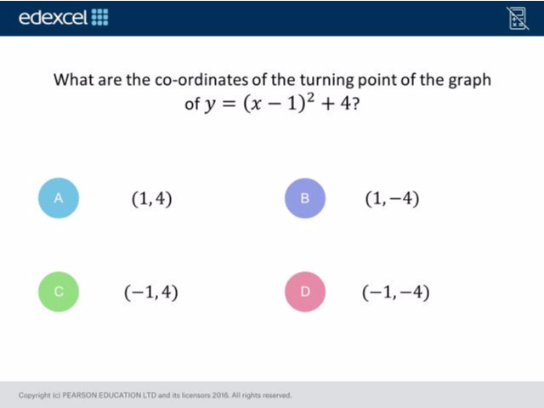
Worst answered question?
Most common wrong answer?

Slide 2
ANSWERS

Slide 3
Worst answered question?

Slide 4
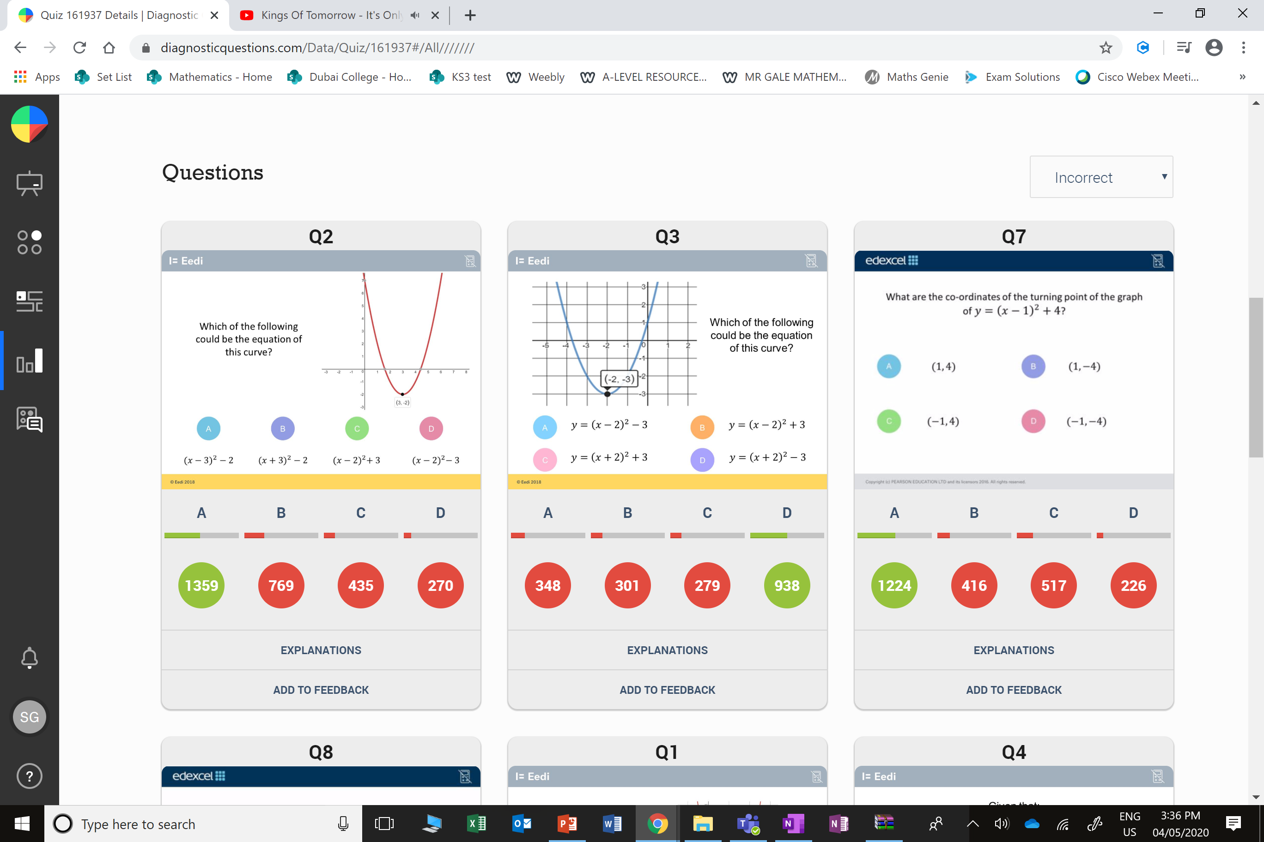
B
The student has got the sign on the x value wrong.

Slide 5
C
The student has got the wrong signs for their values.

