Slide 1
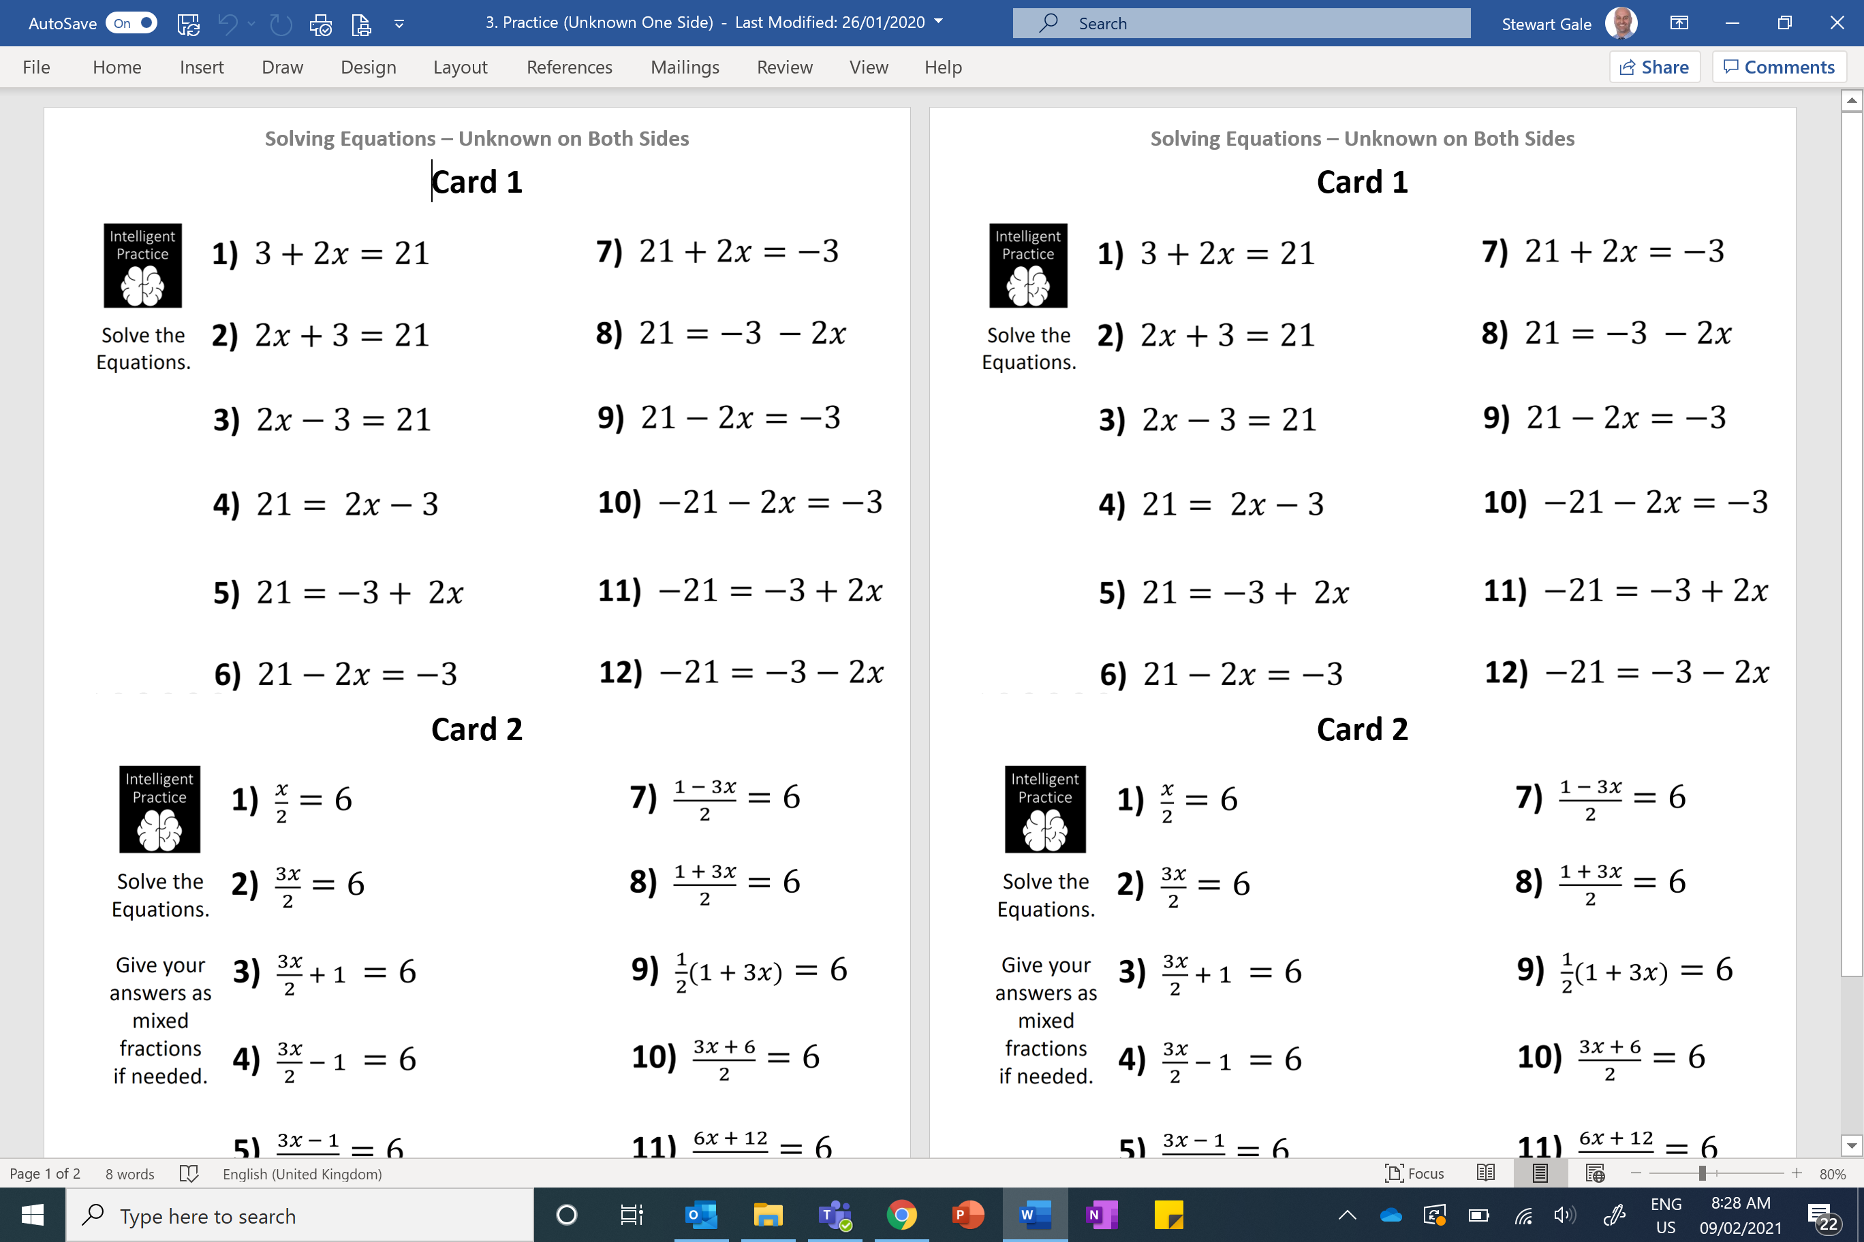
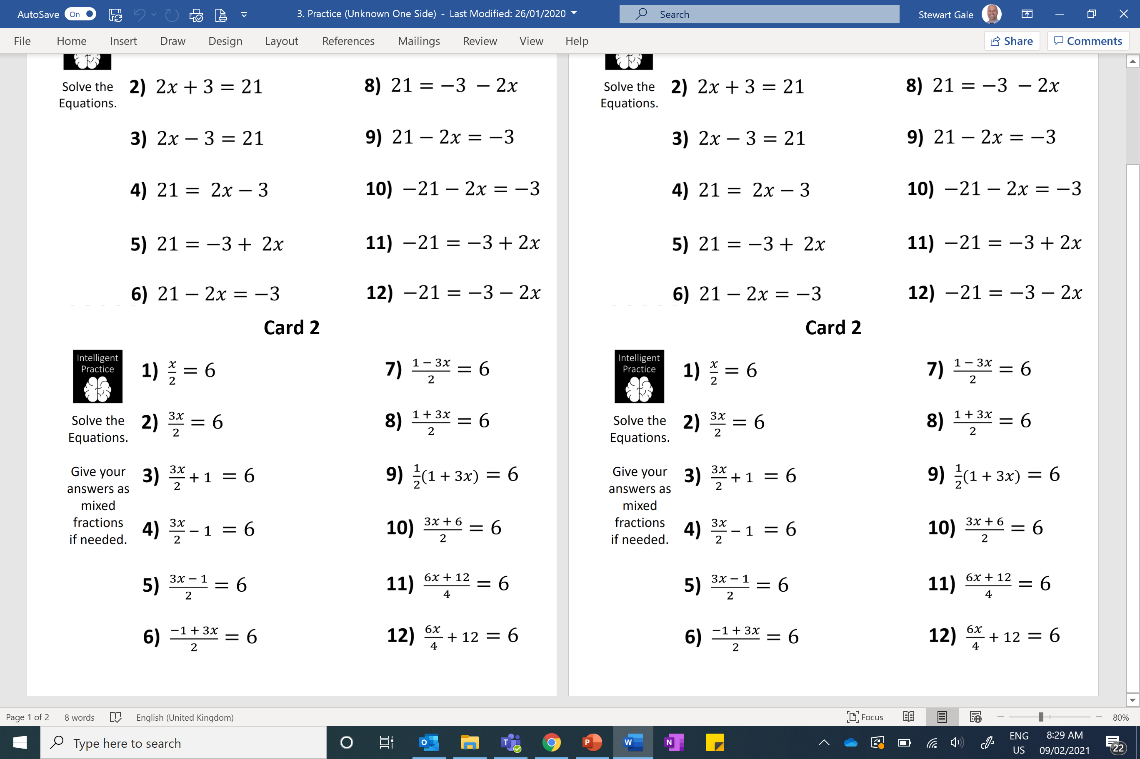
Solve the Equations. Give your answers as mixed fractions if needed.
Foundation
Higher

Slide 2
ANSWERS

Slide 3
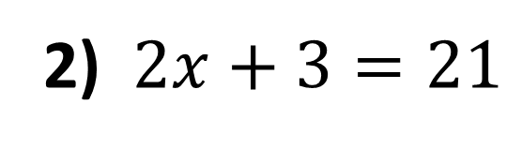
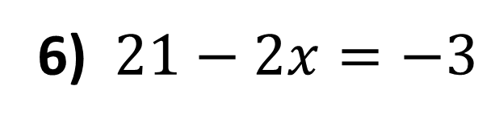
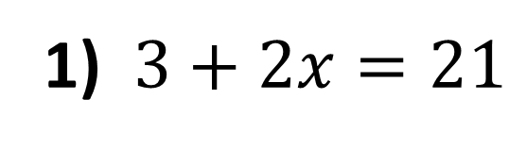
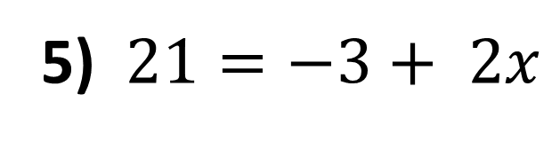
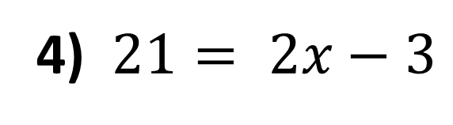
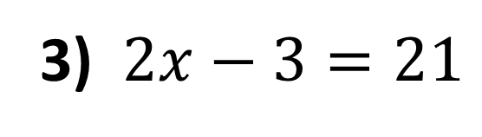
1) $3+2x=21$
x = 9
2) $2x+3=21$
x = 9
3) $2x−3=21$
x = 12
4) $21= 2x−3$
x = 12
5) $21=−3+ 2x$
x = 12
6) $21−2x=−3$
x = 12

Slide 4
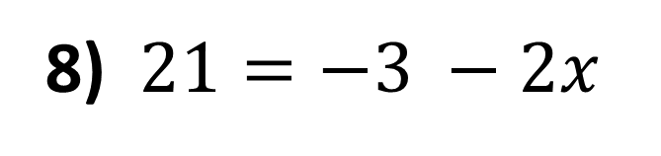
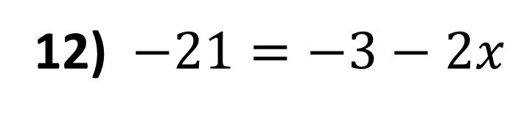
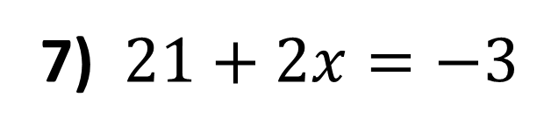
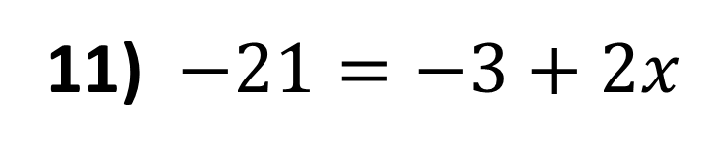
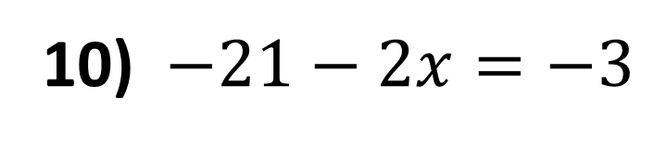
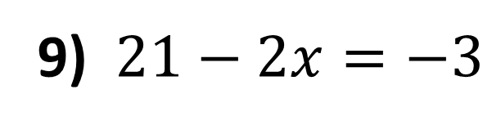
7) $21+2x=−3$
x = -12
8) $21=−3 −2x$
x = -12
9) $21−2x=−3$
x = 12
10) $−21−2x=−3$
x = -9
11) $−21=−3+2x$
x = -9
12) $−21=−3−2x$
x = 9

Slide 5
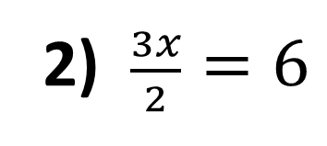
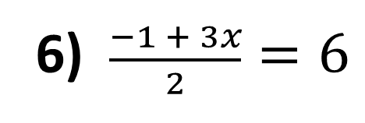
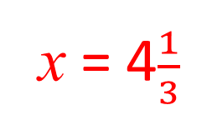
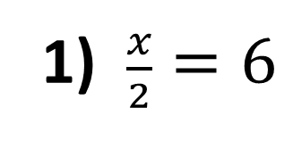

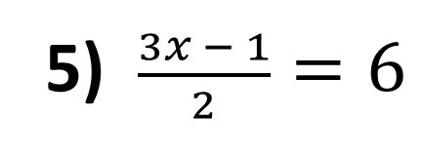
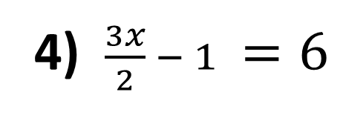

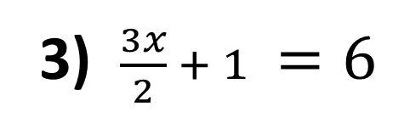
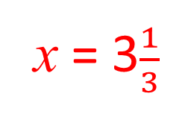
1) $\frac{x}{2}=6$
x = 12
2) $\frac{3x}{2}=6$
x = 4
3) $\frac{3x}{2} + 1 =6$
x = 3$\frac{1}{3}$
4) $\frac{3x}{2} − 1 =6$
x = 4$\frac{2}{3}$
5) $\frac{3x − 1}{2}=6$
x = 4$\frac{1}{3}$
6) $\frac{−1 + 3x}{2}=6$
x = 4$\frac{1}{3}$

Slide 6
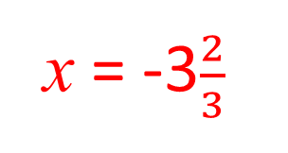
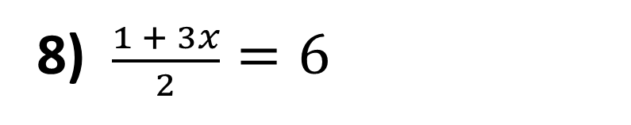
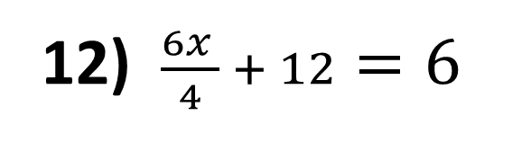
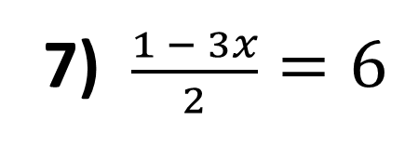
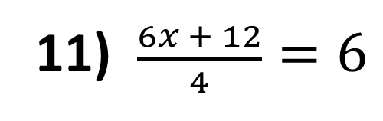
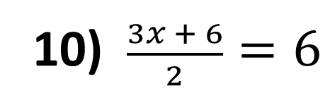
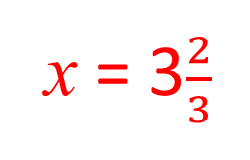
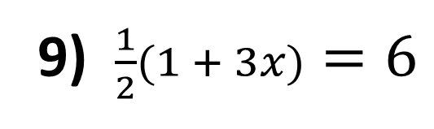
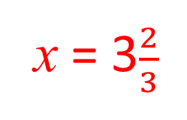
7) $\frac{1 − 3x}{2}=6$
x = -3$\frac{2}{3}$
8) $\frac{1 + 3x}{2}=6$
x = 3$\frac{2}{3}$
9) $\frac{1}{2}(1 + 3x)=6$
x = 3$\frac{2}{3}$
10) $\frac{3x + 6}{2}=6$
x = 2
11) $\frac{6x + 12}{4}=6$
x = 2
12) $\frac{6x }{4} + 12=6$
x = -4

