Slide 1
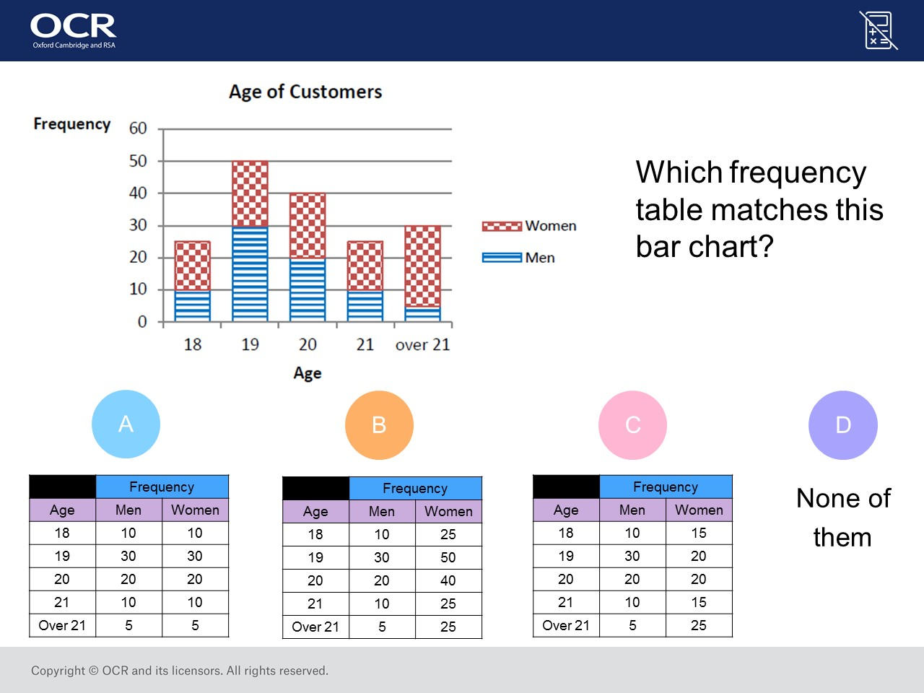
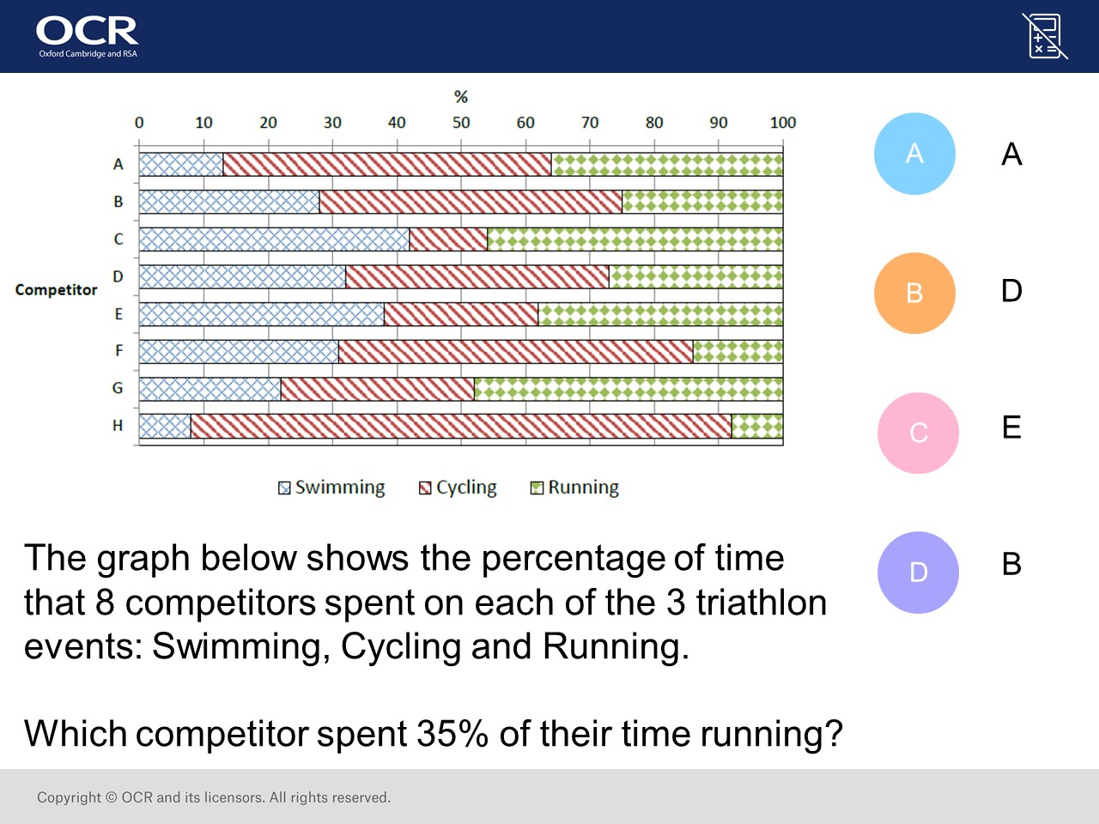
Worst answered question?
Most common wrong answer?

Slide 2
ANSWERS

Slide 3
Worst answered question?

Slide 4

C
They did swimming rather than running.

Slide 5
B
The student did not check the heights of the women.

