Slide 1
LO: Rearranging Formula
(Factorising)

Slide 2
Factorise 2f + 2g
2(f + g)

Slide 3
Factorise xy + xf + xg
x(y + f + g)

Slide 4
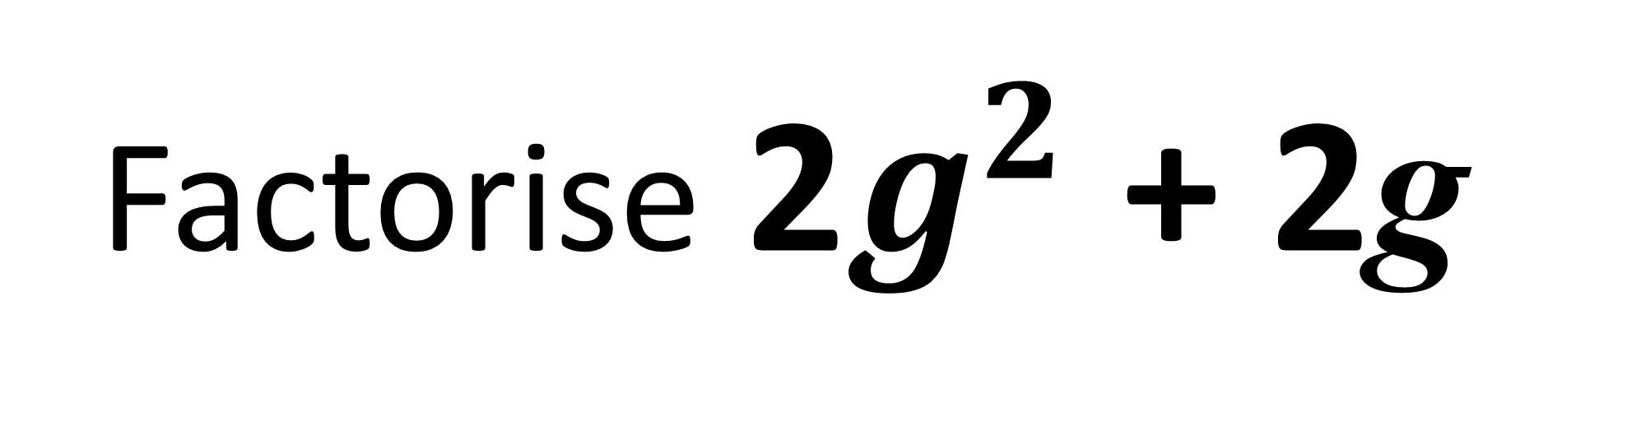
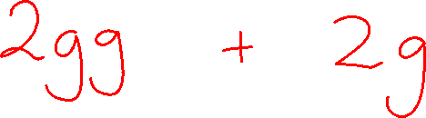
Factorise 2$g^{2}$ + 2g
2g(g + 1)

Slide 5
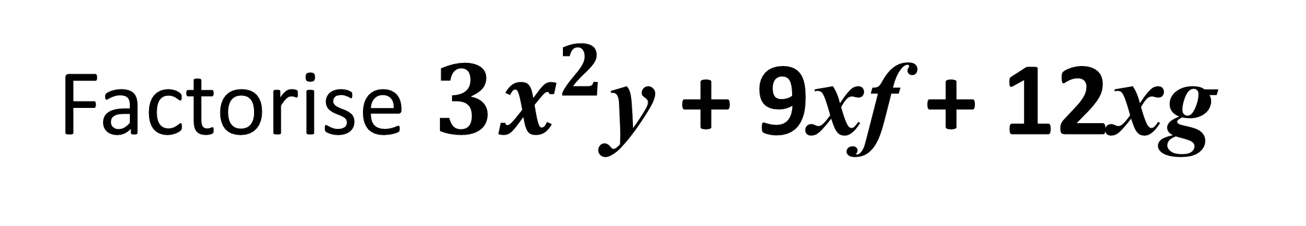
Factorise ${3x}^{2}$y + 9xf + 12xg
3x(xy + 3f + 4g)

Slide 6
Is x the subject of the formula?
x = y + ax
x = y + ax
No

Slide 7
Make x the subject of the formula.
x = y + ax
x = y + ax
What makes this question tricky?

Slide 8
What do you do with multiple subjects?
- get all the subjects on one side
- factorise out the subject
- take the bracket across and divide

Slide 9
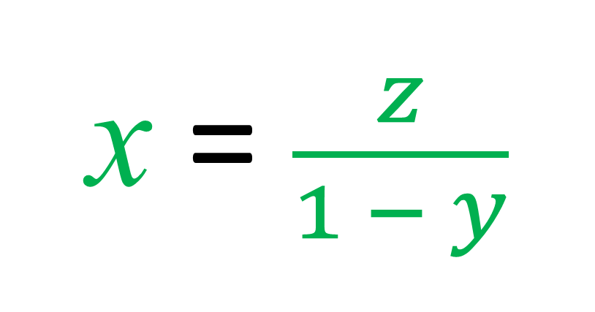
x = xy + z
Make x the subject
x – xy = z
x(1 – y) = z
x = $\frac{z}{1 − y}$

Slide 10
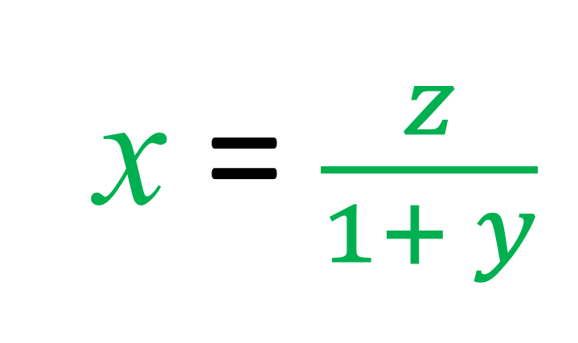
x = z – xy
Make x the subject
x + xy = z
x(1 + y) = z
x = $\frac{z}{1+ y}$

Slide 11
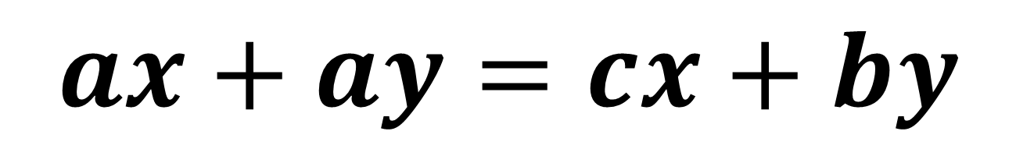
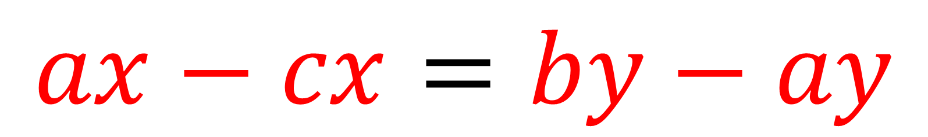
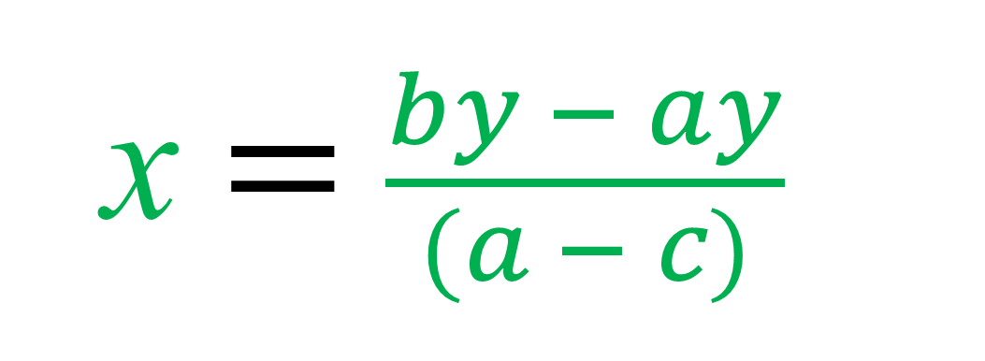
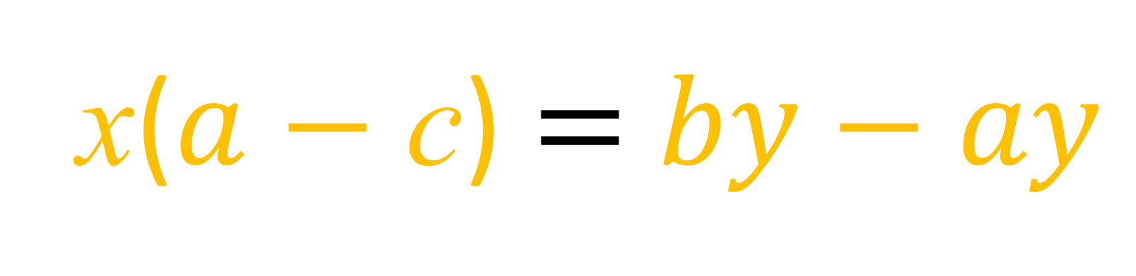
$$ax+ay=cx+by$$
Make x the subject
$$ax−cx=by−ay$$
x($a$ $−$ c) $=$ $by−ay$
x $=$ $\frac{by − ay}{(a − c)}$

Slide 12
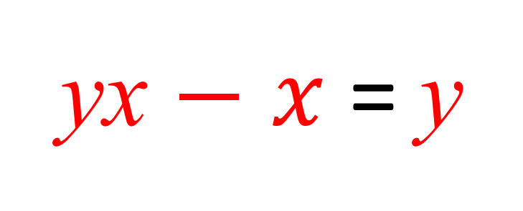
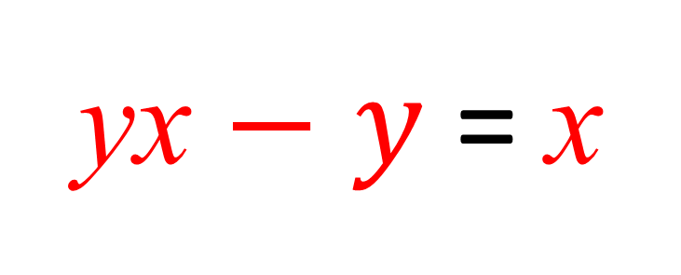
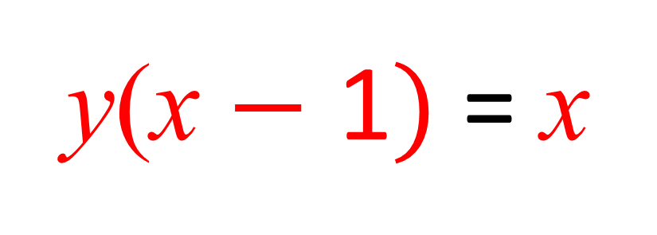
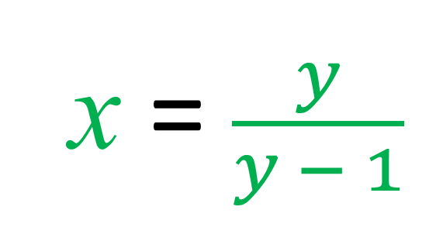
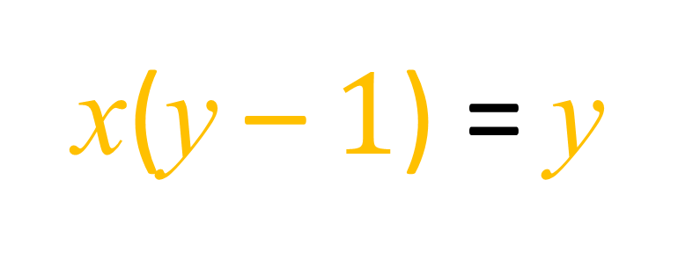
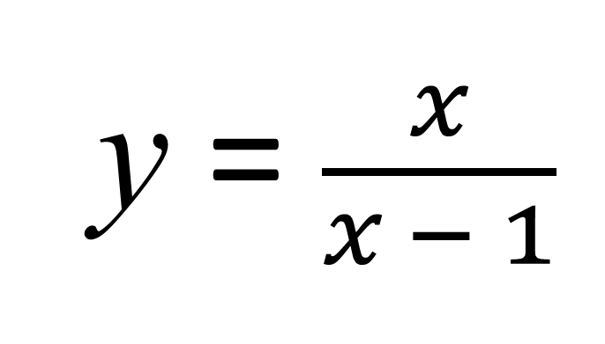
y = $\frac{x}{x − 1}$
Make x the subject
y(x $−$ 1$)$ = x
x(y – $1$) = y
yx $−$ $y$ = x
x = $\frac{y}{y − 1}$
yx $−$ $x$ = y

Slide 13
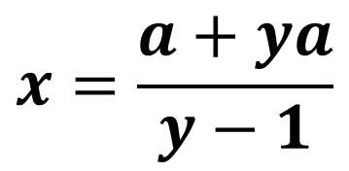
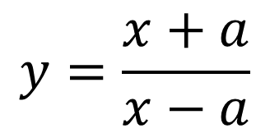

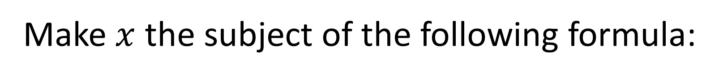



Make $x$ the subject of the following formula:
$$y=\frac{x+a}{x−a}$$
$$y\left(x−a\right)=x+a$$
$$yx−ya=x+a$$
$$yx−x=a+ya$$
$$x(y−1)=a+ya$$
$$x=\frac{a+ya}{y−1}$$

