Slide 1
Variable Acceleration
Using Integration
Chapter 11
(Part 3 of 3)

Slide 2
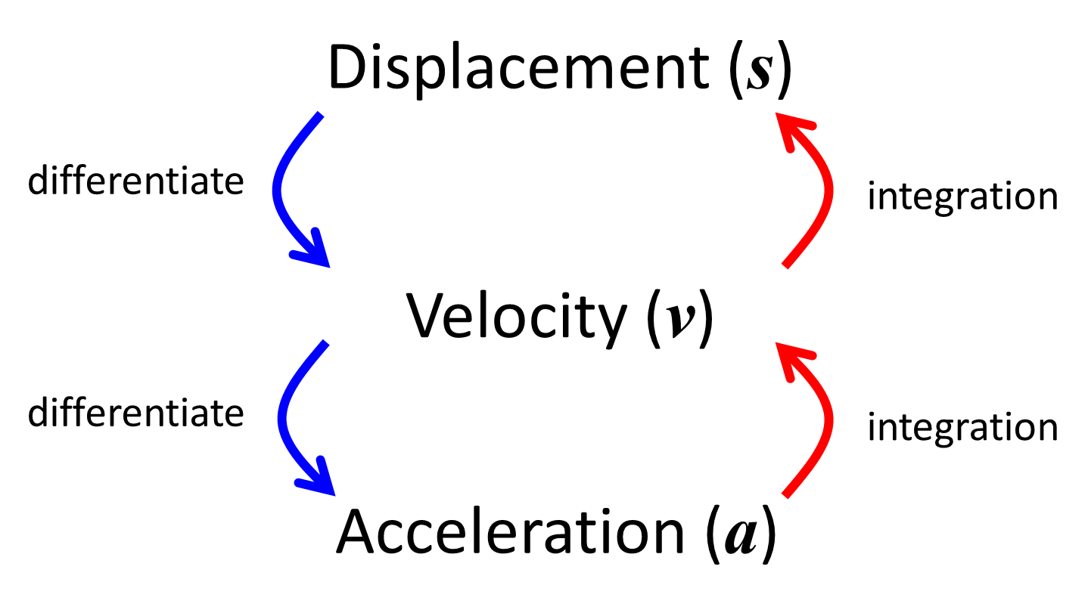

Slide 3

Variable Acceleration:
Using integration
the constant value
after you integrate!

Slide 4
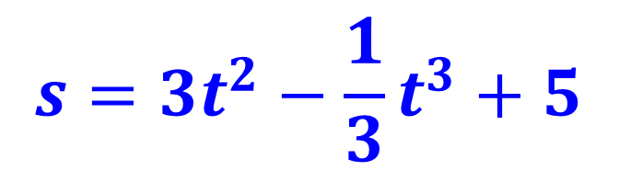
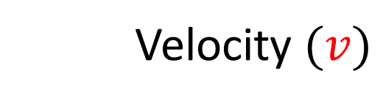
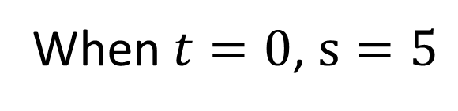
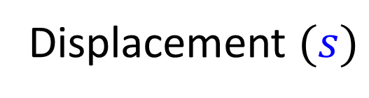
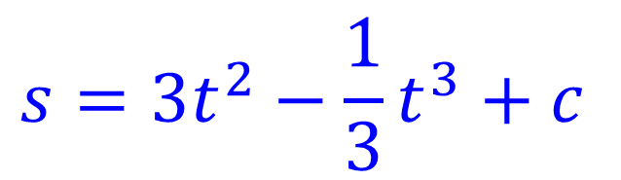
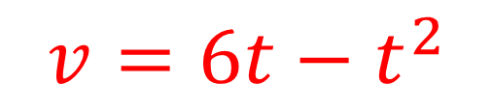
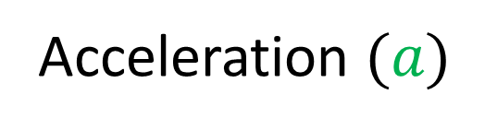
Find an equation for the displacement.
$$s=3t^{2}−\frac{1}{3}t^{3}+c$$
$$s=3t^{2}−\frac{1}{3}t^{3}+5$$
Displacement $(s)$
When $t=0$, $s=5$
Velocity $(v)$
$$v=6t−t^{2}$$
Acceleration $(a)$

Slide 5
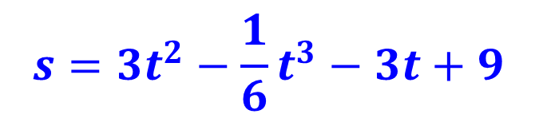
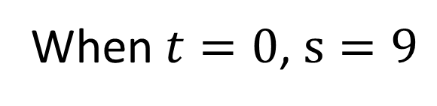
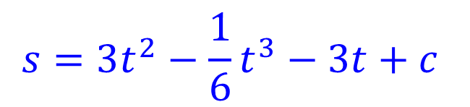
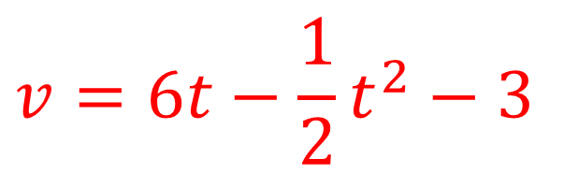
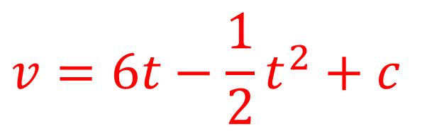
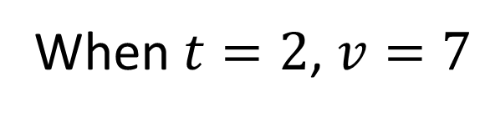
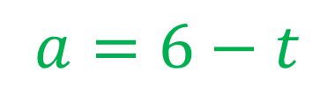
Find an equation for the displacement.
Displacement $(s)$
$$s=3t^{2}−\frac{1}{6}t^{3}−3t+c$$
$$s=3t^{2}−\frac{1}{6}t^{3}−3t+9$$
When $t=0$, $s=9$
$$v=6t−\frac{1}{2}t^{2}+c$$
$$v=6t−\frac{1}{2}t^{2}−3$$
Velocity $(v)$
When $t=2$, $v=7$
Acceleration $(a)$
$$a=6−t$$

Slide 6
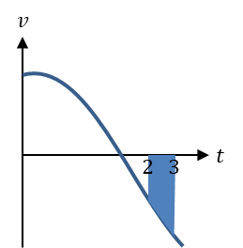

Area under the graph of a velocity time graph can help you find what?
$$Total Distnace travelled$$
$$in a given time$$

Slide 7
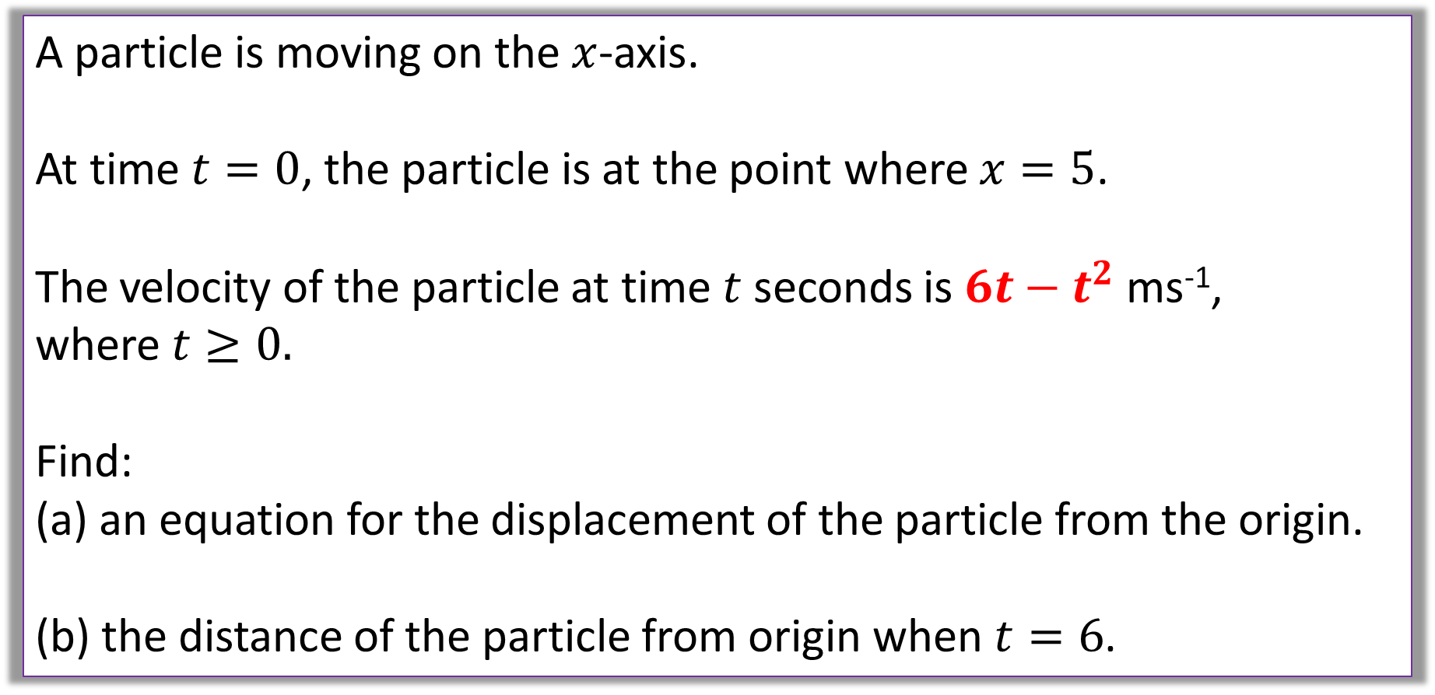
Question A
A particle is moving on the $x$-axis.
At time $t=0$, the particle is at the point where $x=5$.
The velocity of the particle at time $t$ seconds is $6t−t^{2}$ ms⁻¹,
where $t≥0.$
Find:
an equation for the displacement of the particle from the origin.
the distance of the particle from origin when $t=6$.

Slide 8
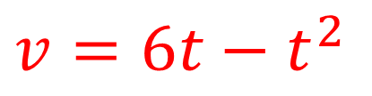

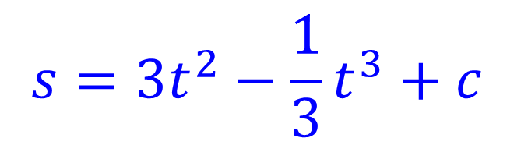
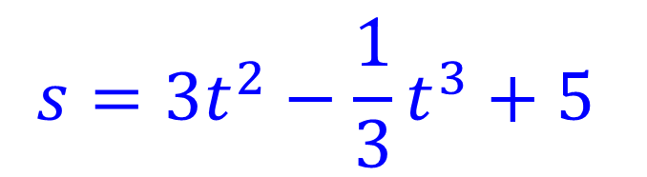
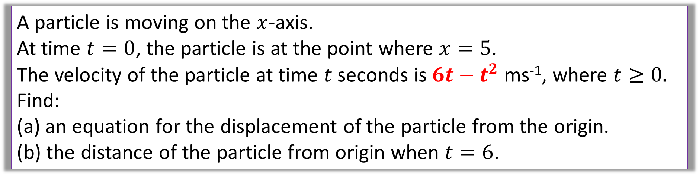

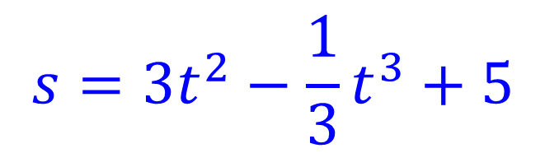


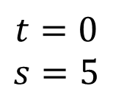
A particle is moving on the $x$-axis.
At time $t=0$, the particle is at the point where $x=5$.
The velocity of the particle at time $t$ seconds is $6t−t^{2}$ ms⁻¹, where $t≥0.$
Find:
an equation for the displacement of the particle from the origin.
the distance of the particle from origin when $t=6$.
$$s=3t^{2}−\frac{1}{3}t^{3}+c$$
$$s=3t^{2}−\frac{1}{3}t^{3}+5$$
$(s)$
→
$$t=0$$
$$s=5$$
$$c=5$$
$$(v)$$
$$v=6t−t^{2}$$
a)
$$s=3t^{2}−\frac{1}{3}t^{3}+5$$
$(a)$

Slide 9
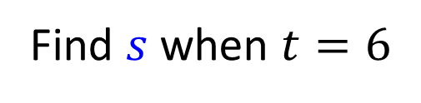

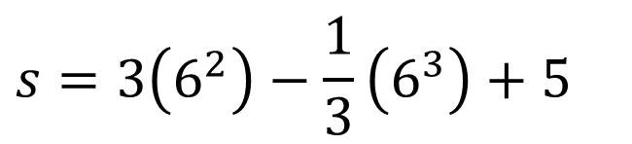
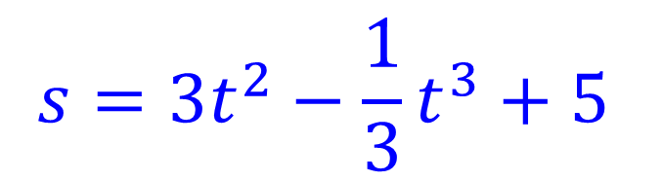
A particle is moving on the $x$-axis.
At time $t=0$, the particle is at the point where $x=5$.
The velocity of the particle at time $t$ seconds is $6t−t^{2}$ ms⁻¹, where $t≥0.$
Find:
an equation for the displacement of the particle from the origin.
the distance of the particle from origin when $t=6$.
$$s=3t^{2}−\frac{1}{3}t^{3}+5$$
b)
Find $s$ when $t=6$
$(s)$
$$s=3\left(6^{2}\right)−\frac{1}{3}\left(6^{3}\right)+5$$
$$(v)$$
$$v=6t−t^{2}$$
$$s=41$$
$(a)$

Slide 10
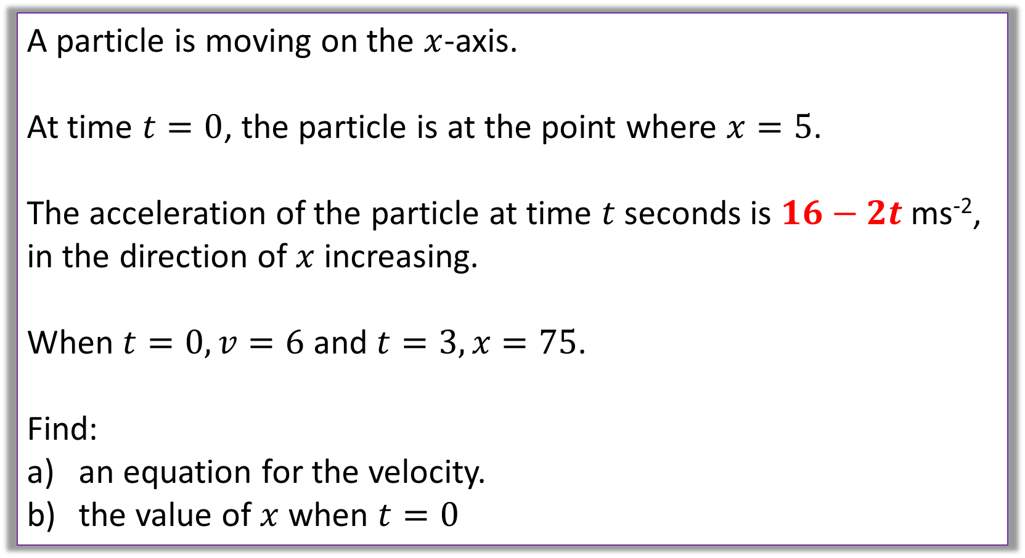
Question B
A particle is moving on the $x$-axis.
At time $t=0$, the particle is at the point where $x=5$.
The acceleration of the particle at time $t$ seconds is $16−2t$ms⁻²,
in the direction of $x$ increasing.
When $t=0, v=6$ and $t=3, x=75$.
Find:
an equation for the velocity.
the value of $x$ when $t=0$

Slide 11
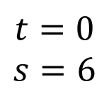
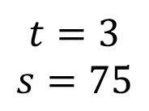

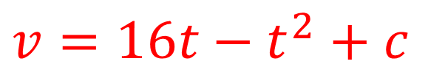
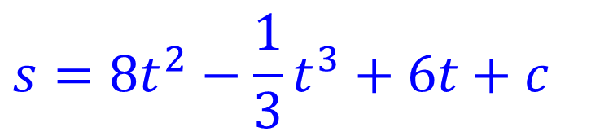
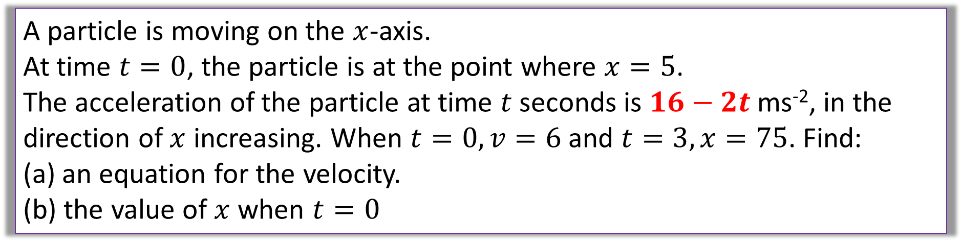


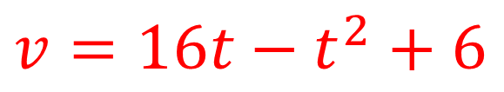
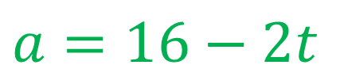
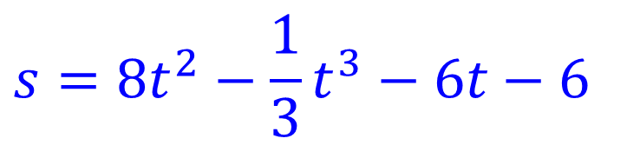
A particle is moving on the $x$-axis.
At time $t=0$, the particle is at the point where $x=5$.
The acceleration of the particle at time $t$ seconds is $16−2t$ms⁻², in the direction of $x$ increasing. When $t=0, v=6$ and $t=3, x=75$. Find:
an equation for the velocity.
the value of $x$ when $t=0$
$$s=8t^{2}−\frac{1}{3}t^{3}+6t+c$$
$$s=8t^{2}−\frac{1}{3}t^{3}−6t−6$$
$(s)$
→
$$t=3$$
$$s=75$$
$$c=−6$$
$$(v)$$
$$v=16t−t^{2}+c$$
→
$$v=16t−t^{2}+6$$
$$t=0$$
$$s=6$$
$$c=6$$
$(a)$
$$a=16−2t$$

Slide 12
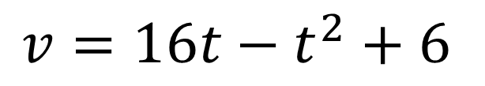
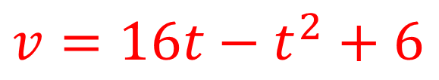


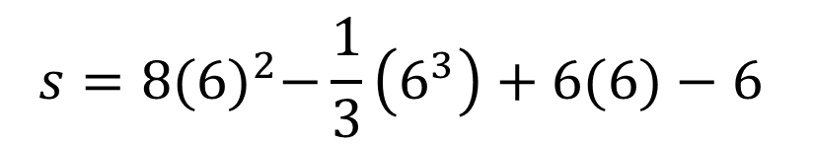

A particle is moving on the $x$-axis.
At time $t=0$, the particle is at the point where $x=5$.
The acceleration of the particle at time $t$ seconds is $16−2t$ms⁻², in the direction of $x$ increasing. When $t=0, v=6$ and $t=3, x=75$. Find:
an equation for the velocity.
the value of $x$ when $t=0$
$$s=8t^{2}−\frac{1}{3}t^{3}−6t−6$$
$$v=16t−t^{2}+6$$
$(s)$
a)
b)
Find $s$ when $t=0$
$$(v)$$
$$v=16t−t^{2}+6$$
$$s=8{(6)}^{2}−\frac{1}{3}\left(6^{3}\right)+6(6)−6$$
$(a)$
$$a=16−2t$$
$$s=246$$

Slide 13
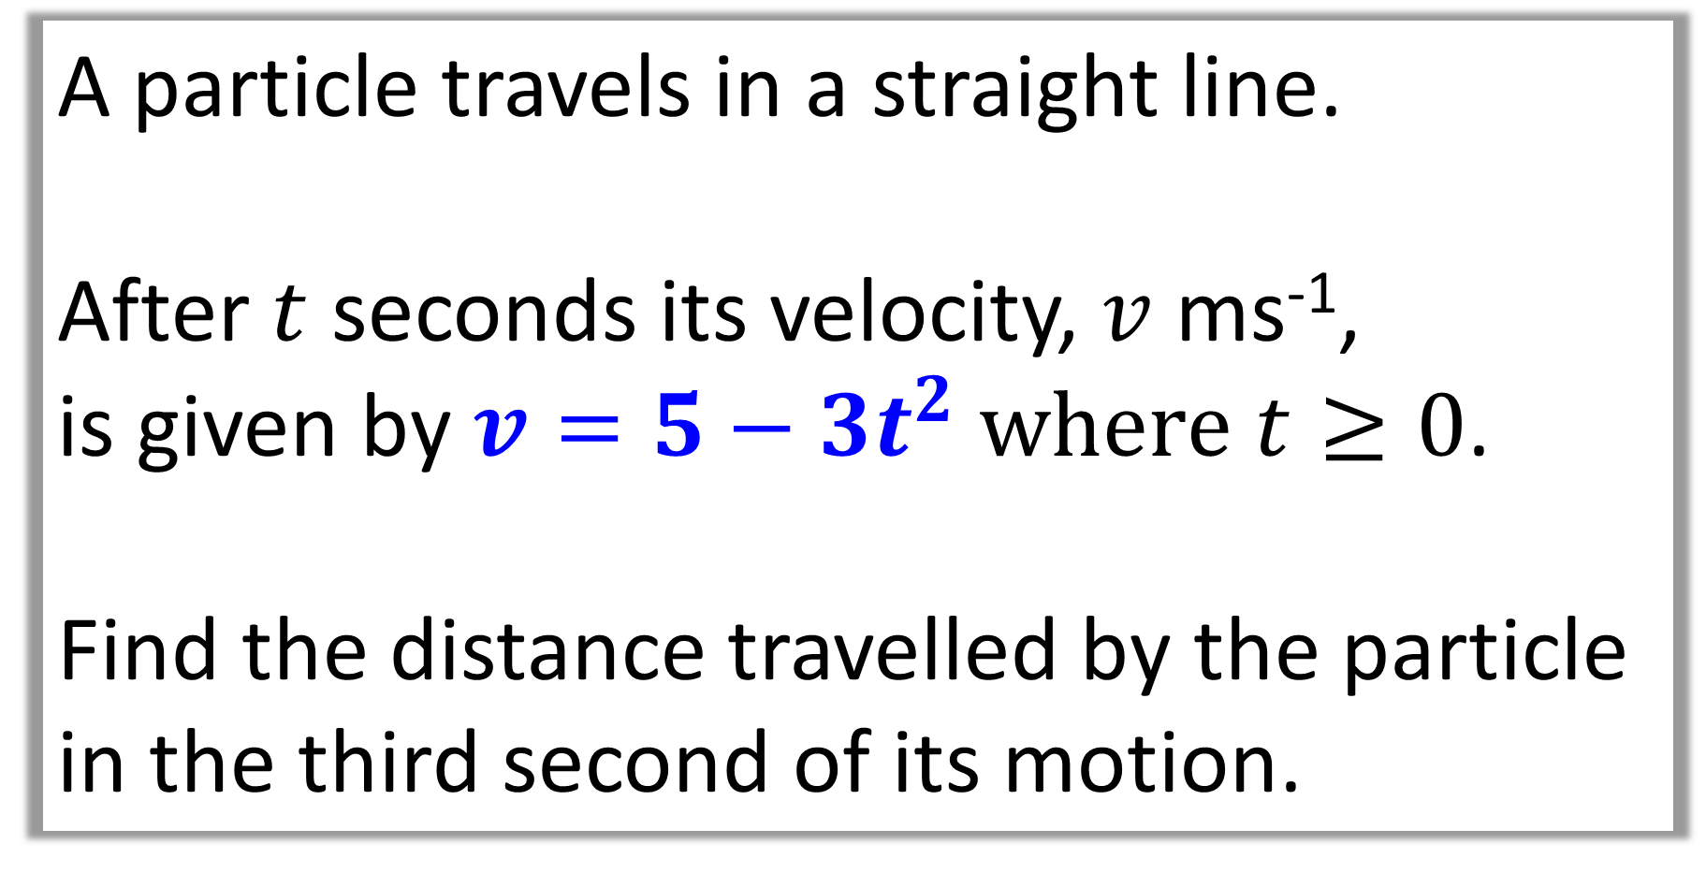
Question C
A particle travels in a straight line.
After $t$ seconds its velocity, $v$ ms⁻¹,
is given by $v=5−3t^{2} where$ $t≥0$.
Find the distance travelled by the particle
in the third second of its motion.

Slide 14
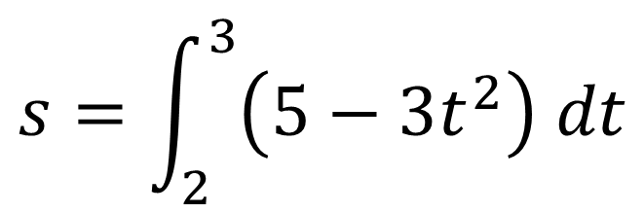
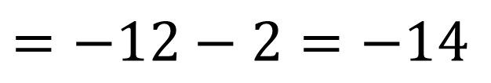
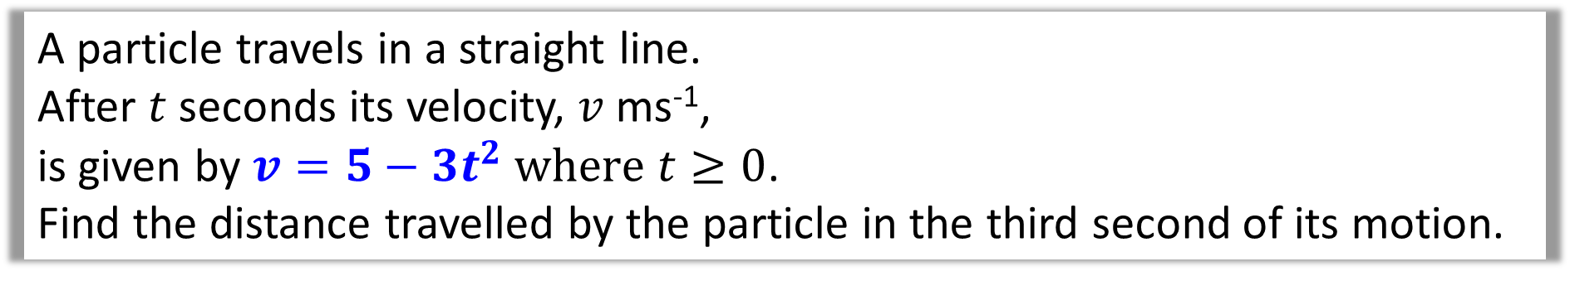
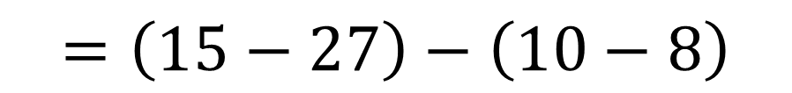
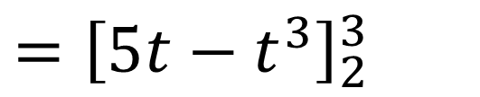
A particle travels in a straight line.
After $t$ seconds its velocity, $v$ ms⁻¹,
is given by $v=5−3t^{2} where$ $t≥0$.
Find the distance travelled by the particle in the third second of its motion.
$$s=\int_{2}^{3}{\left(5−3t^{2}\right) dt}$$
$$={\left[5t−t^{3}\right]}_{2}^{3}$$
$$=\left(15−27\right)−\left(10−8\right)$$
$$=−12−2=−14$$
Distance travelled is 14 m

Slide 15
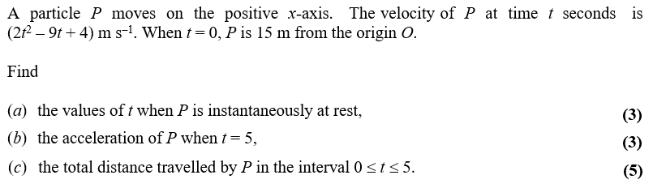
Question D

Slide 16


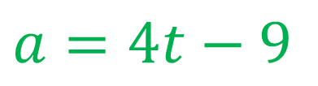
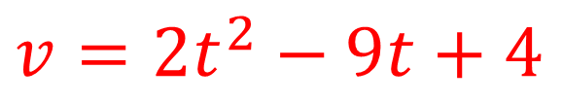
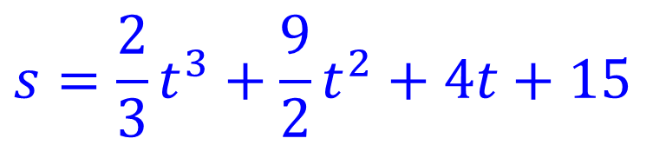

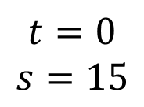

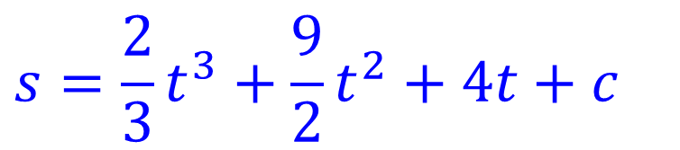
$$s=\frac{2}{3}t^{3}+\frac{9}{2}t^{2}+4t+c$$
$$s=\frac{2}{3}t^{3}+\frac{9}{2}t^{2}+4t+15$$
$(s)$
→
$$t=0$$
$$s=15$$
$$c=15$$
$$(v)$$
$$v=2t^{2}−9t+4$$
$(a)$
$$a=4t−9$$

Slide 17









$$s=\frac{2}{3}t^{3}+\frac{9}{2}t^{2}+4t+15$$
$(s)$
a)
Find $t$ when $v=0$
$$2t^{2}−9t+4=0$$
$$(v)$$
$$v=2t^{2}−9t+4$$
$$t=0.5 or t=4$$
$(a)$
$$a=4t−9$$

Slide 18



$$s=\frac{2}{3}t^{3}+\frac{9}{2}t^{2}+4t+15$$
$(s)$
b)
Find $a$ when $t=5$
$$a=4(5)−9$$
$$(v)$$
$$v=2t^{2}−9t+4$$
$$a=11$$
$(a)$
$$a=4t−9$$

Slide 19



$$s=\frac{2}{3}t^{3}+\frac{9}{2}t^{2}+4t+15$$
c)

