Slide 1
Further Kinematics
Vectors
Chapter 8
(Part 1 of 5)

Slide 2
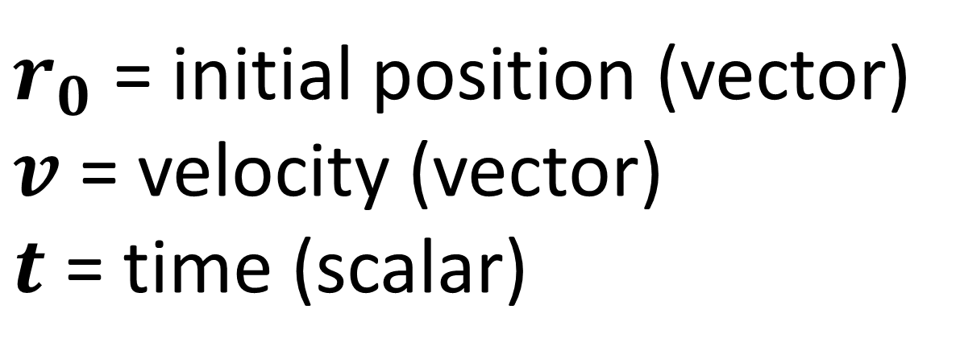

To describe the motion of a particle
you can use the equation:
$$r=r_{0}+vt$$
$r_{0}$ = initial position (vector)
$v$ = velocity (vector)
$t$ = time (scalar)

Slide 3
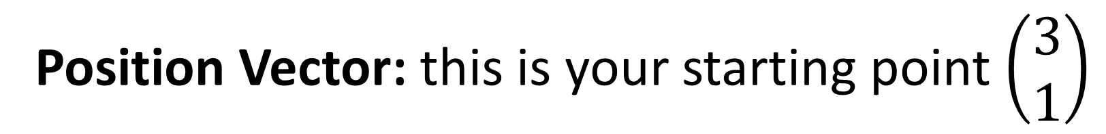

$$r_{0}$$
Position Vector: this is your starting point $\left(\begin{matrix}3 \\ 1\end{matrix}\right)$
1
0
3

Slide 4

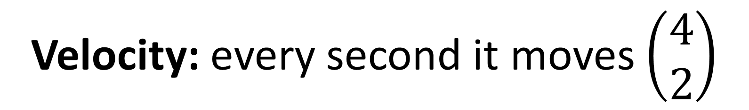



$$v$$
Velocity: every second it moves $\left(\begin{matrix}4 \\ 2\end{matrix}\right)$
t = 3
t = 2
$$\left({4 \atop 2}\right)$$
t = 1
$$\left({4 \atop 2}\right)$$
1
$$\left({4 \atop 2}\right)$$
0
3

Slide 5
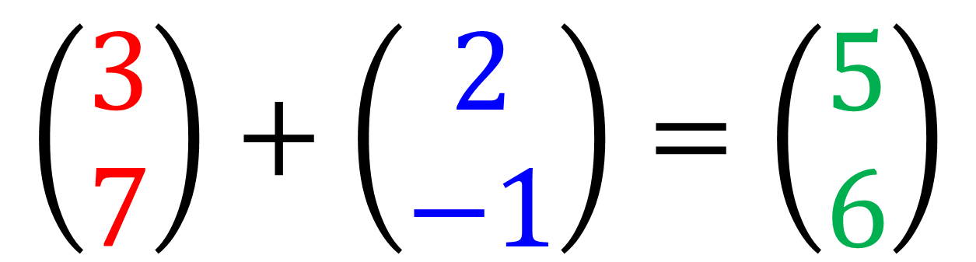
Vector Notation
Make life easier for yourself by using column vectors.
$$\left(3i+7j\right)+\left(2i−j\right)=\left(5i+6j\right)$$
$$\left(\begin{matrix}3 \\ 7\end{matrix}\right)+\left(\begin{matrix}2 \\ −1\end{matrix}\right)=\left(\begin{matrix}5 \\ 6\end{matrix}\right)$$

Slide 6
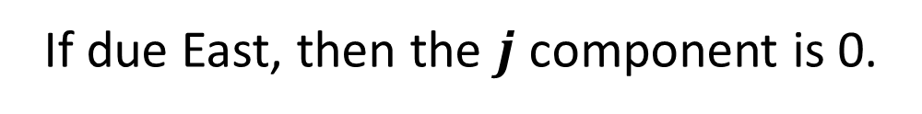
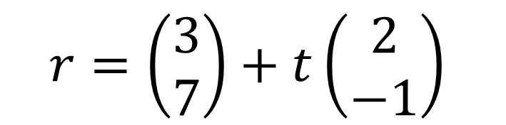
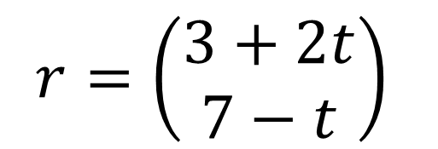
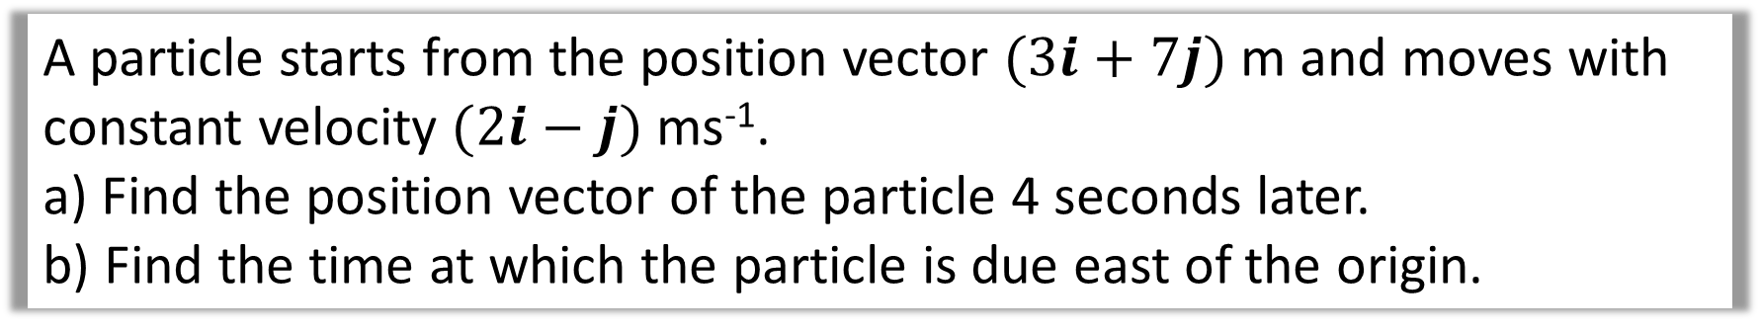
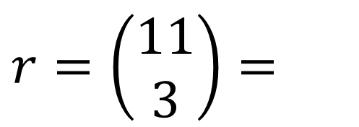
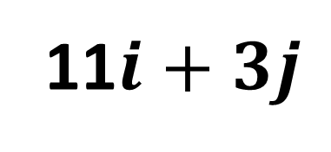
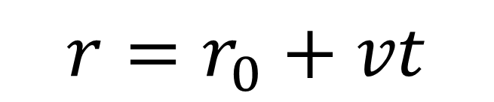
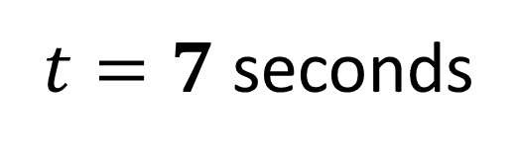
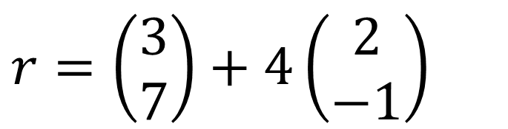
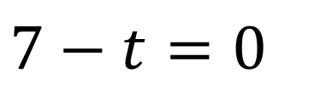
A particle starts from the position vector $(3i+7j)$ m and moves with constant velocity $(2i−j)$ ms⁻¹.
a) Find the position vector of the particle 4 seconds later.
b) Find the time at which the particle is due east of the origin.
$$r=r_{0}+vt$$
$$r=\left(\begin{matrix}3 \\ 7\end{matrix}\right)+t\left(\begin{matrix}2 \\ −1\end{matrix}\right)$$
a
b
$$r=\left(\begin{matrix}3 \\ 7\end{matrix}\right)+4\left(\begin{matrix}2 \\ −1\end{matrix}\right)$$
$$r=\left(\begin{matrix}3+2t \\ 7−t\end{matrix}\right)$$
$$r=\left(\begin{matrix}11 \\ 3\end{matrix}\right)=$$
11$i+3j$
If due East, then the $j$ component is 0.
$$7−t=0$$
$t=7$ seconds

Slide 7


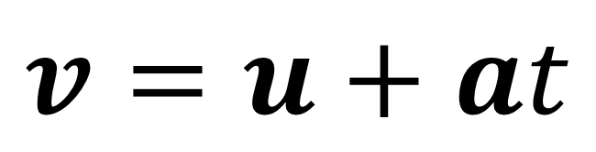
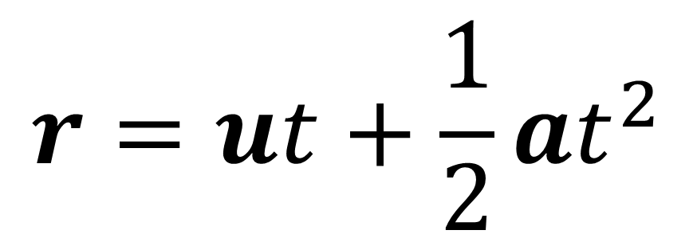
Vectors and $suvat$
Some $suvat$ equations work with vectors.
We use $r$ instead of $s$ for displacement.
$$r=ut+\frac{1}{2}at^{2}$$
$$v=u+at$$

Slide 8
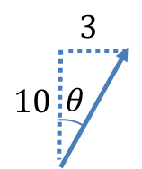
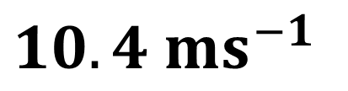
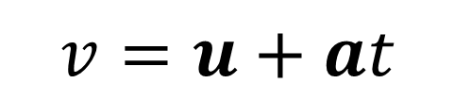
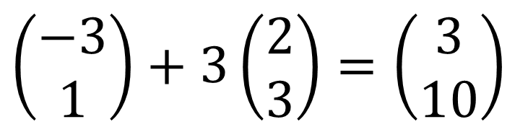
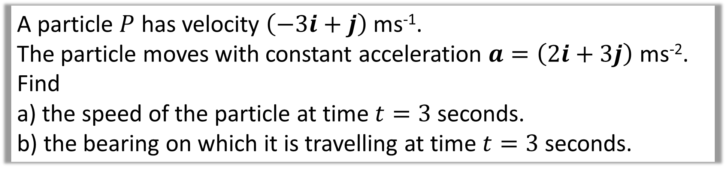
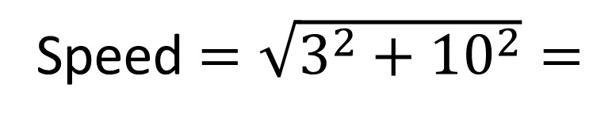
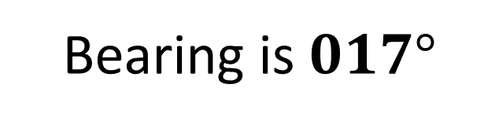
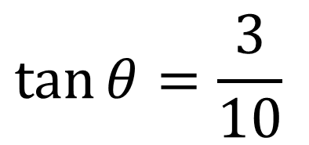
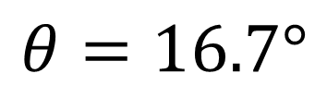
A particle $P$ has velocity $\left(−3i+j\right)$ ms⁻¹.
The particle moves with constant acceleration $a=\left(2i+3j\right)$ ms⁻². Find
a) the speed of the particle at time $t=3$ seconds.
b) the bearing on which it is travelling at time $t=3$ seconds.
a
$$v=u+at$$
b
$$\tan{θ}=\frac{3}{10}$$
$$\left(\begin{matrix}−3 \\ 1\end{matrix}\right)+3\left(\begin{matrix}2 \\ 3\end{matrix}\right)=\left(\begin{matrix}3 \\ 10\end{matrix}\right)$$
$$θ=16.7°$$
Speed $=\sqrt{3^{2}+{10}^{2}}=$
$10.4$ $ms^{−1}$
Bearing is $017°$

Slide 9
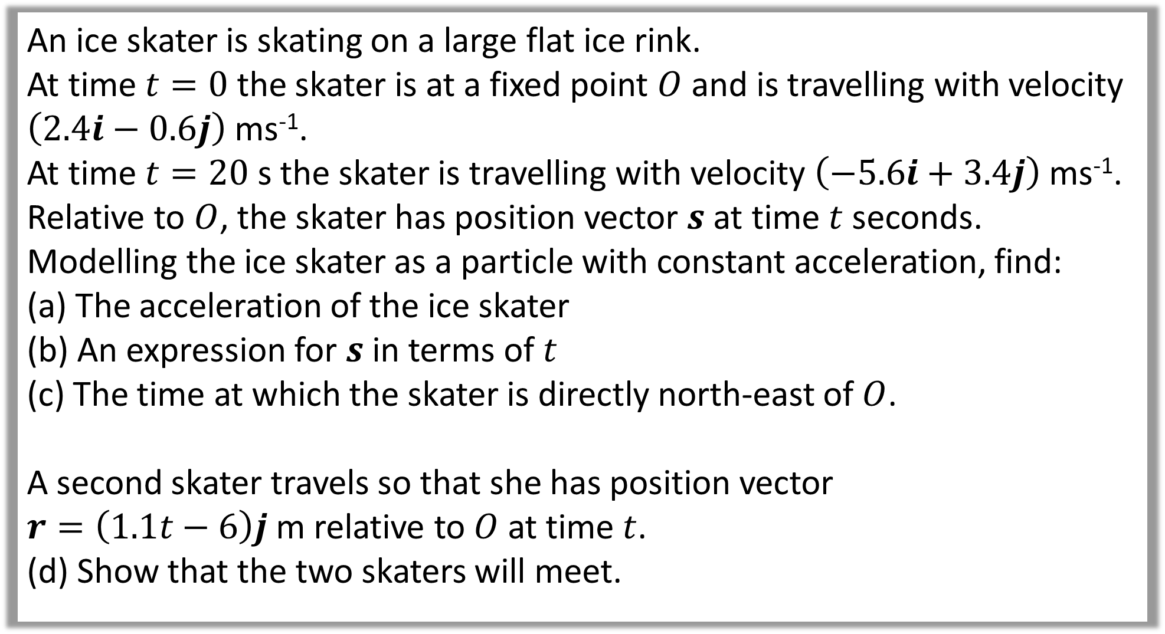
An ice skater is skating on a large flat ice rink.
At time $t=0$ the skater is at a fixed point $O$ and is travelling with velocity $\left(2.4i−0.6j\right)$ ms⁻¹.
At time $t=20$ s the skater is travelling with velocity $\left(−5.6i+3.4j\right)$ ms⁻¹.
Relative to $O$, the skater has position vector $s$ at time $t$ seconds.
Modelling the ice skater as a particle with constant acceleration, find:
The acceleration of the ice skater
An expression for $s$ in terms of $t$
The time at which the skater is directly north-east of $O$.
A second skater travels so that she has position vector
$r=\left(1.1t−6\right)j$ m relative to $O$ at time $t$.
(d) Show that the two skaters will meet.

Slide 10
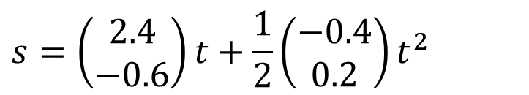

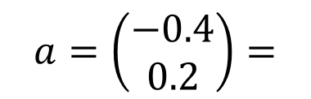
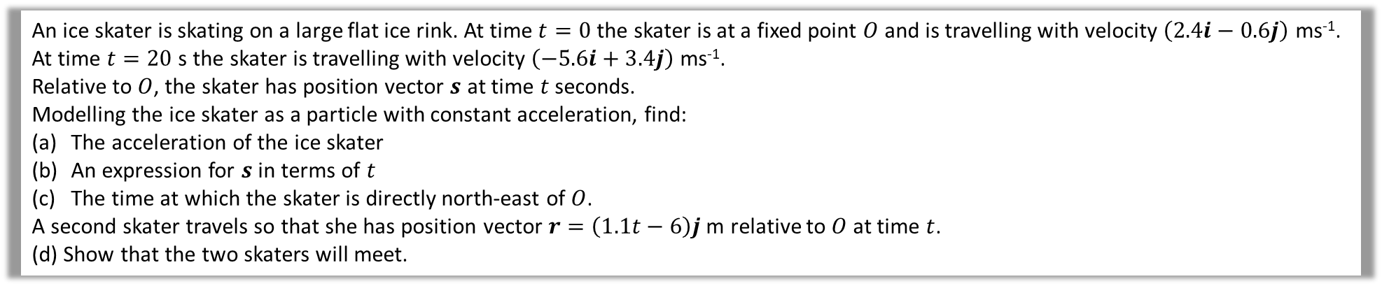
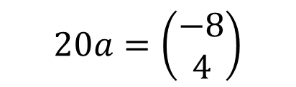
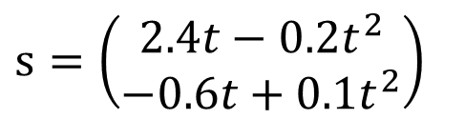
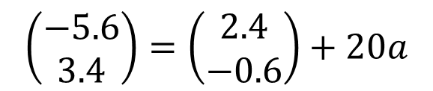
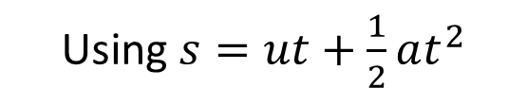

An ice skater is skating on a large flat ice rink. At time $t=0$ the skater is at a fixed point $O$ and is travelling with velocity $\left(2.4i−0.6j\right)$ ms⁻¹.
At time $t=20$ s the skater is travelling with velocity $\left(−5.6i+3.4j\right)$ ms⁻¹.
Relative to $O$, the skater has position vector $s$ at time $t$ seconds.
Modelling the ice skater as a particle with constant acceleration, find:
The acceleration of the ice skater
An expression for $s$ in terms of $t$
The time at which the skater is directly north-east of $O$.
A second skater travels so that she has position vector $r=\left(1.1t−6\right)j$ m relative to $O$ at time $t$.
(d) Show that the two skaters will meet.
a
Using $v=u+at$
b
Using $s=ut+\frac{1}{2}at^{2}$
$$\left(\begin{matrix}−5.6 \\ 3.4\end{matrix}\right)=\left(\begin{matrix}2.4 \\ −0.6\end{matrix}\right)+20a$$
$$s=\left(\begin{matrix}2.4 \\ −0.6\end{matrix}\right)t+\frac{1}{2}\left(\begin{matrix}−0.4 \\ 0.2\end{matrix}\right)t^{2}$$
$$20a=\left(\begin{matrix}−8 \\ 4\end{matrix}\right)$$
$$s=\left(\begin{matrix}2.4t−0.2t^{2} \\ −0.6t+0.1t^{2}\end{matrix}\right)$$
$$a=\left(\begin{matrix}−0.4 \\ 0.2\end{matrix}\right)=$$
$$s=\left(2.4t−0.2t^{2}\right)i+\left(−0.6t+0.1t^{2}\right)j$$
$$−0.4i+0.2j ms^{−2}$$

Slide 11
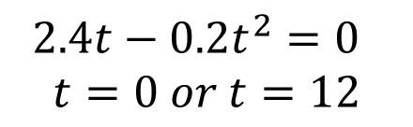
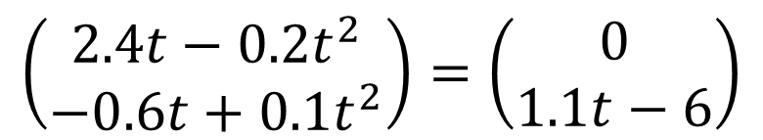
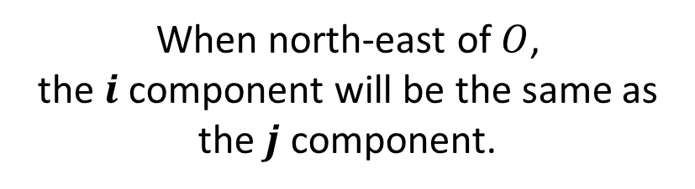


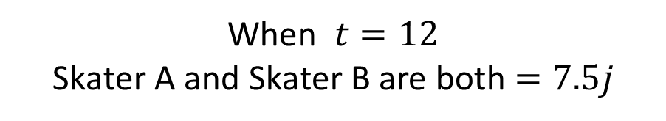
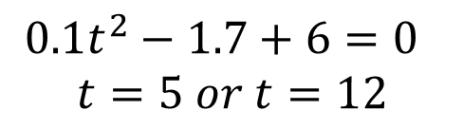
An ice skater is skating on a large flat ice rink. At time $t=0$ the skater is at a fixed point $O$ and is travelling with velocity $\left(2.4i−0.6j\right)$ ms⁻¹.
At time $t=20$ s the skater is travelling with velocity $\left(−5.6i+3.4j\right)$ ms⁻¹.
Relative to $O$, the skater has position vector $s$ at time $t$ seconds.
Modelling the ice skater as a particle with constant acceleration, find:
The acceleration of the ice skater
An expression for $s$ in terms of $t$
The time at which the skater is directly north-east of $O$.
A second skater travels so that she has position vector $r=\left(1.1t−6\right)j$ m relative to $O$ at time $t$.
(d) Show that the two skaters will meet.
c
When north-east of $O$,
the $i$ component will be the same as
the $j$ component.
d
Vectors will be the same:
$$\left(\begin{matrix}2.4t−0.2t^{2} \\ −0.6t+0.1t^{2}\end{matrix}\right)=\left(\begin{matrix}0 \\ 1.1t−6\end{matrix}\right)$$
$$2.4t−0.2t^{2}=−0.6t+0.1t^{2}$$
$$2.4t−0.2t^{2}=0$$
$$t=0 or t=12$$
$$0.1t^{2}−1.7+6=0$$
$$t=5 or t=12$$
$$3t\left(1−0.1t\right)=0$$
$$t=0 or t=10$$
When $t=12$
Skater A and Skater B are both $=7.5j$

