Slide 1
LO: Percentages
of an Amount
(Non-Calculator Method)

Slide 2

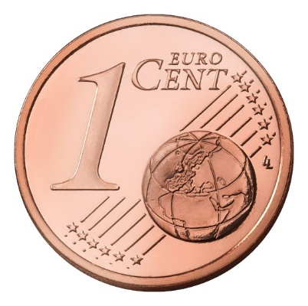
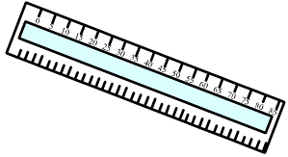
Percentages
How many words can you think of that begin with cent?
1900 - 2000
"Percent" means……..
out of a hundred.

Slide 3
Find a percentage of an amount
 | 50% of 600 =
 | 25% of 600 =
 | 75% of 600 =
300
150
450

Slide 4
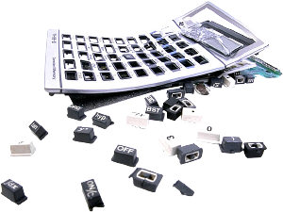
Some percentages are easy to work out mentally
1%
100
÷ 100
10%
10
÷ 10

Slide 5
How can you break down 20%?
20%
+
10%
10%

Slide 6
How can you break down 2%?
2%
+
1%
1%

Slide 7
How can you break down 11%?
11%
+
10%
1%

Slide 8
How can you break down 5%?
5%
half
10%
5%

Slide 9
How can you break down 17.5%?
17.5%
half
half
10%
5%
2.5%

Slide 10
What is 32% of 420?
42
10% | =
10% | =
10% | =
1% | =
1% | =
32% | =
42
42
4.2
4.2
134.4

Slide 11
What is 52% of 82?
50% | =
1% | =
1% | =
52% | =
41
0.82
0.82
42.64

