Slide 1
1) 7 is a prime factor of 12 (True / False)
2) 6 is a prime factor of 12 (True / False)
3) 5 is a prime factor of 12 (True / False)
4) 4 is a prime factor of 12 (True / False)
5) 3 is a prime factor of 12 (True / False)
6) 2 is a prime factor of 12 (True / False)
7) 1 is a prime factor of 12 (True / False)
8) 1 is a prime factor of 27 (True / False)
9) 2 is a prime factor of 27 (True / False)
10) 3 is a prime factor of 27 (True / False)
11) 7 is a prime factor of 27 (True / False)
12) 9 is a prime factor of 27 (True / False)
13) 13 is a prime factor of 27 (True / False)
14) 13 is a prime factor of 26 (True / False)
15) 3 is a prime factor of 26 (True / False)
16) 2 is a prime factor of 26 (True / False)
17) 2 is a prime factor of 25 (True / False)
18) 5 is a prime factor of 25 (True / False)
19) 12.5 is a prime factor of 25 (True / False)

Slide 2
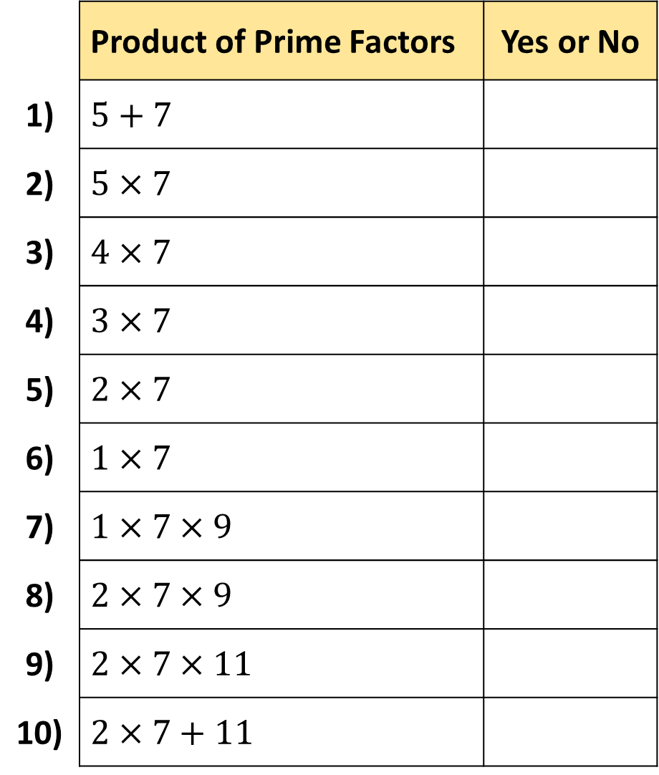
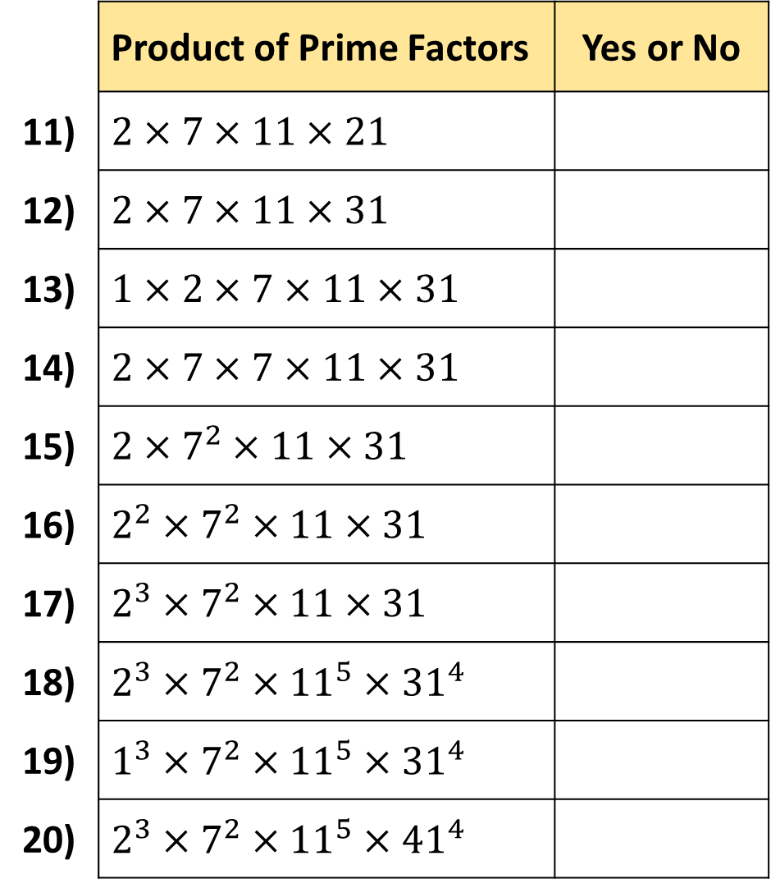
 | Product of Prime Factors | Yes or No
1) | $$5+7$$
2) | $$5×7$$
3) | $$4×7$$
4) | $$3×7$$
5) | $$2×7$$
6) | $$1×7$$
7) | $$1×7×9$$
8) | $$2×7×9$$
9) | $$2×7×11$$
10) | $$2×7+11$$
 | Product of Prime Factors | Yes or No
11) | $$2×7×11×21$$
12) | $$2×7×11×31$$
13) | $$1×2×7×11×31$$
14) | $$2×7×7×11×31$$
15) | $$2×7^{2}×11×31$$
16) | $$2^{2}×7^{2}×11×31$$
17) | $$2^{3}×7^{2}×11×31$$
18) | $$2^{3}×7^{2}×{11}^{5}×{31}^{4}$$
19) | $$1^{3}×7^{2}×{11}^{5}×{31}^{4}$$
20) | $$2^{3}×7^{2}×{11}^{5}×{41}^{4}$$

Slide 3
ANSWERS

Slide 4
1) 7 is a prime factor of 12 (True / False)
2) 6 is a prime factor of 12 (True / False)
3) 5 is a prime factor of 12 (True / False)
4) 4 is a prime factor of 12 (True / False)
5) 3 is a prime factor of 12 (True / False)
6) 2 is a prime factor of 12 (True / False)
7) 1 is a prime factor of 12 (True / False)
8) 1 is a prime factor of 27 (True / False)
9) 2 is a prime factor of 27 (True / False)
10) 3 is a prime factor of 27 (True / False)
11) 7 is a prime factor of 27 (True / False)
12) 9 is a prime factor of 27 (True / False)
13) 13 is a prime factor of 27 (True / False)
14) 13 is a prime factor of 26 (True / False)
15) 3 is a prime factor of 26 (True / False)
16) 2 is a prime factor of 26 (True / False)
17) 2 is a prime factor of 25 (True / False)
18) 5 is a prime factor of 25 (True / False)
19) 12.5 is a prime factor of 25 (True / False)

Slide 5
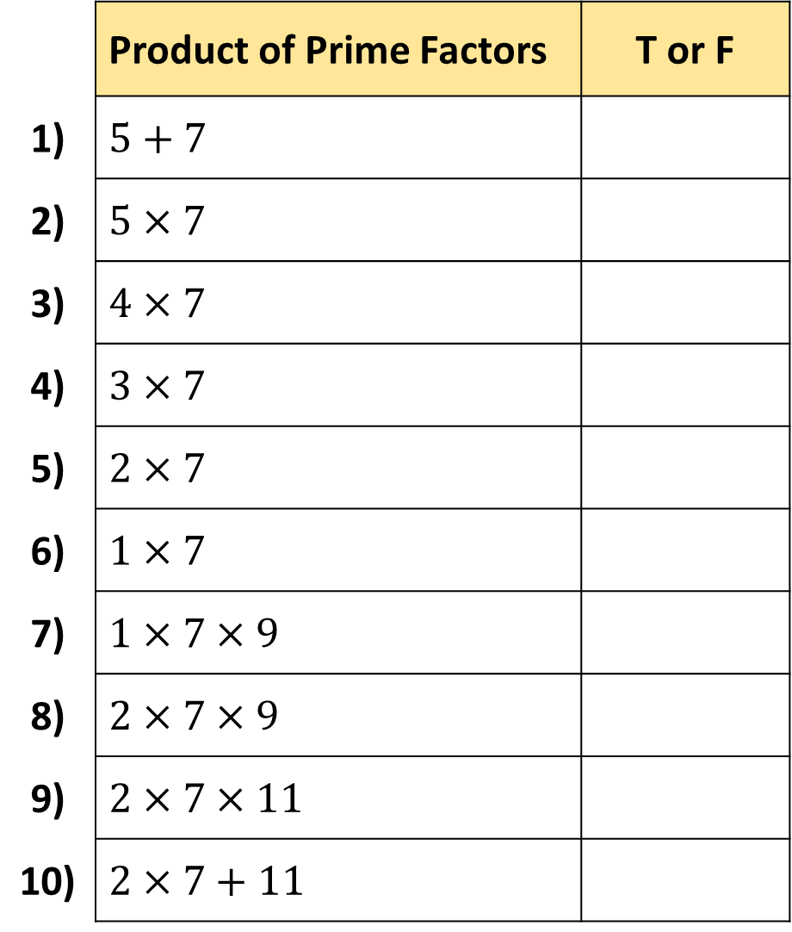
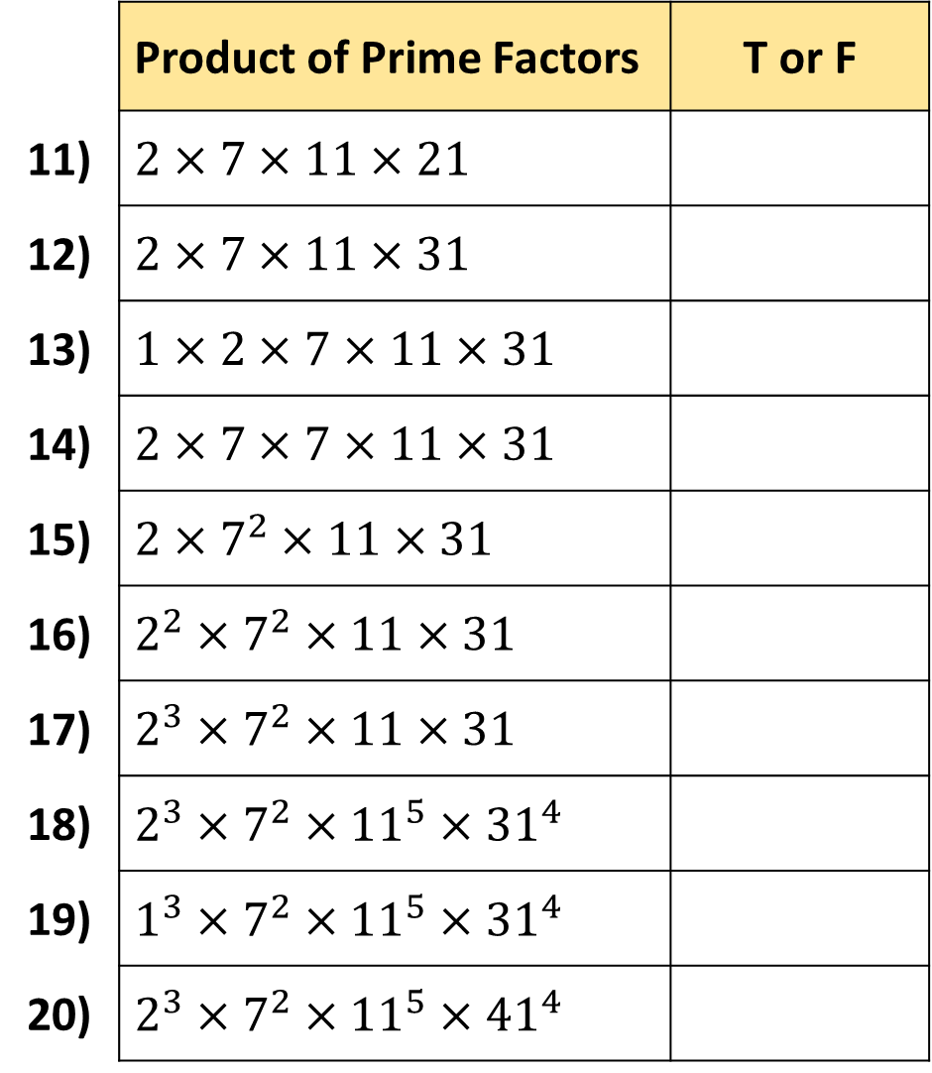
 | Product of Prime Factors | T or F
1) | $$5+7$$
2) | $$5×7$$
3) | $$4×7$$
4) | $$3×7$$
5) | $$2×7$$
6) | $$1×7$$
7) | $$1×7×9$$
8) | $$2×7×9$$
9) | $$2×7×11$$
10) | $$2×7+11$$
 | Product of Prime Factors | T or F
11) | $$2×7×11×21$$
12) | $$2×7×11×31$$
13) | $$1×2×7×11×31$$
14) | $$2×7×7×11×31$$
15) | $$2×7^{2}×11×31$$
16) | $$2^{2}×7^{2}×11×31$$
17) | $$2^{3}×7^{2}×11×31$$
18) | $$2^{3}×7^{2}×{11}^{5}×{31}^{4}$$
19) | $$1^{3}×7^{2}×{11}^{5}×{31}^{4}$$
20) | $$2^{3}×7^{2}×{11}^{5}×{41}^{4}$$
F
F
T
T
F
F
T
T
T
T
F
T
F
T
F
T
T
F
F
T

