Slide 1
LO: Proofs
(Counter Examples)

Slide 2
You want to prove something not true.
How many wrong examples do you need to give to disprove something?
1

Slide 3

Statement:
All prime numbers are odd.
2 is prime and even.
Disproved

Slide 4
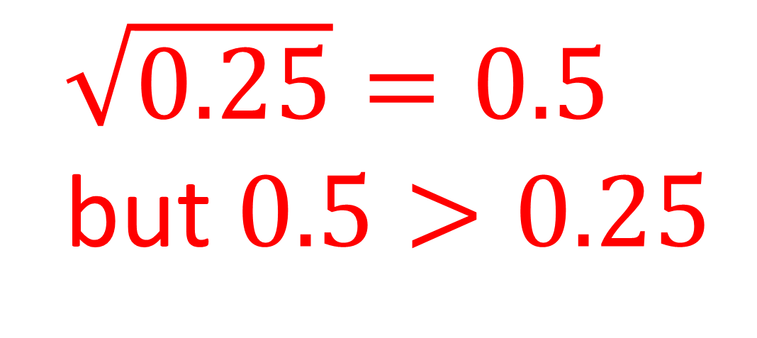
Statement:
The square root of a number is
always smaller than
the number itself.
$\sqrt{0.25}=0.5$
but $0.5>0.25$
Disproved

Slide 5
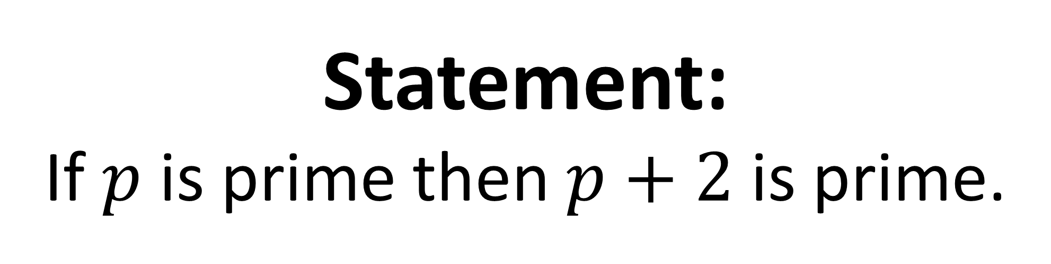
Statement:
If $p$ is prime then $p+2$ is prime.
7 is prime but 9 is not.
Disproved

Slide 6
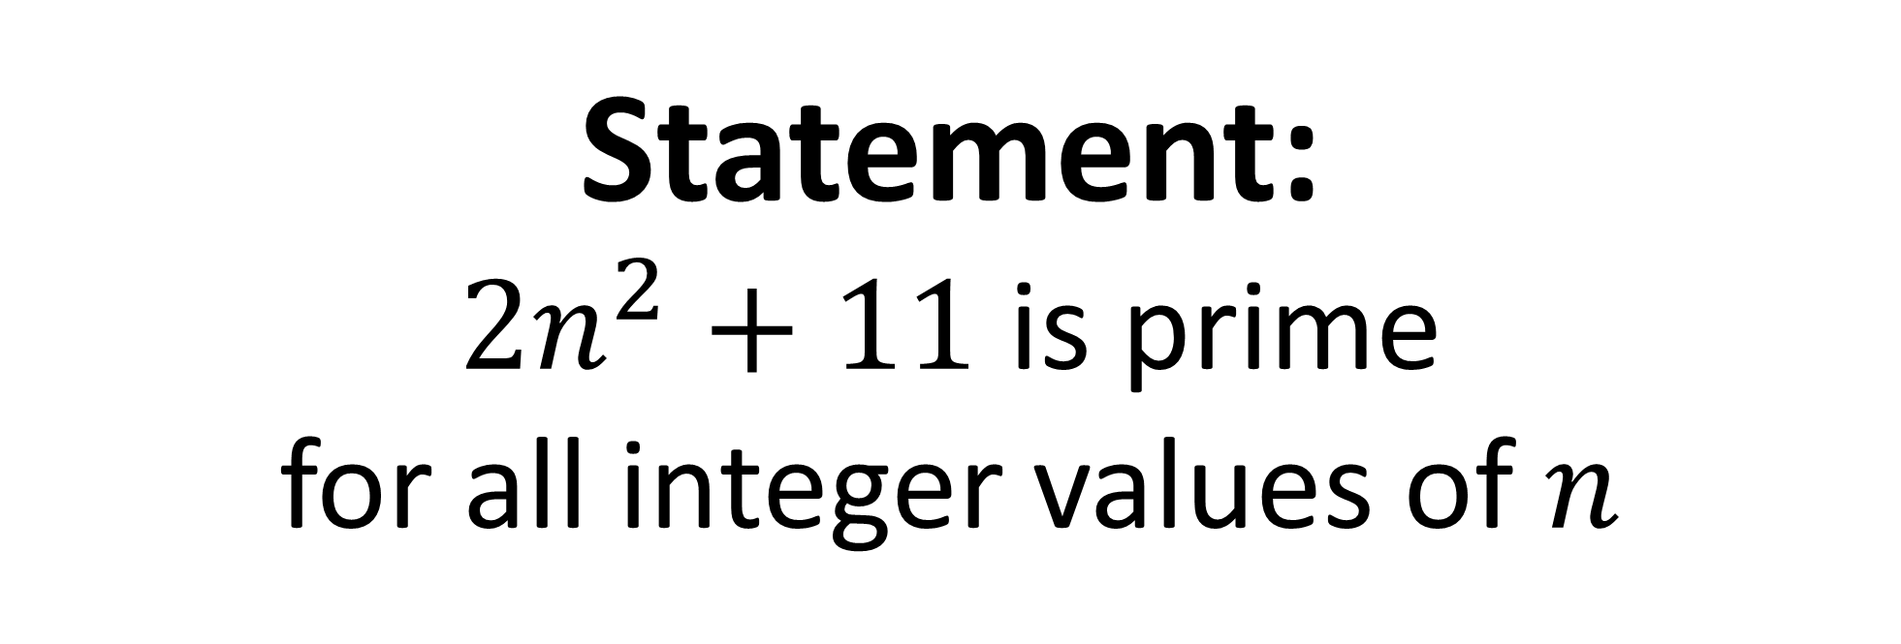
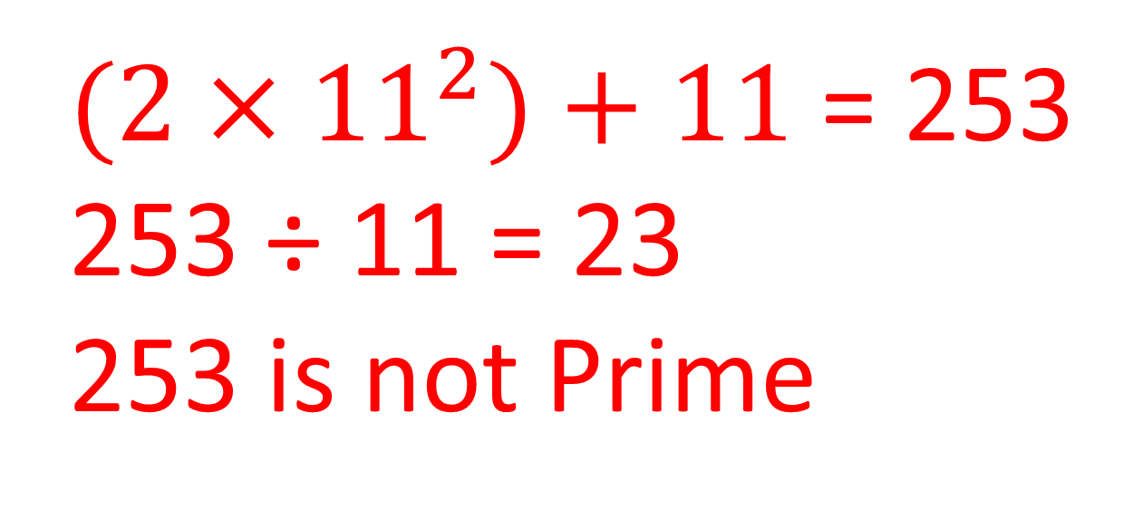
Statement:
$2n^{2}+11$ is prime
for all integer values of $n$
$(2×{11}^{2})+11$ = 253
253 ÷ 11 = 23
253 is not Prime
Disproved

