Slide 1

Diagnostic Assessment .Delta 2
Unit 9
Scale Drawings
and Maps
Bearings
Congruence
Similar Shapes

Slide 2
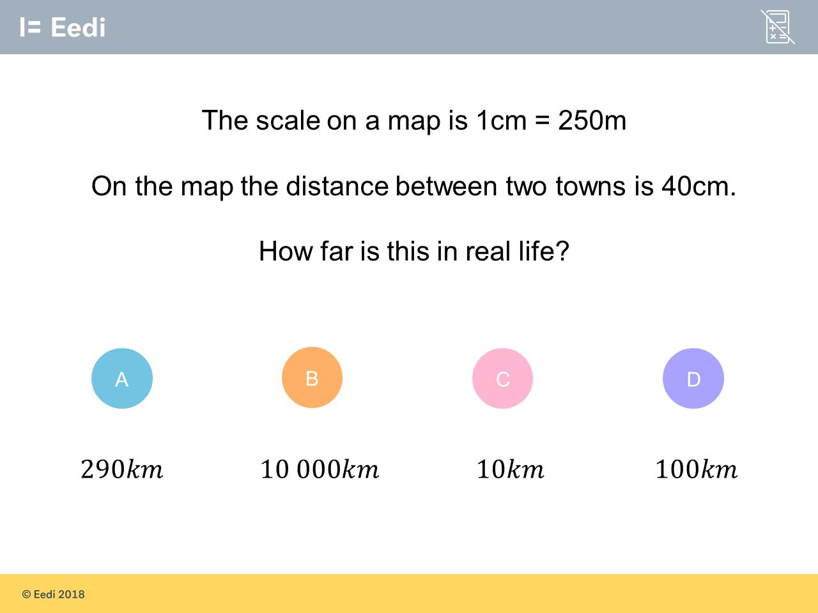
Question 1 – Scale Drawings and Maps

Slide 3
Answer 1 – Scale Drawings and Maps
CORRECT ANSWER | CORRECT EXPLANATION
10km | We have 40 cm equals 40 X 250 = 10000 m. This is 10 km.
COMMON MISTAKES | WHAT MIGHT BE YOUR MISTAKE
290km | The student has added the distance on, rather than multiplying.
10000km | The student may have misread the units.
100km | The student may think that there are 100m in a km.
A B C D

Slide 4
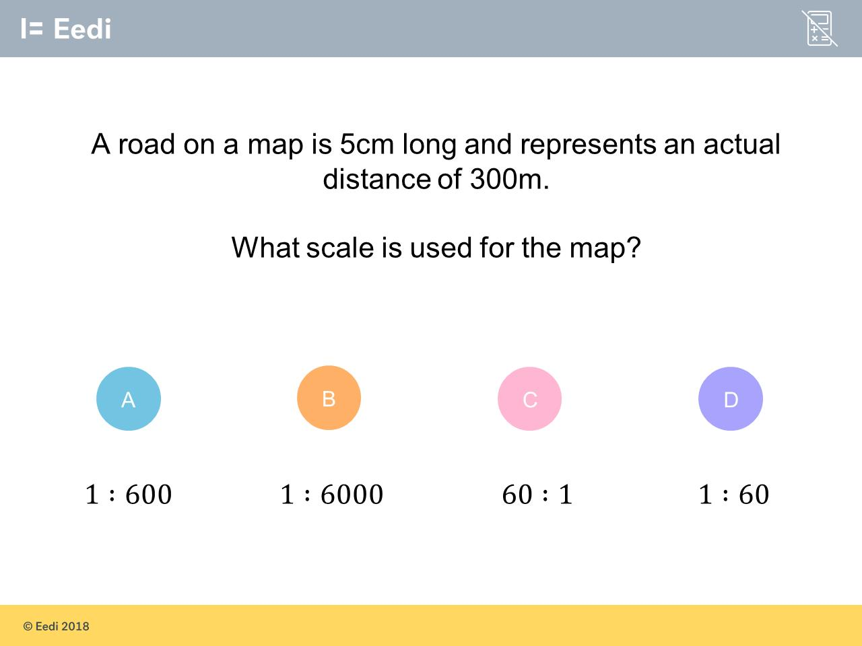
Question 2 – Scale Drawings and Maps

Slide 5
Answer 2 – Scale Drawings and Maps
CORRECT ANSWER | CORRECT EXPLANATION
1:6000 | The ratio is 5:30000, which can be simplified to 1:6000.
COMMON MISTAKES | WHAT MIGHT BE YOUR MISTAKE
1:600 | The student may think that there are 10 cm in a metre.
60:1 | The student has inverted the ratio.
1:60 | The student has misread the units.
A B C D

Slide 6
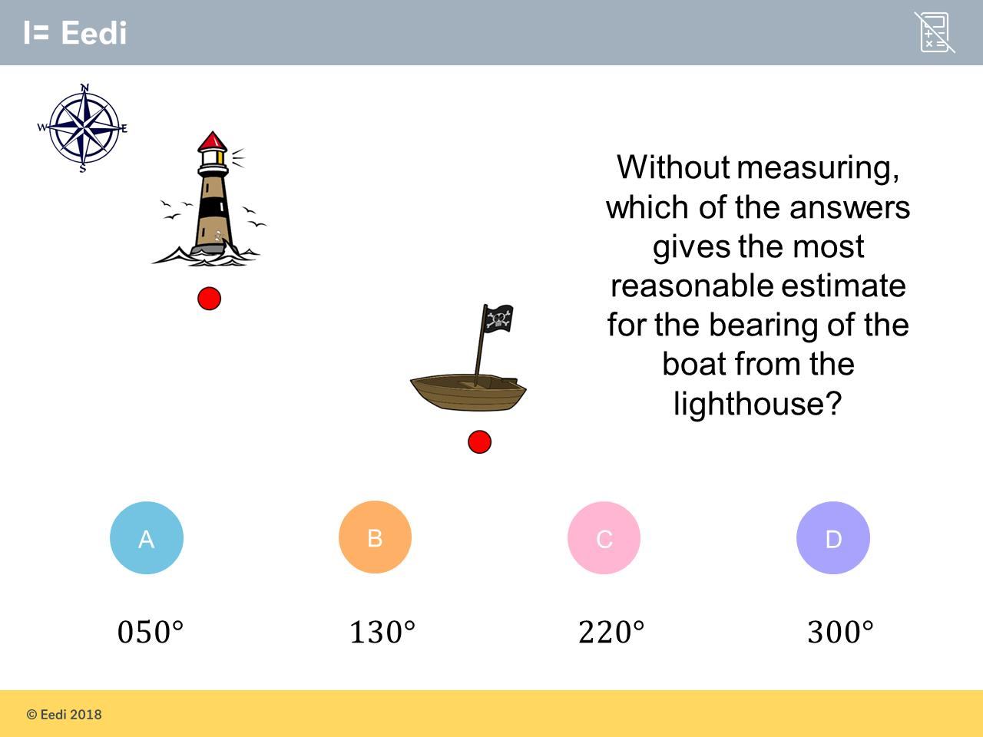
Question 3 – Bearings

Slide 7
Answer 3 – Bearings
CORRECT ANSWER | CORRECT EXPLANATION
130˚ | The bearing would be in the bottom right quadrant of the compass, so we would expect the bearing to be between 90 and 180.
COMMON MISTAKES | WHAT MIGHT BE YOUR MISTAKE
050˚ | The student may believe that bearings are taken anti-clockwise and has misread the question.
220˚ | The student has measured the bearing anti-clockwise.
300˚ | The student has misread the question as the bearing of the lighthouse from the boat.

Slide 8
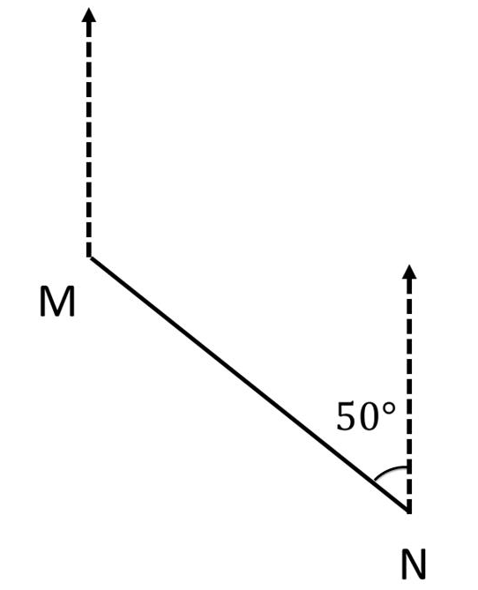
Question 4 – Bearings
What is the bearing of N from M?

Slide 9
Answer 4 – Bearings
What is the bearing of N from M?
CORRECT ANSWER | CORRECT EXPLANATION
130˚ | We can find the bearing by remembering that the interior angles of a parallelogram sum to 180, so the bearing is 180 - 50 = 130.
COMMON MISTAKES | WHAT MIGHT BE YOUR MISTAKE
230˚ | The student has found the bearings anti-clockwise.
310˚ | The student has found the bearing of M from N.
050˚ | The student may believe that the bearings are equal.

Slide 10
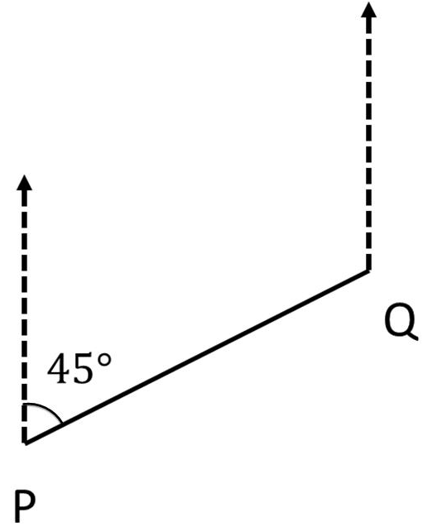
Question 5 – Bearings
What is the bearing of P from Q?

Slide 11
Answer 5 – Bearings
What is the bearing of P from Q?
CORRECT ANSWER | CORRECT EXPLANATION
225˚ | The missing angle at Q is 180 - 45 = 135. The bearing would then be 360 - 135 = 225.
COMMON MISTAKES | WHAT MIGHT BE YOUR MISTAKE
045˚ | The student has found the bearing of Q from P.
135˚ | The student has found the missing angle, but not the bearing.
315˚ | The student may think that the angle at Q is also 45.

Slide 12
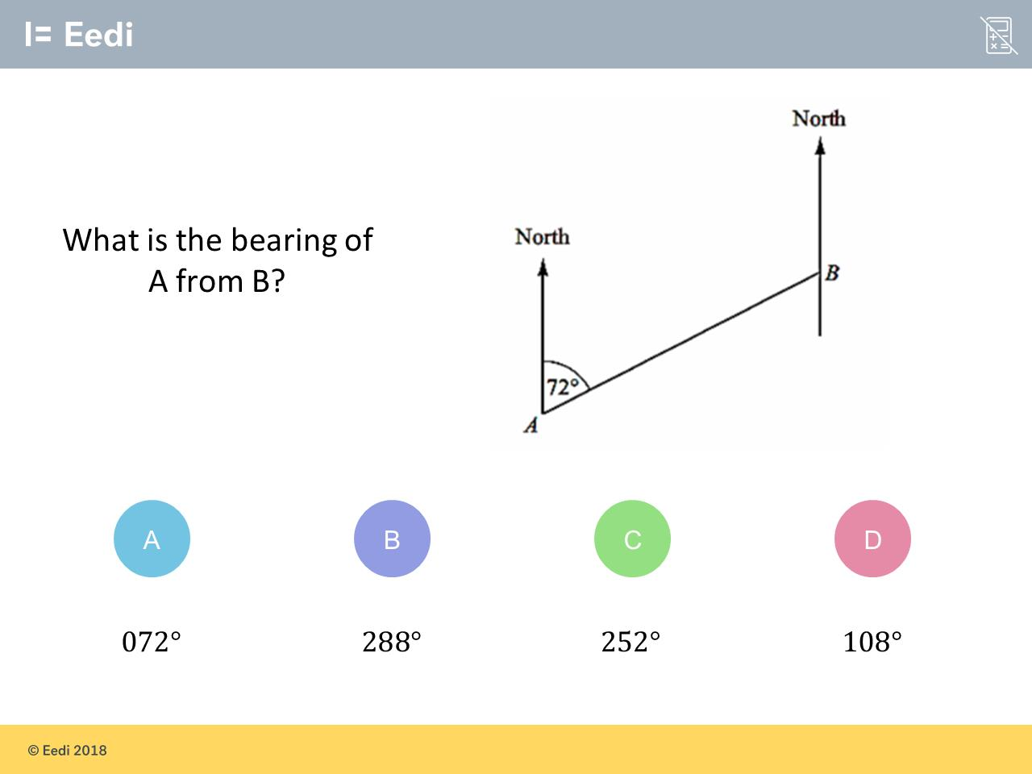
Question 6 – Bearings

Slide 13
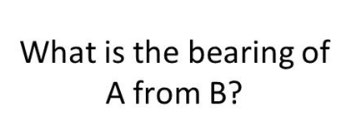
Answer 6 – Bearings
CORRECT ANSWER | CORRECT EXPLANATION
252˚ | The bearing from B to A is made up of a straight line angle and an angle Alternate to that at A, so we have 180 + 72 = 252.
COMMON MISTAKES | WHAT MIGHT BE YOUR MISTAKE
072˚ | The student has given the bearing of B from A.
288˚ | The student has subtracted 72 from 360.
108˚ | The student has subtracted 72 from 180.

Slide 14
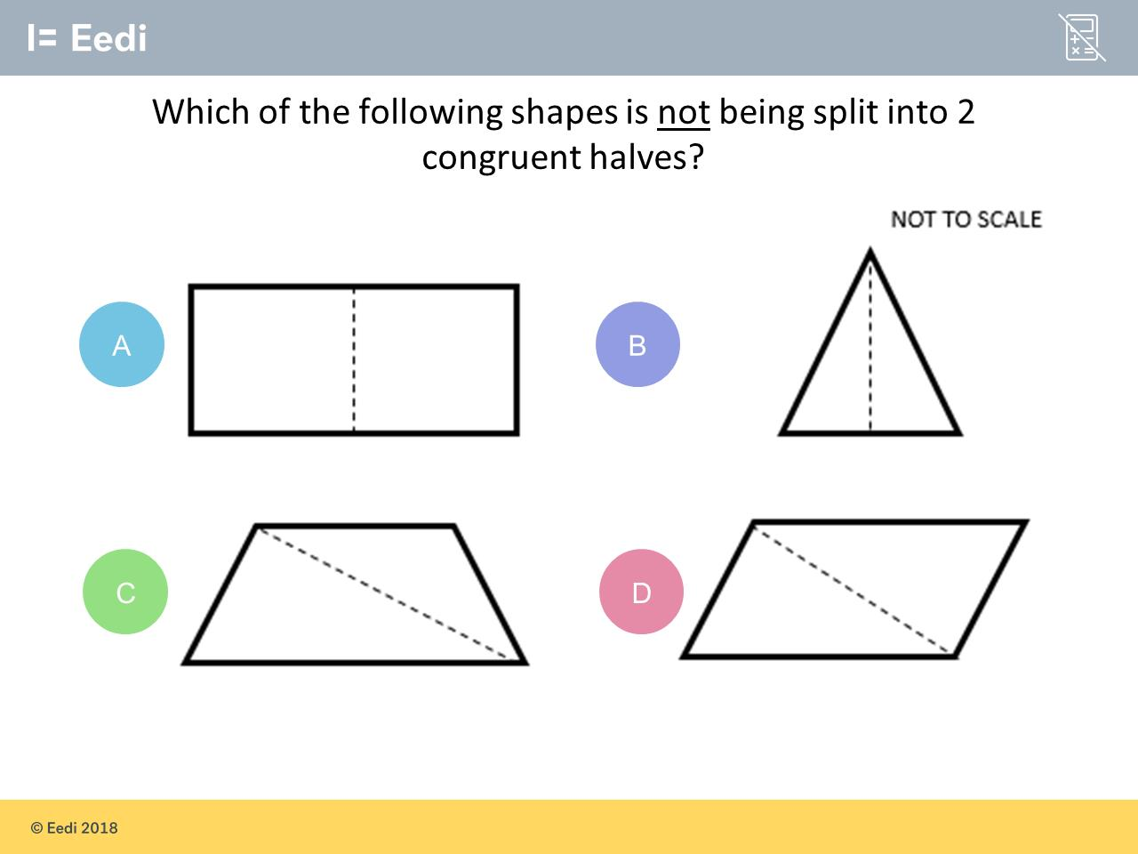
Question 7 – Congruence

Slide 15
Answer 7 – Congruence
CORRECT ANSWER | CORRECT EXPLANATION
C | Opposite angles in a trapezium are not equal.
COMMON MISTAKES | WHAT MIGHT BE YOUR MISTAKE
A | The shapes are exactly the same, but may have been moved, rotated or reflected.
B | The student may not realise that congruence is preserved under reflection.
D | The student may not realise that congruence is preserved under rotation.

Slide 16
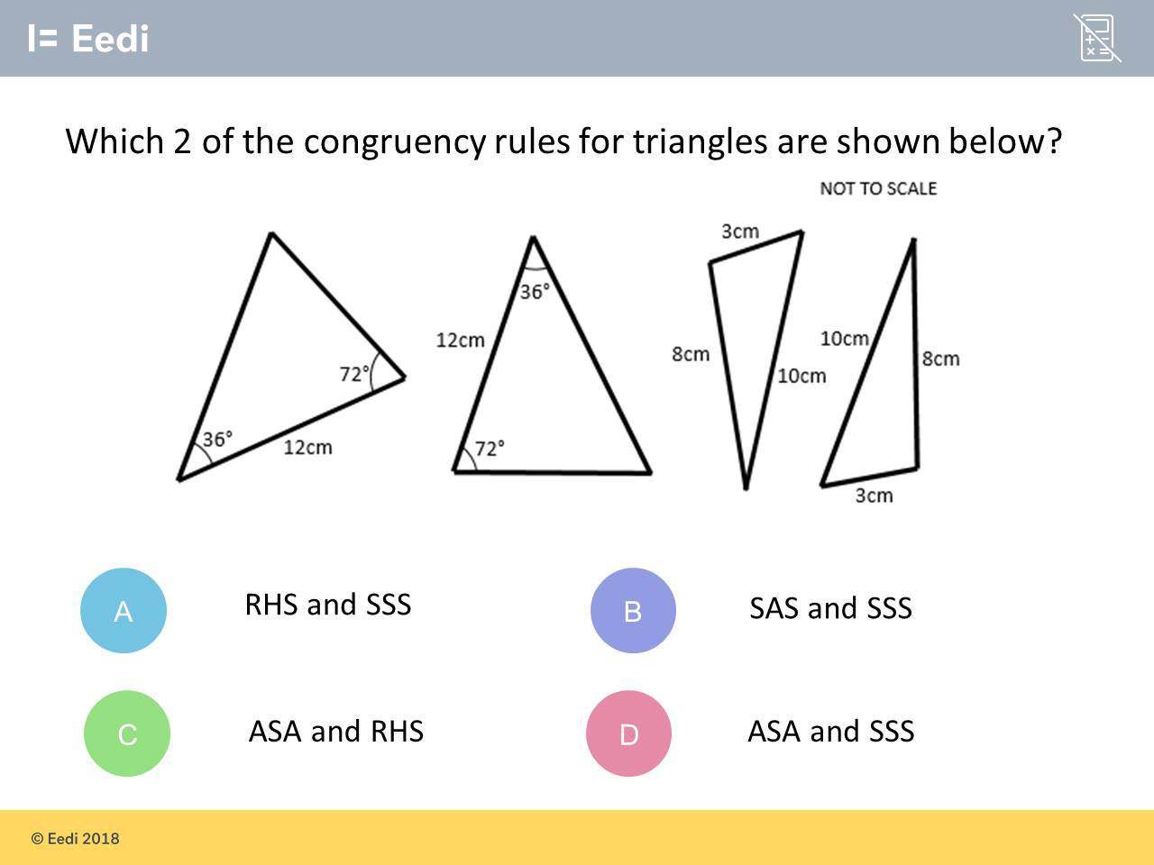
Question 8 – Congruence

Slide 17
Answer 8 – Congruence
CORRECT ANSWER | CORRECT EXPLANATION
D | The first pair of triangles give 2 angles and 1 side, i.e. ASA. The second pair of triangles give 3 sides, i.e. SSS.
COMMON MISTAKES | WHAT MIGHT BE YOUR MISTAKE
A | The student may not understand the acronyms.
B | The student has correctly identified the second pair, but not the first.
C | The student has correctly identified the first pair, but not the second.

Slide 18
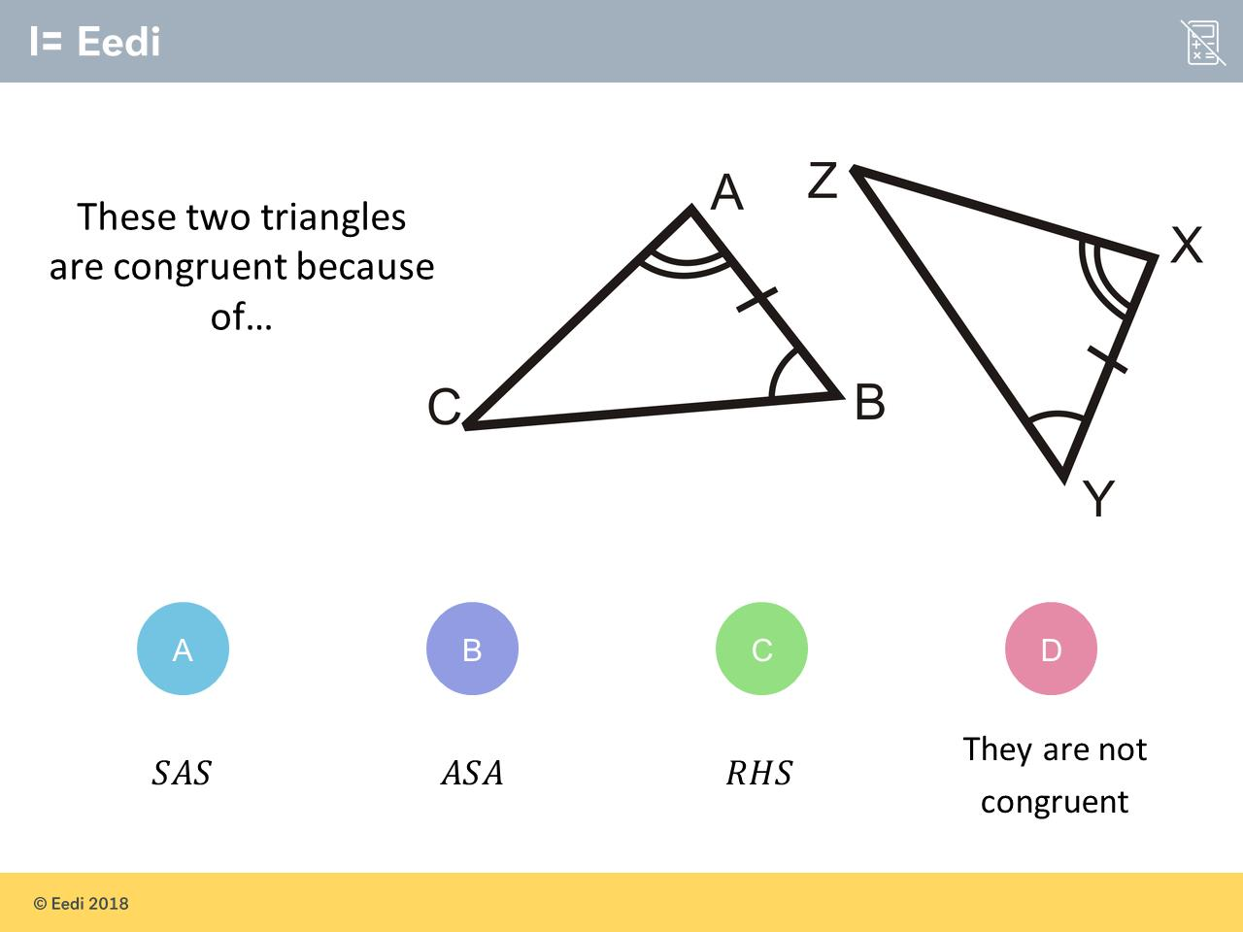
Question 9 – Congruence

Slide 19
Answer 9 – Congruence
CORRECT ANSWER | CORRECT EXPLANATION
B | These triangles are congruent because they have 2 equal angles and 1 equal side, which corresponds to ASA.
COMMON MISTAKES | WHAT MIGHT BE YOUR MISTAKE
A | SAS is two equal sides and 1 equal angle
C | RHS is right angle, hypotenuse and 1 other equal side.
D | The student may be confused about congruency laws.

Slide 20
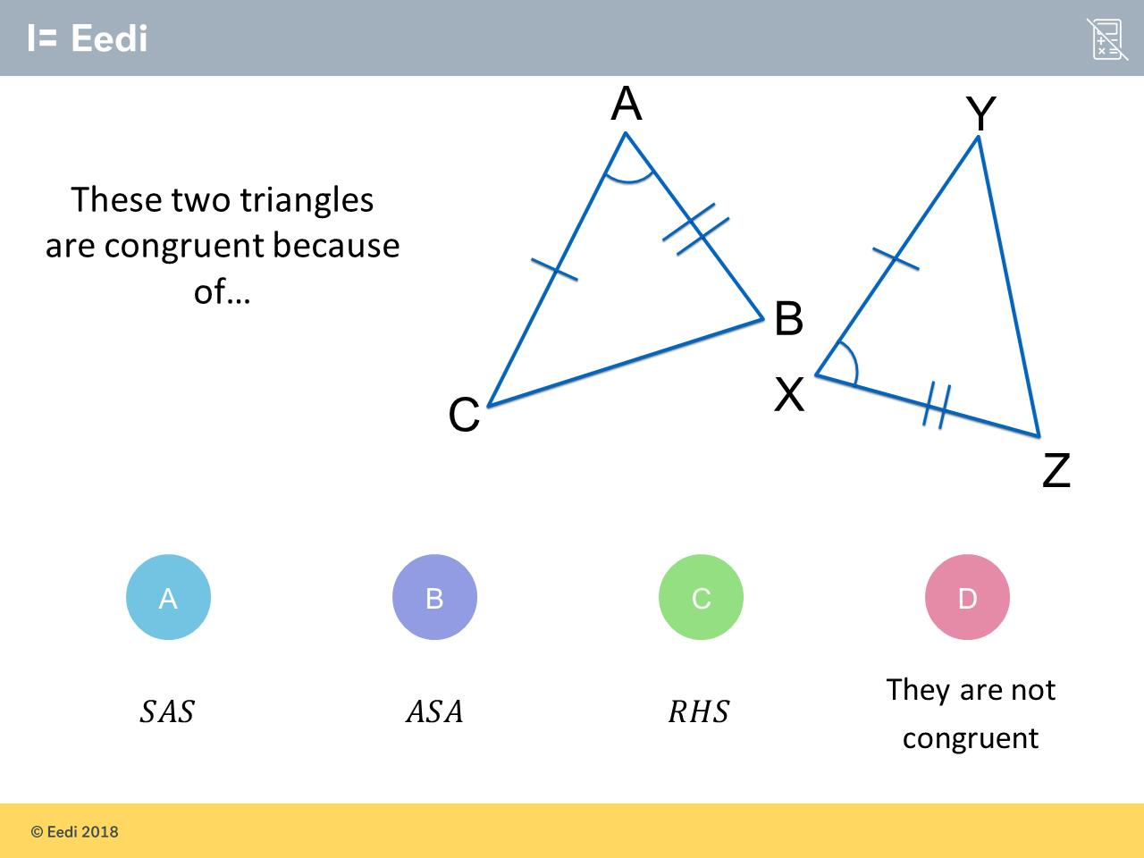
Question 10 – Congruence

Slide 21
Answer 10 – Congruence
CORRECT ANSWER | CORRECT EXPLANATION
A | These triangle are congruent, as they have two equal length sides, and the angle between the two sides is also the same. We write this as SAS.
COMMON MISTAKES | WHAT MIGHT BE YOUR MISTAKE
B | SAS is 2 equal sides and 1 equal angle
C | RHS is right angle, hypotenuse and 1 other equal side.
D | The student may be confused about congruency laws.

Slide 22
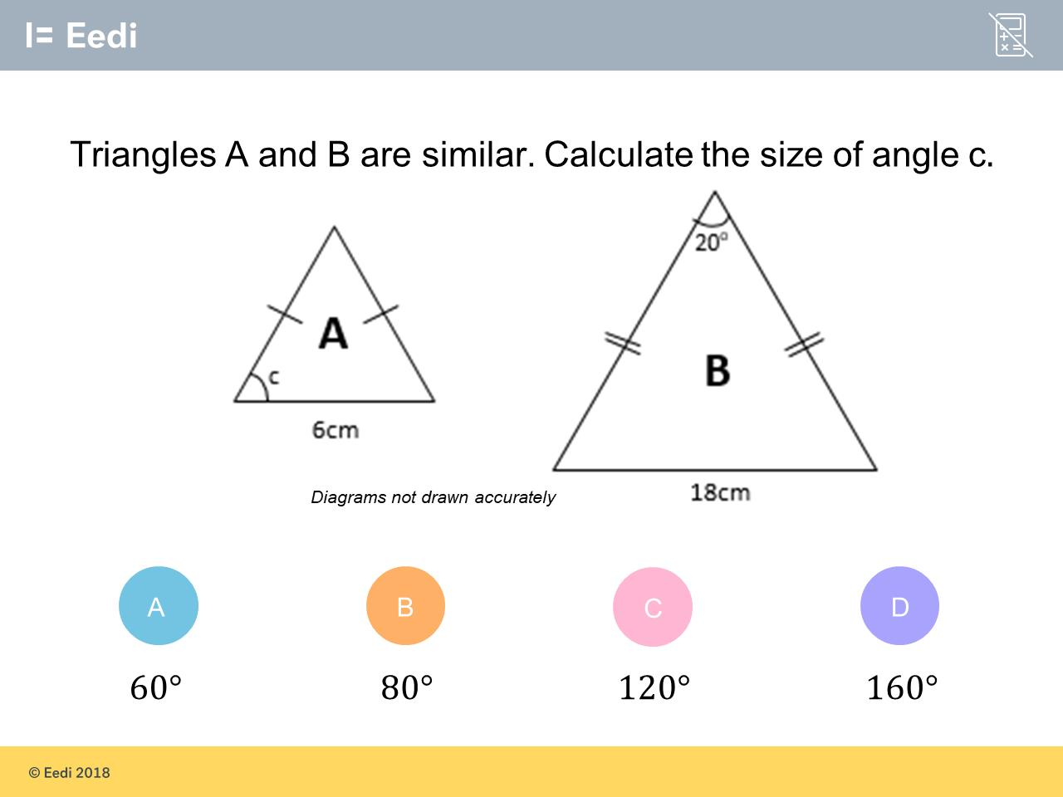
Question 9 – Similar Shapes

Slide 23
Answer 9 – Similar Shapes
CORRECT ANSWER | CORRECT EXPLANATION
80˚ | Similar triangle will have the same angles. Since the triangles are isosceles the two missing angles will be of equal size. (180 - 20) ÷ 2 = 80°.
COMMON MISTAKES | WHAT MIGHT BE YOUR MISTAKE
60˚ | The student may think because the scale factor is 3, the angle is multiplied by 3.
120˚ | The student may have multiplied the 20 angle by 3 due to the scale factor, then subtracted it from 180.
160˚ | The student may have subtracted 20 from 180 but forgotten to divide by two.

Slide 24
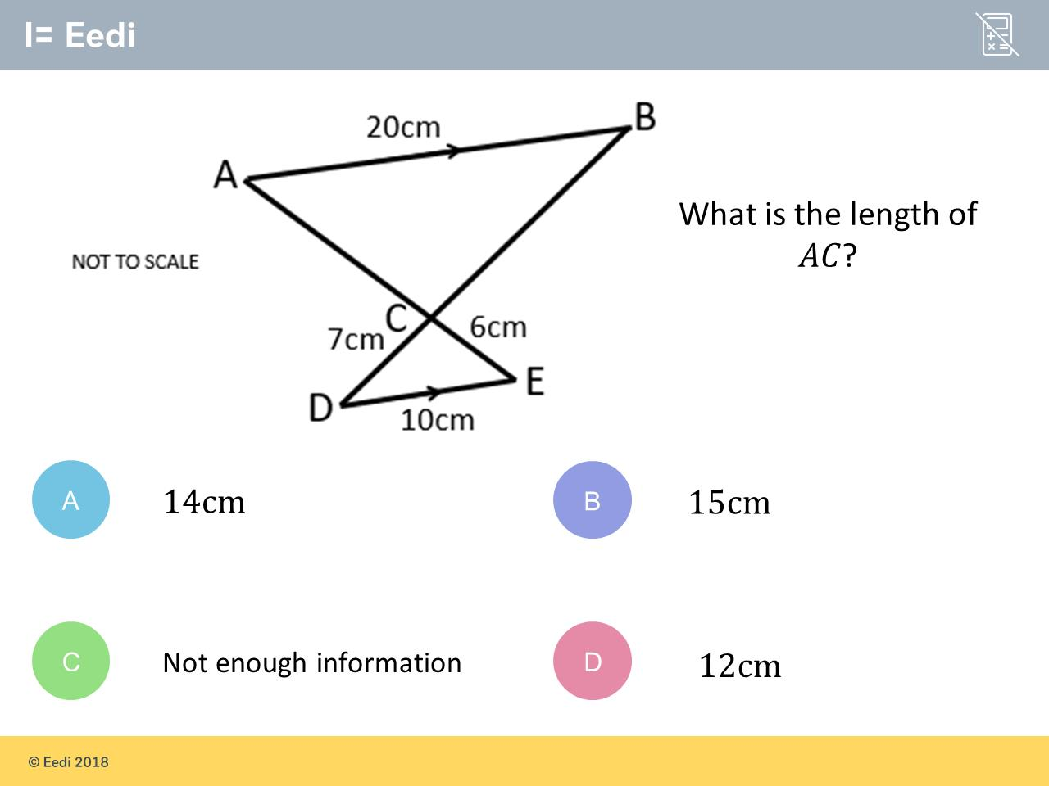
Question 10 – Similar Shapes

Slide 25
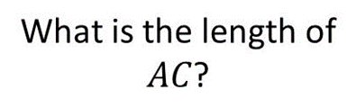
Answer 10 – Similar Shapes
CORRECT ANSWER | CORRECT EXPLANATION
D | The two triangles are similar, with the bigger triangle being an enlargement scale factor 2 of the smaller triangle. This means that AC is 2 × 6 = 12.
COMMON MISTAKES | WHAT MIGHT BE YOUR MISTAKE
A | The student has correctly identified the scale factor, but has applied the enlargement to the wrong side.
B | The student may have tried to estimate, although the diagram is not to scale.
C | The student may not understand that similarity is implied by parallel lines.

Slide 26
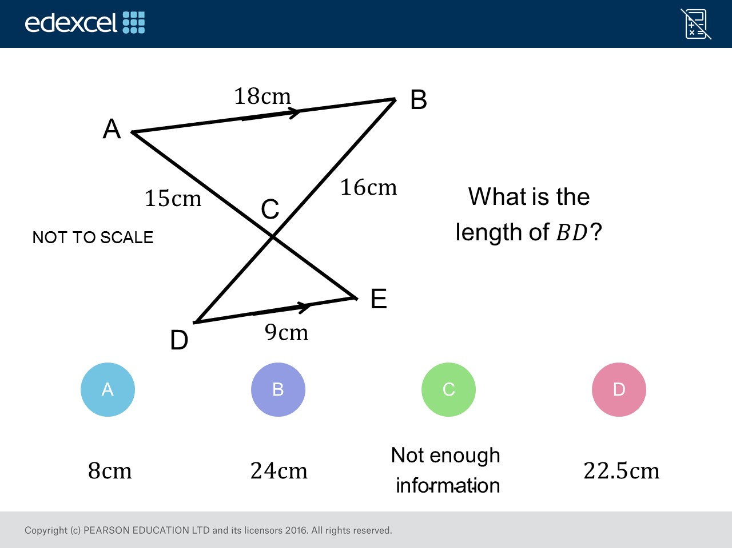
Question 11 – Similar Shapes

Slide 27
Answer 11 – Similar Shapes
CORRECT ANSWER | CORRECT EXPLANATION
24cm | The scale factor is 2 because 18/9=2 and then 16/2=8 so 16+8=24
COMMON MISTAKES | WHAT MIGHT BE YOUR MISTAKE
8cm | The student found the length of CD and forget to add CB (16cm)
23.5cm | The student match CD with AC. 15/2 = 7.5 and 7.5 + 16cm
7.5 cm | The student match CD with AC. 15/2 = 7.5

Slide 28
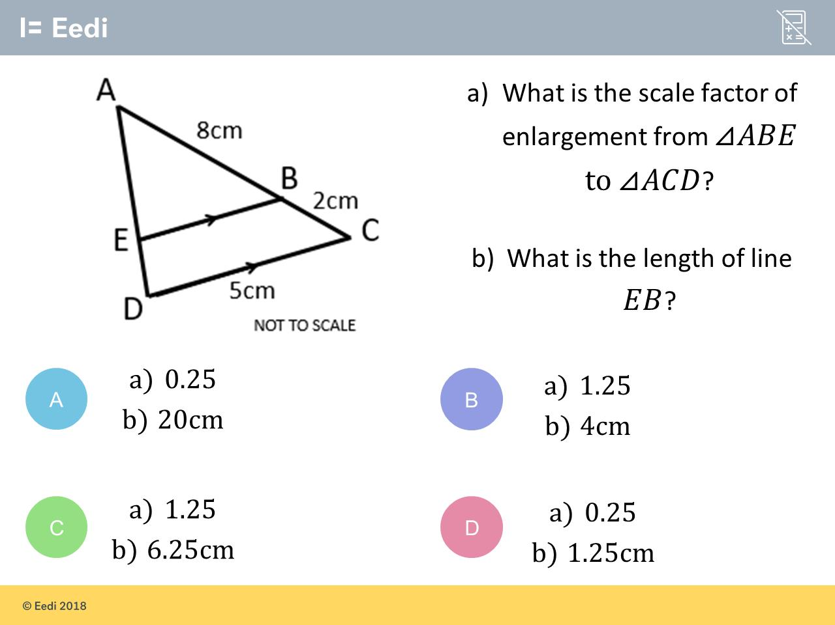
Question 12 – Similar Shapes

Slide 29
Answer 12 – Similar Shapes
CORRECT ANSWER | CORRECT EXPLANATION
B | The scale factor can be found by calculating (8+2)÷ 8, which equals 1.25. EB can then be found by doing 5 ÷ 1.25 = 4.
COMMON MISTAKES | WHAT MIGHT BE YOUR MISTAKE
A | The student may have calculated the scale factor by computing 2÷ 8.
C | The student found the correct scale factor, but used incorrect application to the length.
D | The student calculated the scale factor using 2÷ 8, then used the wrong application.

Slide 30
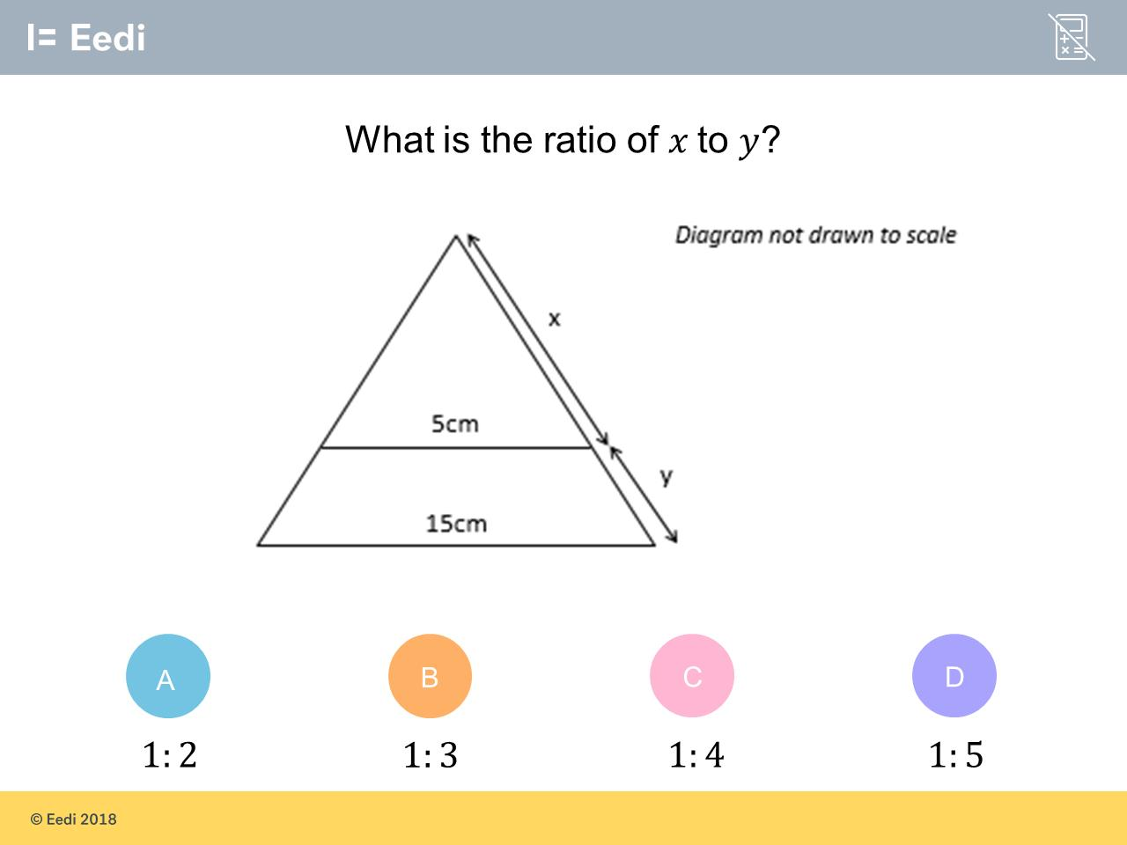
Question 13 – Similar Shapes

Slide 31
Answer 13 – Similar Shapes
CORRECT ANSWER | CORRECT EXPLANATION
1:2 | The scale factor is 15 ÷ 5 = 3. So the side of the large triangle (x + y) should be 3 times the small triangle x. So x + y = 3x. Subtracting x from both sides gives y = 2x. So the ratio is 1 : 2
COMMON MISTAKES | WHAT MIGHT BE YOUR MISTAKE
1:3 | The student may have calculated 15 ÷ 5 = 3 and think this is the ratio.
1:4 | The student may not understand the question.
1:5 | The student may assume that because both 5 and 15 are in the 5 times table, the ratio must be 1:5.

