Slide 1
LO: Sine Rule
(Angles)

Slide 2
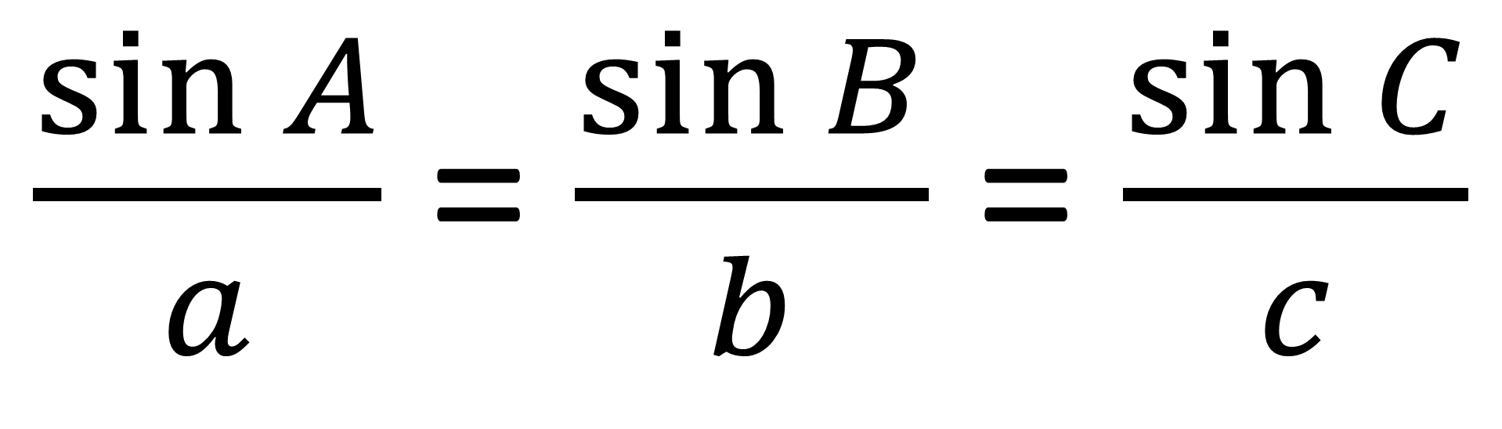
$\frac{\sin{A}}{a}$ = $\frac{\sin{B}}{b}$ = $\frac{\sin{C}}{c}$
Capital letters represent angles.
Lower case letters represent sides.

Slide 3
A
Labelling a Triangle
b
c
C
a
B

Slide 4
Don't be afraid to relabel the triangle
A
X
b
c
Z
C
a
Y
B

Slide 5
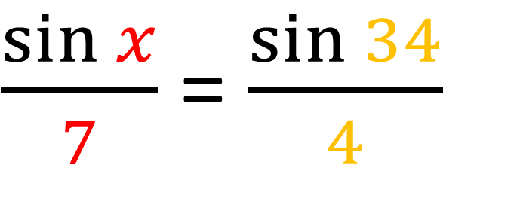
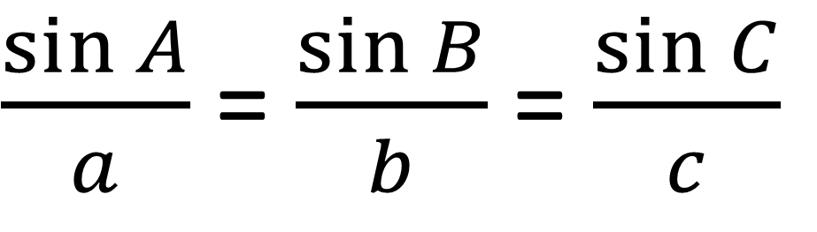
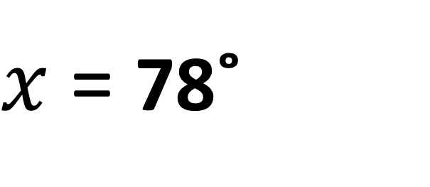
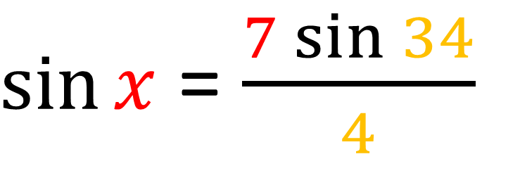
$\frac{\sin{A}}{a}$ = $\frac{\sin{B}}{b}$ = $\frac{\sin{C}}{c}$
A
x
b
$\frac{\sin{x}}{7}$ = $\frac{\sin{34}}{4}$
c
4cm
C
34˚
$\sin{x}$ = $\frac{7\sin{34}}{4}$
7cm
B
a
$x$ = 78˚

Slide 6
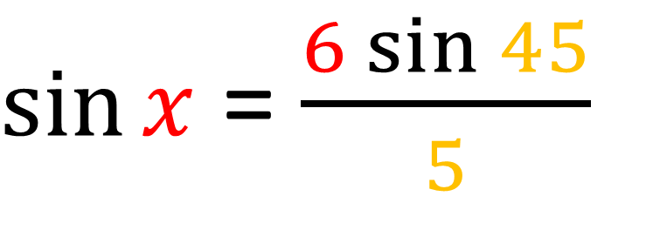
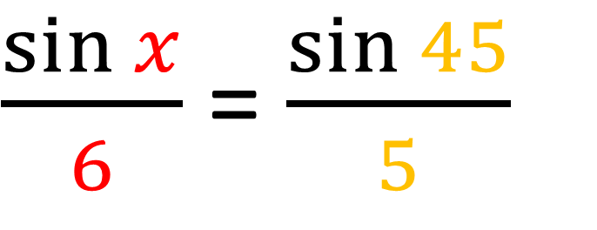
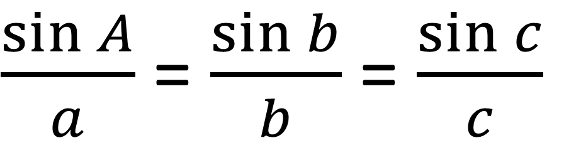
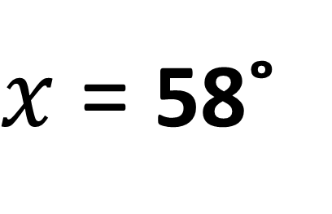
$\frac{\sin{A}}{a}$ = $\frac{\sin{b}}{b}$ = $\frac{\sin{c}}{c}$
b
A
5cm
x
C
c
$\frac{\sin{x}}{6}$ = $\frac{\sin{45}}{5}$
6cm
45˚
a
$\sin{x}$ = $\frac{6\sin{45}}{5}$
B
$x$ = 58˚

Slide 7
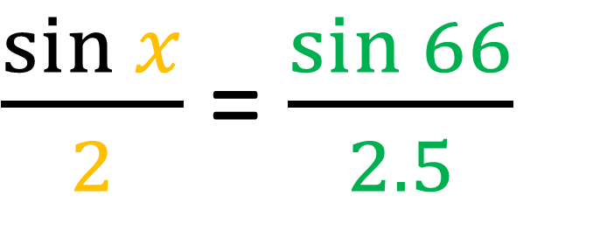
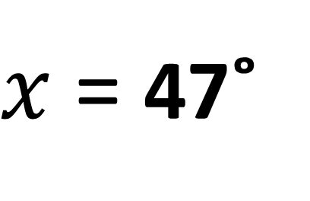
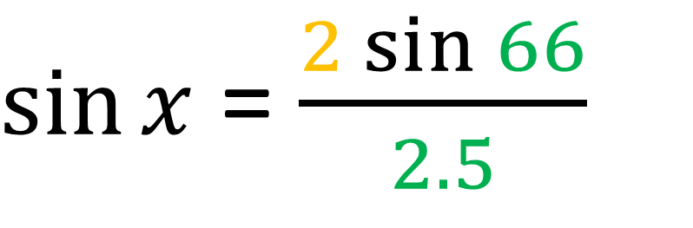
$\frac{\sin{A}}{a}$ = $\frac{\sin{b}}{b}$ = $\frac{\sin{c}}{c}$
A
c
2cm
2.5cm
$\frac{\sin{x}}{2}$ = $\frac{\sin{66}}{2.5}$
b
66˚
x
C
a
$\sin{x}$ = $\frac{2\sin{66}}{2.5}$
B
$x$ = 47˚

Slide 8
Do you have the correct information to use the sine rule?
A
a | A
7 | x
b | B
4 | 34˚
x
b
c
4cm
c | C
Do you have two complete pairs?
C
34˚
7cm
B
a

Slide 9
Sine rule or Not
A
a | A
7
b | B
3 | x
c
b
8cm
3cm
c | C
8
Not
x
C
7cm
B
a

Slide 10
Sine rule or Not
A
a | A
 | 40˚
b | B
6 | x
x
c
b
8cm
6cm
c | C
 | 8
Not
C
a
B

Slide 11
Sine rule or Not
c
A
7cm
a | A
b | B
5 | 34˚
B
34˚
b
5cm
x
c | C
7 | x
Yes
a
C

Slide 12
Sine rule or Not
c
B
A
x
a | A
4 | x
b | B
3
b
4cm
3cm
Not
c | C
a
C

Slide 13
Sine rule or Not
c
B
A
x
70˚
a | A
6 | x
b | B
4 | 70˚
b
6cm
4cm
c | C
 | 60˚
Yes
a
60˚
C

