Slide 1
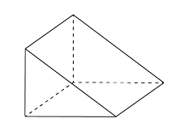

 | Plan | Front View | Side View

Slide 2
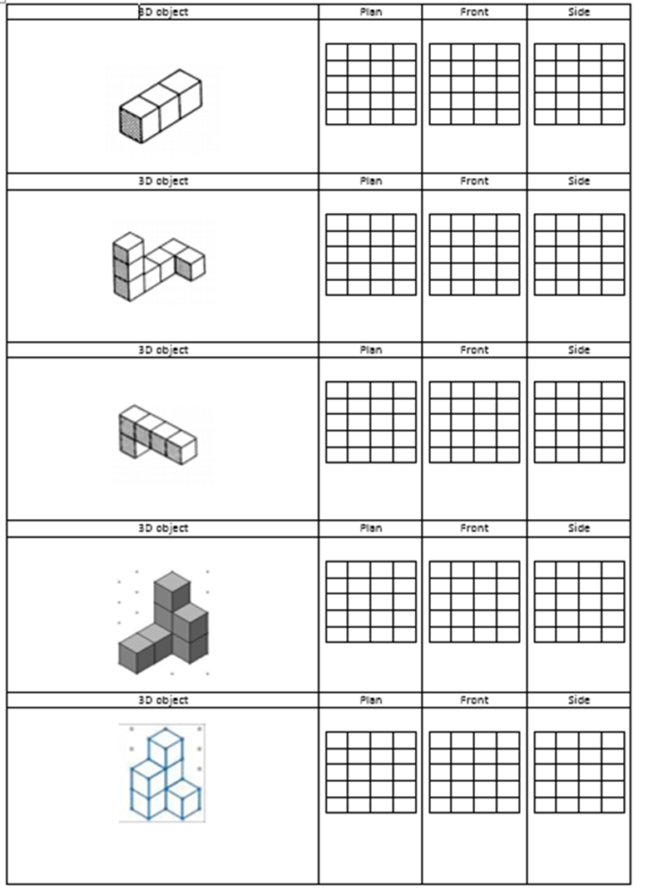

Slide 3
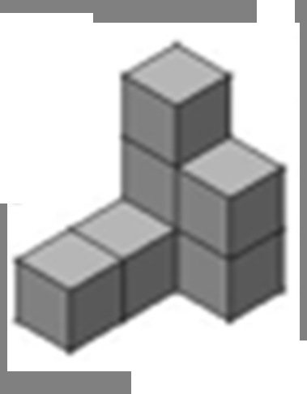

Slide 4

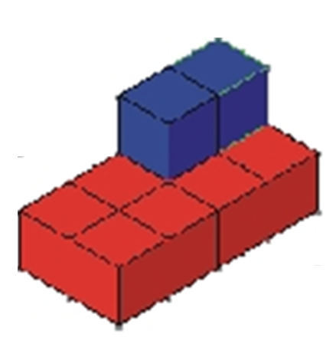

Slide 5
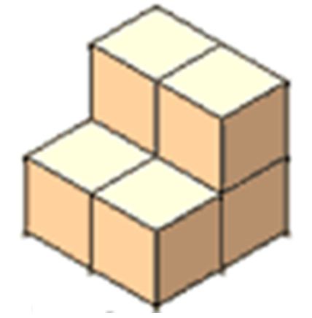


Slide 6
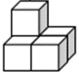
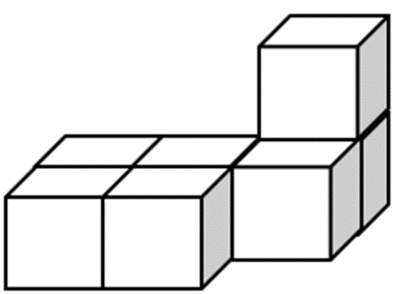

Slide 7
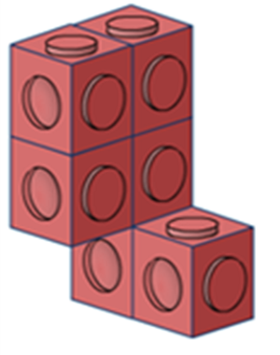


Slide 8
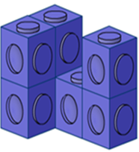
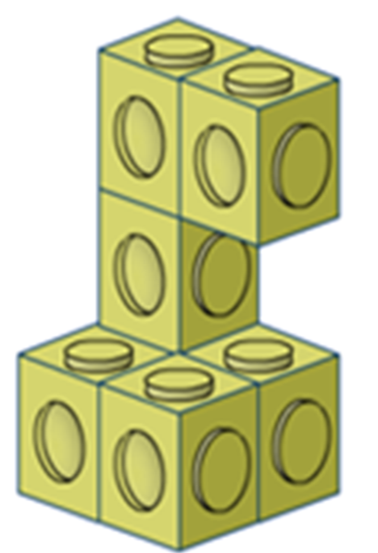

Slide 9
ANSWERS

Slide 10
 | Plan | Front View | Side View

Slide 11
Plan | Front View | Side View

Slide 12
Plan | Front View | Side View

Slide 13
Plan | Front View | Side View

Slide 14
Plan | Front View | Side View

Slide 15
Plan | Front View | Side View

Slide 16
Plan | Front View | Side View

Slide 17
Plan | Front View | Side View

