Slide 1

Diagnostic
uestions
Misconceptions

Slide 2
Worst answered question?
John records some measurements 1.2, 3.4, 2.8, 8.1, 4.4 Which of the following is correct?
A Median is 2.8 | B Median is 3.4
C Median 3.98 | D Median is 4.65
Which average should not be used if you do not have any repeating data?
A Mean | B Median
C Mode | D Range
40% Incorrect
37% Incorrect

Slide 3
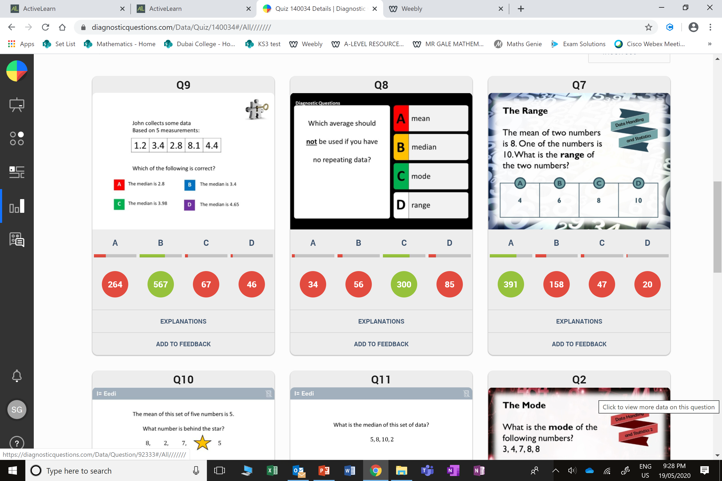
Most common wrong answer?
John records some measurements 1.2, 3.4, 2.8, 8.1, 4.4 Which of the following is correct?
A Median is 2.8 | B Median is 3.4
C Median 3.98 | D Median is 4.65
A
They did not put the data in order of smallest to biggest .

Slide 4
Most common wrong answer?
Which average should not be used if you do not have any repeating data?
A Mean | B Median
C Mode | D Range
C
They thought range is not an average.

