Slide 1
Vectors
Geometric Problems
Chapter 12
(Part 5 of 6)

Slide 2
For more general problems involving vectors, you will need to recall basic geometry facts.
Often drawing a diagram
can help.

Slide 3
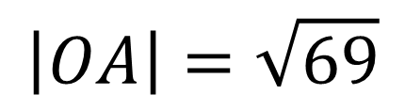
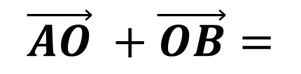
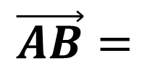
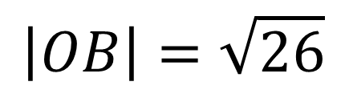
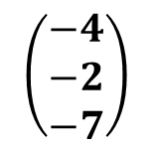
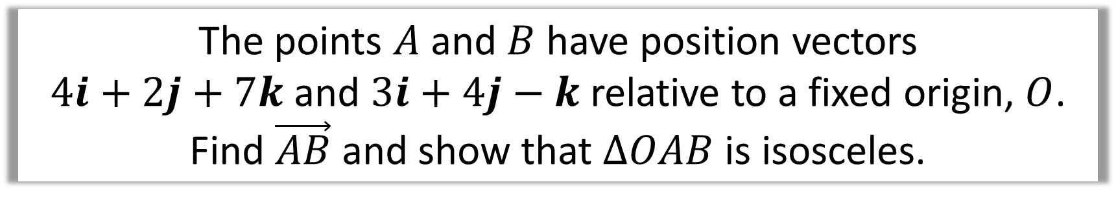
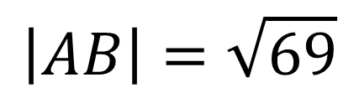
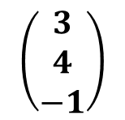
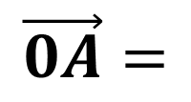
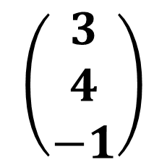
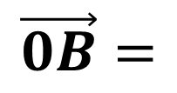
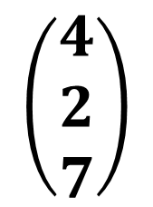
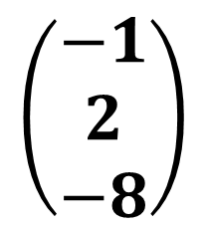
The points $A$ and $B$ have position vectors
$4i+2j+7k$ and $3i+4j−k$ relative to a fixed origin, $O$.
Find $\vec{AB}$ and show that $ΔOAB$ is isosceles.
$$\left(\begin{aligned}3 \\ 4 \\ −1\end{aligned}\right)$$
$$\left(\begin{aligned}4 \\ 2 \\ 7\end{aligned}\right)$$
$$\left(\begin{matrix}−1 \\ 2 \\ −8\end{matrix}\right)$$
$$\vec{0B}=$$
$$\vec{0A}=$$
$$\vec{AB}=$$
$$\vec{AO} +\vec{OB}=$$
$$\left(\begin{aligned}−4 \\ −2 \\ −7\end{aligned}\right)$$
$$\left(\begin{aligned}3 \\ 4 \\ −1\end{aligned}\right)$$
$$\left|OB\right|=\sqrt{26}$$
$$\left|OA\right|=\sqrt{69}$$
$$\left|AB\right|=\sqrt{69}$$
Two side (AB and OA) are the same length
hence it is an isosceles triangle.

Slide 4
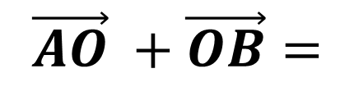
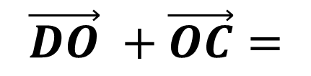
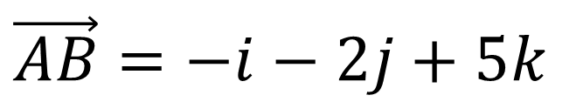
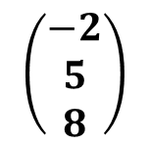
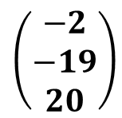
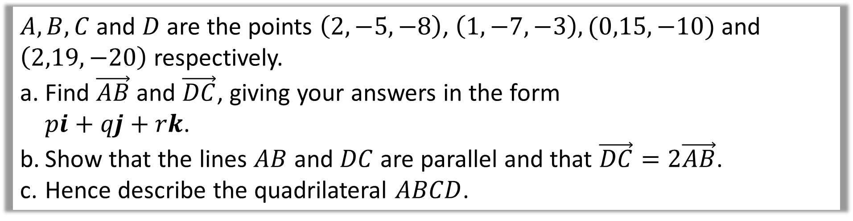
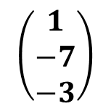
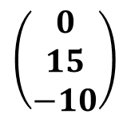
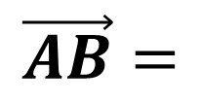
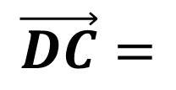
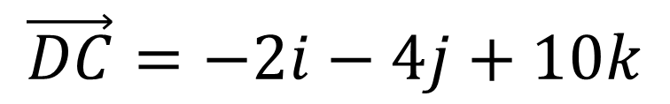
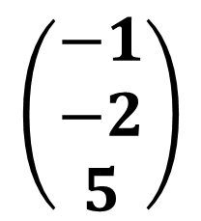
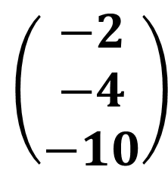
$A, B, C$ and $D$ are the points $\left(2,−5,−8\right)$, $\left(1,−7,−3\right), (0,15,−10)$ and $\left(2,19,−20\right)$ respectively.
Find $\vec{AB}$ and $\vec{DC}$, giving your answers in the form
$pi+qj+rk$.
Show that the lines $AB$ and $DC$ are parallel and that $\vec{DC}=2\vec{AB}$.
Hence describe the quadrilateral $ABCD$.
$$\left(\begin{matrix}−1 \\ −2 \\ 5\end{matrix}\right)$$
a)
$$\vec{AB}=$$
$$\vec{AO} +\vec{OB}=$$
$$\vec{AB}=−i−2j+5k$$
$$\left(\begin{aligned}−2 \\ 5 \\ 8\end{aligned}\right)$$
$$\left(\begin{aligned}1 \\ −7 \\ −3\end{aligned}\right)$$
$$\left(\begin{matrix}−2 \\ −4 \\ −10\end{matrix}\right)$$
$$\vec{DC}=$$
$$\vec{DO} +\vec{OC}=$$
$$\vec{DC}=−2i−4j+10k$$
$$\left(\begin{aligned}−2 \\ −19 \\ 20\end{aligned}\right)$$
$$\left(\begin{aligned}0 \\ 15 \\ −10\end{aligned}\right)$$

Slide 5

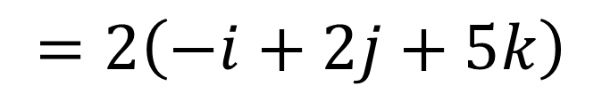
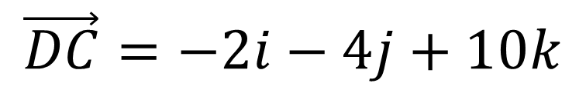
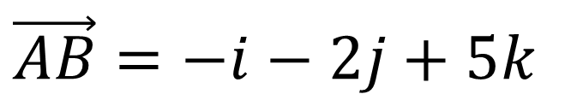
$A, B, C$ and $D$ are the points $\left(2,−5,−8\right)$, $\left(1,−7,−3\right), (0,15,−10)$ and $\left(2,19,−20\right)$ respectively.
Find $\vec{AB}$ and $\vec{DC}$, giving your answers in the form
$pi+qj+rk$.
Show that the lines $AB$ and $DC$ are parallel and that $\vec{DC}=2\vec{AB}$.
Hence describe the quadrilateral $ABCD$.
b)
$$\vec{AB}=−i−2j+5k$$
$$\vec{DC}=−2i−4j+10k$$
$$=2\left(−i+2j+5k\right)$$
$$\vec{DC}=2\vec{AB}$$
They are multiples $∴$ parallel.

Slide 6
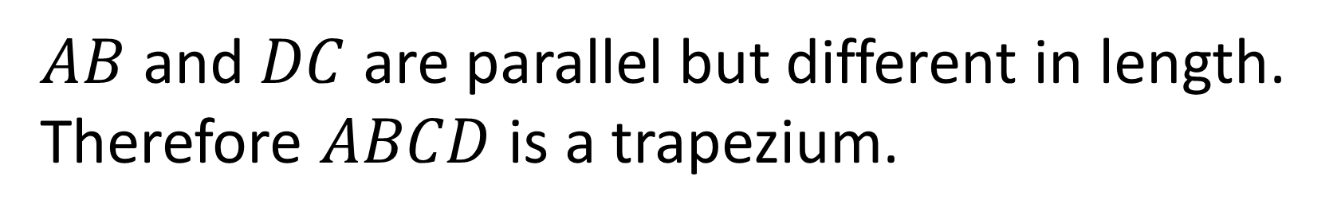
$A, B, C$ and $D$ are the points $\left(2,−5,−8\right)$, $\left(1,−7,−3\right), (0,15,−10)$ and $\left(2,19,−20\right)$ respectively.
Find $\vec{AB}$ and $\vec{DC}$, giving your answers in the form
$pi+qj+rk$.
Show that the lines $AB$ and $DC$ are parallel and that $\vec{DC}=2\vec{AB}$.
Hence describe the quadrilateral $ABCD$.
c)
$AB$ and $DC$ are parallel but different in length. Therefore $ABCD$ is a trapezium.

Slide 7
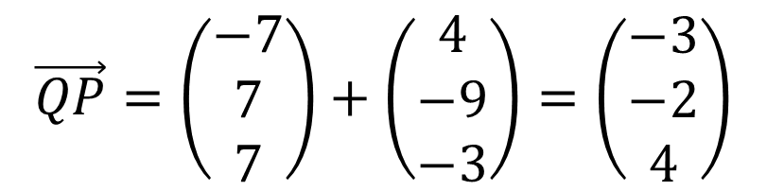


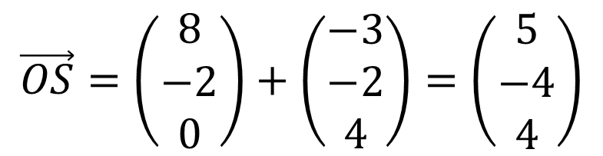
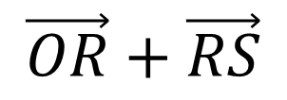
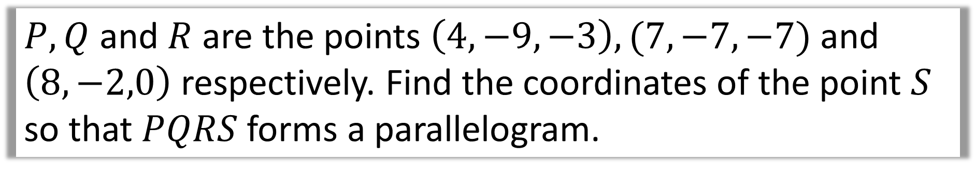

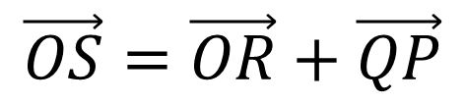


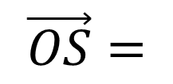


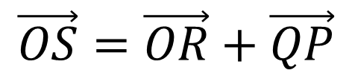
$P, Q$ and $R$ are the points $\left(4,−9,−3\right),(7,−7,−7)$ and $\left(8,−2,0\right)$ respectively. Find the coordinates of the point $S$ so that $PQRS$ forms a parallelogram.
$$S$$
$$\vec{QP}=$$
$$\vec{QO}+\vec{OP}$$
$$\vec{QP}=\left(\begin{matrix}−7 \\ 7 \\ 7\end{matrix}\right)+\left(\begin{matrix}4 \\ −9 \\ −3\end{matrix}\right)=\left(\begin{matrix}−3 \\ −2 \\ 4\end{matrix}\right)$$
$$P(4,−9,−3)$$
$$R(8,−2,0)$$
$$\vec{OS}=\vec{OR}+\vec{QP}$$
$$Q(7,−7,−7)$$
$$\vec{OS}=\left(\begin{matrix}8 \\ −2 \\ 0\end{matrix}\right)+\left(\begin{matrix}−3 \\ −2 \\ 4\end{matrix}\right)=\left(\begin{matrix}5 \\ −4 \\ 4\end{matrix}\right)$$
$$\vec{OS}=$$
$$\vec{OR}+\vec{RS}$$
$$\vec{OS}=\vec{OR}+\vec{QP}$$
$$S \left(5,−4,4\right)$$

Slide 8
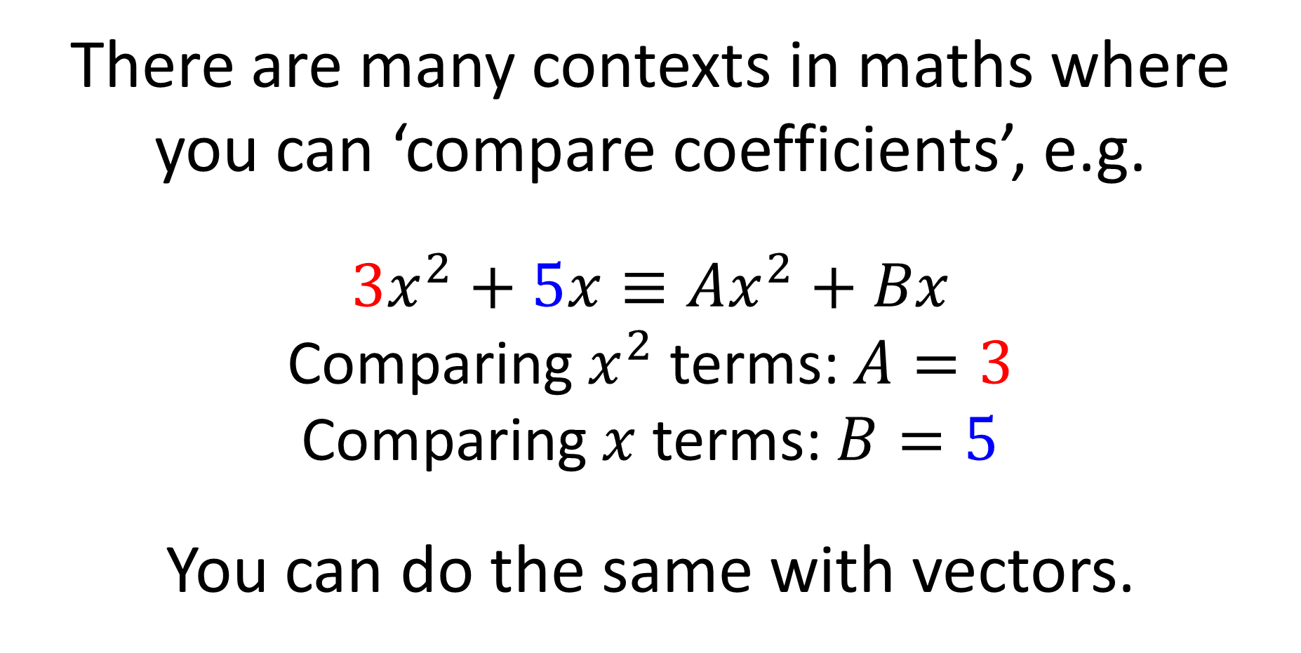
Comparing Coefficients
There are many contexts in maths where
you can ‘compare coefficients’, e.g.
$$3x^{2}+5x≡Ax^{2}+Bx$$
Comparing $x^{2}$ terms: $A=3$
Comparing $x$ terms: $B=5$
You can do the same with vectors.

Slide 9
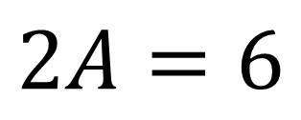


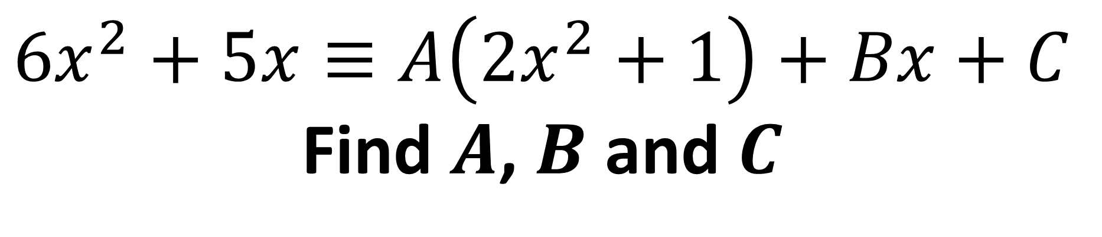
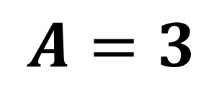
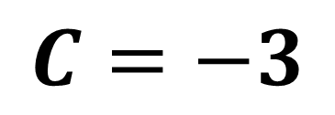

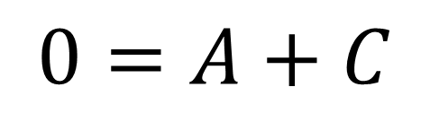
Comparing Coefficients
$$6x^{2}+5x≡A\left({2x}^{2}+1\right)+Bx+C$$
Find $A$, $B$ and $C$
Comparing $x^{2}$ terms:
$$2A=6$$
$$A=3$$
Comparing $x$ terms:
$$B=5$$
Comparing constant terms:
$$0=A+C$$
$$C=−3$$

Slide 10



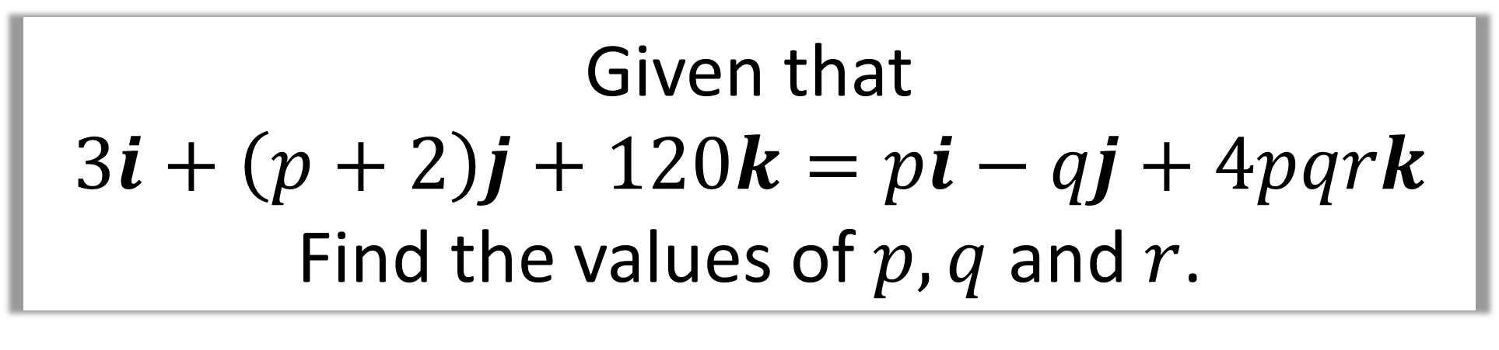
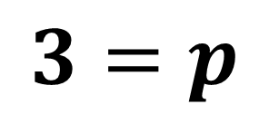
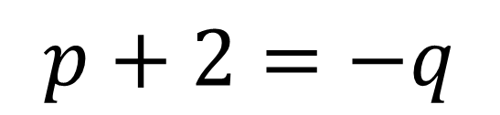
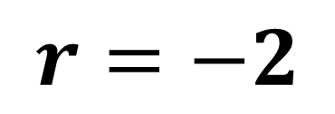
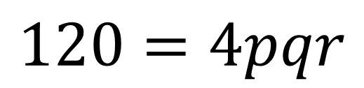
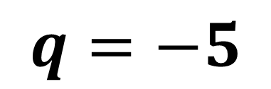
Given that
$3i+\left(p+2\right)j+120k=pi−qj+4pqrk$
Find the values of $p, q$ and $r$.
Comparing $i$:
$$3=p$$
Comparing $j$:
$$p+2=−q$$
$$q=−5$$
Comparing $k$:
$$120=4pqr$$
$$r=−2$$

