Slide 1
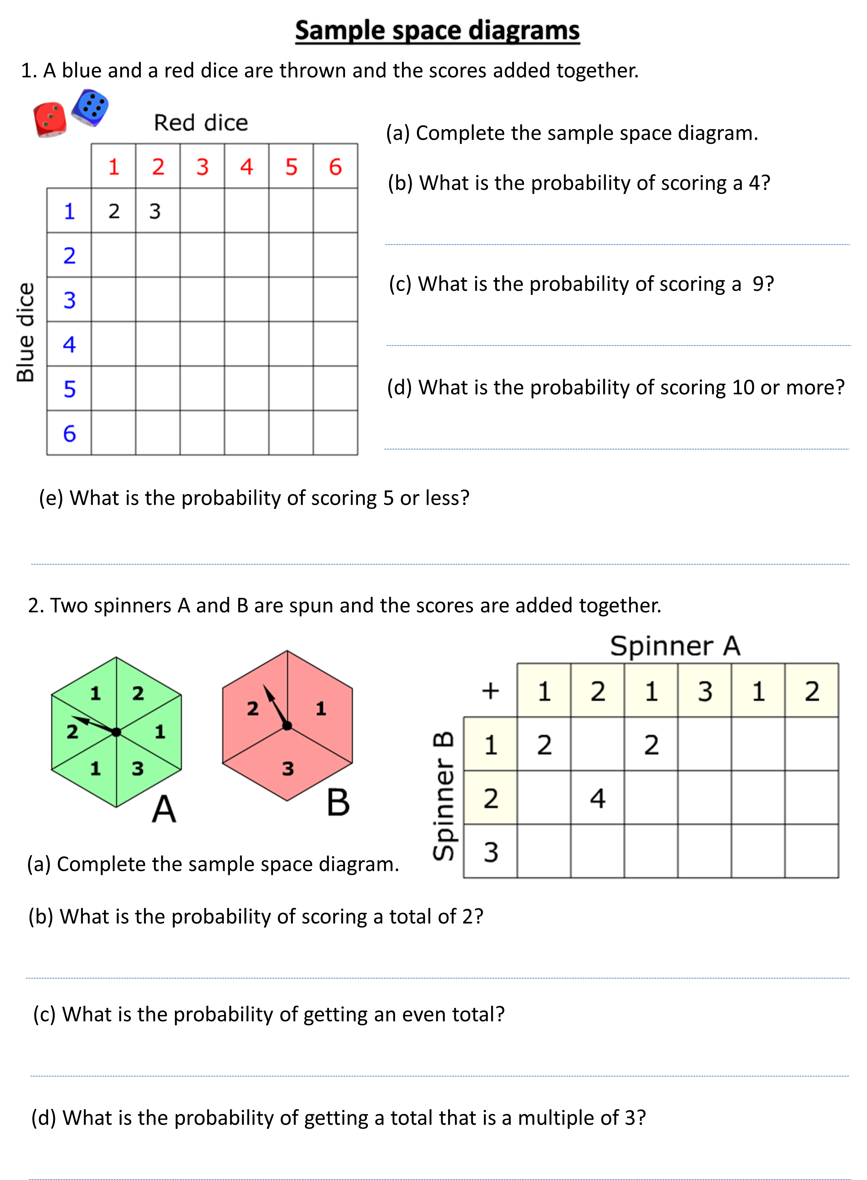
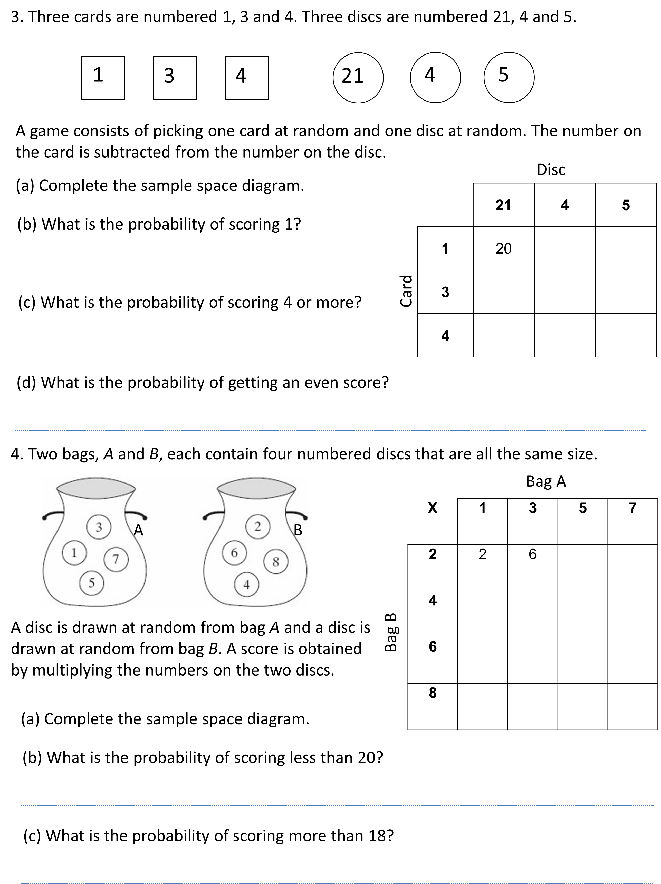

Slide 2
ANSWERS

Slide 3
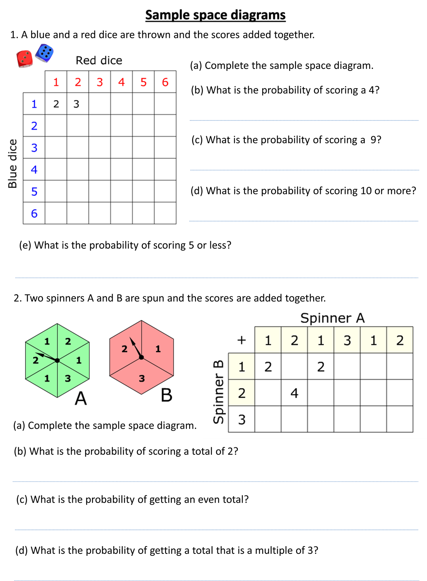
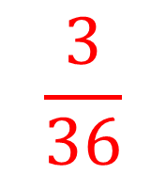
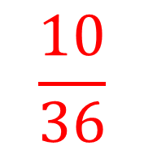
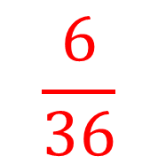
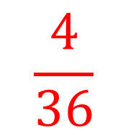
$$\frac{3}{36}$$
4
5
6
7
3
4
5
6
7
8
6
7
8
9
$$\frac{4}{36}$$
4
5
5
6
7
8
9
10
6
7
8
9
10
11
$$\frac{6}{36}$$
7
8
9
10
11
12
$$\frac{10}{36}$$

Slide 4
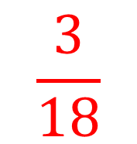
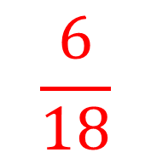
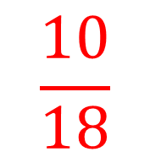
3
4
2
3
3
3
5
3
4
4
5
4
6
4
5
$$\frac{3}{18}$$
$$\frac{10}{18}$$
$$\frac{6}{18}$$

Slide 5
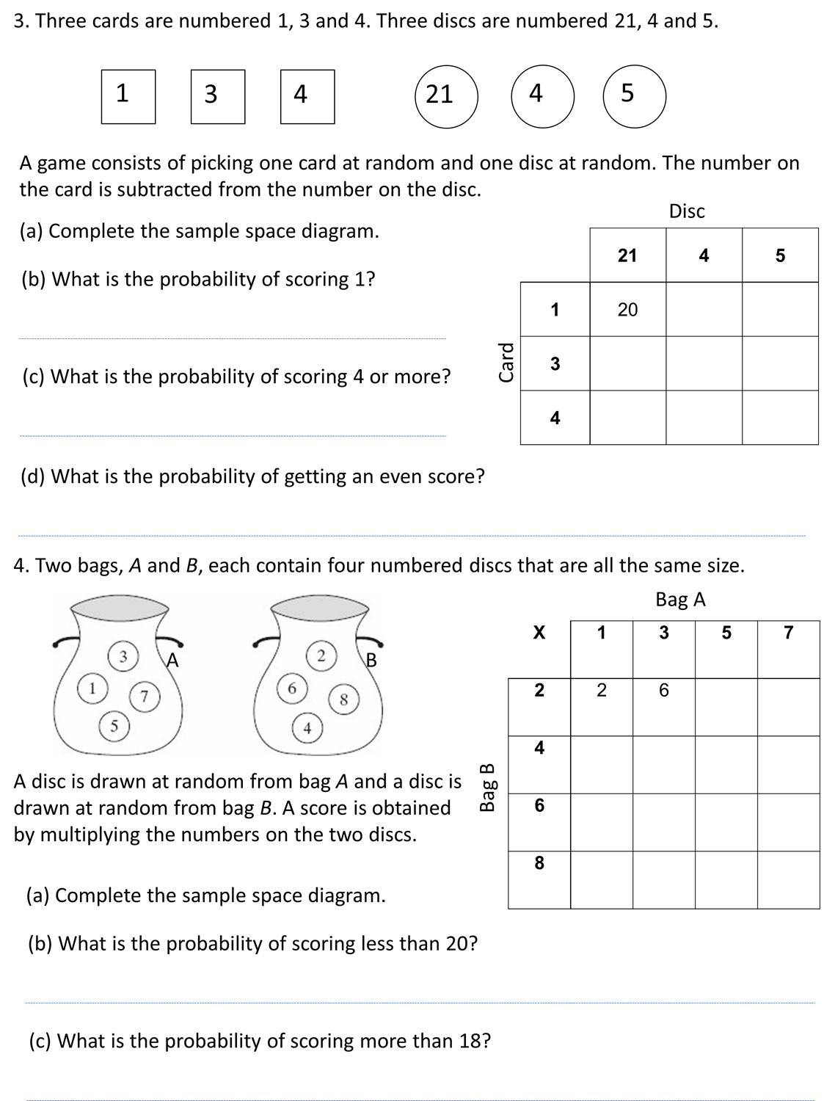
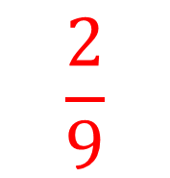
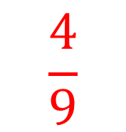
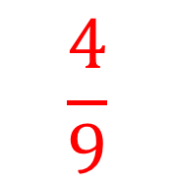
$$\frac{2}{9}$$
3
4
18
1
2
$$\frac{4}{9}$$
17
0
1
$$\frac{4}{9}$$

Slide 6
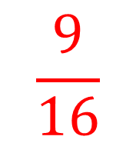
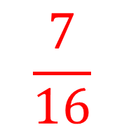
10
14
4
12
20
28
6
18
30
42
8
24
40
56
$$\frac{9}{16}$$
$$\frac{7}{16}$$

