Slide 1
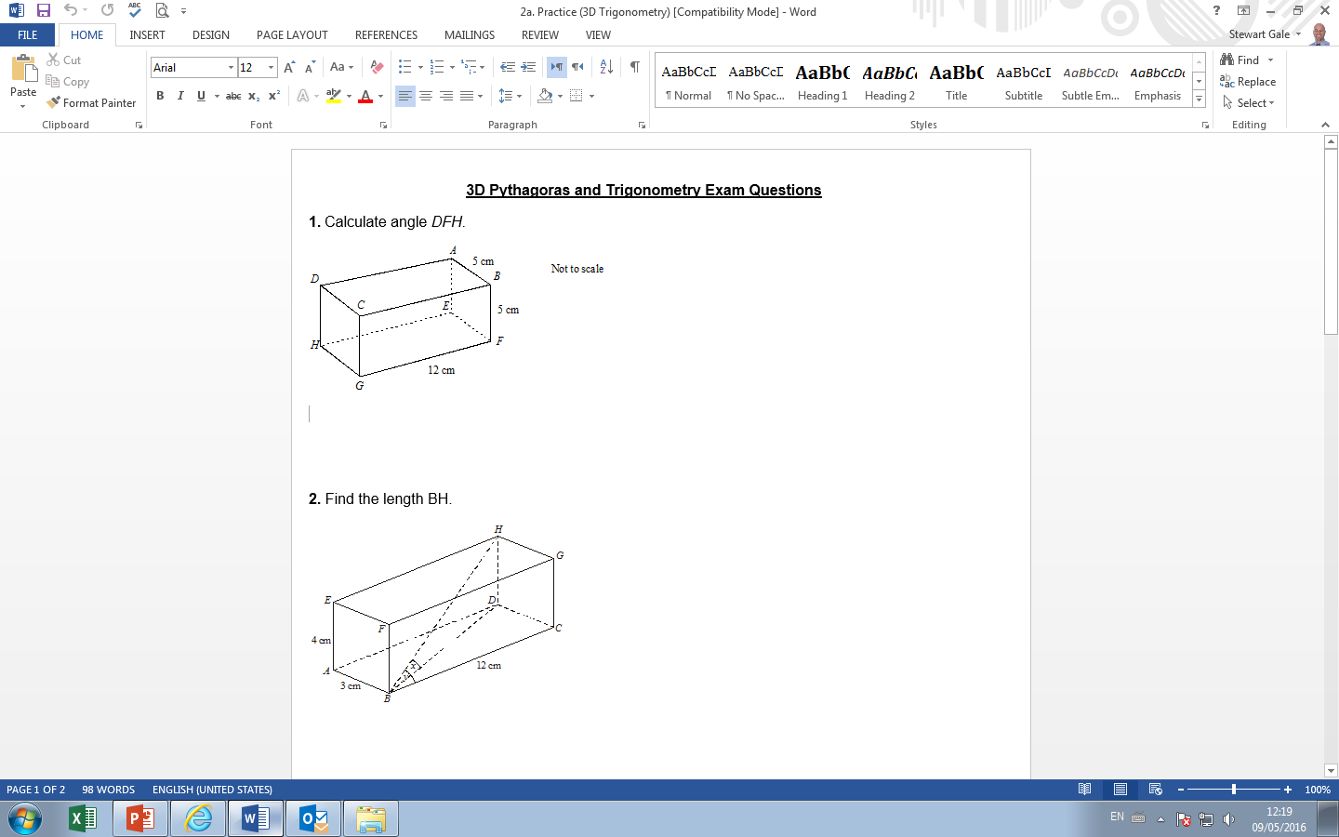
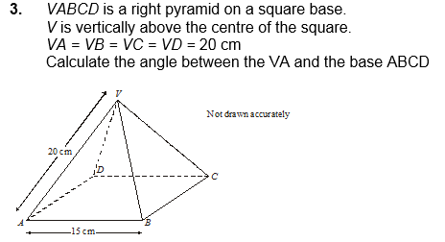
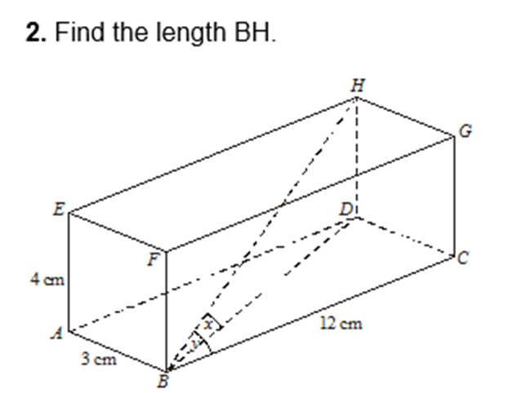
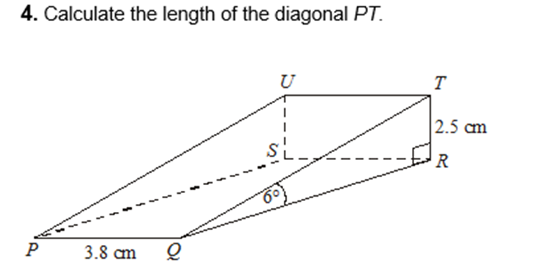

Slide 2
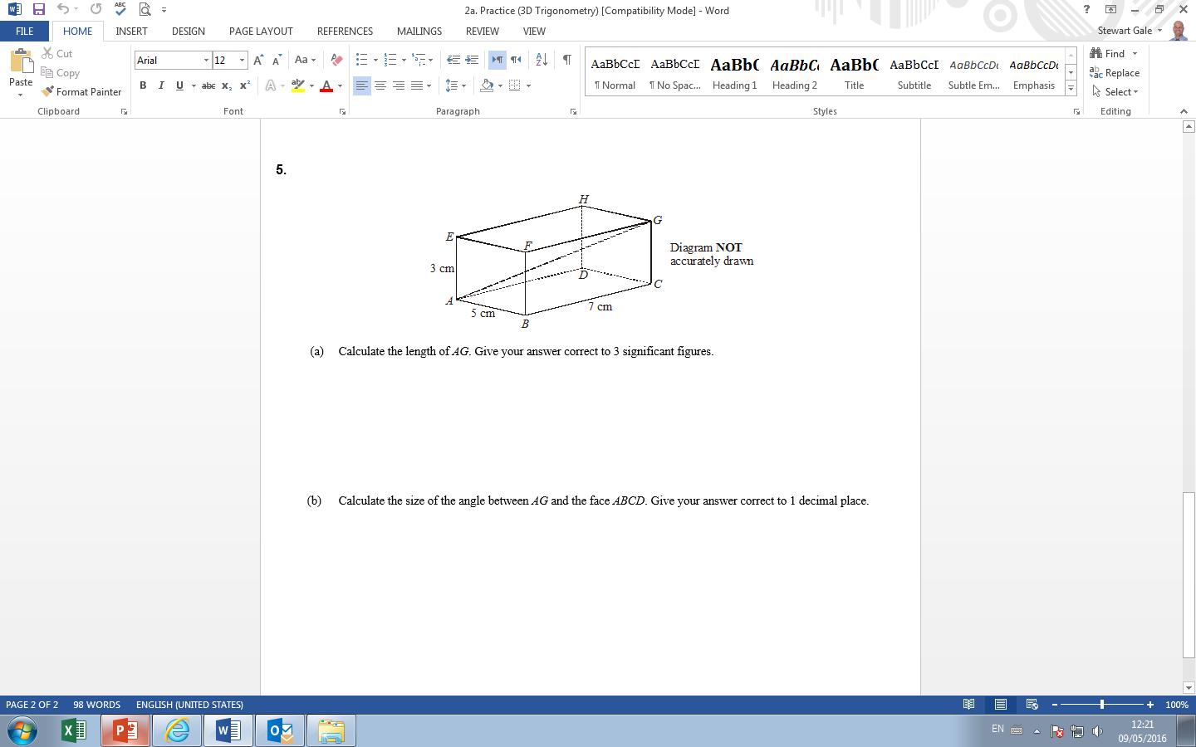

Slide 3
ANSWERS

Slide 4
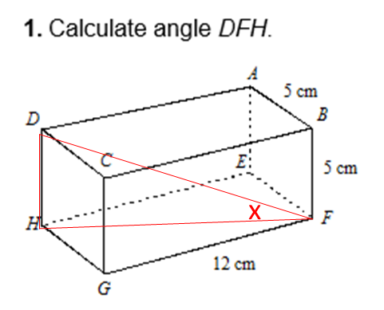

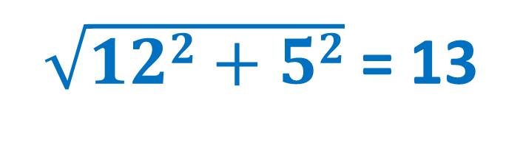
$\sqrt{122+52}$= 13
tan⁻¹ $(\frac{5}{13})$= 21

Slide 5
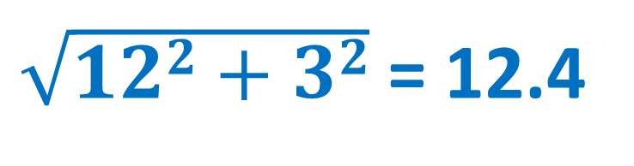
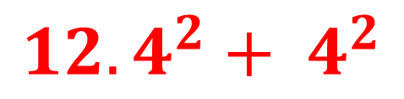

$\sqrt{122+32}$= 12.4
$$\sqrt{…………..d}$$
= 13
$${12.4}^{2}+ 4^{2}$$

Slide 6
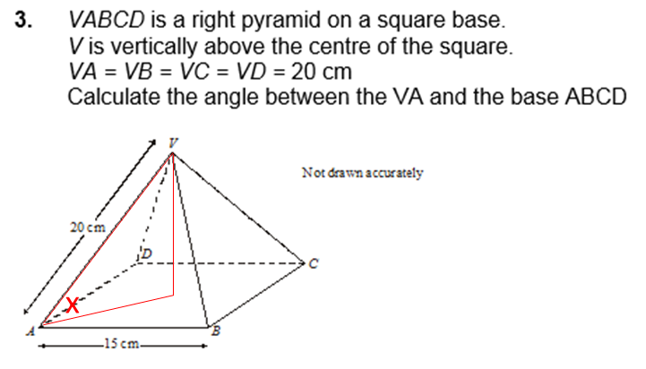

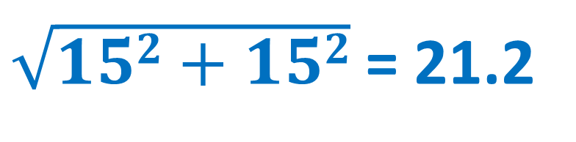

$\sqrt{152+152}$= 21.2
$21.2 ÷ 2$= 10.6
cos⁻¹ $(\frac{10.6}{20})$= 58°

Slide 7
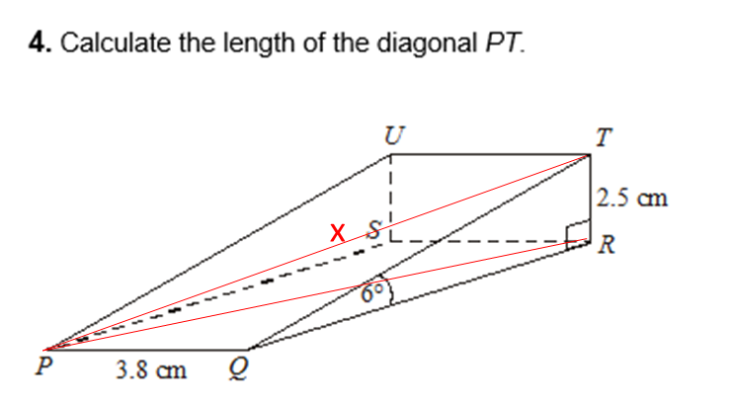
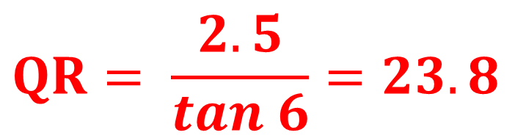


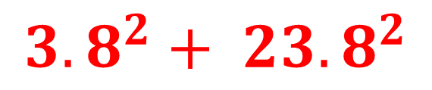

$$QR= \frac{2.5}{tan 6}=23.8$$
$$PR=\sqrt{…………..d}$$
= 24.1
$${3.8}^{2}+ {23.8}^{2}$$
$$PT=\sqrt{…………..d}$$
= 24.2
$${2.5}^{2}+ {24.1}^{2}$$

Slide 8
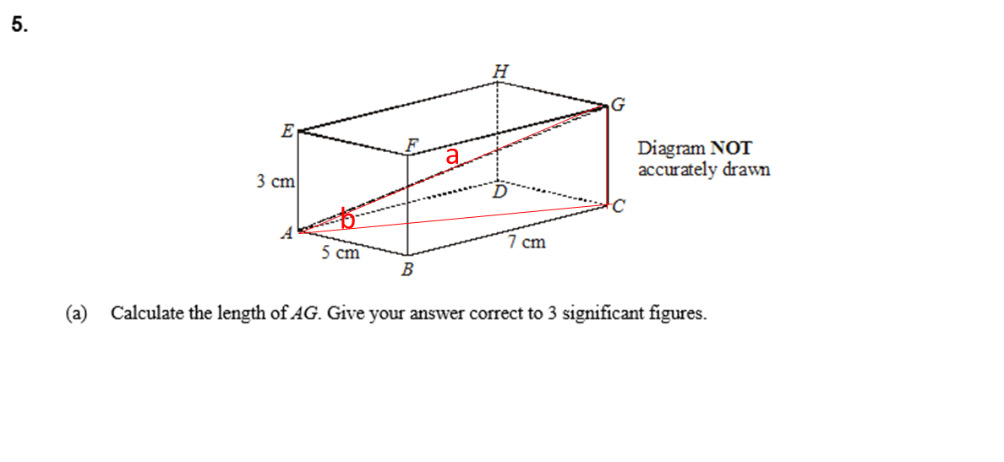
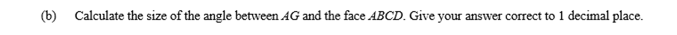
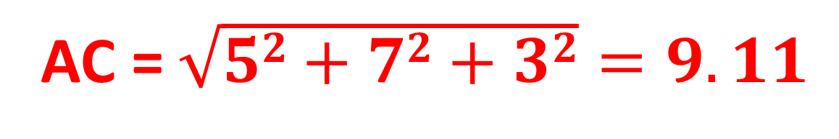

AC$\text{=} \sqrt{52+72+32}=9.11$
tan⁻¹ $(\frac{3}{8.6})=$ 19.2°

