Slide 1

Senior Challenge 5
GOLD

Slide 2
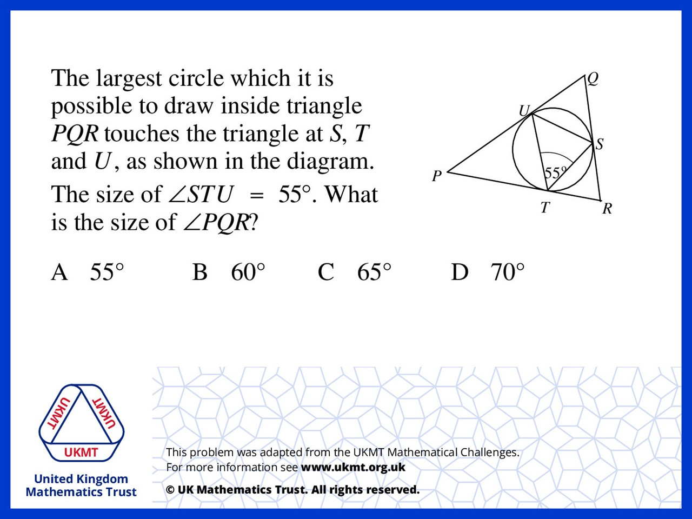
Q1.
QUS = UTS = QSU due to alternate segment circle theorem. Hence QUS = QSU = 55 degrees. USQ = 180 – 55 – 55 = 70 degrees

Slide 3
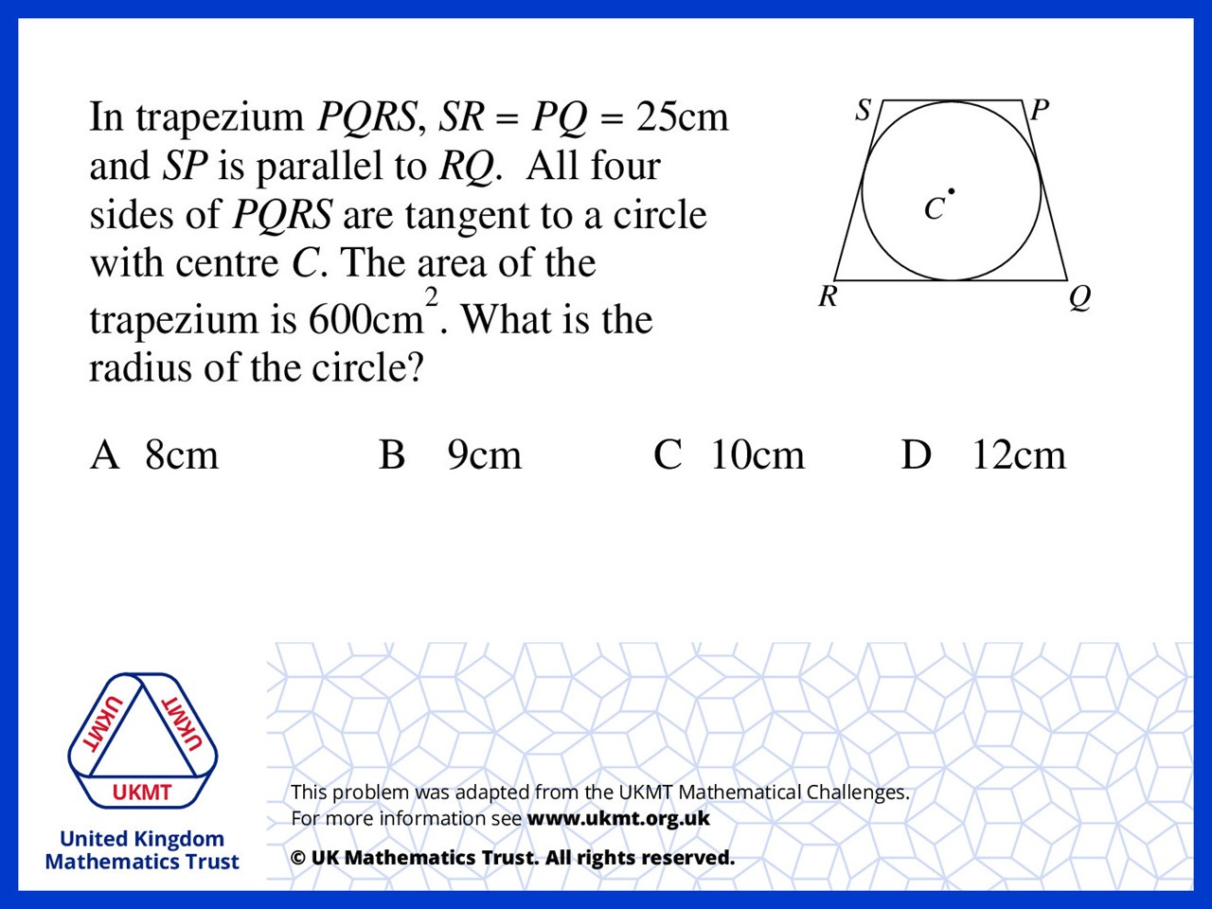
Q2.
Due to the rule of tangent,
SP + RQ = 50cm.
50 x h x 0.5 = 600
h = 24 so the radius is 24 ÷ 2 = 12

Slide 4
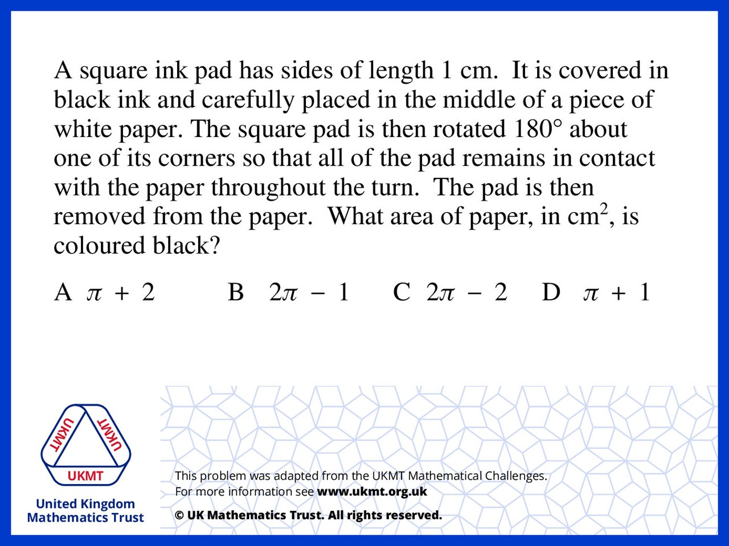
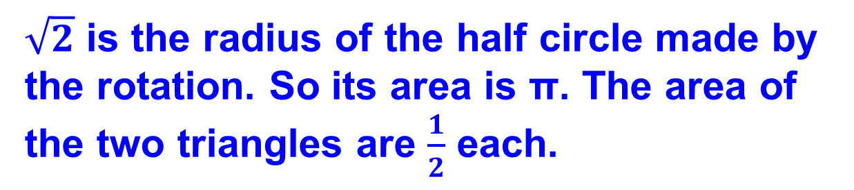
Q3.
$\sqrt{2}$ is the radius of the half circle made by the rotation. So its area is π. The area of the two triangles are $\frac{1}{2}$ each.

Slide 5
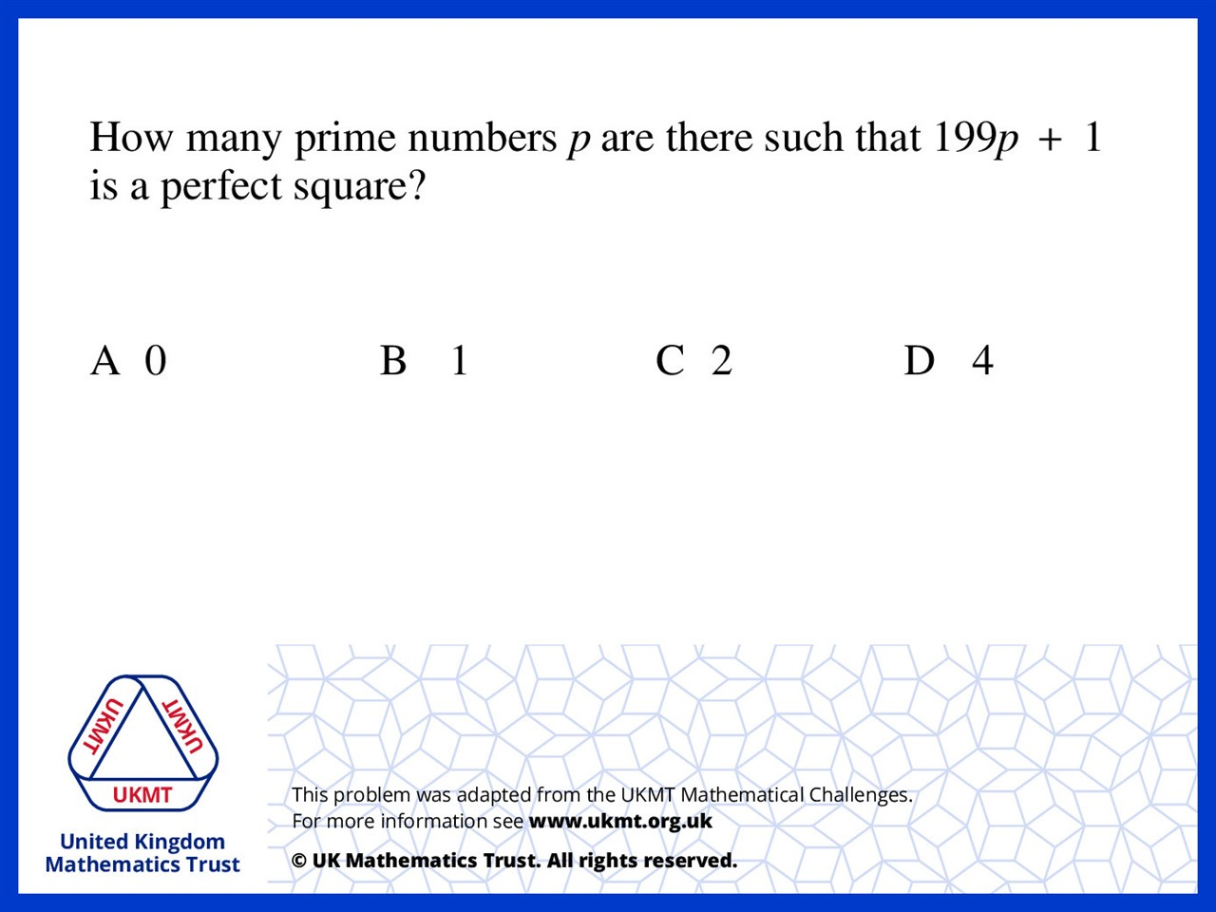
Q4.
Difference of two squares then
199p must be even
and only even prime is 2

Slide 6
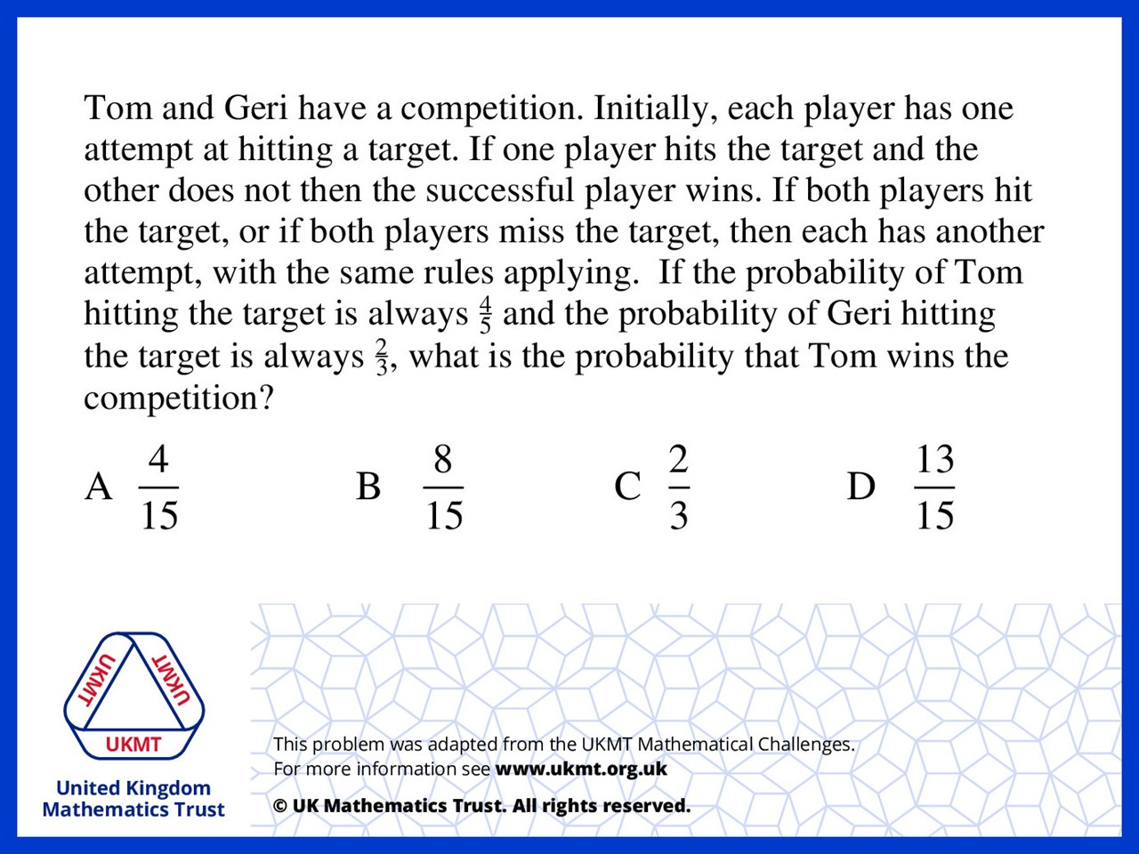
Q5.
Even though there is the option of a tie and then having to do a redo, at the end of the day the only final options are 4/15 (Tom winning) or 2/15 (Geri winning) so 4/6 final options are when Tom wins, which = 2/3

